Slide 1
Sysmon Sysinternal Telemetry and Threat Intelligence
Team Members:
Malavika Reddy Kotha

Slide 2
Literature review and analysis, project plan
Introduction:
The cyber security threats are on the rise, and this brings risks to organizations and individuals. The traditional threat detection systems are based on the rules and do not recognize new and advanced threats. The use of AI in threat detection helps the system to learn from previous events or attacks and detect the threats.
In this project, we use Sysmon to collect system logs and give these logs to Splunk to preprocess them. This processed data will be input for the ML model. Our goal is to develop an AI-based system which automatically classifies and detect threats.

Slide 3
Abstract
The goal is to create an AI model that can identify and classify threats using Sysmon logs and present security findings in a Splunk dashboard.
Sysmon will be used to log system events, process creations, file modifications/creations, and network connections.
Splunk will be used to fetch the Sysmon logs, parse, and preprocess the data.
The data that has been prepared will be used as input for the ML/AI model that performs the threat identification and classification.
The Streamlit dashboards will be developed to provide visualizations that can assist security analysts in enhancing the effectiveness of threat response and providing meaningful conclusions.

Slide 4
Business Need
Due to the increase in cyber attacks on organizations and government institutions, this results in financial losses, damage to the organization’s image, legal consequences, and many others. According to the 2024 IBM report, the cost of a data breach rose by 10% to $4.88 million, from $4.45 million in the previous year.
Many organizations use manual log analysis and rule-based systems for threat detection. As a result of the growing number and complexity of threats, analyzing logs manually results in delayed incident response, increased risks, human errors, and missed threats.
Organizations need intelligent solutions to detect and respond to such threats in real time. The AI-powered threat detection system processes Sysmon logs using Splunk, and an ML model will automatically detect and classify threats. This helps in reducing the time to respond, the chances of human error, and helps organizations to avoid risks.

Slide 5
Problem Statement
The traditional cybersecurity approaches are slow, inelegant, and require more effort to implement, security analysts review logs using SIEM and other endpoint detection tools to identify threats. This is a slow process and can result in increased incident response time, more vulnerabilities, and financial loss; sometimes it can take weeks or months to detect a threat.
Organizations need intelligent and faster systems to detect these threats to avoid the consequences discussed above.
The main aim of our project is to design an AI-based threat detection system using Sysmon logs, Splunk, and ML models to automate this security monitoring task. This helps in reducing the human errors, enhance the threat detection, and decreases response time.

Slide 6
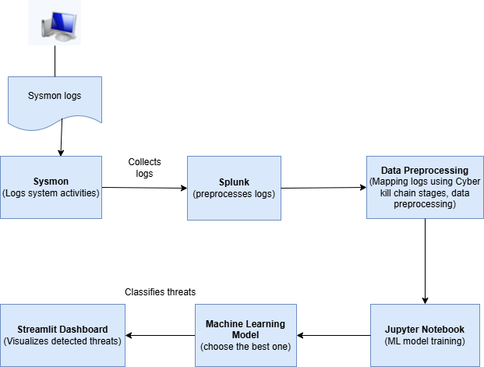
High-Level Architecture

Slide 7
Literature Review
AI and Machine learning in Threat detection:
Artificial intelligence, together with machine learning, has established itself as a vital security tool for threat detection in cybersecurity. The rule-based systems demonstrate effective capabilities, but they cannot effectively address innovative threats that emerge from evolving threats. The ability of machine learning to recognize security patterns in data collections through adaptation makes it suitable for security applications. Machine learning algorithms are divided into three distinct categories that include supervised, unsupervised along with reinforcement learning.
Sysmon and Log Analysis:
Sysmon functions as a Windows system service and device driver that generates precise logs about system events. Sysmon collects diverse system events, including process creation, network connections, file creations/modifications and registry modifications, and other information. Sysmon logs are valuable for detecting security threats, as they provide detailed information about system activities that can be correlated with known attack behaviors.
However, Sysmon logs are extremely detailed and large, which can be challenging to analyze manually. Therefore, in this project Splunk is integrated to collect, parse, and preprocess these logs into a structured format for further analysis.

Slide 8
Literature Review Contd. 1
Splunk:
Splunk is a powerful Security Information and Event Management (SIEM) tool. In this project, Splunk is used to collect and organize Sysmon logs, using the Sysmon Add-on, which facilitates the parsing and processing of raw log data. This add-on enables Splunk to extract relevant fields such as process names, user accounts, source IP addresses, event types, and timestamps from unstructured logs. Sysmon events become easily analyzable through the Splunk parsing process, which performs automated field extraction and indexing. This processed data is exported as a CSV dataset that can be used in Jupyter Notebook for machine learning model development and serves as input. The threat detection models become more accurate and efficient through this method because it selects only significant, high-quality features for training.
Cyber Kill Chain (CKC) framework:
The Cyber Kill Chain (CKC) provides a model that explains the entire sequence of cyberattack activities, which begins with reconnaissance and ends with malicious task execution. CKC breaks down threats into 7 stages: Reconnaissance, Weaponization, Delivery, Exploitation, Installation, Command and Control (C2), and Actions on Objectives. Mapping the Sysmon log data against these stages enables early detection of attacks that help halt their synchronization before further development. This helps in classifying the logs as ‘threat’ or ‘benign’ and in detecting attacks early in the kill chain.

Slide 9
Literature Review Contd. 2
Data Preprocessing in Threat Detection:
The Sysmon logs will be detailed and may have inappropriate values, so data preprocessing is a crucial step to train a machine learning model. The data preprocessing steps/techniques for logs include Feature Extraction: extract relevant features from Sysmon logs, data cleaning (removing unnecessary columns), handling missing values, handling time data because most of the logs have time data, encoding categorical data as the logs have categorical data like message, user, computer, destination etc. Ensure that Sysmon log data is clean, well-structured, and ready for model training.
Classifying Threats:
The classification of logs is crucial for automating threat detection and assisting SOC teams in filtering critical events from regular system activity. We will use both supervised and unsupervised machine learning models for classification. Models like Logistic regression, Random forest, XGBoost, and Support vector machines (SVM) can be used to detect as we have labeled data using the CKC framework.
Streamlit Dashboard Creation:
A Streamlit dashboard was developed to visualize threats classified by Cyber Kill Chain stages. It provides real-time filtering, interactive charts, and event timelines to assist SOC analysts in quick decision-making.

Slide 10
Initial Sysmon and Splunk Environment set up
Sysmon Installation from Microsoft Sysinternals:
Collects logs from Windows Event Viewer from the local computer(can also use logs from multiple devices in an organization).
Installation: sysmon.exe -accepteula -i sysmonconfig-export.xml
Logs will be stored in Event Viewer: Applications and Services Logs > Microsoft > Windows > Sysmon > Operational
Splunk Enterprise Installation:
Extracting Sysmon log data (.csv) from Splunk.
Input File / .CSV file: CKC_data.csv

Slide 11
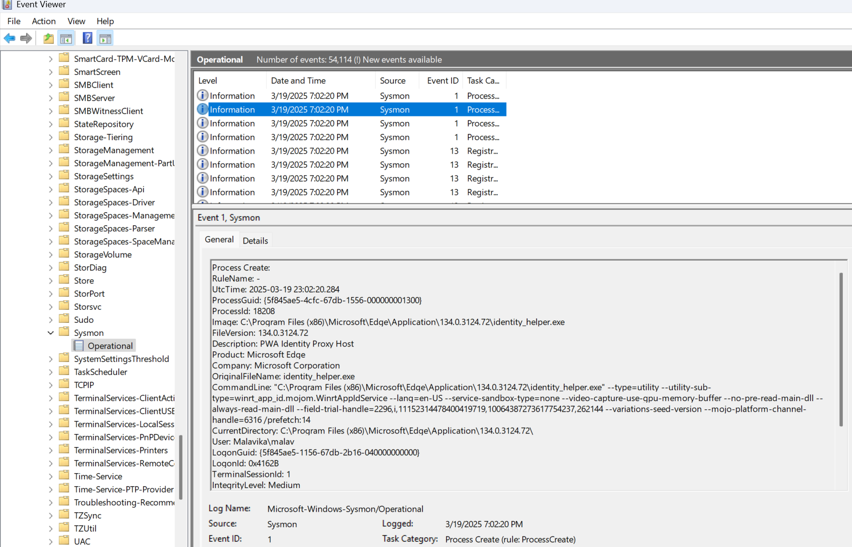
Data Source Identification
Sysmon Logs: The System Monitor (Sysmon) serves as a Windows system service and driver which Microsoft provides through the Sysinternals Suite. These logs are collected using a customized sysmonconfig.xml configuration and exported via Splunk, where they are parsed and preprocessed. This real-world telemetry forms the backbone of the project’s dataset.

Slide 12
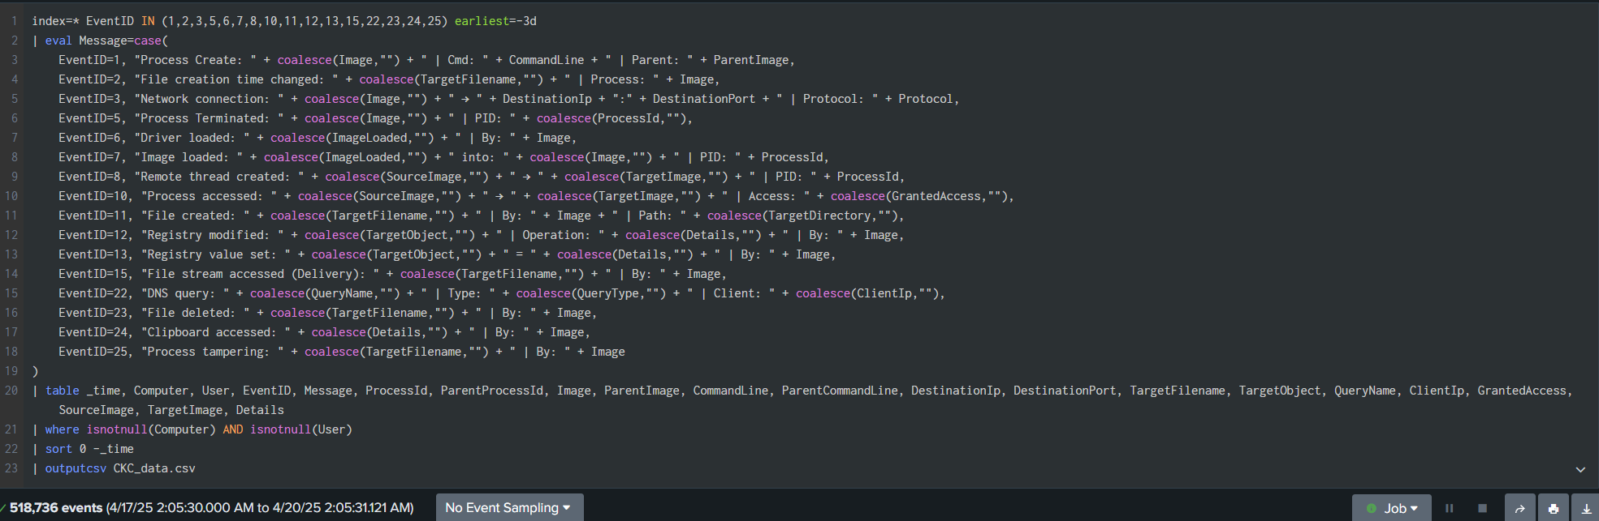
SPL query used to export Sysmon log data set from Splunk

Slide 13
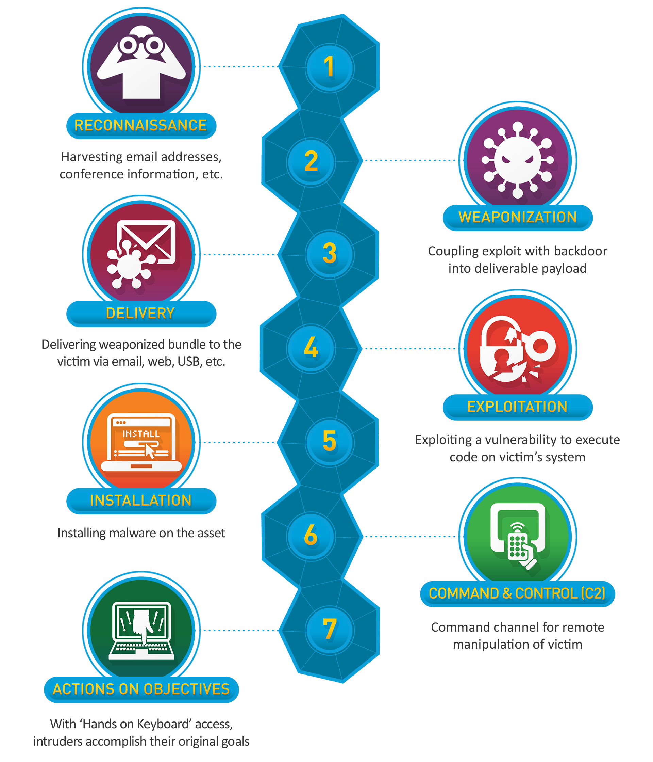
Cyber Kill Chain (CKC) Framework
The Cyber Kill Chain (CKC), developed by Lockheed Martin, is a framework that breaks down a cyberattack into 7 different stages, helping security teams understand, detect, and stop threats at any point in the chain.
By mapping Sysmon logs to CKC stages, we train ML models to not just detect threats but understand the attacker’s position in the kill chain.

Slide 14
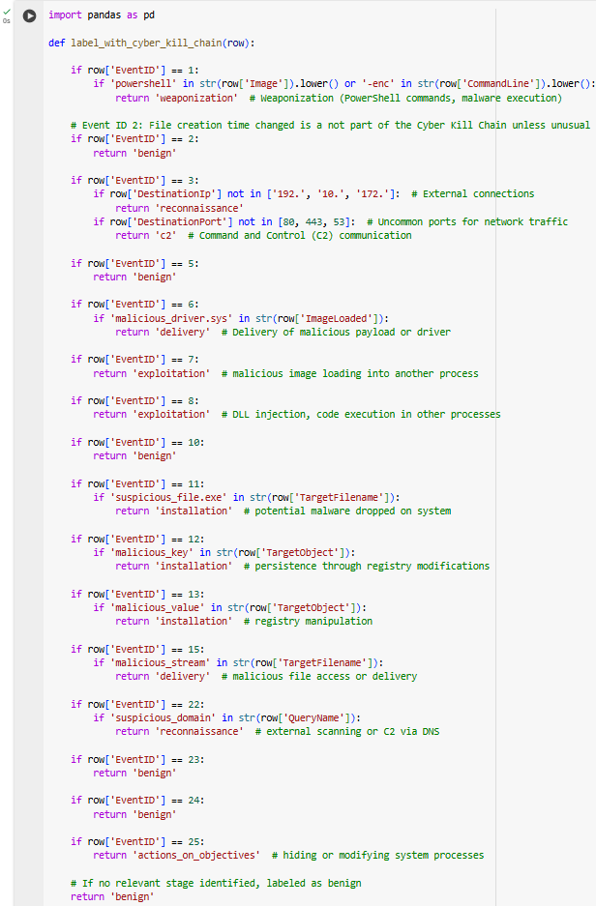
CKC Sysmon Log mapping

Slide 15
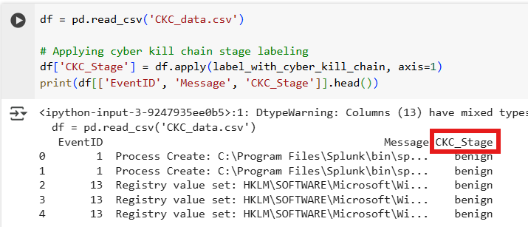
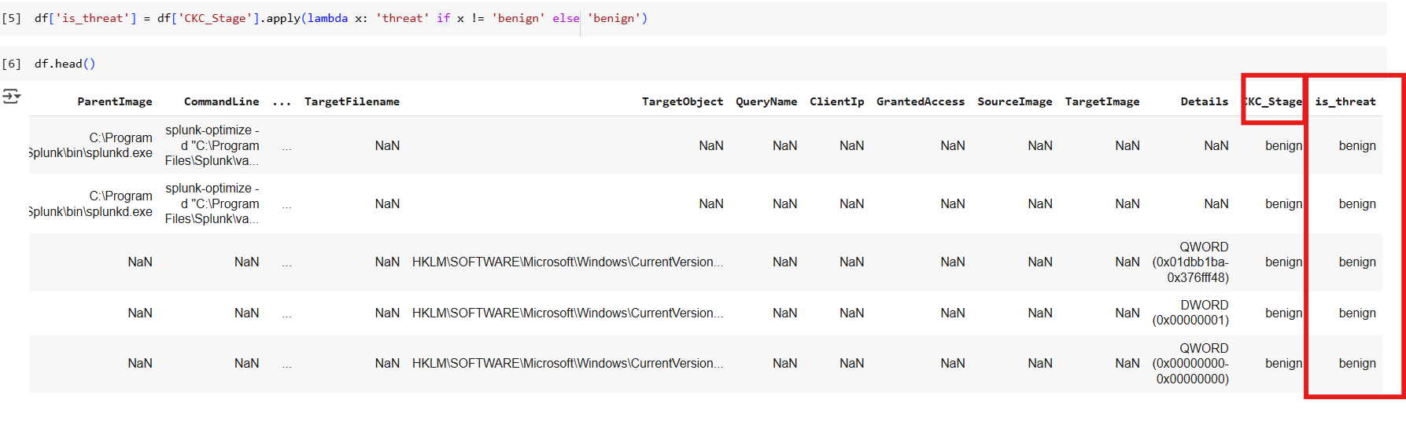
Log Mapping contd..
Labeling every log using CKC stages. The stage value is stored in ‘CKC_stage’.
If ‘CKC_stage’ is assigned with any one of the 7 stages, it is labeled as ‘threat’, else labeled as a ‘benign’.

Slide 16
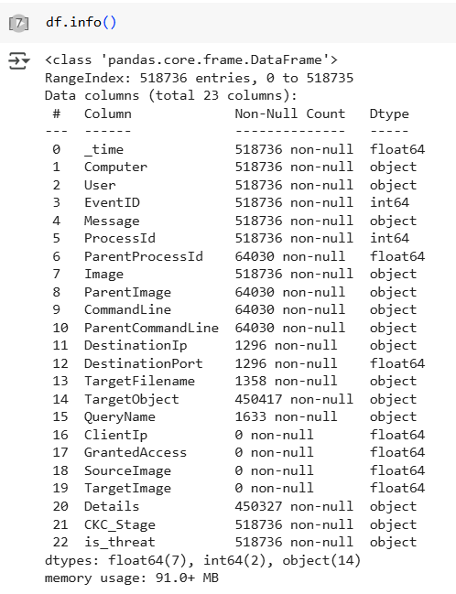
Data preprocessing
Data Cleaning: Removing unnecessary columns.
Handled missing values: Remove missing values/fill them.
Encoding: handling categorical data for the training model
Handling Time Date: extracting _time column
df.info() shows the missing values, column data, and the datatype of the columns.
We have 5,18,736 logs in the input dataset.

Slide 17
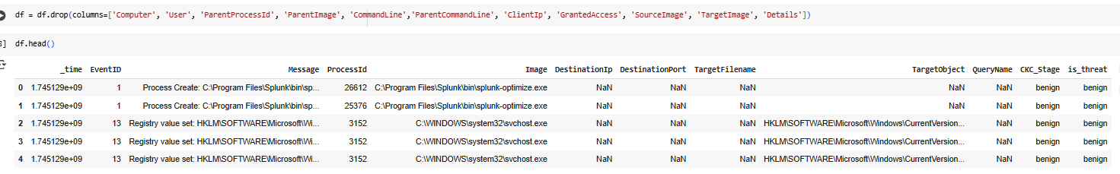
Data Cleaning: Removing unnecessary columns
As we are implementing this on the local computer, we are removing ‘Computer’ and ‘user’ columns, but they are crucial for forensic purposes.

Slide 18
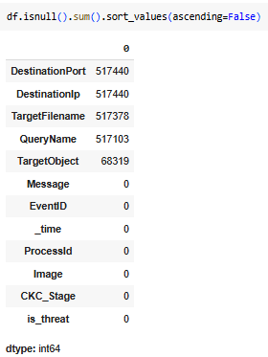
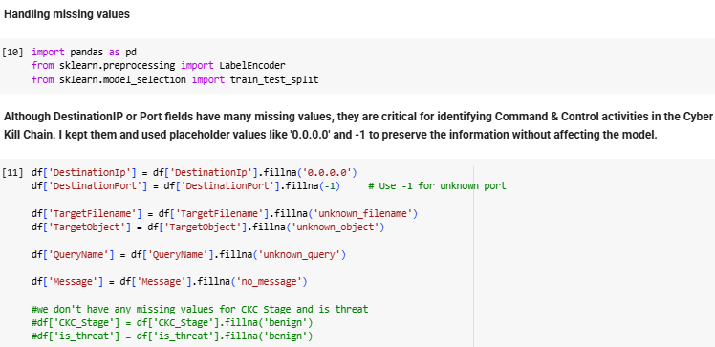
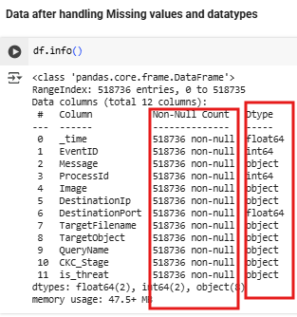
Handled missing values After checking the missing values count

Slide 19
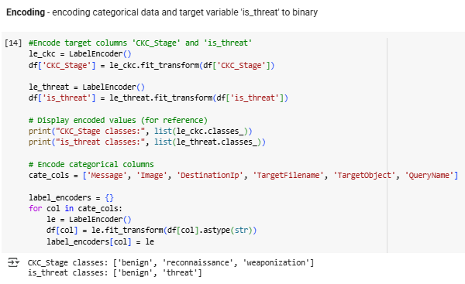
Encoding
Encoding all the categorical data columns.

Slide 20
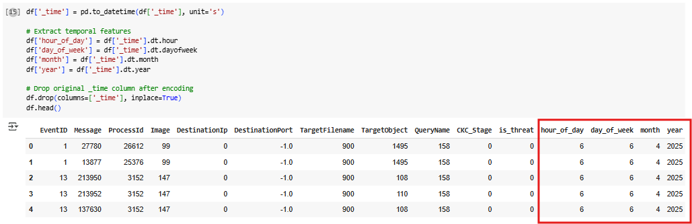
Handling Time Date
Log data has a ‘_time’ column, which is useful for forensic purposes.

Slide 21
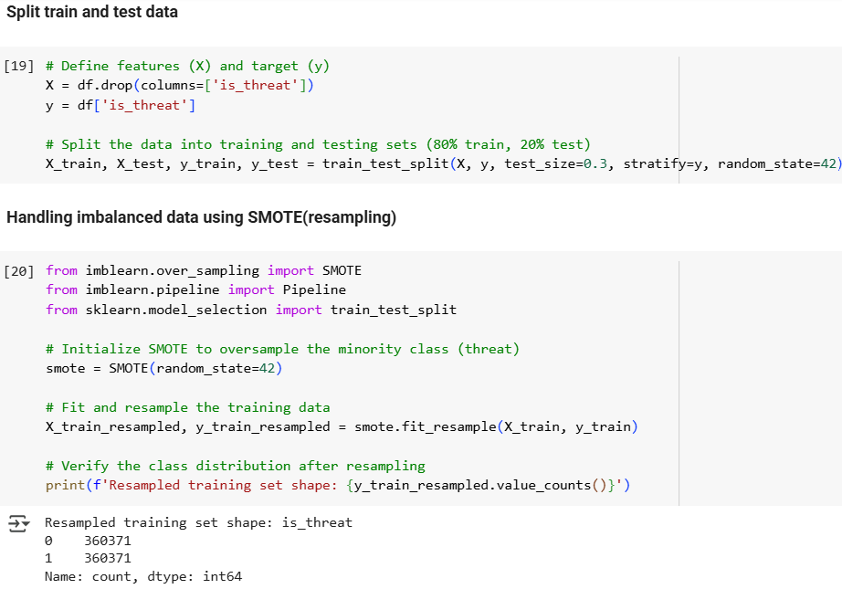
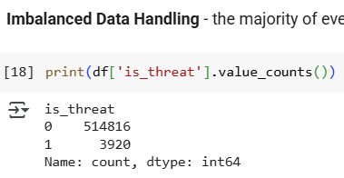
Handling Imbalanced data
The majority of events are labeled as ‘benign’, and a small percentage are labeled as ‘threat’.
We have 5,14,816 logs labeled as ‘benign’ and only 3,920 logs as ‘threat’

Slide 22
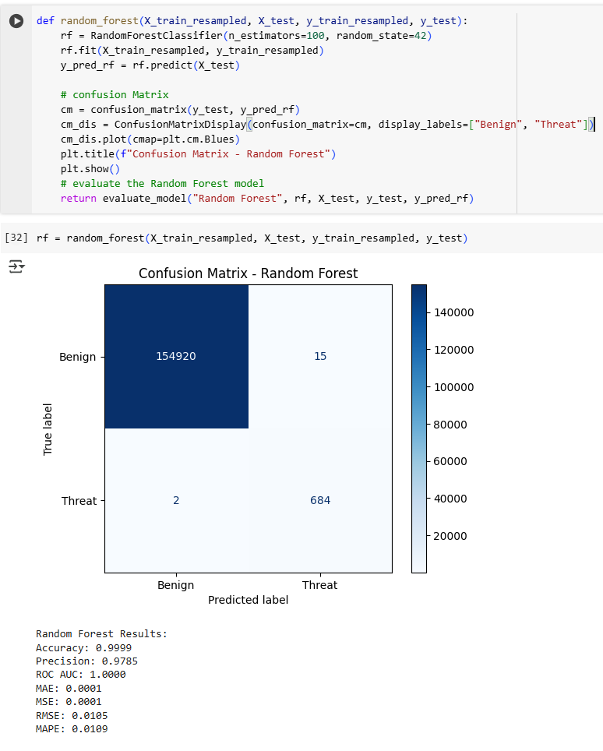
Model Implementation 1
1. Random Forest:
Random Forest is a machine learning model that builds many decision trees instead of just one. Each tree is trained on a random portion of the data, and its results are combined. This method reduces errors and overfitting, and it usually makes very strong predictions. We chose Random Forest because it’s very reliable for large and complex datasets like system logs, where many small patterns matter.

Slide 23
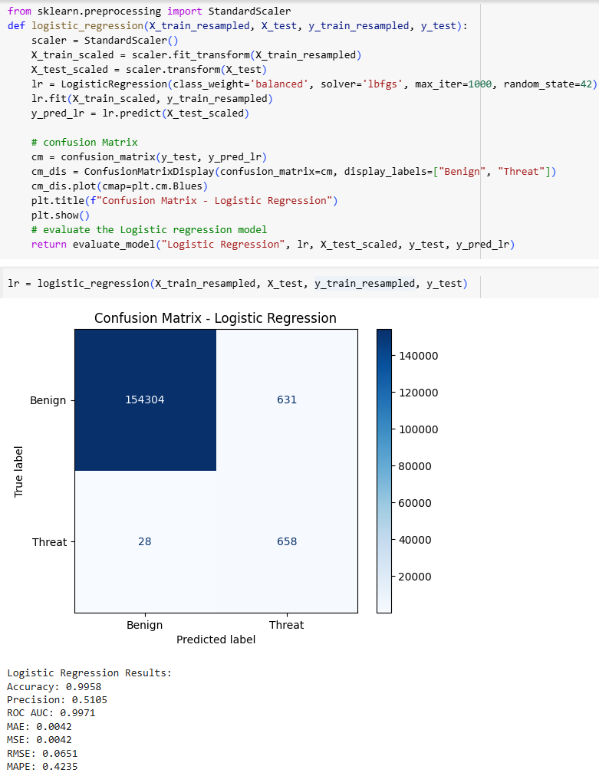
Model Implementation 2
2. Logistic Regression:
Logistic regression is one of the simplest models we can use for classification. It calculates the probability of an event happening, like whether a log is a threat or benign. Even though it’s simple, it’s powerful if the data has a linear relationship. We have included Logistic Regression because it’s fast, easy to train, and gives a good baseline to compare with more complex models.

Slide 24
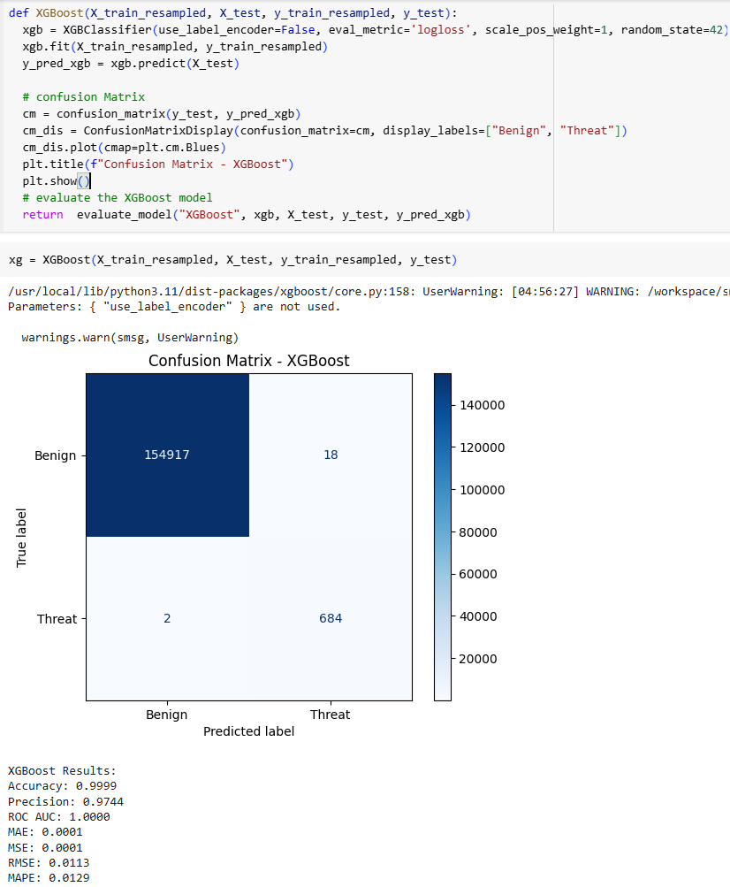
Model Implementation 3
3. XGBoost:
XGBoost stands for Extreme Gradient Boosting. It works by building trees one after another, and each new tree tries to fix the mistakes made by the previous trees. XGBoost is known for its very high accuracy and speed, especially on structured data like cybersecurity logs. We chose XGBoost because it’s often one of the best performers in competitions and real-world projects.

Slide 25
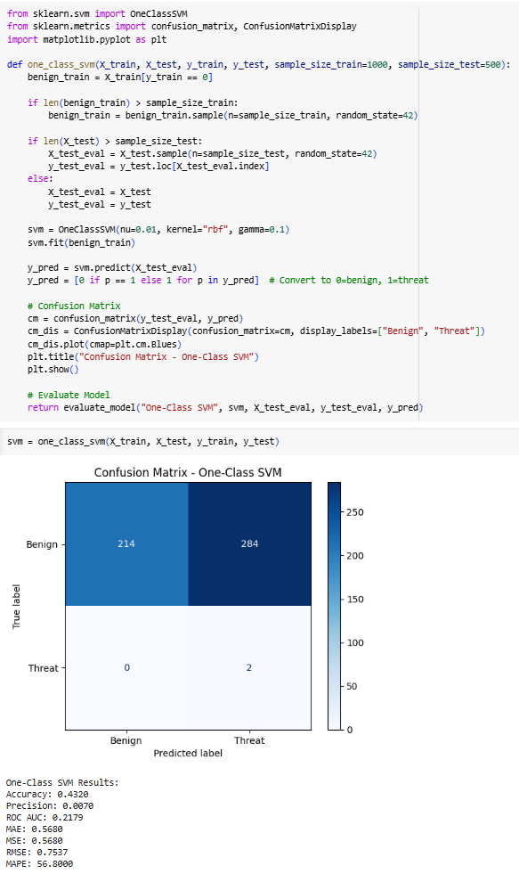
Model Implementation 4
4. One-Class SVM:
One-Class SVM is different from the others because it’s made for anomaly detection. It only learns what normal behavior looks like, in this case, benign logs, and anything that looks different is flagged as a possible threat. This is useful when you have lots of normal examples but very few attack examples. We used One-Class SVM to detect unknown or rare types of threats that the supervised models might miss.

Slide 26
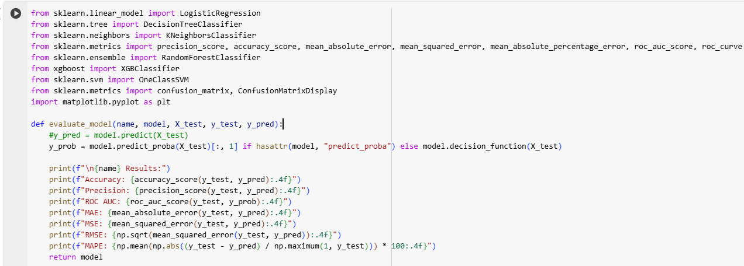
Model Evaluation
We evaluated Random Forest, Logistic Regression, and XGBoost models on multiple metrics, including Accuracy, Precision, ROC AUC, and error metrics.
Function for model evaluation metrics:

Slide 27
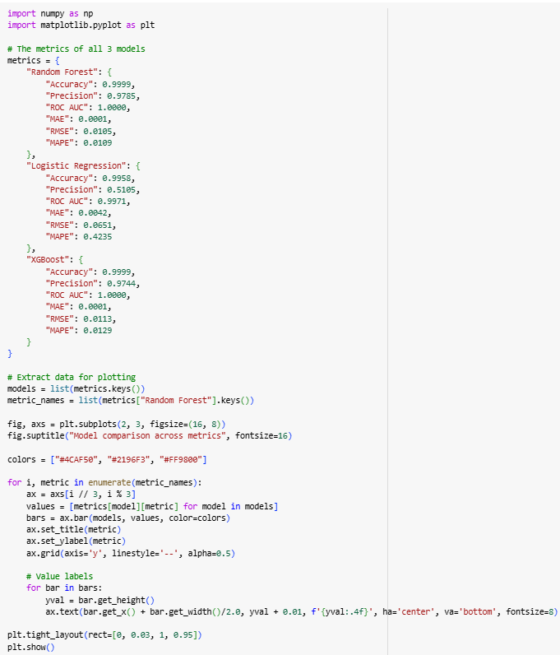
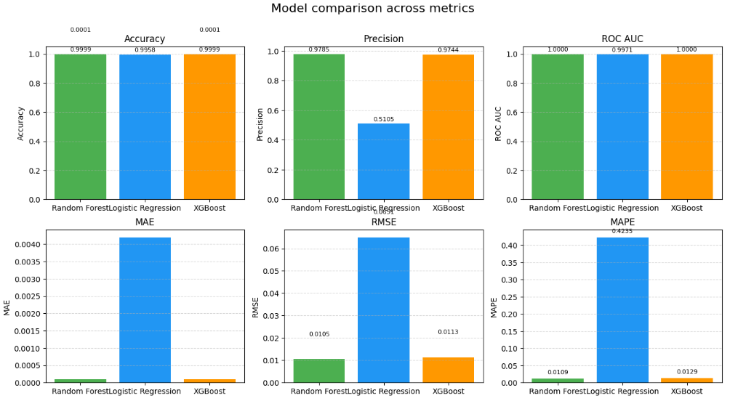
Comparison of Evaluation Metrics for each model

Slide 28
Comparison of Evaluation Metrics for each model
Random Forest and XGBoost both achieved extremely high performance across all evaluation metrics.
Both models had Accuracy close to 99.99%, ROC AUC of 1.0, and very low MAE and RMSE values.
Precision for Random Forest (0.9785) was slightly higher compared to XGBoost (0.9744), but both were very strong.
Logistic Regression showed good overall performance in terms of Accuracy (99.58%) and ROC AUC (0.9971).
However, its Precision was much lower (0.5105), meaning it had difficulty correctly identifying threat events.
Logistic Regression also had a much higher MAPE (42.35%) compared to Random Forest and XGBoost (around 1%).
One-Class SVM is mainly used for anomaly detection.
- It worked well for detecting rare or unknown threats.
However, compared to supervised models like Random Forest and XGBoost, its overall precision and recall were lower.
Conclusion: Random Forest is the most reliable model for threat detection based on its superior precision, accuracy, and robustness against imbalanced data. It successfully minimized false positives while achieving near-perfect classification results, making it highly suitable for threat detection.

Slide 29
References
[1] L. Zhao, “Navigating the Cyber Kill Chain: A modern approach to pentesting,” Applied and Computational Engineering, vol. 38, no. 1, pp. 170–175, Feb. 2024, doi: 10.54254/2755-2721/38/20230549.
[2] P. Shelke and T. Frantti, “Exploring the Possibilities of Splunk Enterprise Security in Advanced Cyber Threat Detection.”
[3] E. M. Hutchins, M. J. Cloppert, and R. M. Amin, “Intelligence-Driven Computer Network Defense Informed by Analysis of Adversary Campaigns and Intrusion Kill Chains.”
[4] “Cyber_Attack_Prediction_From_Traditional_Machine_Learning_to_Generative_Artificial_Intelligence”.
[5] J. Yu, A. v. Shvetsov, and S. H. Alsamhi, “Leveraging Machine Learning for Cybersecurity Resilience in Industry 4.0: Challenges and Future Directions,” IEEE Access, 2024, doi: 10.1109/ACCESS.2024.3482987.
[6] F. Binbeshr, M. Imam, M. Ghaleb, M. Hamdan, M. A. Rahim, and M. Hammoudeh, “The Rise of Cognitive SOCs: A Systematic Literature Review on AI Approaches,” IEEE Open Journal of the Computer Society. Institute of Electrical and Electronics Engineers Inc., 2025. doi: 10.1109/OJCS.2025.3536800.
[7] G. Ali, S. Shah, and M. ElAffendi, “Enhancing cybersecurity incident response: AI-driven optimization for strengthened advanced persistent threat detection,” Results in Engineering, vol. 25, Mar. 2025, doi: 10.1016/j.rineng.2025.104078.
[8] 2019 IEEE Conference on Application, Information and Network Security (AINS). IEEE, 2019.
[9] I. H. Sarker, A. S. M. Kayes, S. Badsha, H. Alqahtani, P. Watters, and A. Ng, “Cybersecurity data science: an overview from machine learning perspective,” Journal of Big Data, vol. 7, no. 1, Dec. 2020, doi: 10.1186/s40537-020-00318-5.
[10] F. Kamoun, F. Iqbal, M. A. Esseghir, and T. Baker, “AI and machine learning: A mixed blessing for cybersecurity,” in 2020 International Symposium on Networks, Computers and Communications, ISNCC 2020, Institute of Electrical and Electronics Engineers Inc., Oct. 2020. doi: 10.1109/ISNCC49221.2020.9297323.
[11] https://learn.microsoft.com/en-us/sysinternals/downloads/sysmon
[12] https://www.splunk.com/en_us/products/splunk-enterprise.html
[13] https://www.lockheedmartin.com/en-us/capabilities/cyber/cyber-kill-chain.html
[14] https://github.com/SwiftOnSecurity/sysmon-config?tab=readme-ov-file

Slide 30
Peer-Reviewed Articles
1. AI and Machine Learning: A Mixed Blessing for Cybersecurity by IEEE, 2020 Link
2. Enhancing Cybersecurity Incident Response: AI-Driven Optimization for Strengthened Advanced Persistent Threat Detection by Gauhar Ali, Sajid Shah, Mohammed ElAffendi Link
3. Cyber Attack Prediction: From Traditional Machine Learning to Generative Artificial Intelligence Link
4. Cybersecurity Data Science: An Overview from Machine Learning Perspective by Iqbal H. Sarker et al. Link
5. Leveraging Machine Learning for Cybersecurity Resilience in Industry 4.0: Challenges and Future Directions by Jia Yu, Alexey V. Shvetsov, Saeed Hamood Alsamhi Link
6. Real-Time Detection System Against Malicious Tools by Monitoring DLL on Client Computers by 2019 IEEE Conference on Application, Information and Network Security Link
7. The Rise of Cognitive SOCs: A Systematic Literature Review on AI Approaches by Farid Binbeshr, Muhammad Imam, Mussadiq Abdul Rahim, Mohammad Hammoudeh Link

Slide 31
Thank You

