Slide 1

Natural language processing
University of Crete
14 April 2021
Maria Koutsogiannaki

Slide 2
Background of the lecturer
Maria Koutsogiannaki
National technical university of Athens
Electrical & Computer Engineer
Mobile communications
University of Crete
MSc & PhD
Signal and speech processing
Machine learning
Samsung Research United Kingdom
Senior researcher
Speech modifications
Audio enhancement (Deep neural networks)
Basque Research Center of cognition Brain and Language
Postdoctoral researcher
Cognitive tasks, online auditory feedback alterations
SHERPA.AI
AI researcher
NLP (Text classification and text generation using Transformers)
2 conference
publications
Institute of Computer Science (FORTH Hellas)
European Listening Talker project (FET 7)
Toshiba Research Laboratory (1 patent)
Bequest Fellowship award
1 patent
integration on Samsung 8 Galaxy mobile phone
Marie Curie Seal of Excellence
Transformers Bert, T5
Replaced company’s traditional NLP dialogue systems (best in internal Golden competition)

Slide 3
Background of the lecturer
Maria Koutsogiannaki
< 2 years experience
National technical university of Athens
Electrical & Computer Engineer
Mobile communications
University of Crete
MSc & PhD
Signal and speech processing
Machine learning
Samsung Research United Kingdom
Senior researcher
Speech modifications
Audio enhancement (Deep neural networks)
Basque Research Center of cognition Brain and Language
Postdoctoral researcher
Cognitive tasks, online auditory feedback alterations
SHERPA.AI
AI researcher
NLP (Text classification and text generation using Transformers)
2 conference
publications
Institute of Computer Science (FORTH Hellas)
European Listening Talker project (FET 7)
Toshiba Research Laboratory (1 patent)
Bequest Fellowship award
1 patent
integration on Samsung 8 Galaxy mobile phone
Marie Curie Seal of Excellence
Transformers Bert, T5
Replaced company’s traditional NLP dialogue systems (best in internal Golden competition)

Slide 4
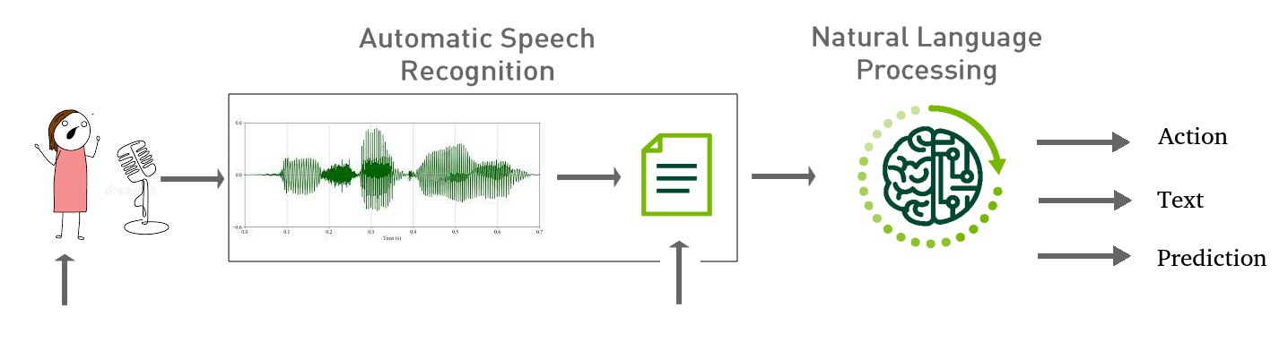
What is NLP and why is it a hot subject?
Natural language processing (NLP) is a branch of artificial intelligence that helps computers understand, interpret and manipulate human language.

Slide 5
Examples of NLP - perform an Action
ASR system | NLP system | Mobile System - Action
Put an alarm at three a.m. | Domain: alarm , Intent: put, Slot: time=3 , time_ref = a.m. | from systems time increase time until you find 0300 and set alarm at 03.00
Tomorrow I have to wake up very early. Put an alarm at three | Domain: alarm Intent: put Slot: day = tomorrow, time=3 , time_ref = a.m. | from calendar see date. Increase by one day and set alarm at 0300

Slide 6
Examples of NLP - perform an Action
ASR system | NLP system | Mobile System - Action
Put an alarm at three a.m. | Domain: alarm , Intent: put, Slot: time=3 , time_ref = a.m. | from systems time increase time until you find 0300 and set alarm at 03.00
Tomorrow I have to wake up very early. Put an alarm at three | Domain: alarm Intent: put Slot: day = tomorrow, time=3 , time_ref = a.m. | from calendar see date. Increase by one day and set alarm at 0300
Sounds easy?
“I have not slept for sixteen hours so don’t
you dare wake me up at three!”
“I have not slept for sixteen hours so maniana no te atreves levantarme at three!”

Slide 7
Examples of NLP - classify
Text review from Tripadvisor | NLP system - Classification (Aspect based sentiment analysis)
Grecocina is a great choice for informal dinners or lunch. The interior space is small but very nicely decorated The greek salad is really one of the best greek salads I’ve had. The vegetarian Mousaka is a fantastic Idea that unfortunately lacked in exexution. Some dishes were a bit too experimental for our party such as the cinnamon cream desert. But, overall everyone was Happy with their plates and I would be Happy to revisit. | Food - positive Price - none Quality - positive Environment - positive

Slide 8
Examples of NLP - clasify
Text review from Tripadvisor | NLP system - Aspect based sentiment analysis
Grecocina is a great choice for informal dinners or lunch. The interior space is small but very nicely decorated The greek salad is really one of the best greek salads I’ve had. The vegetarian Mousaka is a fantastic Idea that unfortunately lacked in exexution. Some dishes were a bit too experimental for our party such as the cinnamon cream desert. But, overall everyone was Happy with their plates and I would be Happy to revisit. | Food - positive Price - none Quality - positive Environment - positive
Sounds easy?
When humans are asked to perform this task there is an 80% only of agreement

Slide 9
Examples of NLP - translate/summarize/generate
Text | NLP system - Text (summarization)
Grecocina is a great choice for informal dinners or lunch. The interior space is small but very nicely decorated The greek salad is really one of the best greek salads I’ve had. The vegetarian Mousaka is a fantastic Idea that unfortunately lacked in exexution. Some dishes were a bit too experimental for our party such as the cinnamon cream desert. But, overall everyone was Happy with their plates and I would be Happy to revisit. | Grecocina ‘s interior space is small but very nicely decorated. The greek salad is the best I’ve had but the vegetarian Mousaka lacked in exexution. Some dishes were a bit too experimental for our party but I would be Happy to revisit.

Slide 10
Examples of NLP - translate/summarize/generate
Text | NLP system - Text (translation)
Grecocina is a great choice for informal dinners or lunch. The interior space is small but very nicely decorated The greek salad is really one of the best greek salads I’ve had. The vegetarian Mousaka is a fantastic Idea that unfortunately lacked in exexution. Some dishes were a bit too experimental for our party such as the cinnamon cream desert. But, overall everyone was Happy with their plates and I would be Happy to revisit. | Η Grecocina είναι μια εξαιρετική επιλογή για ανεπίσημα δείπνα ή μεσημεριανό γεύμα. Ο εσωτερικός χώρος είναι μικρός αλλά πολύ όμορφα διακοσμημένος Η ελληνική σαλάτα είναι πραγματικά μια από τις καλύτερες ελληνικές σαλάτες που είχα. Η χορτοφάγος Μουσάκα είναι μια φανταστική ιδέα που δυστυχώς δεν έλειπε. Μερικά πιάτα ήταν λίγο πολύ πειραματικά για το πάρτι μας, όπως η έρημος με κρέμα κανέλας. Όμως, γενικά όλοι ήταν ευχαριστημένοι με τα πιάτα τους και θα ήμουν ευτυχής να το ξαναδώ.

Slide 11
Examples of NLP - translate/summarize/generate
Text - table | NLP system - Text (generation)
 | Η Grecocina είναι μια εξαιρετική επιλογή για ανεπίσημα δείπνα ή μεσημεριανό γεύμα. Ο εσωτερικός χώρος είναι μικρός αλλά πολύ όμορφα διακοσμημένος Η ελληνική σαλάτα είναι πραγματικά μια από τις καλύτερες ελληνικές σαλάτες που είχα. Η χορτοφάγος Μουσάκα είναι μια φανταστική ιδέα που δυστυχώς δεν έλειπε. Μερικά πιάτα ήταν λίγο πολύ πειραματικά για το πάρτι μας, όπως η έρημος με κρέμα κανέλας. Όμως, γενικά όλοι ήταν ευχαριστημένοι με τα πιάτα τους και θα ήμουν ευτυχής να το ξαναδώ.
ΕΣΤΙΑΤΟΡΙΟ | ΤΥΠΟΣ | ΠΟΙΟΤΗΤΑ | ΧΩΡΟΣ | ΣΥΝΟΛΙΚΗ ΕΙΚΟΝΑ
Grecocina - table | γεύμα δείπνο ανεπίσημο | ελληνικη σαλατα - ωραια μουσακας - πειραματικος | μικρος ωραια διακοσμηση | θετικη

Slide 12



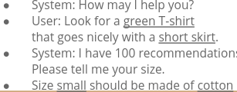


Why is it a hot subject?
Dialogue system Sentiment Analysis Text Analysis
Service User satisfaction, reviews User preference, market tendencies
Language Understanding

Slide 13
Clients
automatic voice assistants: chatbox, voice systems e.g. alexa, call centers
reviews from internet (movies, restaurants, political aspects, and more!)
recommendations (behavioral analysis from social media)
translation systems
All that has to do with human language understanding!!

Slide 14
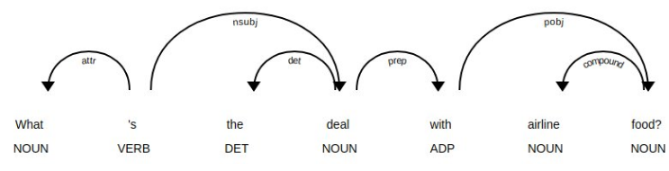
How did we do it?
Rule-based approaches
old method
focus on pattern-matching or parsing
can often be thought of as "fill in the blanks" method
high performance in specific use cases
suffer performance degradation when generalized

Slide 15
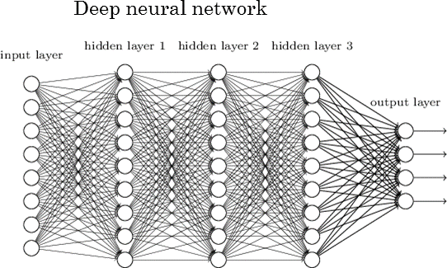
How do we do it?
Deep neural models for language understanding

Slide 16
Sentiment analysis task

Slide 17
Sentiment analysis task - simplify
Text review from Tripadvisor | NLP system - Classification (Aspect based sentiment analysis)
Grecocina is a great choice for informal dinners or lunch. The interior space is small but very nicely decorated The greek salad is really one of the best greek salads I’ve had. The vegetarian Mousaka is a fantastic Idea that unfortunately lacked in exexution. Some dishes were a bit too experimental for our party such as the cinnamon cream desert. But, overall everyone was Happy with their plates and I would be Happy to revisit. | Food - positive Price - none Quality - positive Environment - positive
positive or negative

Slide 18
Sentiment analysis task - simplify
Text review from Tripadvisor | NLP system - Classification (Aspect based sentiment analysis)
Grecocina is a great choice for informal dinners or lunch. The interior space is small but very nicely decorated The greek salad is really one of the best greek salads I’ve had. The vegetarian Mousaka is a fantastic Idea that unfortunately lacked in exexution. Some dishes were a bit too experimental for our party such as the cinnamon cream desert. But, overall everyone was Happy with their plates and I would be Happy to revisit. | Food - positive Price - none Quality - positive Environment - positive
positive or negative

Slide 19
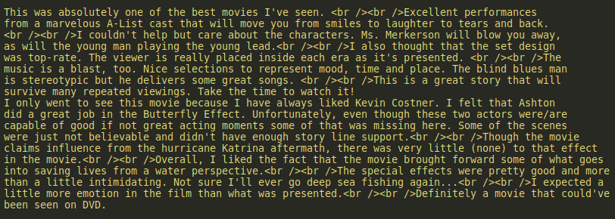


Sentiment analysis task - imdb movie reviews
Benchmark dataset - https://gluebenchmark.com/leaderboard
Movie reviews classified on positive or negative by human annotators
?

Slide 20

Creating a model to recognise sentiments (text)
Complete the graph :)

Slide 21

Creating a model to recognise sentiments (text)
Complete the graph :)

