Slide 1
Predicting the 2016 Election
Maureen Petterson
Capstone II
https://github.com/mkpetterson/2016_elections

Slide 2

CAN WE PREDICT A WINNER?

Slide 3
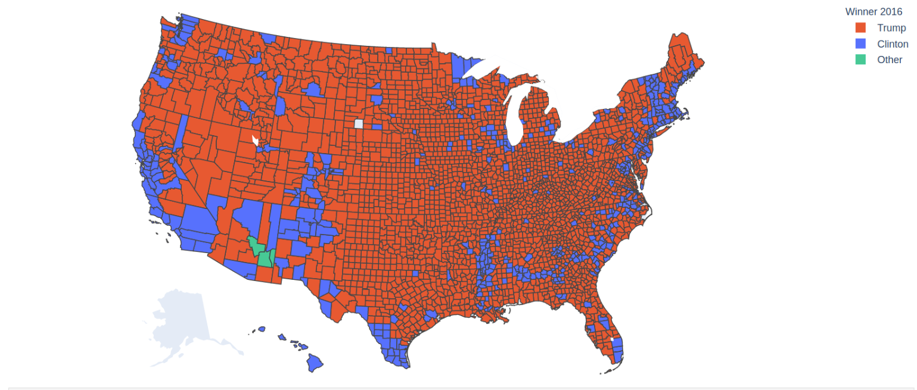
2016 Results by County (the targets)
County Wins:
Trump: ~2600
Clinton: ~ 500
Other Party: 3

Slide 4

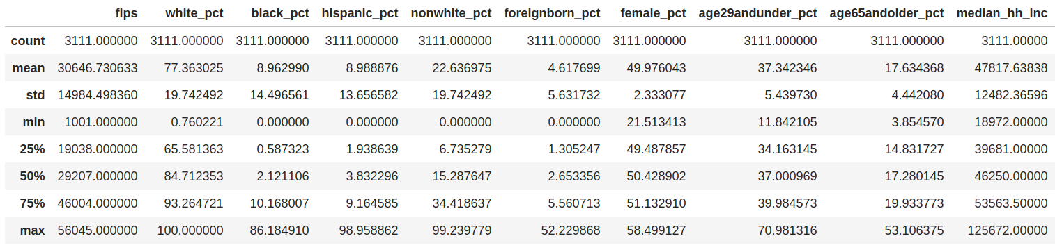
The Data: Demographics
3114 counties in the United States
39 columns; 17 were voting data for 2012-2016
Demographics include: education, income, diversity, age
Wide representation from all demographics

Slide 5
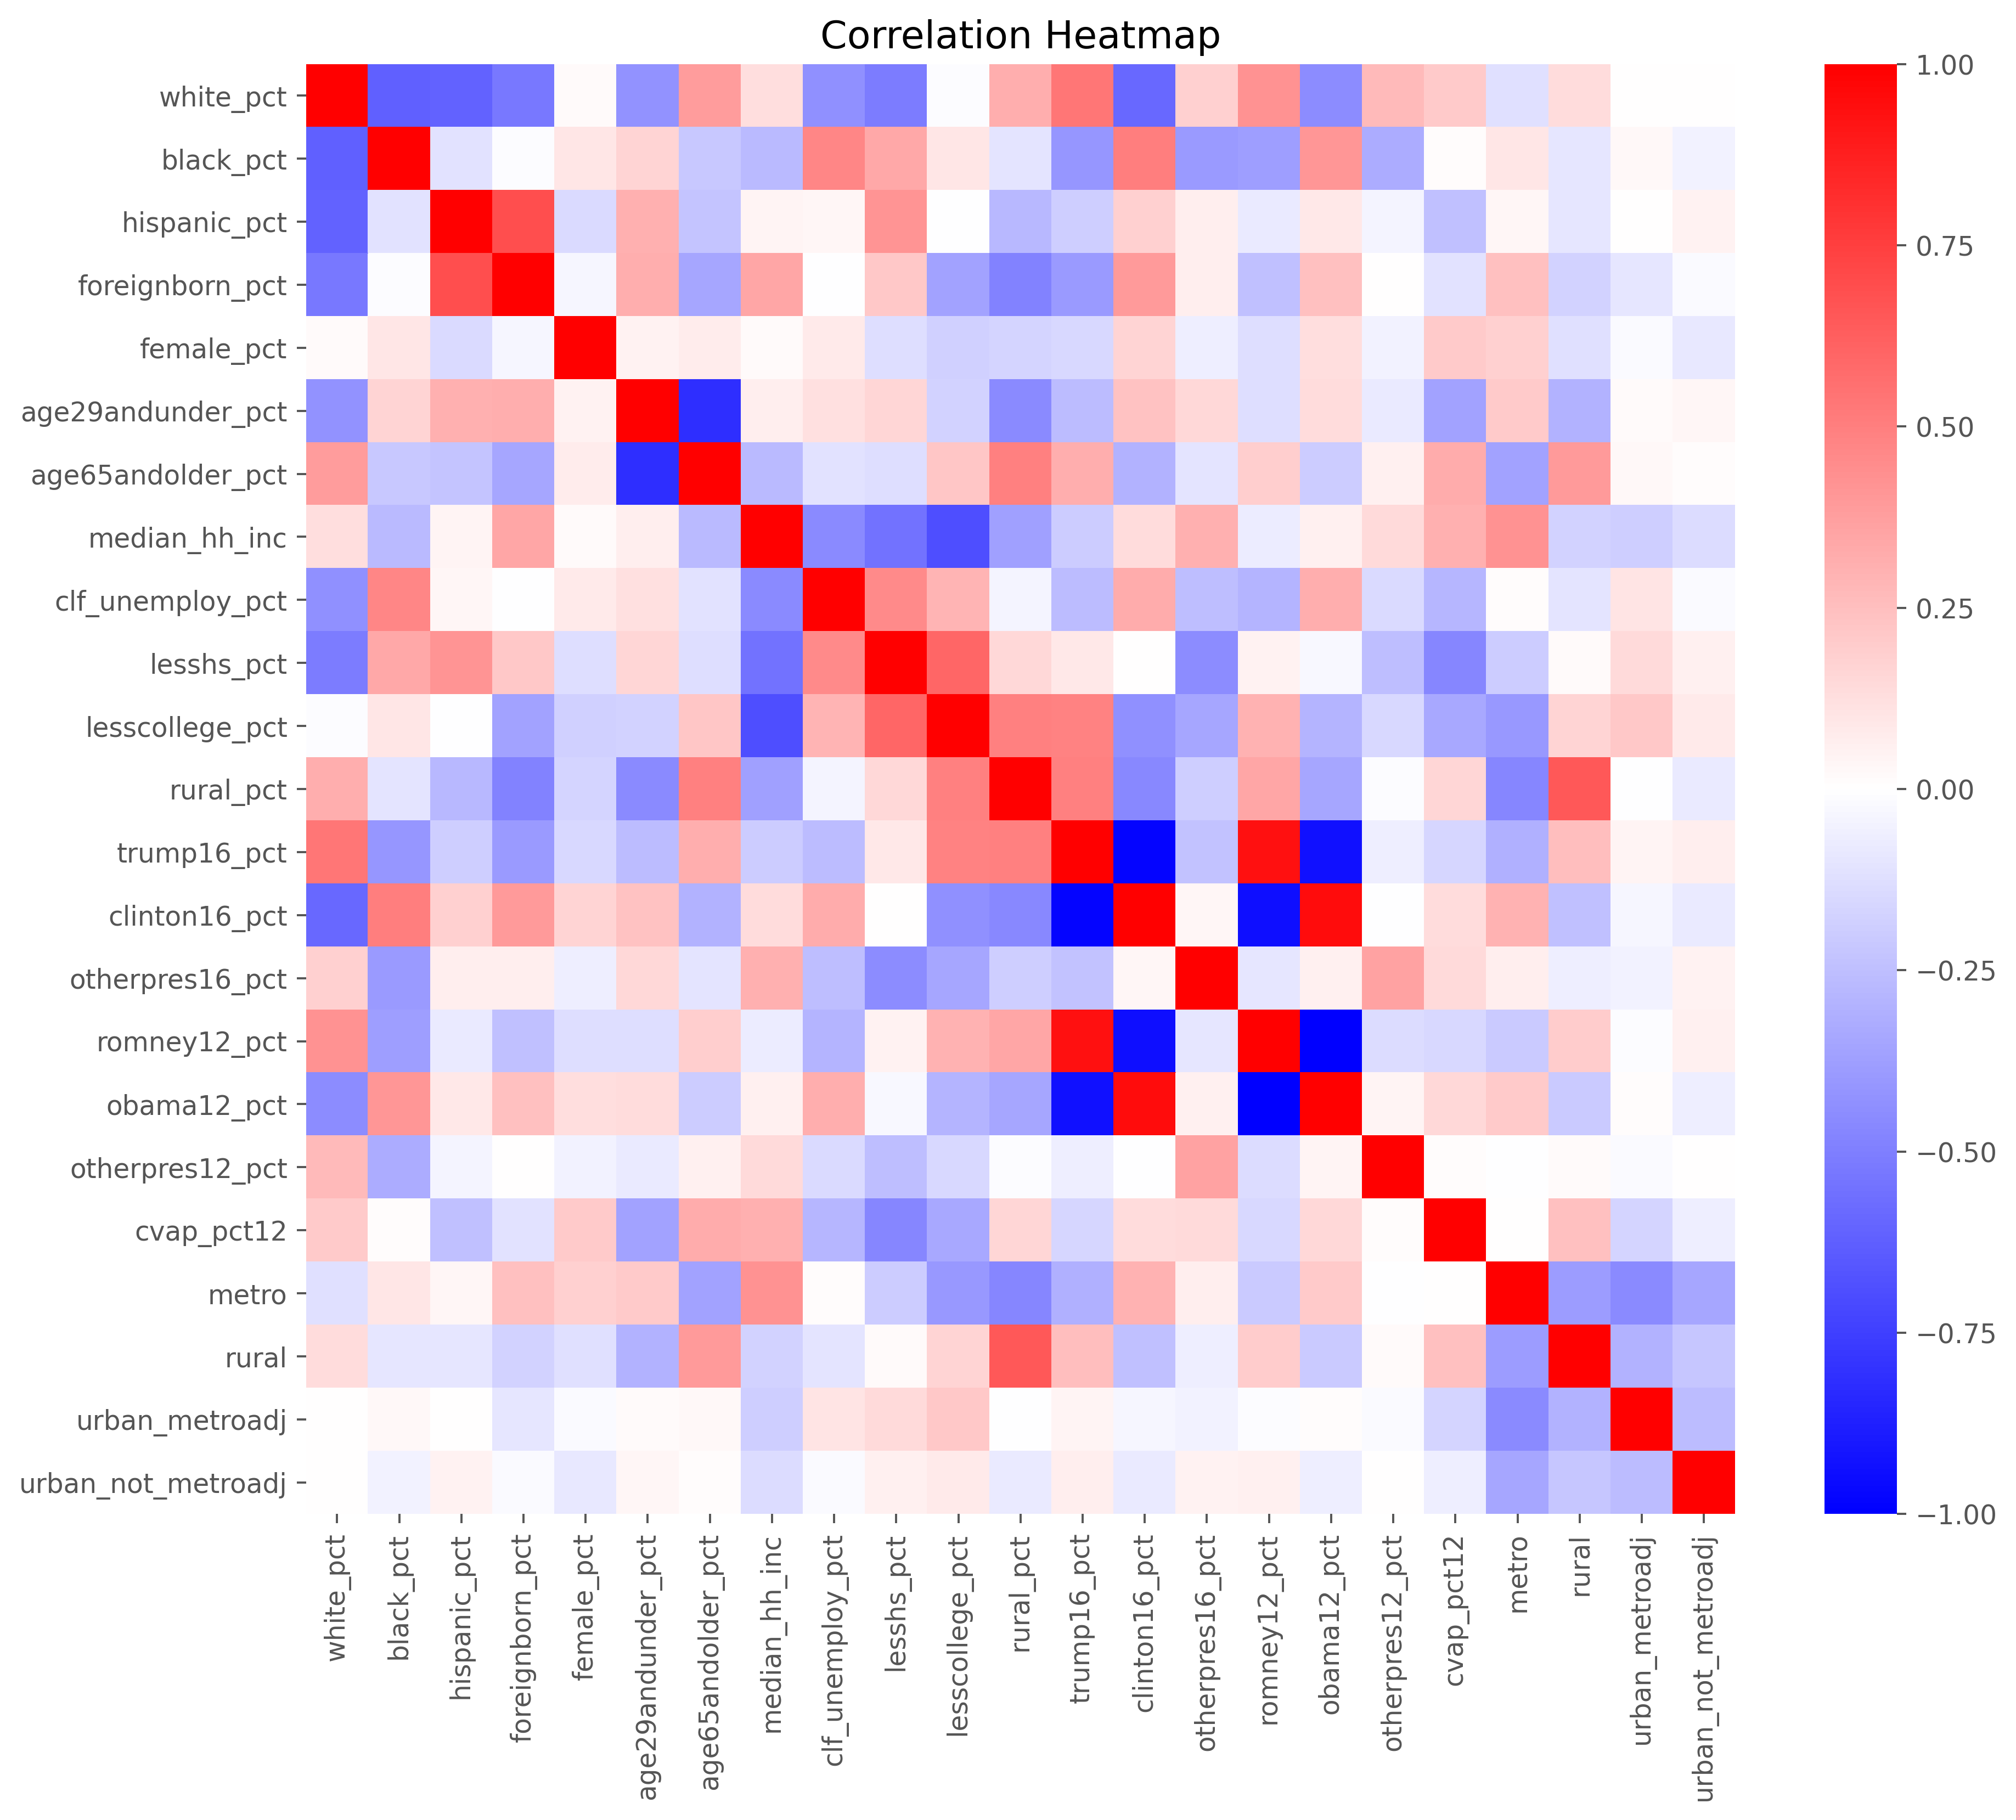
The Data: Cleaning
3 counties removed due to lack of data
Many correlated features removed
OHE for categorical features
17 features kept for initial analysis

Slide 6
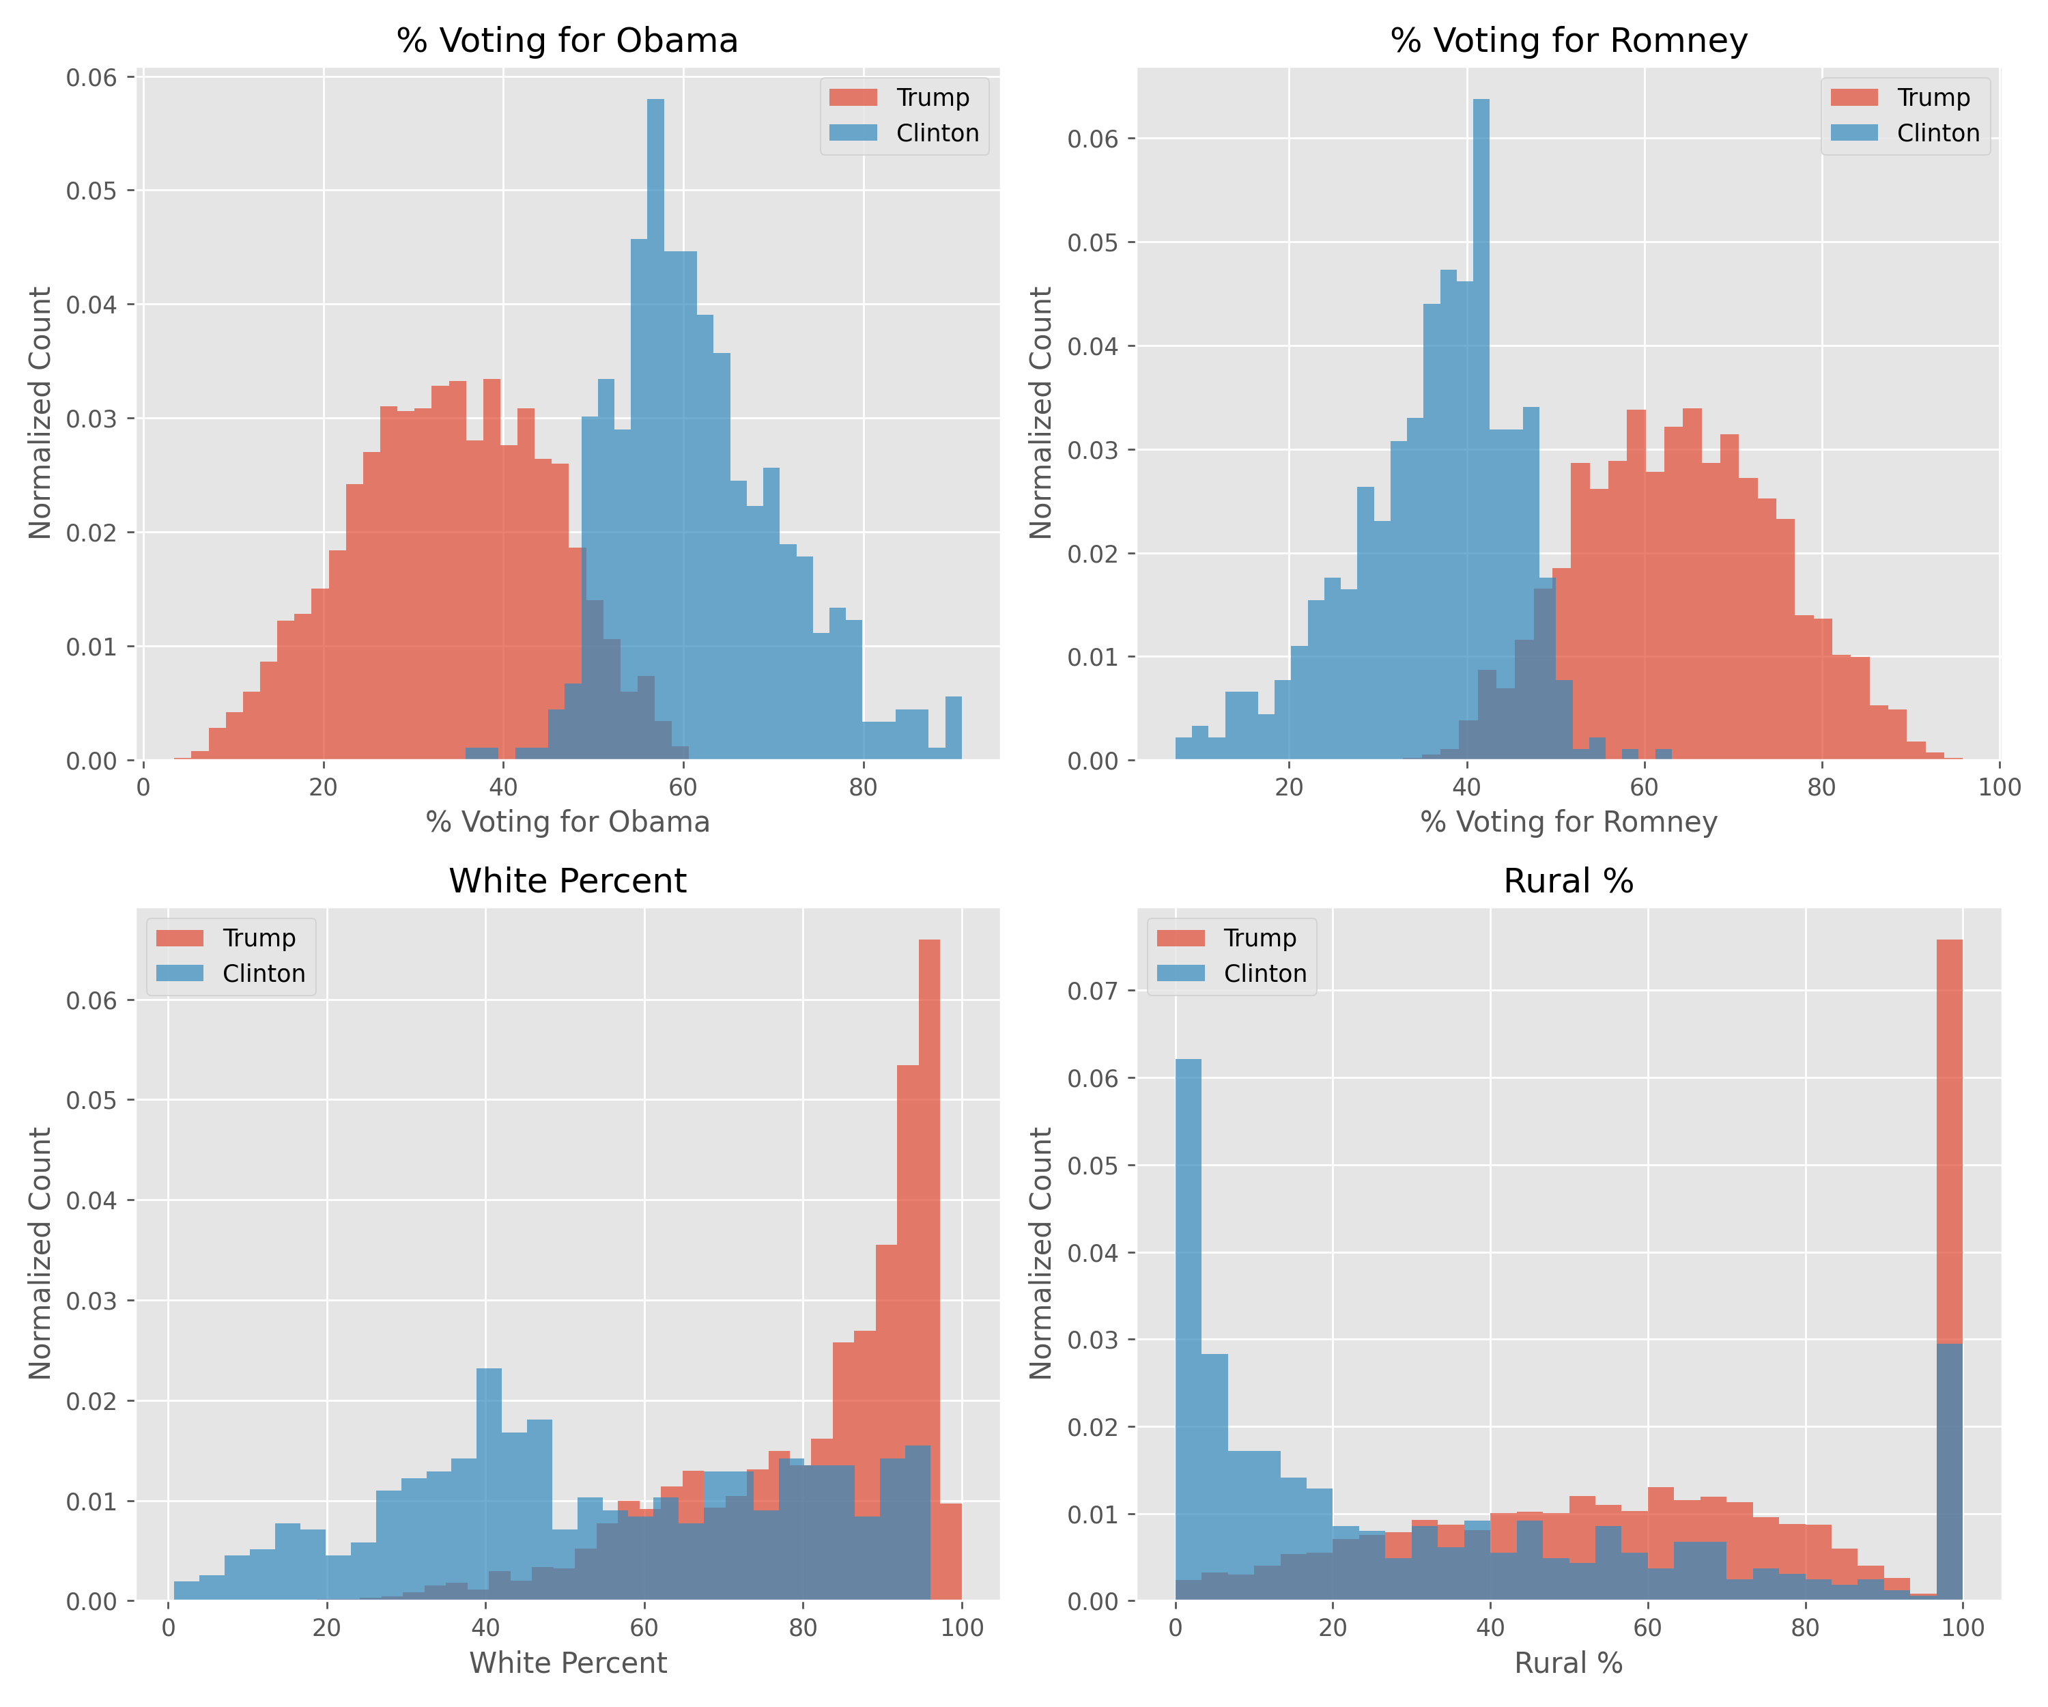
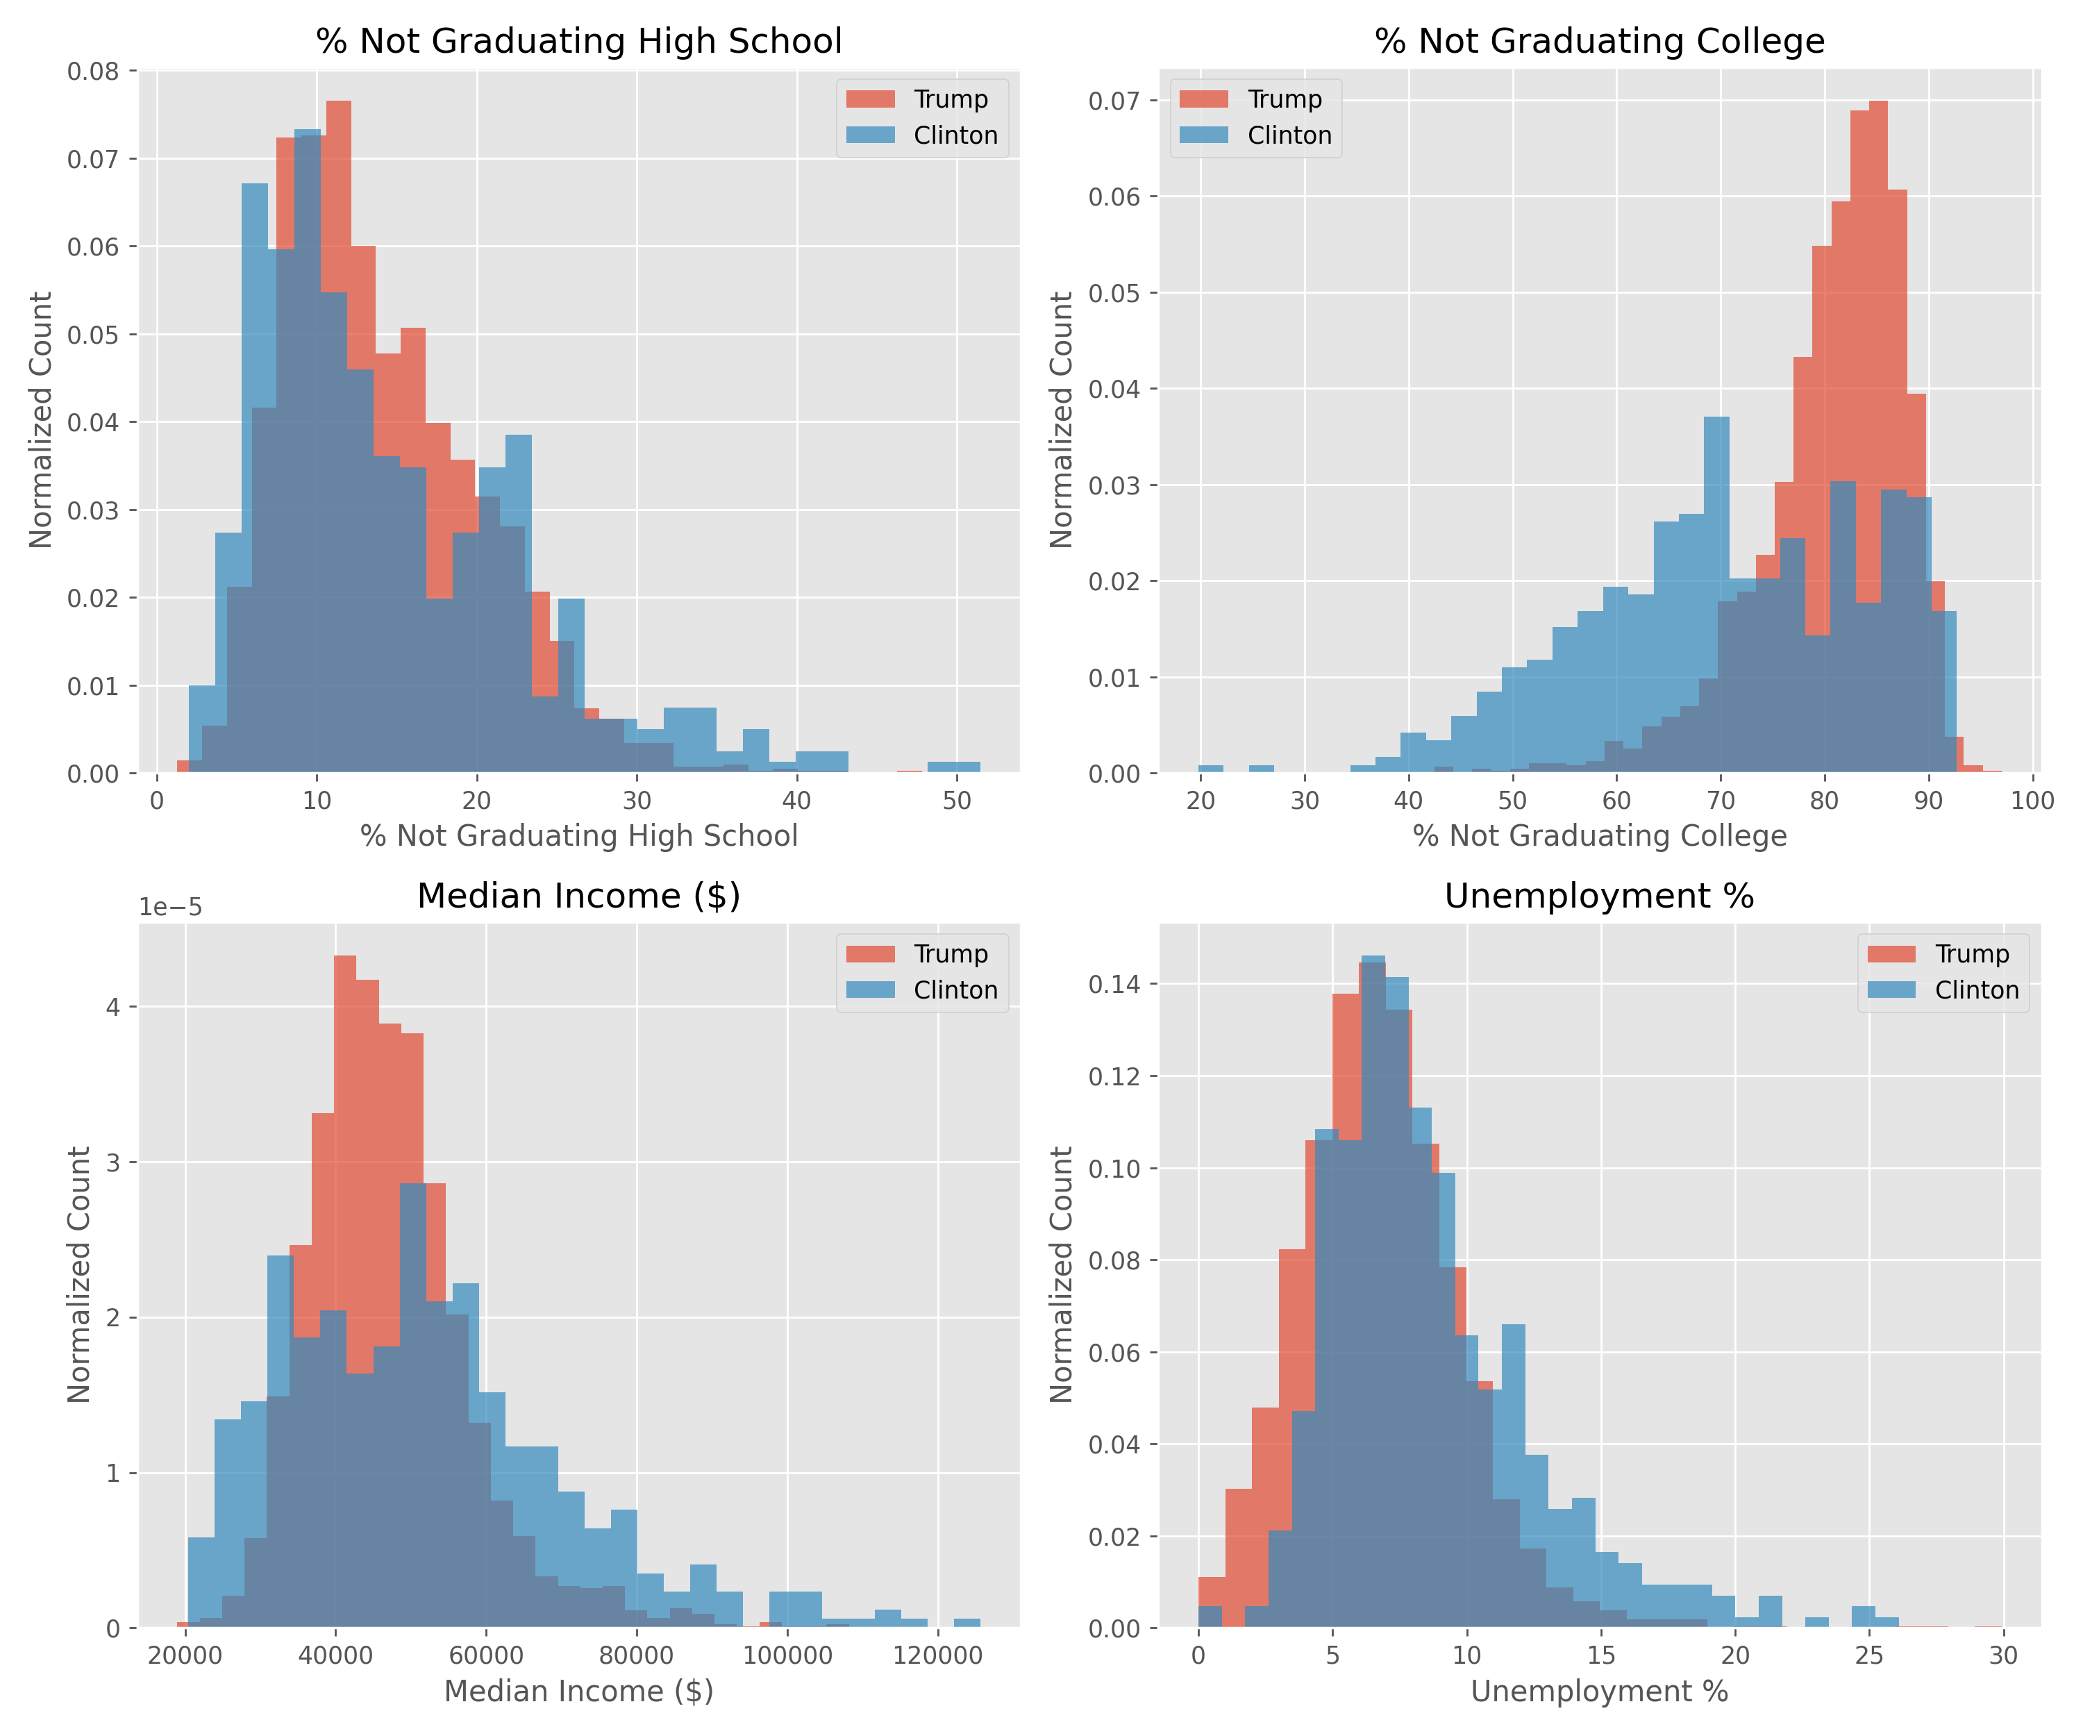
EDA: Can it build intuition for our models?

Slide 7
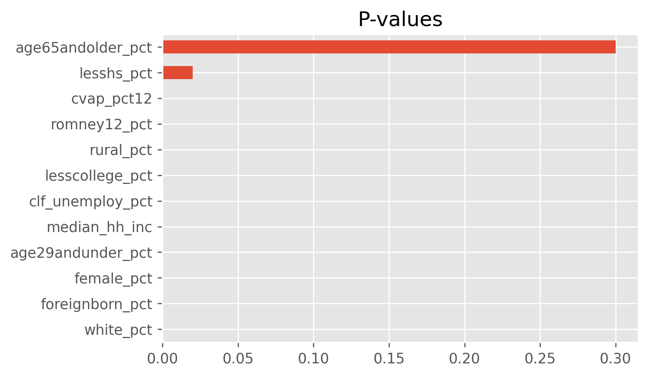
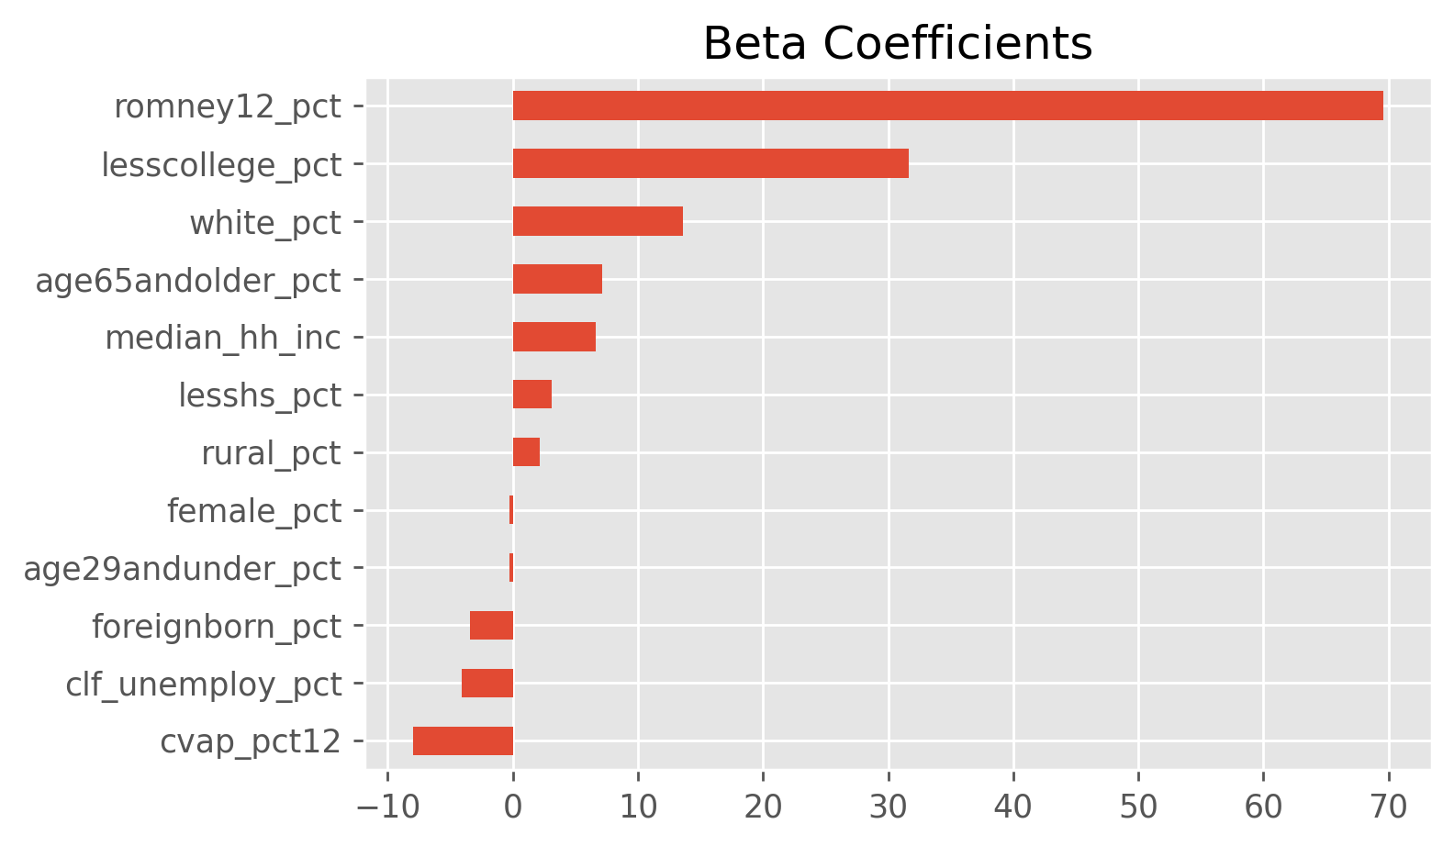
The Models: Linear Regression
Initial Regression model with 17 features showed the OHE variables were not significant
Pre-processing methods altered p-values: indicates too many correlated features
Features removed and model re-run using Kfold cross validation with 5 splits

Slide 8
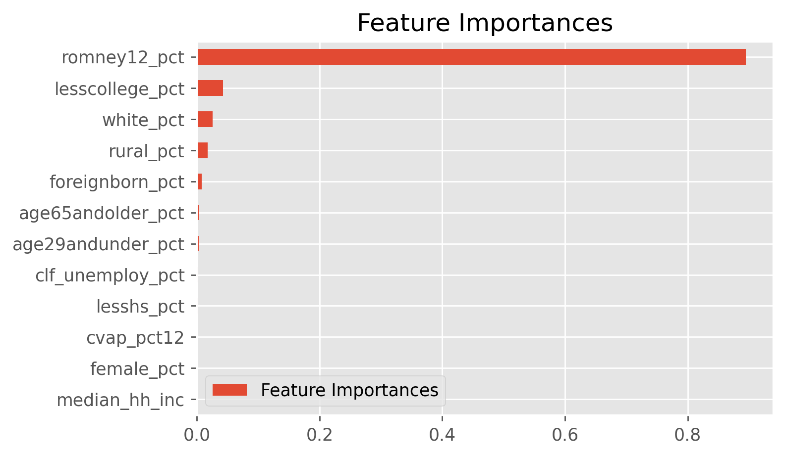

The Models: Random Forest & GBC
Random Forest and GBC also done with KFold cross-validation with 5 splits
Random Forest and GBC performed similarly to each other and to Linear Regression
Results also in line with intuition gained from EDA
Random Forest
Gradient Boosting Classifier

Slide 9
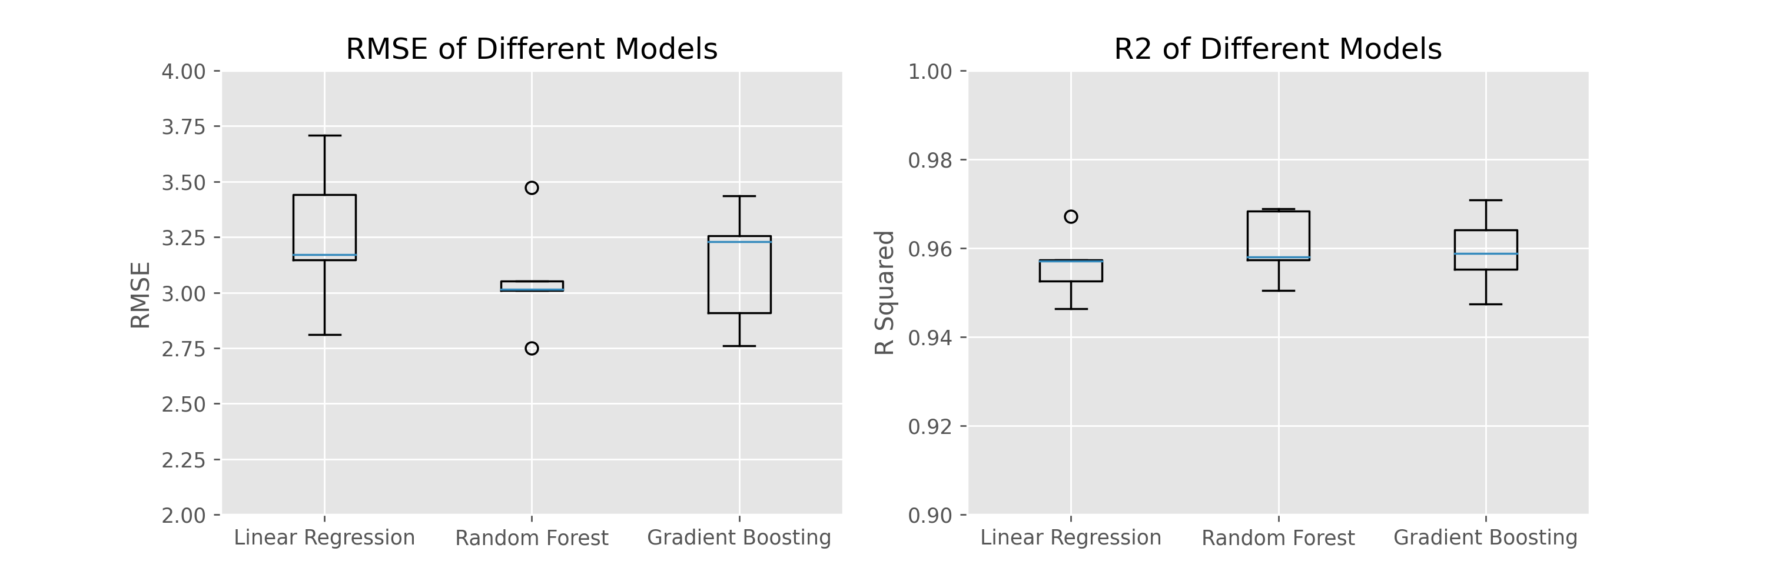
The Models: Overall Performance
They all perform similarly and have high R2 value.

Slide 10
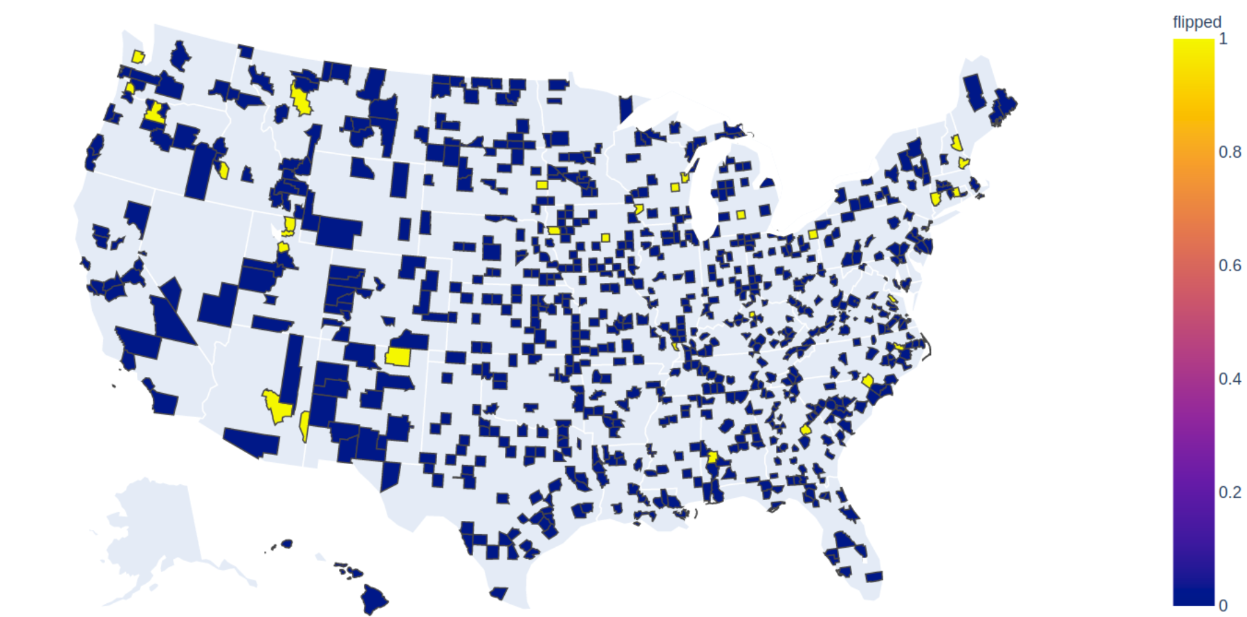
The Predictions
Of the 778 counties in the test set, 95-97% of them were accurately predicted by all models

Slide 11
Conclusion
All the models performed extremely well with correct predictions 95% of the time
The single largest predictor were the results of the previous presidential election
Excluding presidential votes from prior year dropped R2 values to 0.61 – 0.75
Future work includes using updated demographics and apply model to 2020 election

