Slide 1



AutoAcad
Jaypee University of Information Technology, Waknaghat - 173234 (India)
Major Project - II (18B19CI891) | AY 2024-25
End-Term Evaluation | May 16-17, 2025.
Group No.: 103
Team Member (s)
Ansh Mehrotra (211339)
Mayank Kumar (211317)
Prakhar Varshney (211342)
Supervisor (s)
Name: Prof. Vivek Sehgal
Department: Department of CSE & IT
Name: Prof. Shruti Jain
Department: Department of ECE

Slide 2
Outline
Introduction
Problem Statement
Objectives
Work Done (after Mid Term Evaluation)
Project Design
Implementation
Key Learnings
Work Plan (till End-Term Evaluation)
Work Contribution and Attendance
Supervisor Interaction
References

Slide 3
Introduction
AutoAcad is a sophisticated, automated web-based platform developed to revolutionize academic data management and mentoring processes in educational institutions. In today’s academic environment, mentors are often overburdened with administrative tasks such as tracking individual student progress, analyzing performance metrics, and communicating with guardians, which can detract from their primary role of providing personalized support and guidance.
Auto Acad offers a centralized system that integrates various functionalities for both faculty members and guardians, enabling seamless access to student performance data. By automating routine tasks, such as identifying underperforming students, generating performance reports, and notifying guardians about students' academic standing, the platform reduces the workload for educators, allowing them to focus more on mentoring and less on paperwork.

Slide 4
Problem Statement
In most academic institutions, mentoring and performance tracking are done manually, leading to inefficiencies and delays in identifying students who require support. Faculty mentors often struggle with large volumes of student data, making it difficult to:
Communicate regularly with guardians about student performance.
Identify students who need intervention in a timely manner.
Predict academic outcomes for providing early guidance.
This project aims to address these challenges by automating the academic data management process using modern web technologies such as ReactJS, NodeJS, MongoDB etc.

Slide 5
Objectives
The objectives of this project include:
Automate Communication: Automatically notify guardians about students’ performance through predefined criteria.
Performance Analysis: Generate reports to identify students needing extra support based on performance metrics.
Predictive Analytics: Implement machine learning models to forecast future CGPAs, helping mentors provide proactive support.
Data Visualization: Integrate advanced data visualization tools to present student performance metrics in a clear and actionable format. This will help mentors quickly assess trends and identify areas where students may need additional assistance.
Enhanced Security and Privacy: Implement robust security protocols to protect student and guardian data.

Slide 6
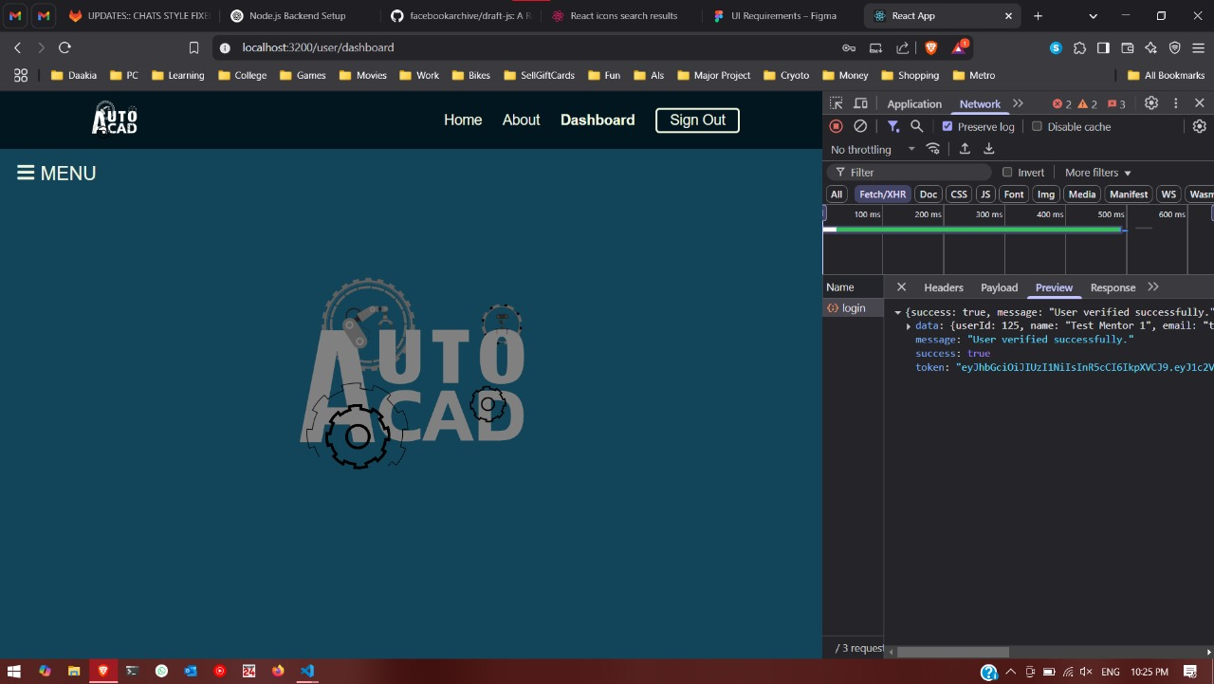
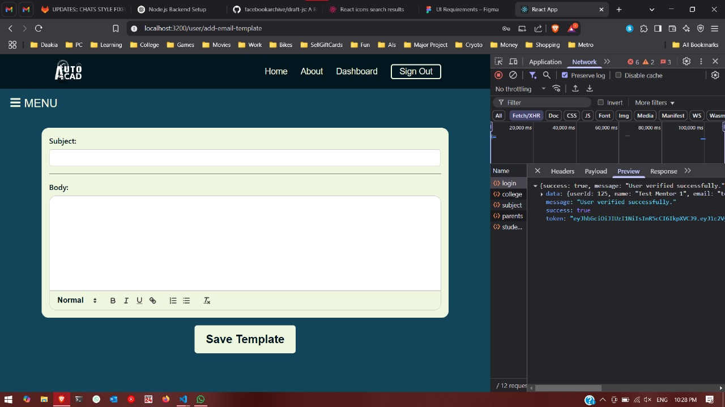
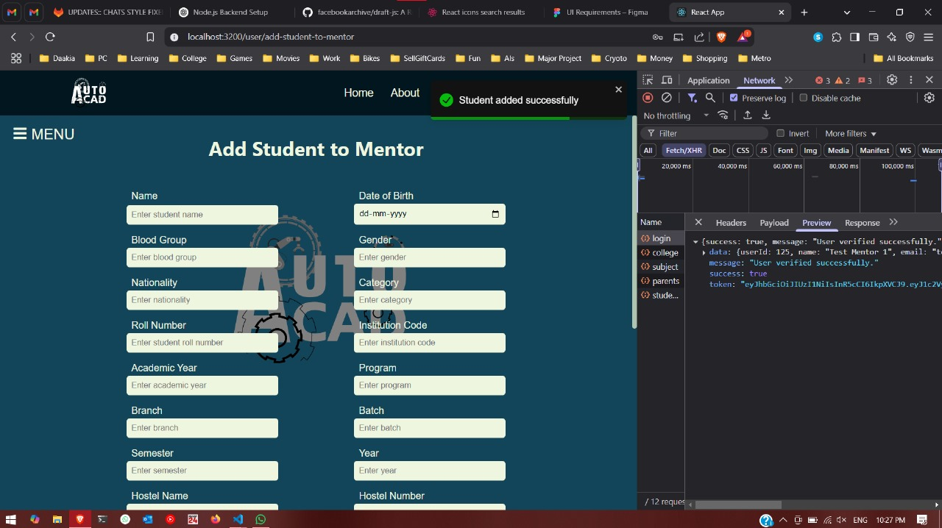
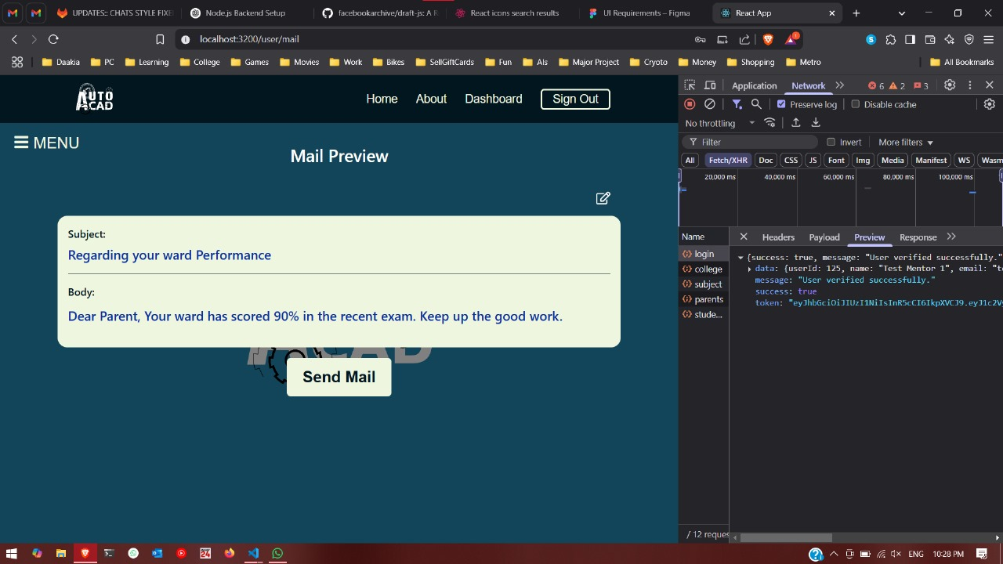
Work Done (after Mid-Term Evaluation)
Mail Template Creation
JWT Authentication
Mail template preview and editing
Adding a student under a mentor api (multiple APIs)

Slide 7
Project Design
1. Title: AutoAcad – Smart Academic Data Management & Mentoring
Key Points:
A web-based platform to streamline student performance tracking and mentoring.
Automates academic reporting, guardian notifications, and progress analysis.
Built with MongoDB , Node.js, Express, and React for efficiency and scalability.

Slide 8
Project Design (cont…)
2. System Architecture
Frontend: React, Axios, Sass, React Router
Backend: Node.js, Express, JWT, bcrypt, cookie-parser
Database: MongoDB Atlas
Security & Authentication: Role-Based Access Control (RBAC), JSON Web Token (JWT), bcrypt
Core Features:
Mentor dashboard for tracking student progress
Automated alerts for underperformance
Guardian portal for academic insights

Slide 9
Project Design (cont…)
Key Objectives & Benefits
Objectives:
Automate academic data tracking.
Enhance mentor efficiency with real-time insights.
Enable transparent communication with guardians.
Ensure secure, role-based access.
Provide an intuitive, user-friendly experience.
Benefits:
Reduced administrative workload for mentors.
Improved student engagement and progress monitoring.
Seamless guardian involvement in academics.

Slide 10
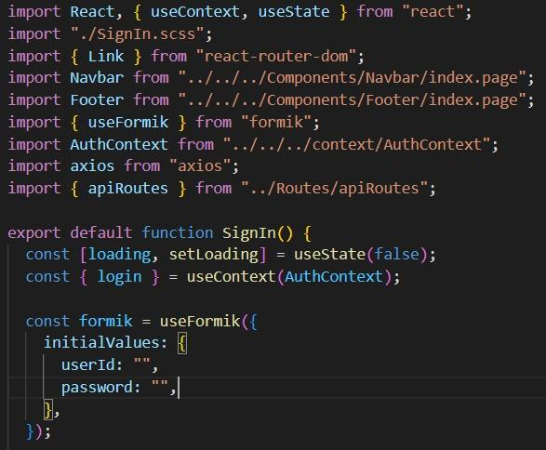
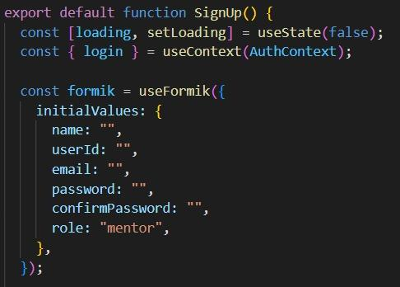
Implementation
Sign in page
Sign up page

Slide 11
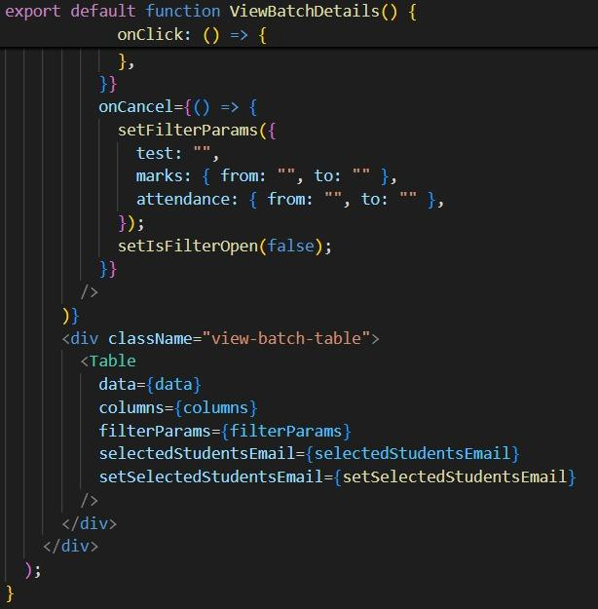
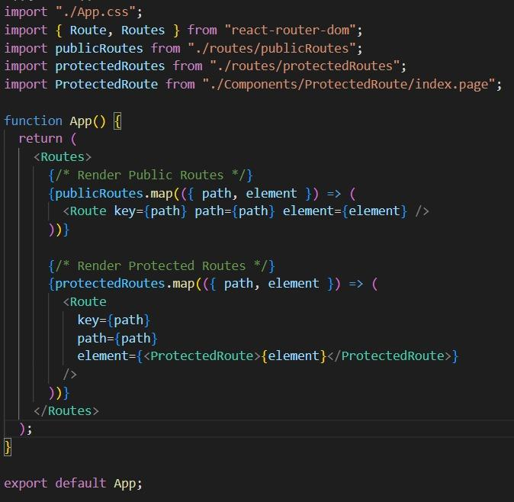
Implementation (cont..)
View Batch Details
Initializing AutoAcad Backend – Routing, Middleware & API Powerhouse!

Slide 12
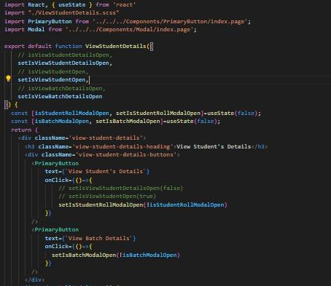
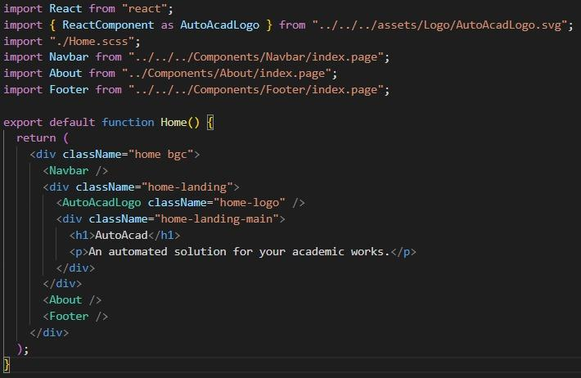
Implementation (cont..)
Student Details
Welcome to AutoAcad Backend – Powering Secure & Smart Academic Management!
– Home Page

Slide 13
Experimental Results and Evaluation
Key Metrics Analyzed:
System Response Time: Average time taken to load dashboards and fetch student data.
API Performance: Measured request-response times for key functionalities like login, student progress retrieval, and notifications.
Database Efficiency: Query execution times and indexing improvements in MongoDB.
Findings:
API response time: ~200ms (optimized with caching strategies).
Page load time: ~1.5s on average (React rendering optimizations).
Secure and fast authentication via JWT (~150ms processing).

Slide 14
Experimental Results and Evaluation (cont…)
1. Increased Engagement: Proactive and collaborative communications have been achieved through the guardian notifications.
2. Ease of Use: It makes for managing all those complicated things via the straightforward intuitive interface and touching navigation: retrieving data and insights without much ado.
3. Reduced Administrative Efforts: Automation does the performance tracking and notification, which aside from saving time and resource, for teachers, takes out the manual effort involved in the process.

Slide 15
Experimental Results and Evaluation (cont…)
Benchmarking Against Traditional Methods:
Planned Improvements:
Implement AI-based student performance prediction.
Optimize database indexing for even faster queries.
Enhance UI/UX with more data visualization tools.
Feature | Traditional | AutoAcad
Student Tracking | Manual Reports | Automated Analysis
Guardian Updates | Irregular Emails | Real-time notification
Performance Analysis | Spreadsheet-based | AI- Driven Insights

Slide 16
Key Learnings
Learned how to connect a MongoDB, Express, React, and Node.js (MERN) stack efficiently, ensuring smooth API communication.
Improved skills in handling React state management and Axios API calls for seamless data flow
Implemented secure authentication and role-based access control (RBAC) using JWT and bcrypt to manage user permissions effectively.

Slide 17
Future Work
Implement Real-Time Notifications using WebSockets or libraries like Socket.IO to instantly inform users (students, mentors, guardians) of important updates.
Integrate Advanced Analytics with charts and dashboards to provide deeper insights into student performance and mentoring effectiveness.
Add Admin Panel for managing users, roles, permissions, and overall system settings with a clean UI and access control.
Support Multi-Institution Access so the app can scale across different colleges/schools with institution-specific data segregation.

Slide 18
Work Contribution and Attendance
GitHub Repository URL: https://github.com/mkr-29/auto-acad and https://github.com/mkr-29/auto-acad-backend
Team Member | Roll No. | Work Done (provide complete details) | Work Contribution (%) | Lines of Code (LoC) | Lab Attendance (%)
1. | 211317 | Project Planning & Requirement Analysis Conducted requirement analysis through discussions with mentors and educators to align platform features with their needs. Integrated JWT authentication & bcrypt for password security and access control. Frontend Development & UI/UX Design Backend Development Developed a Node.js and Express-based backend with MongoDB Atlas for scalable data management. Deployed the system on a cloud platform ensuring accessibility. | 60 | 8000+ | 80
2. | 211339 | Backend Development & Security Implementation Implemented Role-Based Access Control (RBAC) for secure user authentication (mentors, students, guardians). Conducted requirement gathering for academic data automation and role-based access. Defined the core objectives of AutoAcad, focusing on academic data automation and mentoring enhancement. | 20 | 1000 | 30.55
3. | 211342 | Conducted API performance testing, optimizing response times and database queries. Report and ppt making Machine Learning Model | 20 | 1000 | 33.33

Slide 19
Supervisor Interactions (as mentioned in weekly log)
No. of Meetings with Supervisor: 5
Week No. | Duration | Remarks (as mentioned in the weekly log) | Incorporated (Yes/No)
1. | 26/04/2025 to 03/04/2025 | Project setup completed successfully with backend (Node.js, Express, MongoDB Atlas) and frontend (React) initialized. Basic authentication and role-based access control (RBAC) implemented on the backend. Initial UI wireframes and database schema designed, ensuring proper structuring of student-mentor relationships. | Yes
2. | 04/04/2025 to 16/04/2025 | Core API endpoints for user authentication, role management, and basic CRUD operations are functional. Database models created and integrated, with MongoDB Atlas handling data storage effectively. Token-based authentication (JWT) tested successfully for secure user login sessions. | Yes
3. | 17/04/2025 to 23/04/2025 | Login, signup, and role-based dashboard UI components designed and integrated with backend APIs. Protected routes implemented in React with authentication checks ensuring restricted access to specific roles. API calls tested using Axios, with error handling and user feedback mechanisms implemented. | Yes
4. | 24/04/2025 to 01/05/2025 | Core functionalities like student progress tracking, mentor analytics, and guardian notifications integrated. Code refactoring and optimization done to improve performance and scalability. Security enhancements applied, including bcrypt for password hashing and CORS configuration for safe cross-origin requests. | Yes
5. | 02/05/2025 to 07/05/2025 | End-to-end testing completed, covering all major functionalities and fixing critical bugs. Application deployed on a cloud platform (e.g., Vercel for frontend, Render for backend) with a live demo available. Comprehensive project documentation prepared, including API references, setup guides, and future improvement suggestions. | Yes

Slide 20
References
[1] J. Smith and A. Brown, "Introduction to Academic Management Systems," Journal of Education Technology, vol. 15, no. 3, pp. 45-58, 2020. [2] M. Lee and R. Patel, "Machine Learning in Education: A Review," International Journal of Educational Research, vol. 22, no. 4, pp. 133-145, 2019. [3] L. Johnson and T. Clarke, "Modern Web Technologies and Their Application in Academic Systems," Web Development Journal, vol. 10, no. 1, pp. 67-78, 2018. [4] P. Kumar and D. Shah, "Challenges in Traditional Academic Management," Education Insight, vol. 11, no. 2, pp. 89-102, 2021. [5] R. Gupta and S. Sharma, "Performance Tracking Systems in Schools," Academic Performance Review, vol. 8, no. 5, pp. 200-215, 2017. [6] C. Anderson, "Data Visualization for Student Performance Monitoring," Visual Data Science, vol. 5, no. 3, pp. 55-67, 2019. [7] A. Brown and K. Taylor, "Proactive Mentoring with Predictive Analytics," Journal of Student Success, vol. 12, no. 4, pp. 123-136, 2020. [8] S. Patel and M. Singh, "The Role of Real-Time Notifications in Academic Management," Education Today, vol. 18, no. 2, pp. 45-56, 2018.

Slide 21
References (cont…)
[9] L. Wang and F. Zhao, "Machine Learning Frameworks in Academic Systems," Tech in Education, vol. 13, no. 1, pp. 21-34, 2021.
[10] J. Smith and K. Patel, "The Role of Modern JavaScript Frameworks in Frontend Development," Springer Link, 2021.
[11] A. Doe and R. Kumar, "Responsive Web Design and User Experience: Best Practices," ACM Digital Library, 2020.
[12] Z. Wang and S. Li, "RESTful API Design and Implementation for Web Applications," ResearchGate, 2021.
[13] M. Gupta and H. Taylor, "A Comparative Study of Node.js and Django for Backend Development," IEEE Xplore, 2022.
[14] R. Johnson and P. Rivera, "Seamless Integration of Frontend and Backend in Web Applications," Elsevier, 2021.
[15] D. Brown and Y. Zhang, "Web Application Architecture: Patterns and Practices," Springer Link, 2020.
[16] V. Sharma and J. Lee, "Challenges in Full-Stack Web Development: A Case Study," IEEE Xplore, 2022.
[17] S. Kumar and B. Allen, "Building Scalable Web Applications Using MERN Stack," ResearchGate, 2021.
[18] L. Smith and H. Zhao, "Automated Testing for Web Applications: Tools and Techniques," ACM Digital Library, 2021.
[19] P. Gupta and T. Sanders, "Error Handling and Debugging in Web Development," IEEE Access, 2022.
[20] P. Johnson and C. Lee, "Oracle Database in Academic Applications," Data Management Journal, vol. 7, no. 4, pp. 159-172, 2020.

Slide 22
References (cont…)
[21] J. Turner, "The Future of Web-Based Academic Platforms," Future of Education, vol. 14, no. 2, pp. 90-103, 2019. [22] R. Smith and E. Harris, "Advantages of React in Educational Platforms," Web Development Quarterly, vol. 16, no. 3, pp. 22-35, 2021. [23] N. Kapoor and V. Agarwal, "Enhancing Student Engagement through Interactive Platforms," Education Technology Review, vol. 11, no. 2, pp. 10-25, 2019. [24] A. Kumar and L. Mehta, "User Experience in Academic Management Systems," User Experience Journal, vol. 4, no. 1, pp. 45-58, 2020. [25] B. Carter and H. Williams, "Data Analysis and Visualization Tools for Education," Journal of Data Science, vol. 19, no. 2, pp. 75-89, 2021.

Slide 23

Thanks.

