Slide 1
Leasing vs Buying a Car: Which is ACTUALLY Cheaper in 2024?

Slide 2
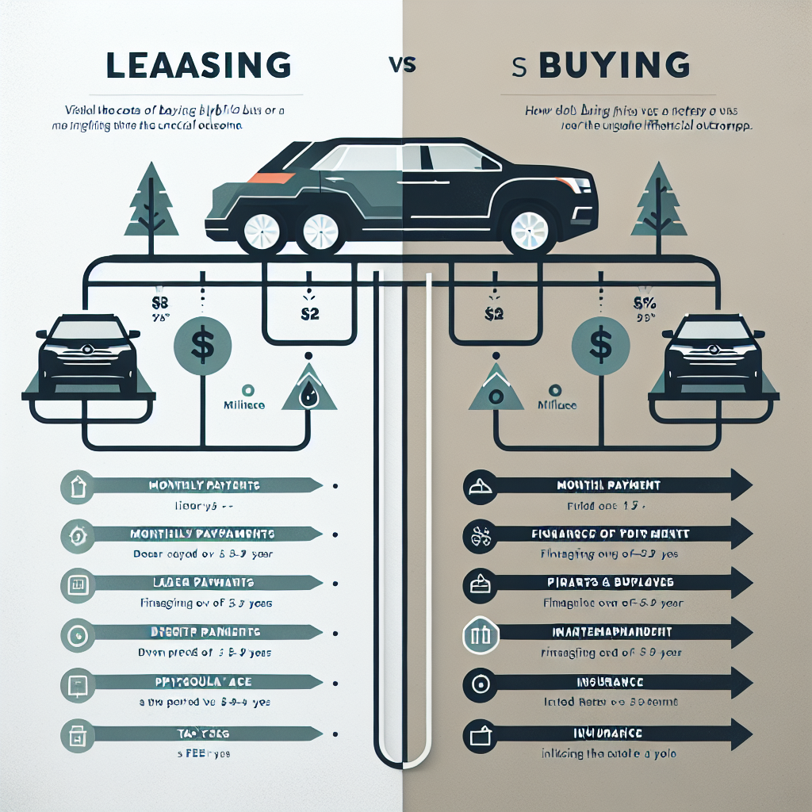
Leasing vs Buying a Car: Cost Comparison
Leasing a car involves renting for ~3 years with monthly payments covering depreciation, interest, taxes, and fees
Buying a car typically requires a down payment and financing over 5-6 years, with payments for principal and interest
The video compares costs of leasing and buying a Toyota RAV4 Hybrid over different terms
Analysis determines which option, leasing or buying, is more financially prudent based on total costs
1
Notes:
• Leasing payments are often lower than loan payments, but you don't own the vehicle at the end of the lease term
• Buying builds equity over time as you pay down the loan balance, but requires higher upfront and monthly costs
• The specific example of a Toyota RAV4 Hybrid is used to model realistic numbers for the comparison
• Factors like mileage, maintenance, repairs, insurance, and resale value also impact the overall financial picture

Slide 3
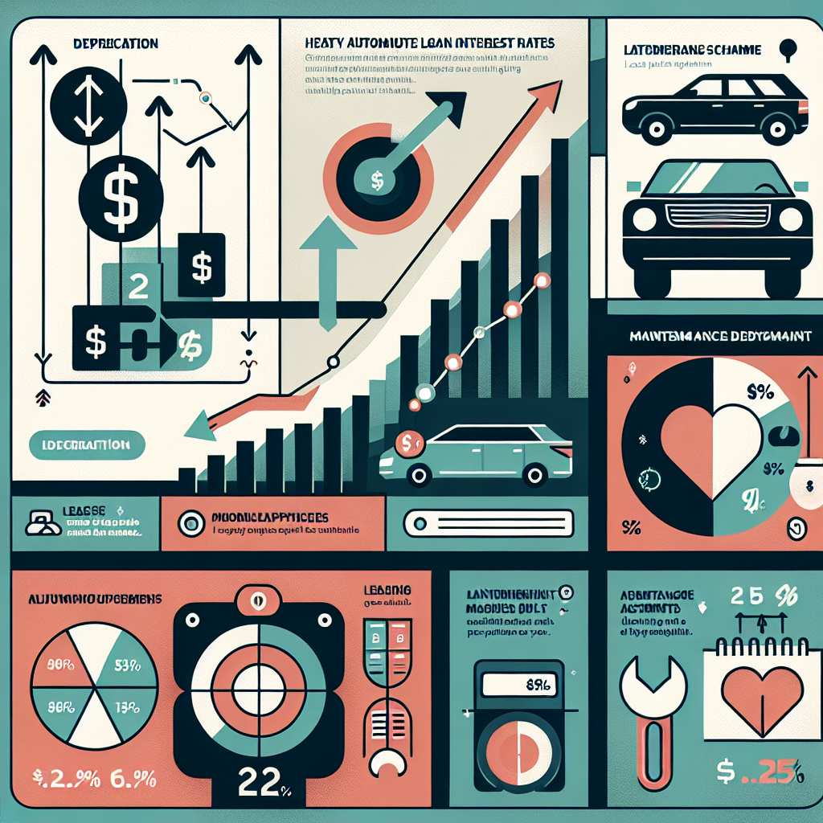
Factors Affecting Car Ownership Costs
High auto loan interest rates have pushed the average monthly payment for a new car in America to nearly $729
Leasing a car can enable purchasing it later at a residual price lower than the market value of the same used car
Intangible factors like depreciation, maintenance plans, and overall sense of ownership impact the lease vs buy decision
Carefully evaluating financial and intangible aspects is key to making the optimal choice between leasing and buying a car
2
Notes:
• Current auto loan rates are at record highs, making new car payments more expensive than ever at an average of almost $729/month
• One potential advantage of leasing is the ability to later purchase the car at a predetermined residual price that may be below market value
• In addition to hard financial factors, lessees and buyers should also consider intangibles like the car's depreciation, included maintenance, and the emotional aspect of ownership
• Making the right decision requires thoroughly weighing both the financial numbers as well as personal preferences and intangible factors

Slide 4
Comparing Costs of Leasing vs Buying a Toyota RAV4 Hybrid
Over a 3-year period, buying a Toyota RAV4 Hybrid costs $8,052 total
Leasing the same vehicle for 3 years then buying and reselling totals $12,148
On a yearly basis, buying costs $2,684/year while leasing costs $4,049/year
In most cases, buying a car is more financially prudent than leasing
This is especially true if planning to own the vehicle for 5+ years
3
Notes:
• The example provided compares the total and yearly costs of buying vs leasing a Toyota RAV4 Hybrid over a 3-year timeframe
• Buying worked out to $8,052 total or $2,684/year, while the lease-then-buy option totaled $12,148 or $4,049/year
• So for this specific vehicle and time period, buying was significantly cheaper than leasing
• In general, buying tends to be the more financially sound choice for most people and vehicles
• The cost benefits of buying are greatest when owning the car for longer periods like 5-7+ years

Slide 5
When Leasing May Be the Better Option
Leasing can be advantageous for high-end vehicles with steep depreciation and maintenance costs
Ideal for those who prefer driving a new car every few years without the commitment of ownership
Leasing terms typically include comprehensive dealer warranties covering maintenance for the duration
Business owners may benefit from writing off a portion of their lease payments
4
Notes:
• Luxury cars and sports cars often have high maintenance costs and lose value quickly. With leasing, maintenance is usually covered by the dealer, and you pay taxes on the depreciated amount rather than the full lease price.
• Leasing allows you to experience a brand new vehicle every three years or so without the long-term responsibilities that come with buying a car outright.
• Those who aren't as diligent about vehicle upkeep may prefer leasing since dealer warranties generally cover any maintenance issues that arise during the lease period.
• If you run a business, leasing a car could provide tax advantages by allowing you to write off some of the payments as a business expense.

Slide 6
Drawbacks of Leasing a Vehicle
Mileage limits on leases can lead to fees of 10-25 cents per mile if exceeded
Early lease termination results in substantial fees, limiting ability to switch vehicles
Lessee does not own the car at end of lease without paying full residual amount
Leasing offers less flexibility and higher long-term costs compared to buying
5
Notes:
• Leases come with annual mileage limits, often 10,000-15,000 miles. Going over the allotted miles results in additional charges per mile.
• Ending a lease early, even if dissatisfied with the vehicle, triggers significant termination fees. This makes it harder to switch to a different car.
• When the lease ends, the lessee must return the car or pay the entire residual value to purchase it outright. Leasing does not build equity.
• While leasing can mean lower monthly payments, it offers less flexibility than owning and is more expensive in the long run if one leases multiple times.

Slide 7
Buying vs Leasing: Characteristics of Buyers and Lessees
Buying is best for those who want optimal finances, don't mind long-term vehicle ownership, and want to avoid lease restrictions
Buyers prefer to drive the same car for many years and enjoy the sense of ownership that comes with it
Leasing appeals to those wanting a new car every 3-4 years or a more expensive car with lower monthly payments
Lessees must be confident they won't exceed mileage limits, and business owners can write off some lease payments
6
Notes:
• Expand on the financial benefits of buying, such as building equity and having no further payments once the car is paid off
• Provide examples of lease limitations like mileage caps, wear and tear fees, and lack of customization
• Discuss how leasing allows people to drive higher-end cars by spreading out the cost over a limited term
• Mention that businesses leasing vehicles can write off a portion of the payments as a tax-deductible expense

Slide 8
Leasing vs. Buying: Key Takeaways
The video compares leasing and buying using a Toyota RAV4 Hybrid as an example
Leasing can be advantageous in certain situations, but buying is usually more financially prudent
Buying is especially beneficial if planning to own the vehicle for an extended period
The decision between leasing and buying depends on individual preferences, habits, and finances
Always run the numbers for your specific situation to determine the best option
7
Notes:
• The video provides a comprehensive comparison to help viewers understand the pros and cons of leasing versus buying a car
• While leasing may work well for some people, buying is generally the more financially sound choice for most individuals and most vehicles
• If you plan to keep the car for a long time, buying becomes an even more attractive option compared to leasing
• Factors like personal preferences, driving habits, and financial circumstances should all be considered when making this decision
• It's crucial to crunch the numbers based on your specific situation to figure out whether leasing or buying makes the most sense for you

