Slide 1


Education Disparity in Chicago Public High Schools
Michael Kralis

Slide 2


Clustering Schools
I began by clustering schools based on data from ISBE using a K-Means clustering algorithm
The K-Means algorithm took demographics as inputs like % Low Income, % White, % Black/African American, % Hispanic, etc.

Slide 3

Trends over Time
In addition to identifying summary statistics of the clusters, we can see how these clusters change over time
More specifically, we are looking to analyze the demographic changes as well as academic changes

Slide 4
Graphical Model
2019 School Clusters
2020 School Clusters
Cluster 1
Cluster 2
Cluster 3
Cluster 4
Cluster 5
Cluster 1
Cluster 2
Cluster 3
Cluster 4
Cluster 5
Create stable matching between years

Slide 5
Snippet of Results from 2019
AVERAGES OF CLUSTER: 3
% Student Enrollment - White 32.73
% Student Enrollment - Black or African American 17.76
% Student Enrollment - Hispanic or Latino 32.92
% Student Enrollment - Asian 10.55
% Student Enrollment - Low Income 41.19
Student Attendance Rate 93.49
High School Dropout Rate - Total 1.67
High School 4-Year Graduation Rate - Total 93.19
% Graduates enrolled in a Postsecondary Institution within 12 months 87.46
Chronic Absenteeism 20.61

Slide 6
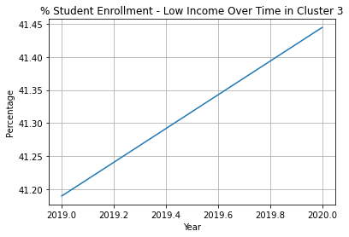
Changes over Time

Slide 7

Github Repo!
Progress can be found in my github repository here: https://github.com/mkralis123/SoReMo

