Slide 1


Education Disparity in Chicago Public High Schools
Michael Kralis

Slide 2


Clustering Schools
I began by clustering schools based on data from ISBE using a K-Means clustering algorithm
The K-Means algorithm took demographics as inputs like % Low Income, % White, % Black/African American, % Hispanic, etc.

Slide 3
K-Means Clustering Algorithm
The goal of the algorithm is to have the “K means” converge to a “stable” point.
The clusters are the partitions created by determining which mean each point is closest to.
In this example, the black dots are the means and K=3

Slide 4
Summary Statistics (Cluster 0)
% Student Enrollment - White 1.11
% Student Enrollment - Black or African American 89.20
% Student Enrollment - Hispanic or Latino 8.38
% Student Enrollment - Asian 0.45
% Student Enrollment - Low Income 84.46
Student Attendance Rate 91.07
High School Dropout Rate - Total 5.44
High School 4-Year Graduation Rate - Total 80.92
% Graduates enrolled in a Postsecondary Institution within 12 months 57.32

Slide 5
Summary Statistics (Cluster 1)
% Student Enrollment - White 4.15
% Student Enrollment - Black or African American 11.15
% Student Enrollment - Hispanic or Latino 81.30
% Student Enrollment - Asian 2.17
% Student Enrollment - Low Income 89.21
Student Attendance Rate 91.74
High School Dropout Rate - Total 4.41
High School 4-Year Graduation Rate - Total 81.06
% Graduates enrolled in a Postsecondary Institution within 12 months 63.23

Slide 6
Summary Statistics (Cluster 2)
% Student Enrollment - White 28.25
% Student Enrollment - Black or African American 17.06
% Student Enrollment - Hispanic or Latino 38.19
% Student Enrollment - Asian 11.95
% Student Enrollment - Low Income 54.30
Student Attendance Rate 94.63
High School Dropout Rate - Total 2.24
High School 4-Year Graduation Rate - Total 91.25
% Graduates enrolled in a Postsecondary Institution within 12 months 81.36

Slide 7

Trends over Time
In addition to identifying summary statistics of the clusters, we can see how these clusters change over time
More specifically, we are looking to analyze the demographic changes as well as academic changes

Slide 8
Graphical Model
2019 School Clusters
2020 School Clusters
Cluster 1
Cluster 2
Cluster 3
Cluster 4
Cluster 5
Cluster 1
Cluster 2
Cluster 3
Cluster 4
Cluster 5
Create stable matching between years

Slide 9
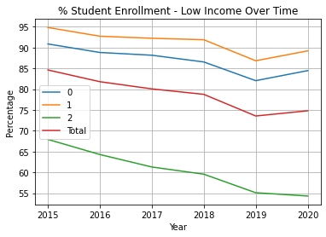
Low Income Proportions Over Time
As we can see, the gap between low-income student enrollment has gotten larger between the clusters.
More specifically, this gap is mainly attributed to the decline in cluster 2.

Slide 10
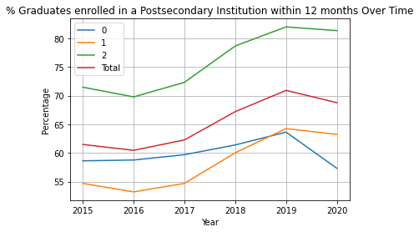
College Enrollment Over Time
Again, the gap between college enrollment statistics has become even larger.
More importantly, we can see how the pandemic halted growth rate of CPS students enrolling in college.
We can also see how the pandemic affected students of color.

Slide 11
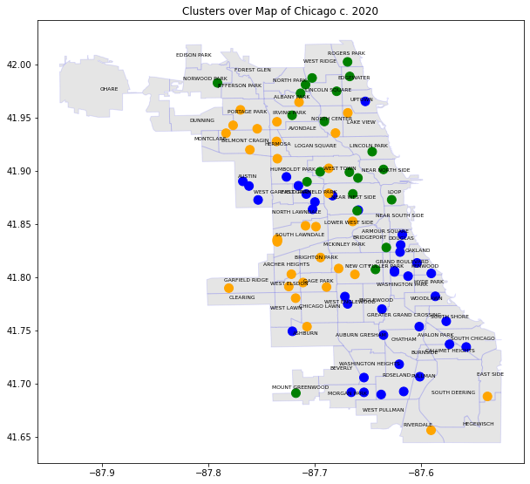

Mapping these Clusters
After seeing these clusters projected onto a map of Chicago, we can see just how segregated the city is.
Not only do the clusters give good indication of academic factors, but also partitions Chicago well.

Slide 12
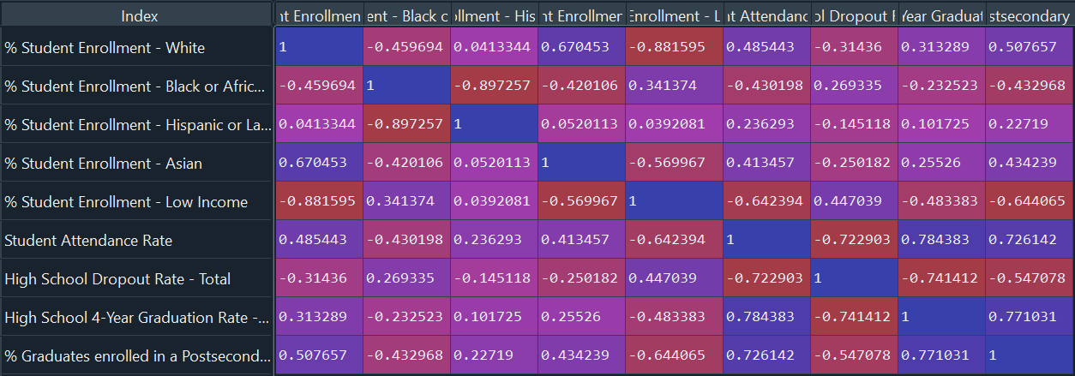
Traditional Approach: Correlation Matrix

Slide 13
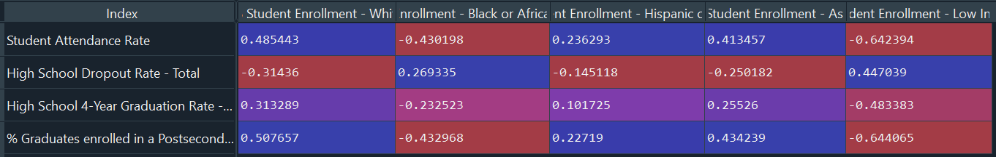
Inference
From this we can see that in every academic factor, proportion of low-income and African American or Black students is the deciding factor.

Slide 14
Possible future work
Using other methods to cluster?
Analyzing different features?
Look into funding of schools?
Using methods in algebraic statistics
Compute Markov basis functions from elimination Gröbner basis
Construct Markov chain to “walk” along fibers
Test for independence

Slide 15

Github Repo!
Progress can be found in my github repository here: https://github.com/mkralis123/SoReMo

