Slide 1
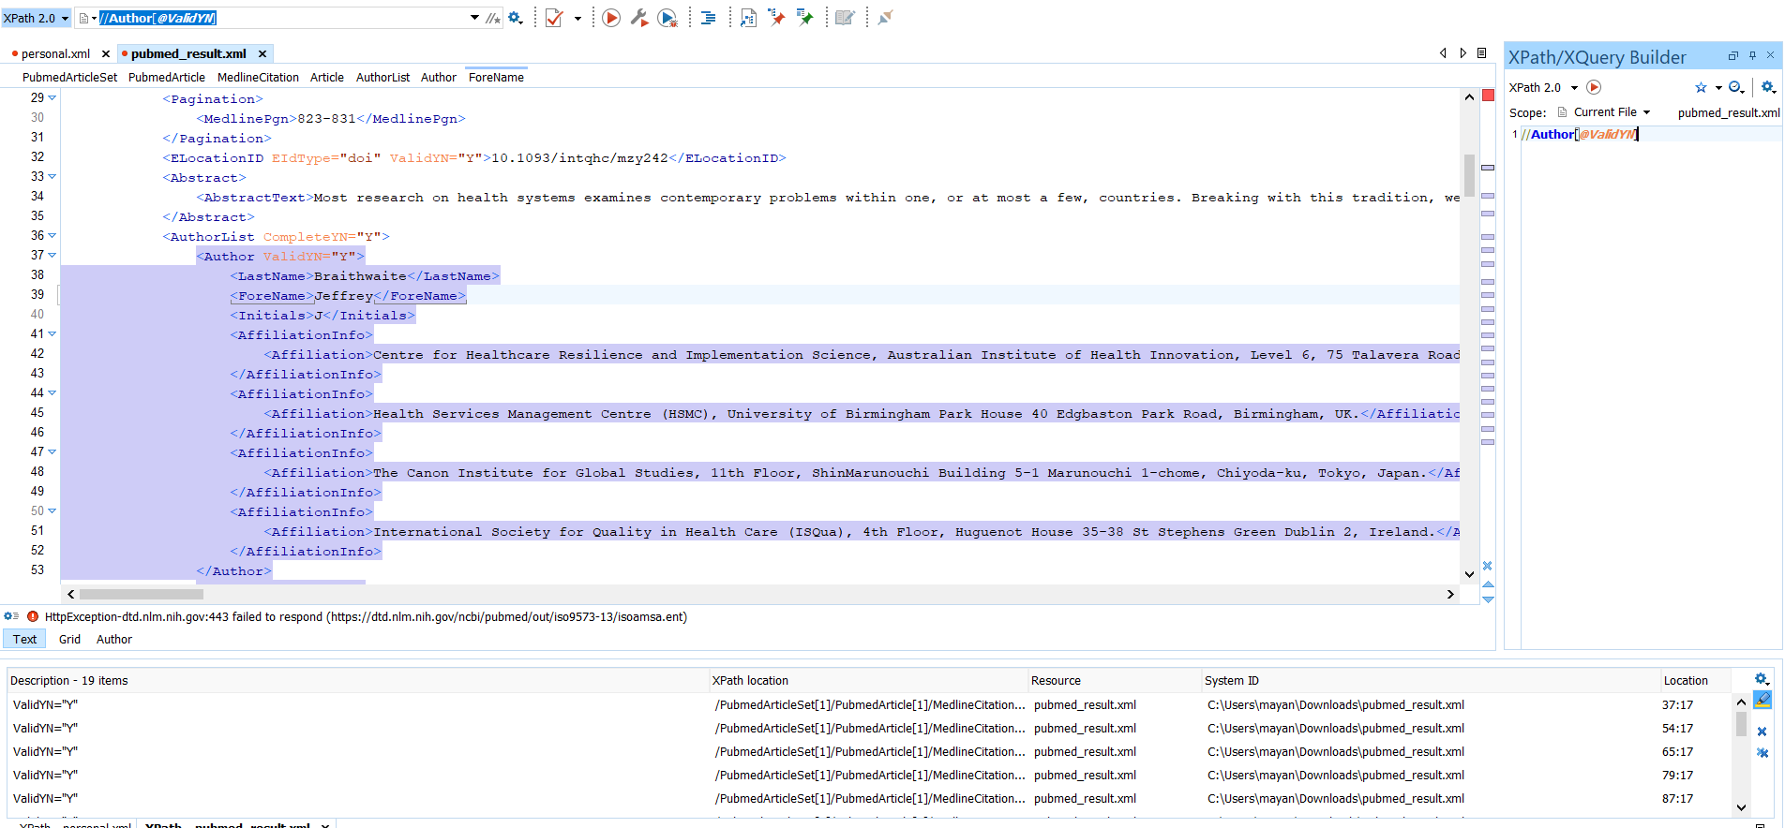
Query 1: Select all the Author elements that have an attribute named ValidYN: //Author[@ValidYN]

Slide 2
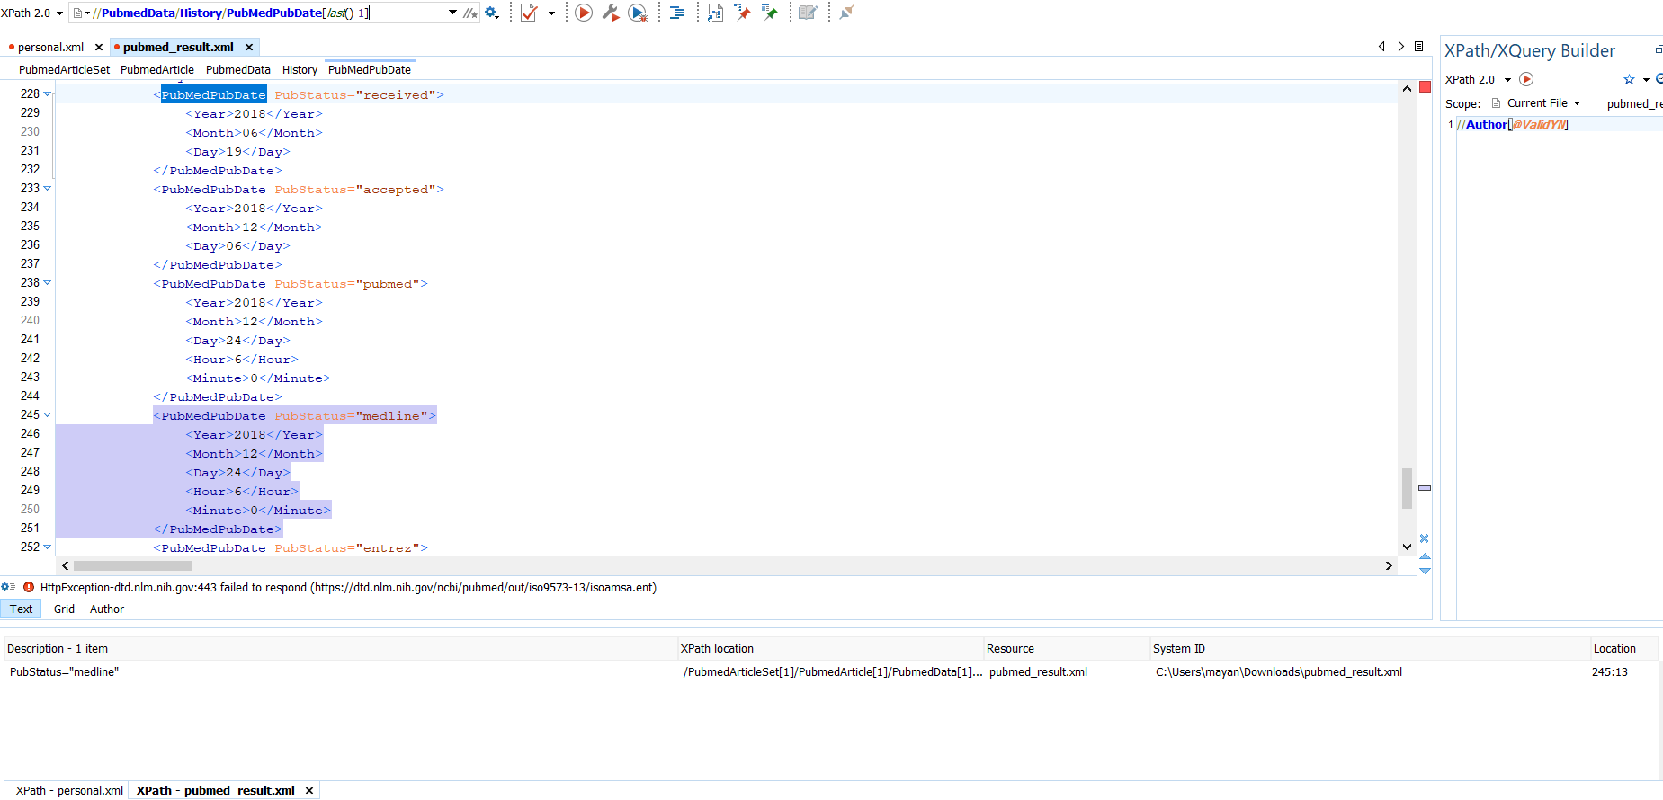
Query 2: Select the last but one PubMedPubDate element that is the child of the History element //PubmedData/History/PubMedPubDate[last()-1]

Slide 3
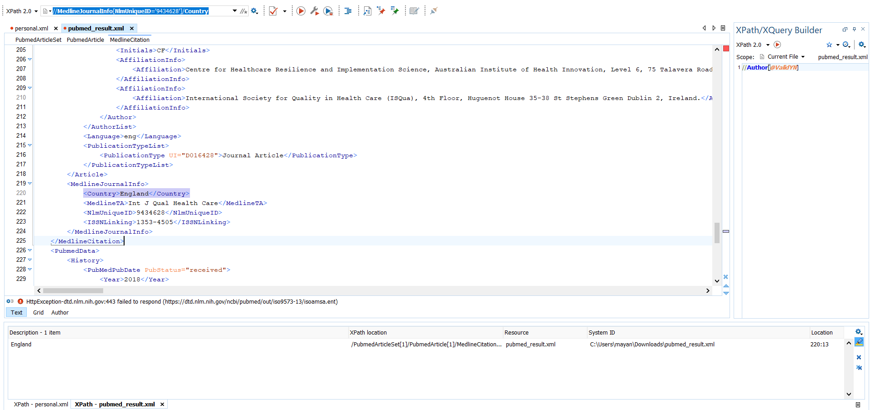
Query 3: Select the name of the country whose NlmUniqueID is 9434628. //MedlineJournalInfo[NlmUniqueID='9434628']/Country

Slide 4
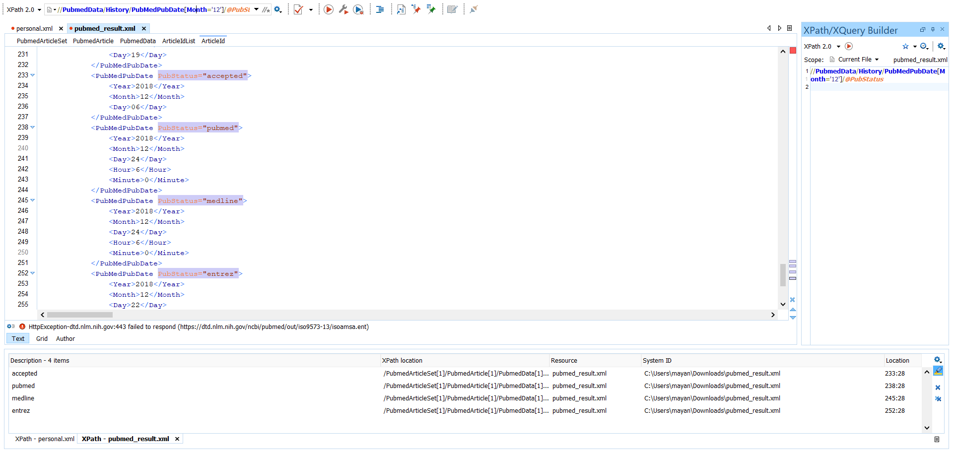
Query 2: Select the attribute PubStatus of PubMedPubDate where month is 12. //PubmedData/History/PubMedPubDate[Month='12']/@PubStatus

Slide 5
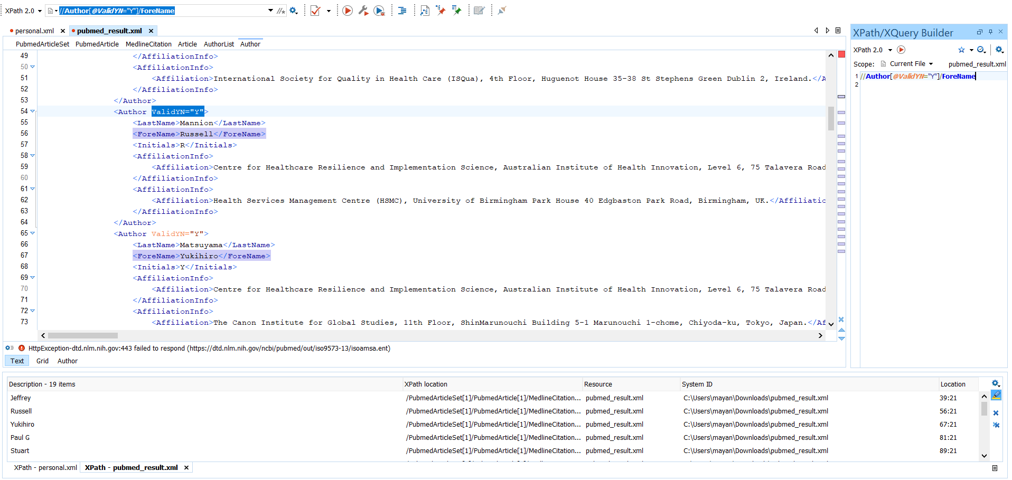
Query 2: Select the Forename of the Author whose attribute ValidYN is set to Yes. //Author[@ValidYN="Y"]/ForeName

