Slide 1
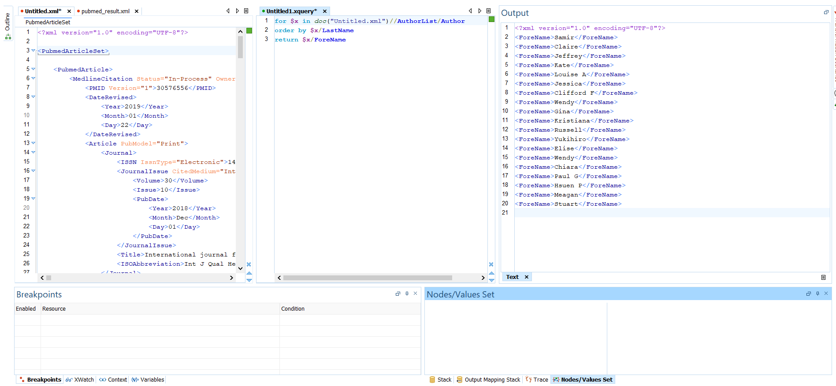
Query 1: Select the forename of all the authors ordered by last name. for $x in doc(“Untitled.xml")//AuthorList/Author order by $x/LastName return $x/ForeName

Slide 2
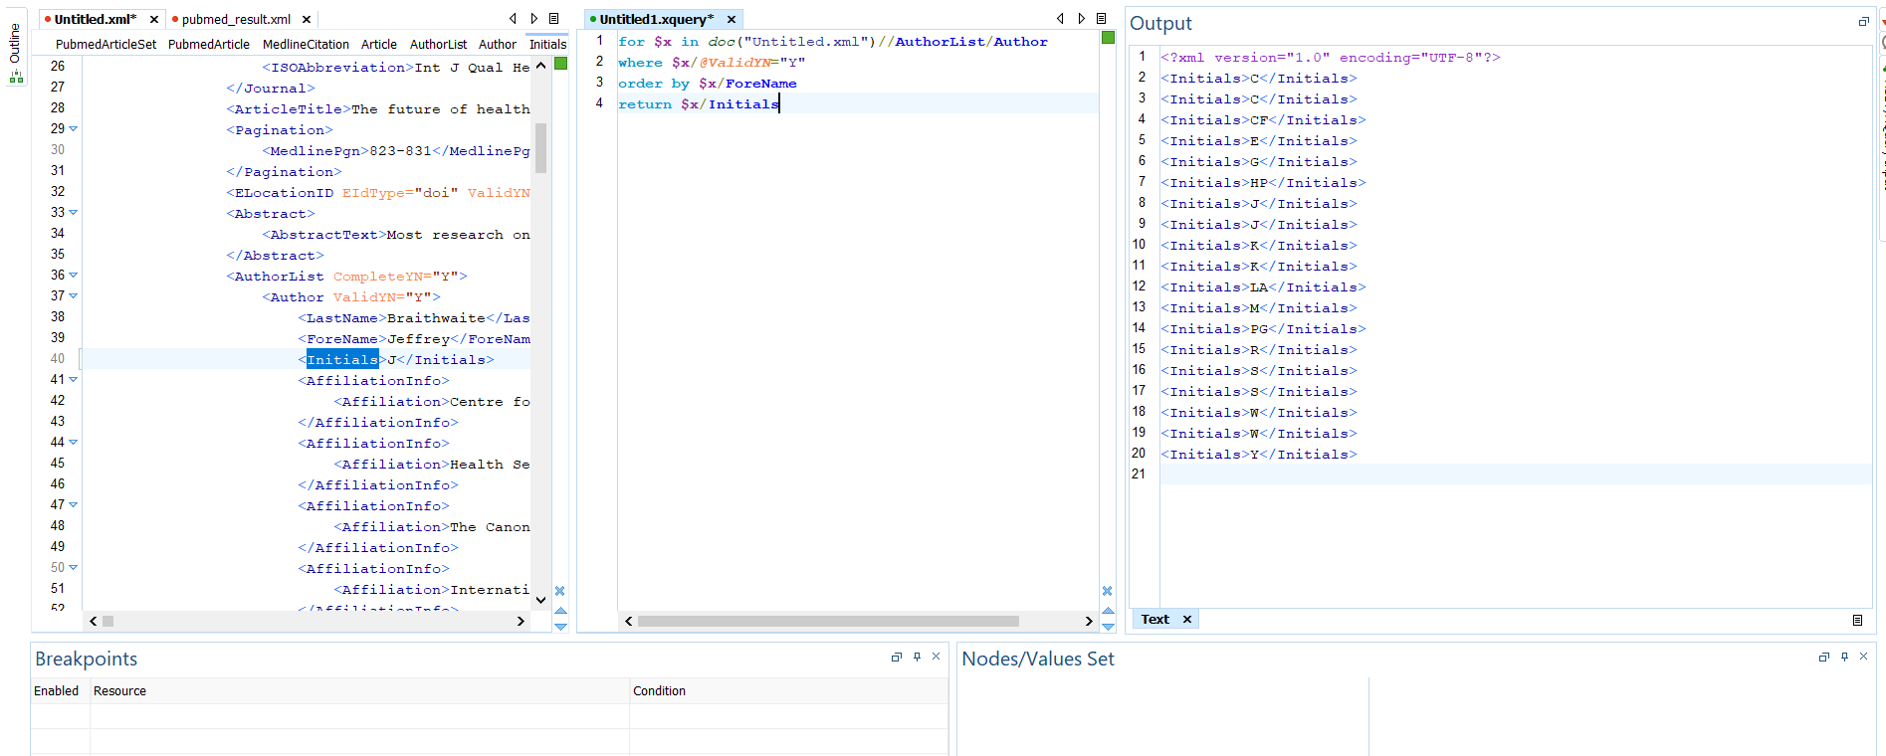
Query 2: Select the Initials of all the authors whose ValidYN=Y and ordered in ascending order by fore name. For $x in doc("Untitled.xml")//AuthorList/Author where $x/@ValidYN=‘Y’ order by $x/ForeName return $x/Initials

Slide 3
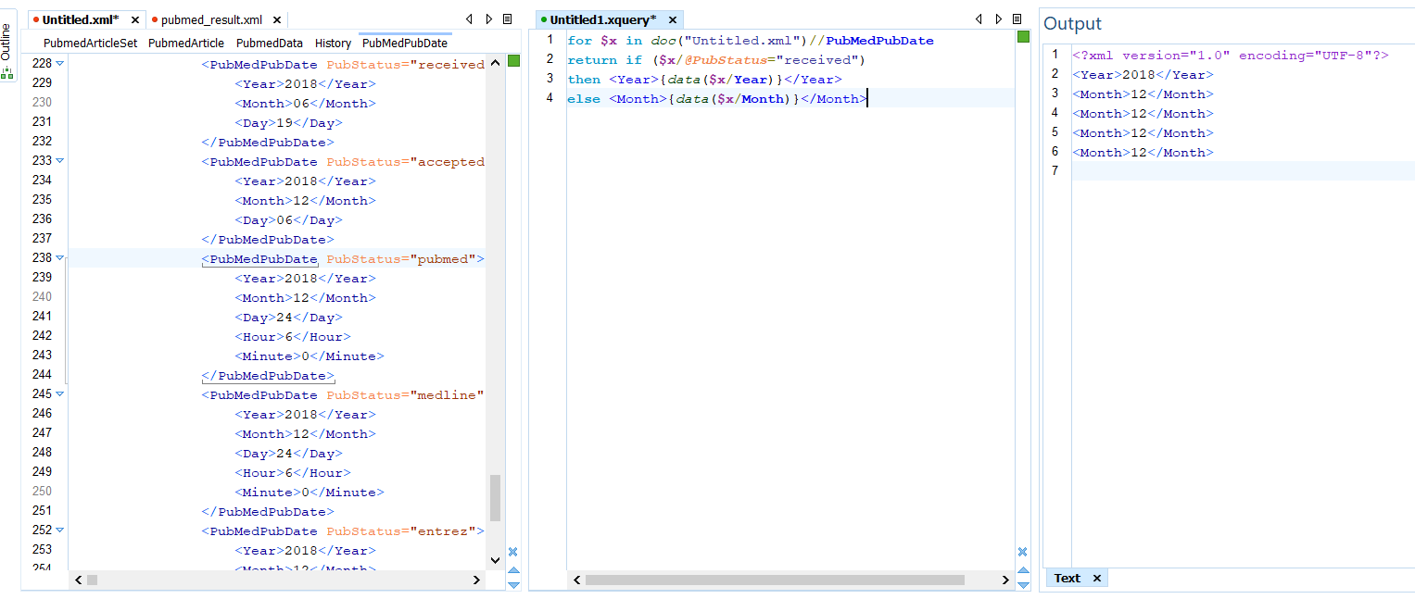
Query 3: Display Year if Pubtatus is ‘received’ and display Month if PubStatus is otherwise. for $x in doc("Untitled.xml")//PubMedPubDate return if ($x/@PubStatus="received") then <Year>{data($x/Year)}</Year> else <Month>{data($x/Month)}</Month>

Slide 4
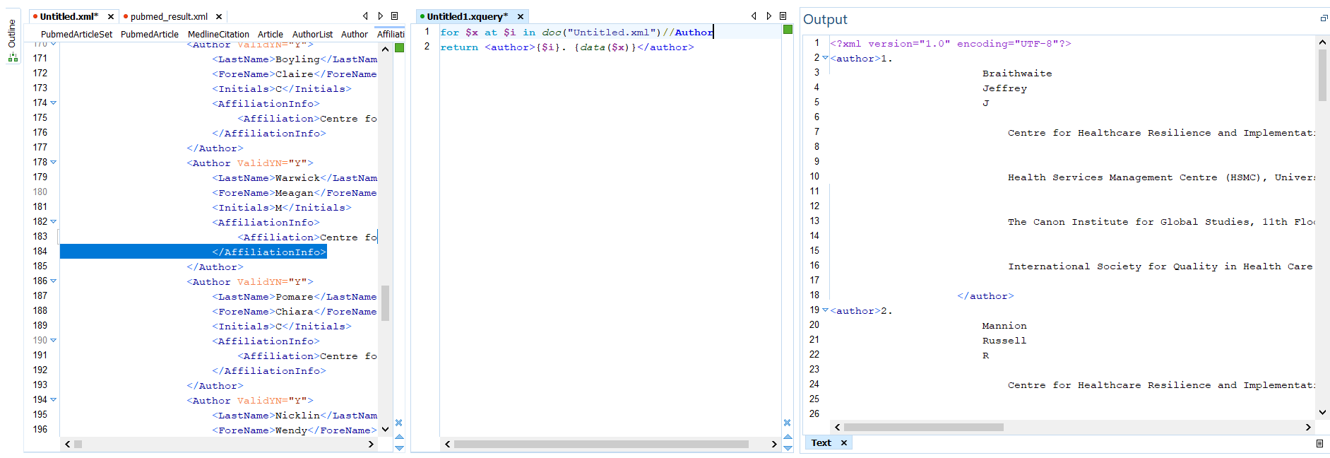
Query 4: Use ‘at’ to count the iteration – Display details of all the authors. for $x at $i in doc("Untitled.xml")//Author return <author>{$i}. {data($x)}</author>

Slide 5
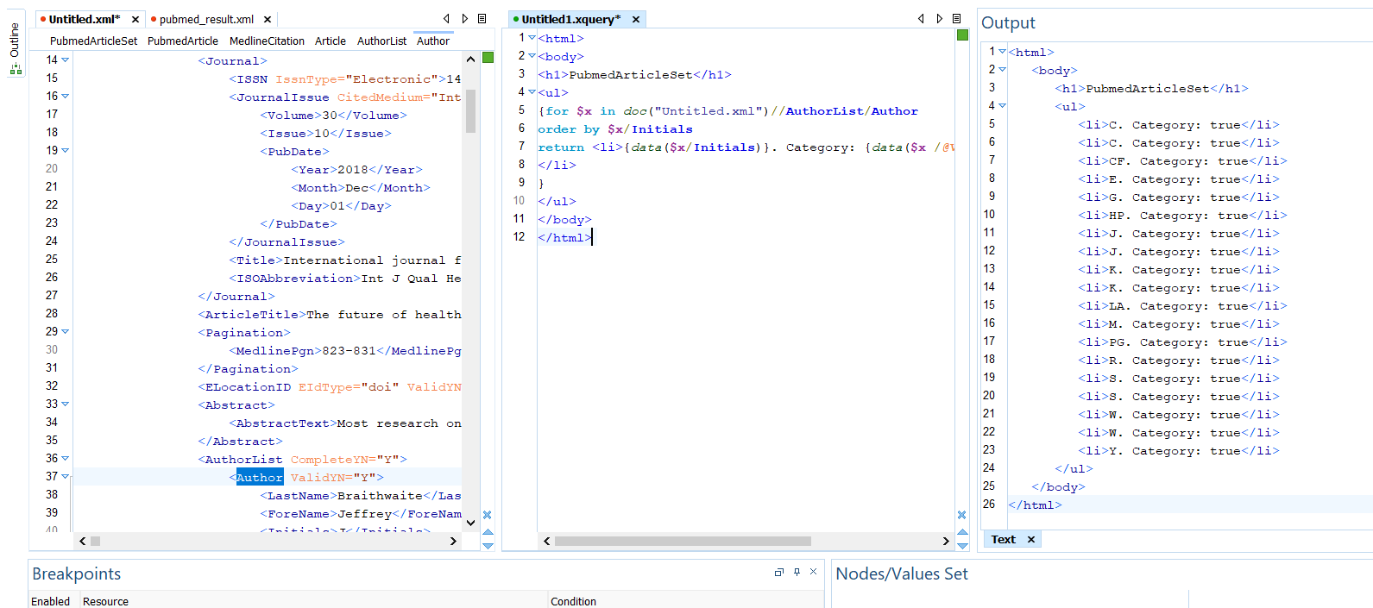
Query 5 Add Add HTML Elements and Text. Return True if PubStatus is ValidYN = Y. <html> <body> <h1>PubmedArticleSet</h1> <ul> {for $x in doc("Untitled.xml")//AuthorList/Author order by $x/Initials return <li>{data($x/Initials)}. Category: {data($x /@ValidYN="Y")} </li> } </ul> </body> </html>

