Slide 1
Assignment 2 instructions
SQL and NoSQL

Slide 2
Overview
The purpose of this assignment is to implement 10 queries using a SQL database. To do this, please use our dataset containing all Web-of-Science indexed publications in the field of information retrieval (1956-2014). There are also some information related to their authors, references, citation information, and journal information. Details about this dataset can be found in P. 9 of this paper: http://docs.wixstatic.com/ugd/01df7d_893df98669124058876d50a3d21ebcd0.pdf

Slide 3
Software: MySQL
PostgreSQL and MyPhpAdmin may not allow users to import a table larger than 64MB. Therefore, in this assignment, you can use a command line-based MySQL tool, which is free to download.
If you have some other related tools (e.g., SQL Server, Navicat, etc.), go ahead and use them for this assignment.

Slide 4
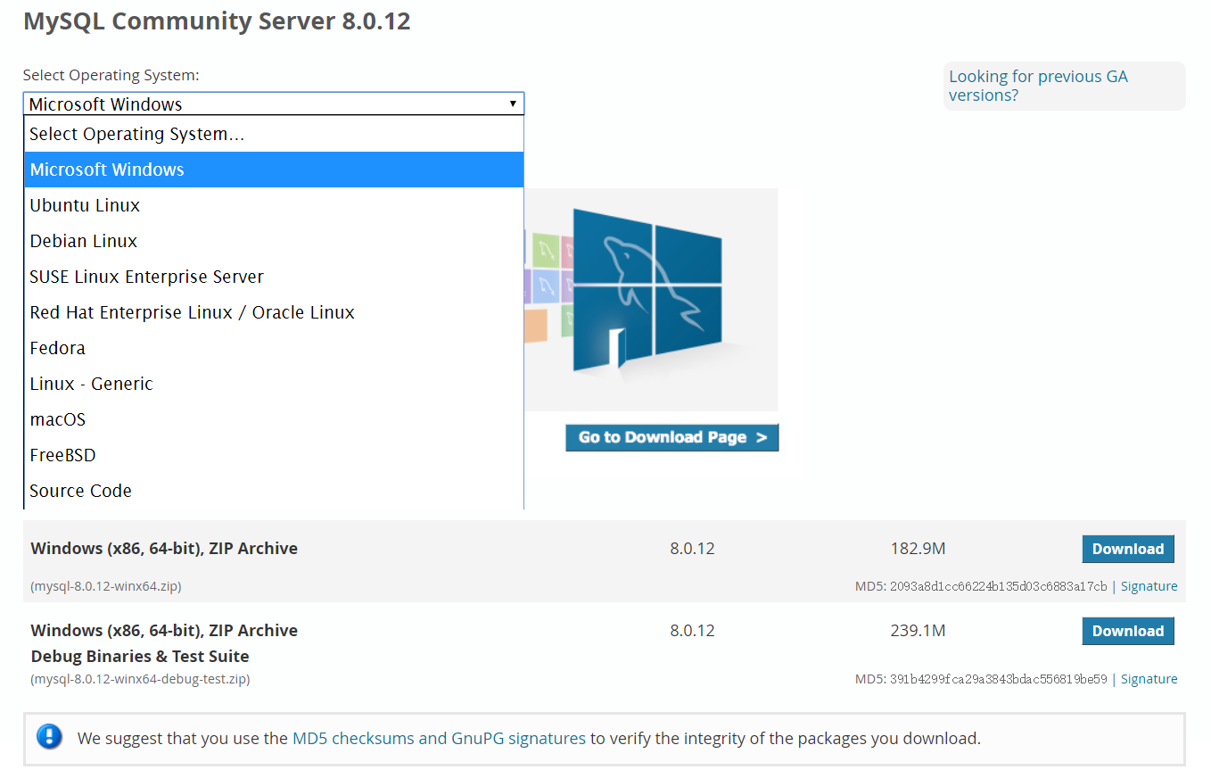
How to install MySQL in your PC?
Visit the download section of the official website of MySQL: https://dev.mysql.com/downloads/mysql/
Download the proper version for you and install it in your PC step by step.

Slide 5
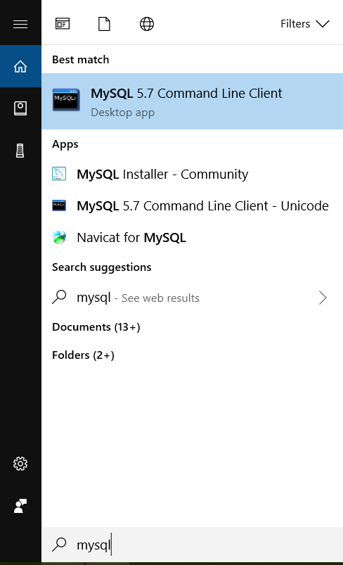
Open MySQL
Type “MySQL” and select “MySQL 5.7 Command Line Client” (maybe different if you choose other versions, subject to change)

Slide 6
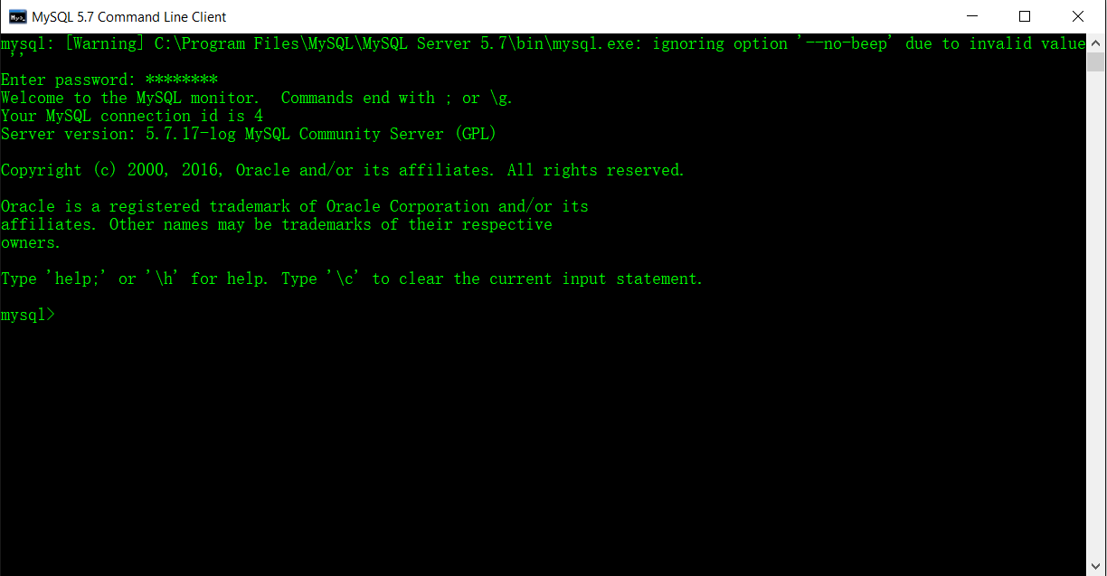
Open MySQL
If you have set up the password, MySQL will ask you to enter it. If not, just ignore this step.

Slide 7
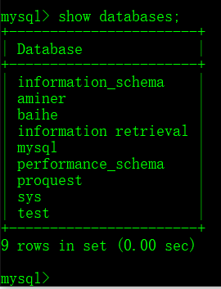
Open MySQL
Show all databases in the local MySQL (note that in MySQL command line, you might need to add a “;” after typing a certain command):
show databases;

Slide 8
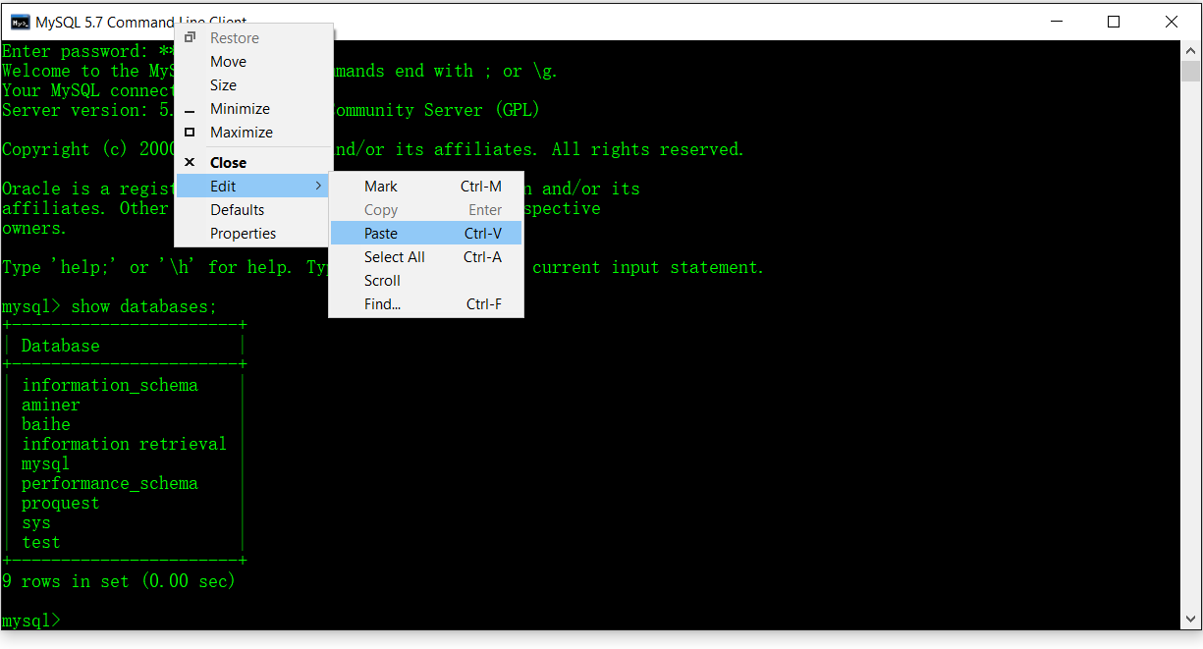

Create a database
To finish this assignment, I would first create a new database called “assignment_3”. If you want to copy and paste codes from this slide to your MySQL command line, please right click the top of your MySQL window, and then click “Edit” and then “Paste”. Ctrl+V does not always work here:
create database assignment_3;

Slide 9
Import extant SQL files to this database
We have prepare the tables for you in several .sql files, in which there are commands to create tables and inserts records.
Table ir_author_allpid contains name-disambiguated authors’ information in the field of Information Retrieval.
Table ir_journal contains the journal/conference information of these papers.
Table ir_paper contains all publications’ information.
Table ir_reference_allpid contains all citing relationships in this field in which “id” is the primary key, and a “cpid” paper cites a “pid” paper.

Slide 10

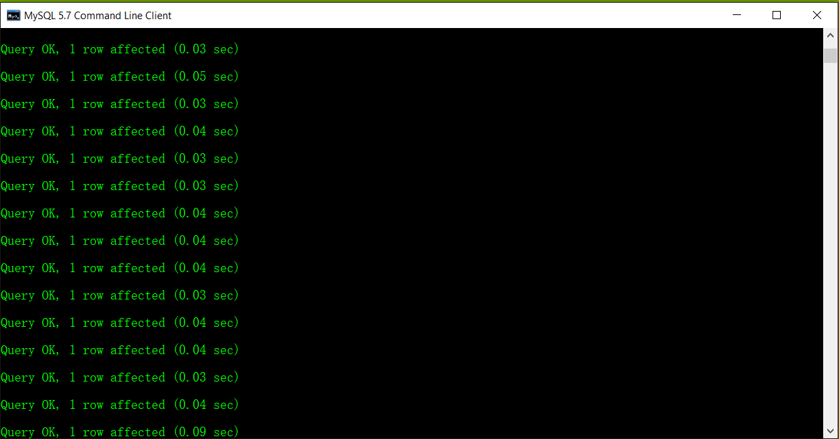
Import extant SQL files to this database
To import these .sql files to your assignment_3 database, type this:
Tells MySQL that you are going to use assignment_3 database
Use assignment_3;
source E:\ir_author_allpid.sql;
The path should be replaced by where you place the .sql files.

Slide 11
If you have “error 2” or “error 22”…
Follow this link:
http://philip.yurchuk.com/software/mysql-failed-to-open-file-error-2-and-22-on-windows/
Try not to use any folder’s name starting with “U”, “D”, etc. That might cause problems in this process.

Slide 12
Import extant SQL files to this database
Importing each .sql file will take you some time. You need to import all of these .sql files one by one in your database.
Then you can start to focus on the below 5 queries one by one.
It is likely that using different strategies will have different results. That is normal. Just let us know what you think of it.
Please show the code you used to complete the queries, the screenshot of your results, and contain them in a PPT file. Finally submit the PPT file to Canvas.

Slide 13
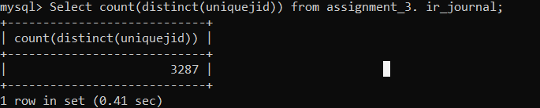
Query 1
Question: Calculate the total number of journals/conferences recorded in the table ir_journal

Slide 14
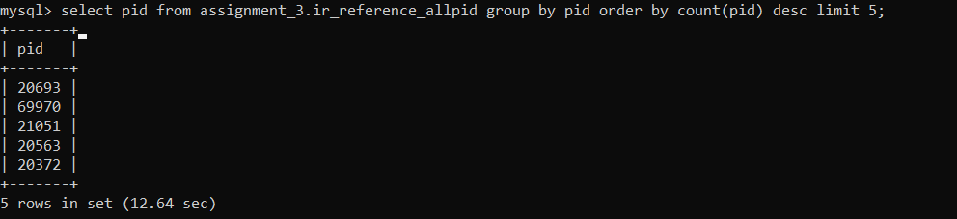
Query 2
Question: Calculate the id of the top 5 papers that received the most number of citations
Hint: You just need to use the table ir_reference_allpid. No need to use ir_paper.

Slide 15
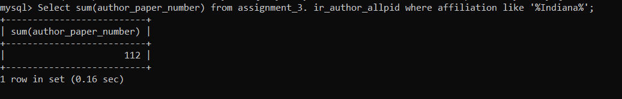
Query 3
Calculate the total number of publications authored or co-authored by authors from affiliations containing “Indiana”
Hint: Use the “affiliation” column in the ir_author_allpid table.

Slide 16
Query 4
Question: Calculate the number of citations of paper titled “exploiting semantic linkages among multiple sources for semantic information retrieval”
Hint: The title of a paper is represented in the column called “p_TI” in ir_paper.
Select count * from assignment_3. ir_reference_allpid where pid=(select pid from assignment_3.ir_paper where p_TI=“exploiting semantic linkages among multiple sources for semantic information retrieval”);

Slide 17
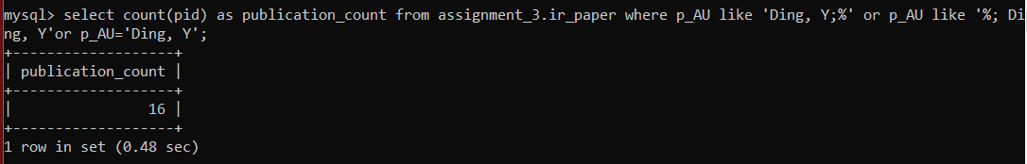
Query 5
Question: Calculate the number of publications authored or co-authored by the person whose name is “Ding, Y”
Hint 1: Do not including publications not recorded in the ir_paper table.
Hint 2: In p_AU in the table of ir_paper, there are all authors’ names separated by “;”. Thus, if an author is the first author of a certain paper, there will be “;” after his/her name; if he/she is not the first author, there will be “;” before his/her name. Taking into consideration of “;” will help you filter those authors such as “Ding, YB”.

Slide 18
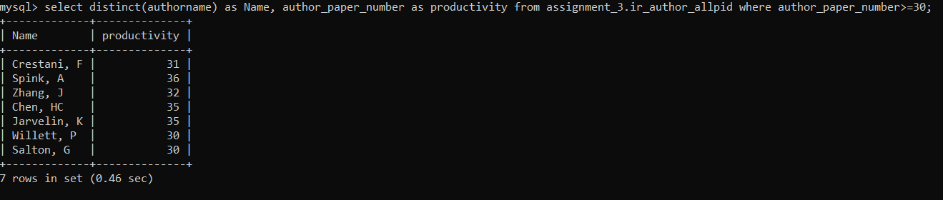
Query 6
Question: Provide the names of the researchers and their number of publications who satisfy the below requirement: Their number of publications is 30 or more recorded in our IR database. Please rename these two columns as “Name” and “Productivity”, respectively in your result.
Explanation: The publication count of an author measures his/her productivity, and is regarded as an important indicator on his/her research performance in the academic communities.
Hint: The author’s number of publications is recorded in the column of author_paper_number in ir_author_allpid. Do not show duplicated names. To rename the column, you can try to use the “as” command.
Select distinct(authorname) as Name, author_paper_number as Productivity from ir_author_allpid group by authorname having count(author_paper_number) >=30;

Slide 19
Query 7
Question: Calculate the number of journals/conferences whose names contain “comput” and start with “a” or “A”. The names of these journals/conferences need to have at least three words.
Hint: Please use the “journalname” field instead of “journalnameshort”.
Select count(jid) from ir_journal where journalname like ‘a%comput%’ or ‘A%comput%’ and length(journalname)-length(replace(journalname, ‘ ‘, ‘’))+1>3;

Slide 20
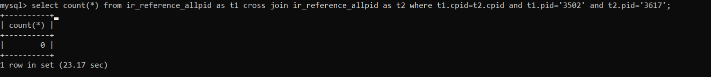
Query 8
Question: Calculate the co-citation frequency between publications 3502 and 3617.
Hint: You just need to use the table ir_reference_allpid to finish this. You can use multiple SQL queries to finish it, as a single query might be complicated. The same for Queries 9 and 10.
Co-citation frequency: If A and B are both cited by another paper C, then A and B are co-cited. The number of papers that co-cite both A and B is called co-citation frequency. Bibliometrically, co-citation has been used to map knowledge domains and depict scientific intellectual structures.

Slide 21
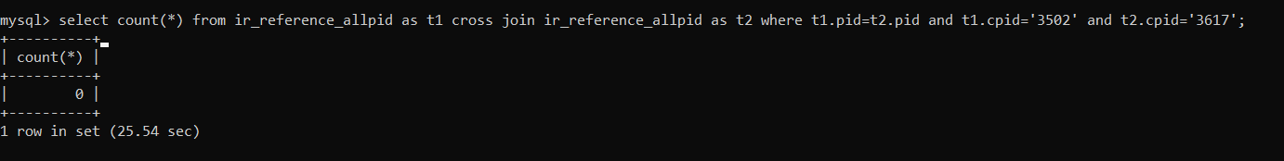
Query 9
Question: Calculate the bibliographic coupling strength between publications 3502 and 3617.
Hint: You just need to use the table ir_reference_allpid to finish this.
Bibliographic coupling strength: If A and B both cite the same paper, A and B are called bibliographic coupled. The number of papers they both cite is equal to their bibliographic coupling strength.

Slide 22
Query 10
Question: Citing cascade of paper A is defined as a network whose nodes include A and all of its citing papers. The edges of citing cascade of A include all of the citation relationship among its nodes. We know that in such as network, there might occur some triangles. For instance, A and B, B and C, and C and A all have citation relationships. Please calculate the number of triangles of the citing cascade of paper 24142.

Slide 23
THANK YOU
Assignment 2, SQL and NoSQL

