Slide 1
Assignment -5
Neo4j

Slide 2
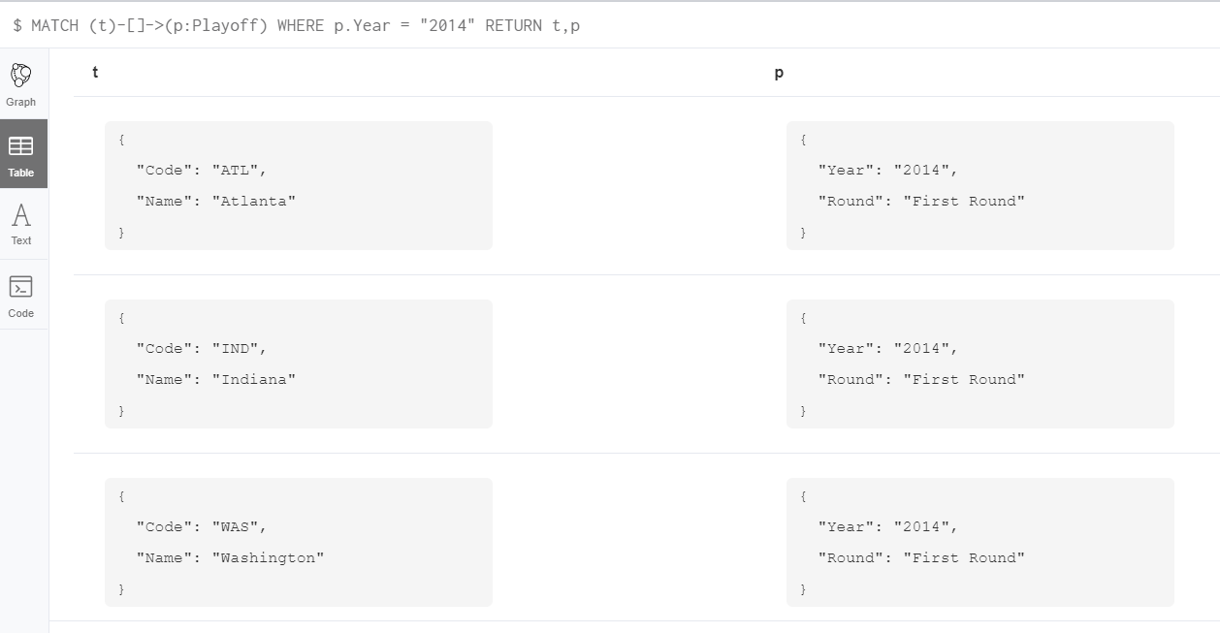
Query 1:Display entire 2014 playoff result

Slide 3
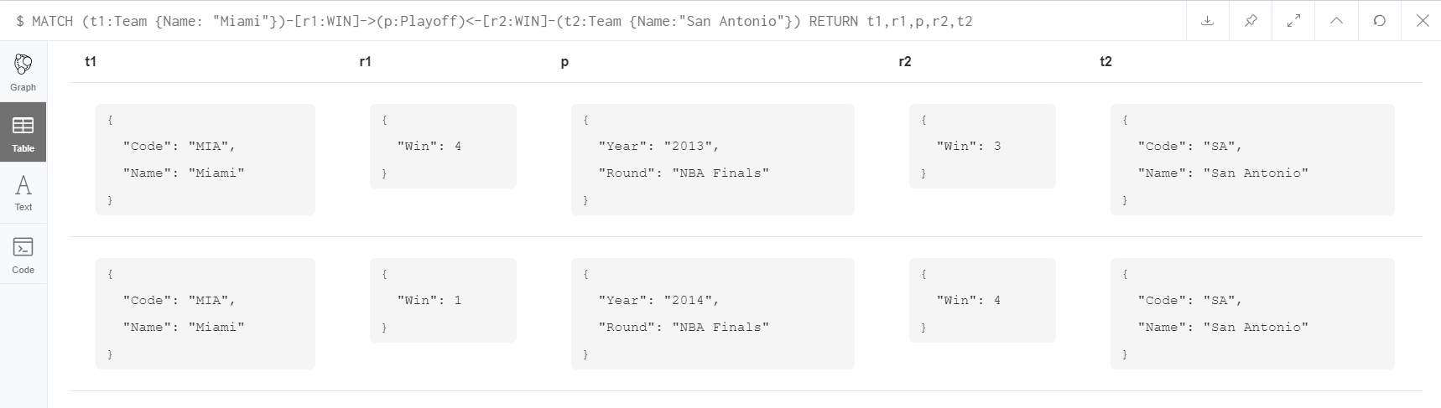
Query 2:Display playoff history between 2 teams

Slide 4
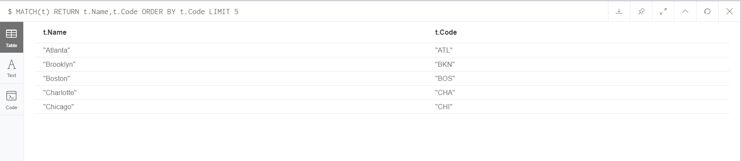
Query 3:Display top 5 team in Ascending order of their Code

Slide 5
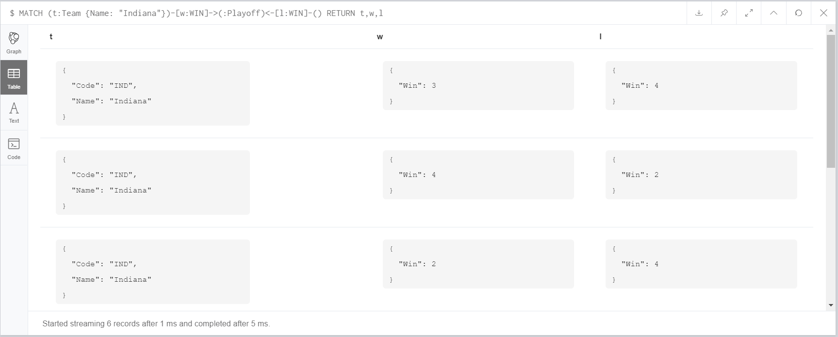
Query 4:Display all historical playoffs of INDIANA.

Slide 6
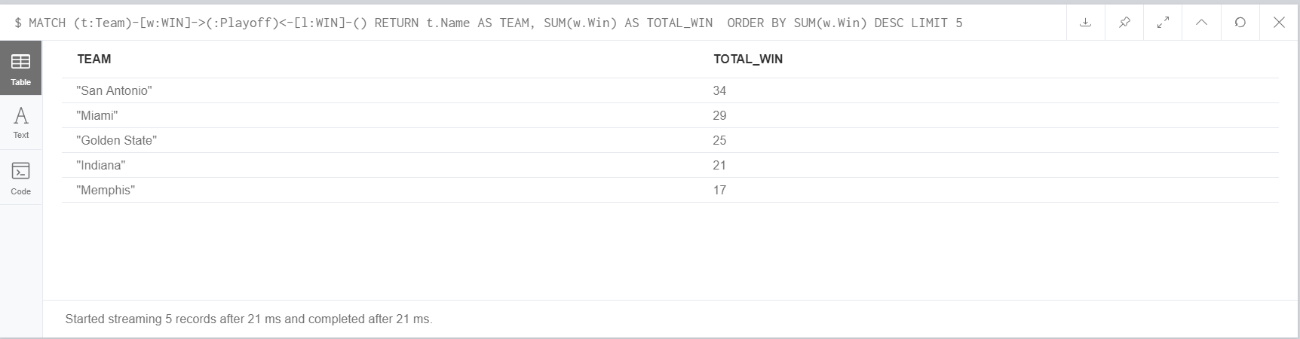
Query 5: Display top 5 teams with maximum number of wins.

Slide 7
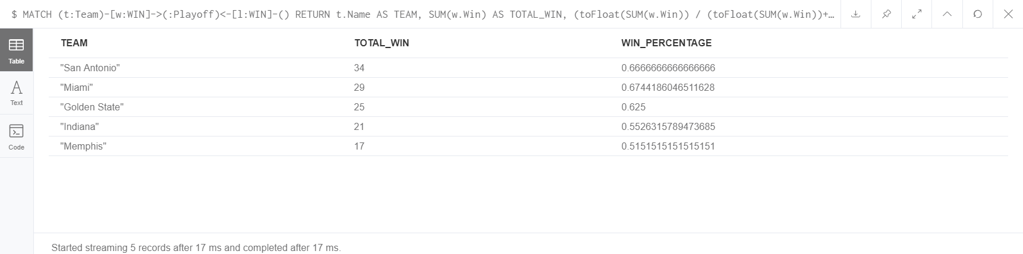
Query 6: Display top 5 teams with maximum WIN Percentage.

Slide 8
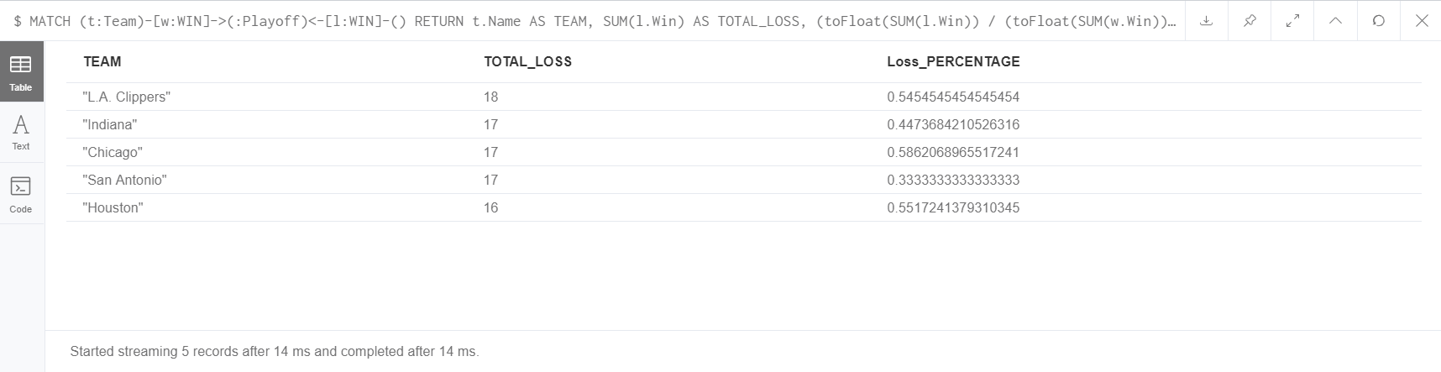
Query 7:Display top 5 teams with highest loss percentage and total_loss

Slide 9
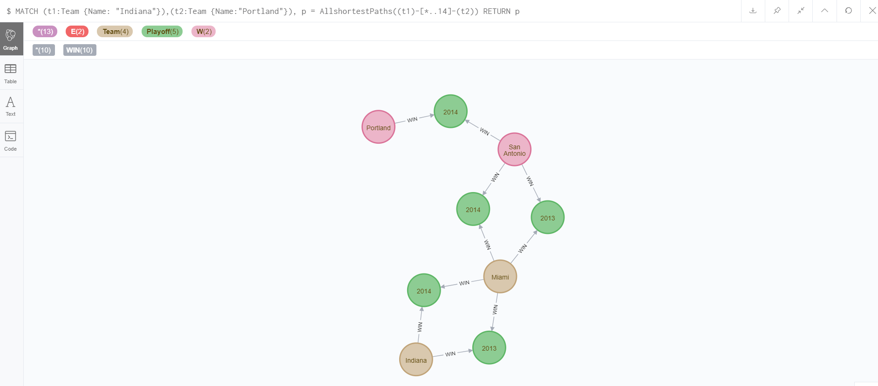
Query 8:Display the shortest path between Indiana and Portland

Slide 10
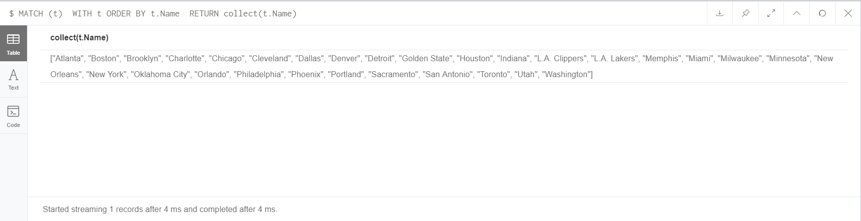
Query 9:Display all the Country’s Name participated in the tournament of NBA in List using With

Slide 11
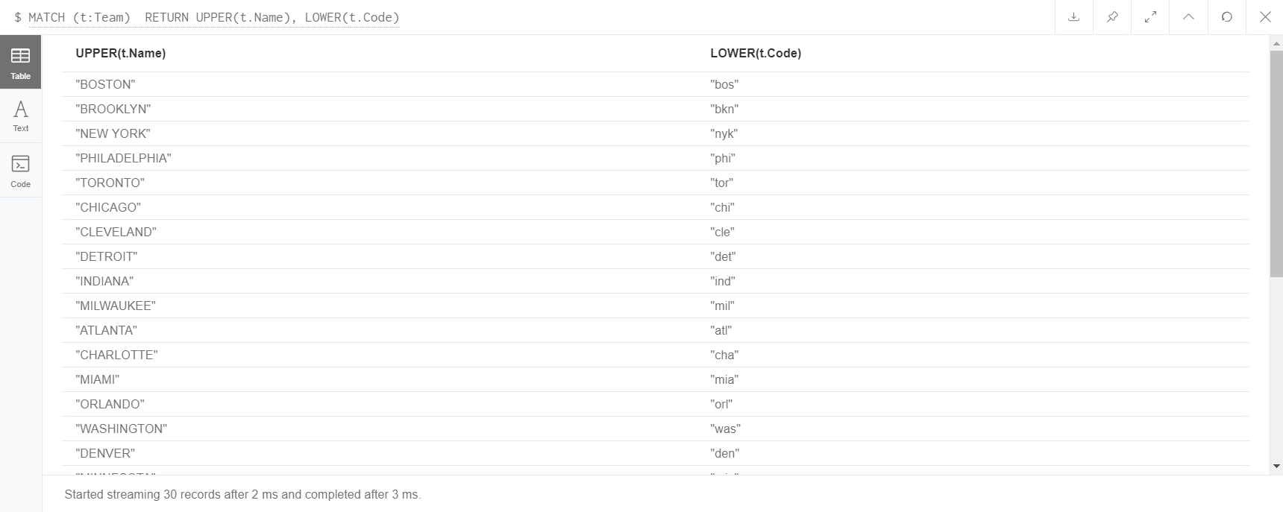
Query 10:Convert Names of all the teams in upper case and Code of all the teams in lower case

