Slide 1
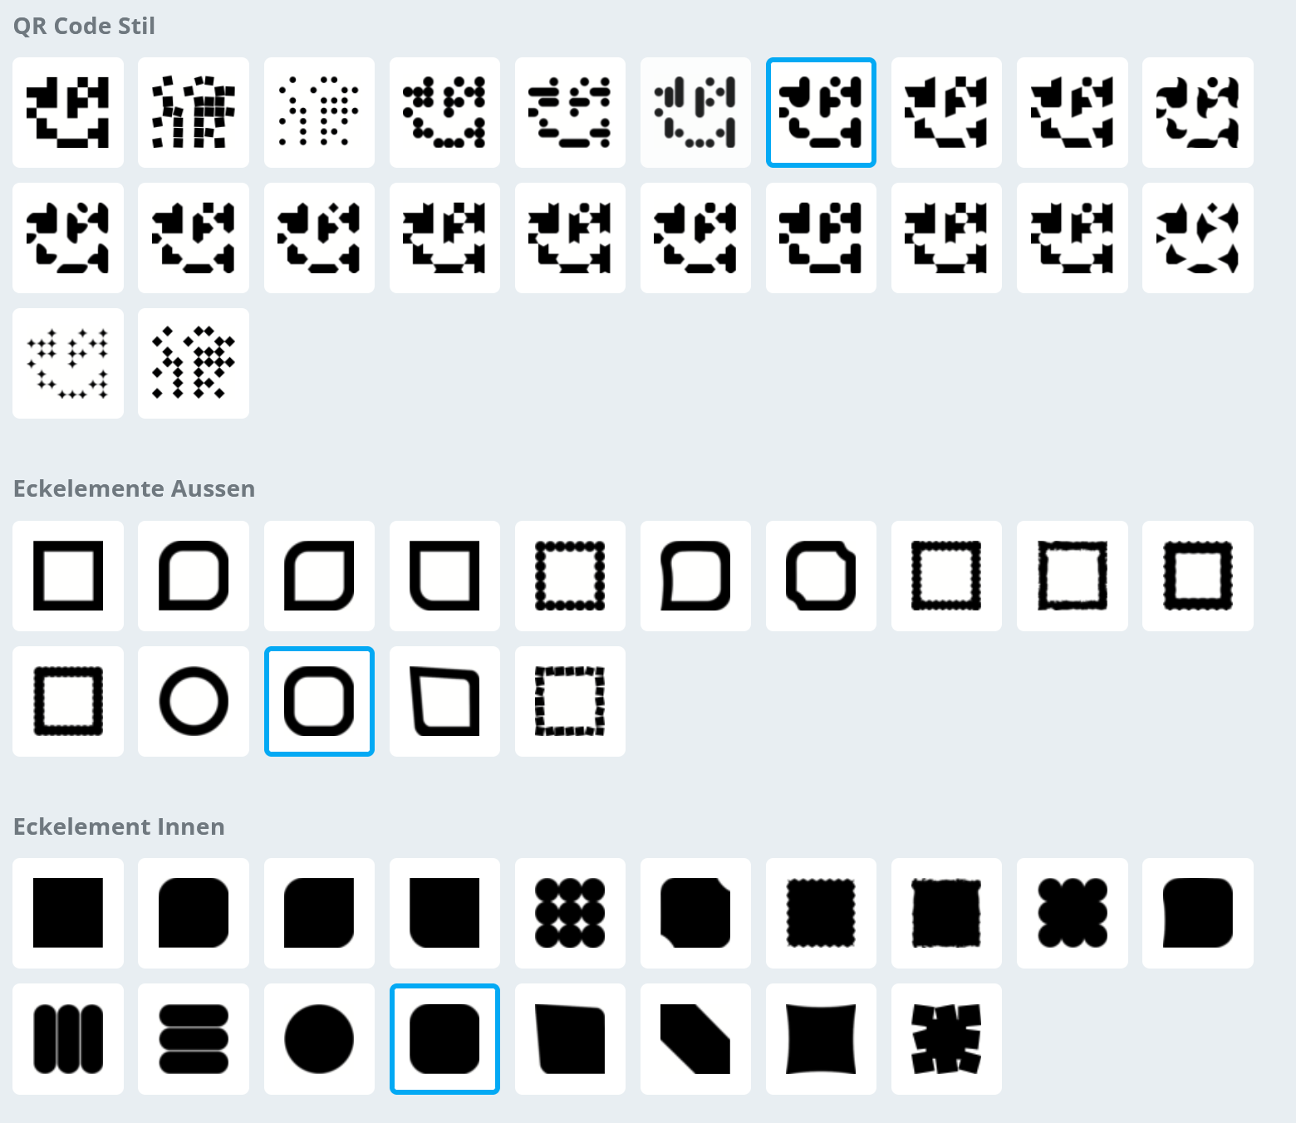
QR-Codes Style
Kontakt: kraus@ibk.baug.ethz.ch
#5D5F68

Slide 2



Kontakt: kraus@ibk.baug.ethz.ch
R. Bischof | S. Kuhn | N. Chiaverio
Physics-Informed Neural Networks for Structural Concrete Engineering | Parametric Modelling and Generative Design: A Multi-Step Machine Learning Approach for Design and Optimization of Network Tied-Arch Bridges | Parametric Modelling and Generative Design of Concrete Structures
Kontakt: kraus@ibk.baug.ethz.ch

Slide 3


L. Florez | M. Härdi
Machine learning-based generative design and verification of construction pits | AI-based prediction model for the „Rockburst“ impact test for reinforced shotcrete slabs
Kontakt: kraus@ibk.baug.ethz.ch

