Slide 1

Monty’s Coders Section
Mrinal Roy | Code in Place | 2024
Week 1 [April 25, 2024]

Slide 2
Welcome to the section!

Slide 3
Congratulations!
Notes:
You’re here. That’s awesome. We’re going to learn together.

Slide 4
Introduction Let’s get to know each other!

Slide 5
Materials
Course Materials: https://github.com/mkrdip/codeinplace-2024
Week 1: https://github.com/mkrdip/codeinplace-2024/tree/main/week1
Section Leader: Mrinal (Mree-nal) Roy
Email: mkrdip@gmail.com
Notes:
I’ll post section materials on Github with notes.

Slide 6
Why are we here?
Section is what makes Code in Place different.
section != lecture
Building a community of learners.
Notes:
I’m not here to judge if you didn’t watch lecture. Come to section even if you didn’t watch. Come to section *especially* if you didn’t watch.

Slide 7
How can you get the most out of this time?
This is your time.
Finishing problem isn’t important.
If we run over, no pressure to stay.
Notes:
Interrupt me. Ask questions.

Slide 8

Naming this section
Naming Things is Hard
There are two hard things in computer science: cache invalidation, naming things, and off-by-one errors.

Slide 9

Naming this section
Monty’s Coder Section
Suggested by Arthur 2024 Name this for 2025, comment in Introduction forum post.
There are two hard things in computer science: cache invalidation, naming things, and off-by-one errors.
Notes:
Suggested by Arthur

Slide 10
Approaching a problem

Slide 11
Approaching a problem

Slide 12
Approaching a problem
Understand
Write stuff down.
Explain problem out loud to someone.
Draw a picture.

Slide 13
Approaching a problem
Understand
Write stuff down.
Explain problem out loud to someone.
Draw a picture.
Strategize
Walk through an example or two.
Look for patterns.
Think about what things you’ll need: loops, conditions, helper functions, etc.

Slide 14
Approaching a problem
Understand
Write stuff down.
Explain problem out loud to someone.
Draw a picture.
Strategize
Walk through an example or two.
Look for patterns.
Think about what things you’ll need: loops, conditions, helper functions, etc.
Translate
First into pseudocode.
Then into Python.
Notes:
We’ll get lots of practice with this, because this is the way we’ll approach each section problem.

Slide 15
Control Flow

Slide 16
Control flow
if
if/else
for
while

Slide 17
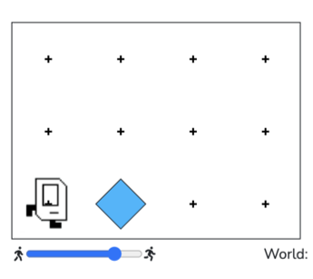
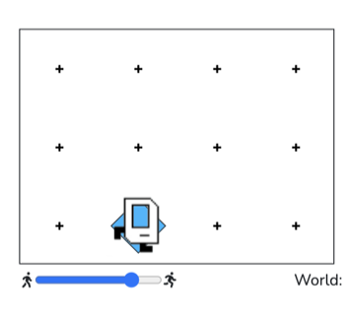
Control flow
if
Do something when a condition is met.
if/else
for
if front_is_clear(): move()
while

Slide 18
Control flow
if
if/else
for
while

Slide 19
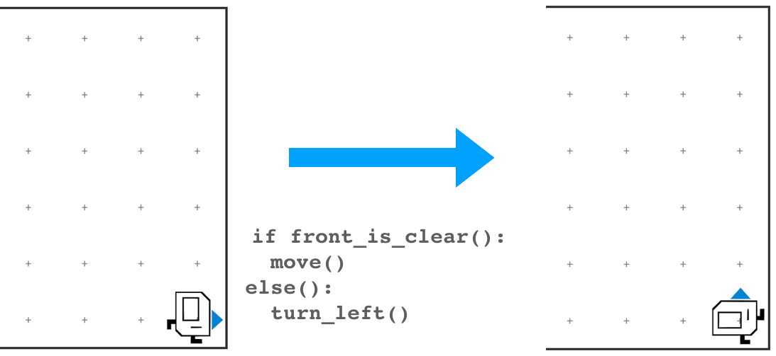
Control flow
if
if/else
Also do something else when a condition is not met.
for
while

Slide 20
Control flow
if
if/else
for
while

Slide 21
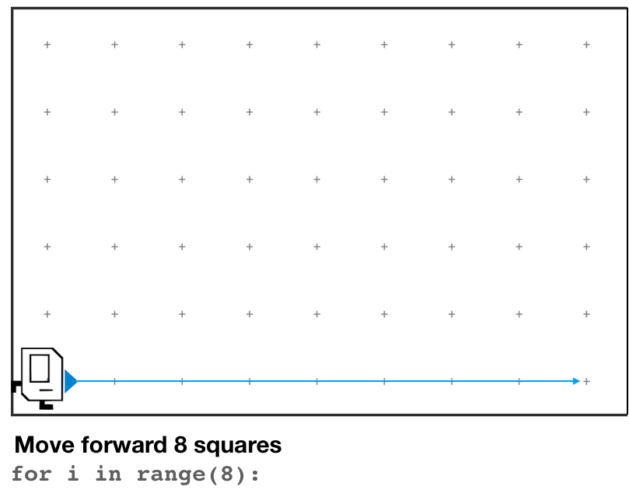
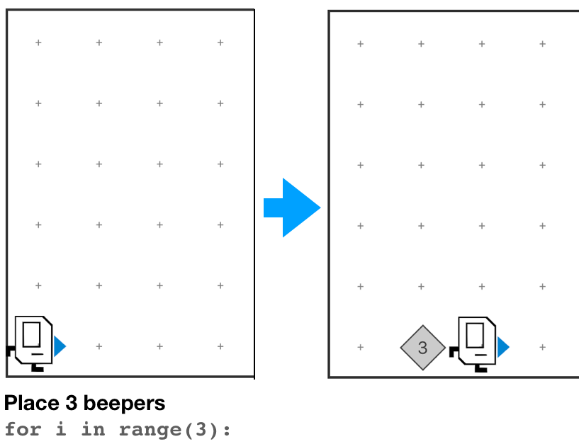
Control flow
if
if/else
for
Do something a set number of times.
while

Slide 22
Control flow
if
if/else
for
while

Slide 23
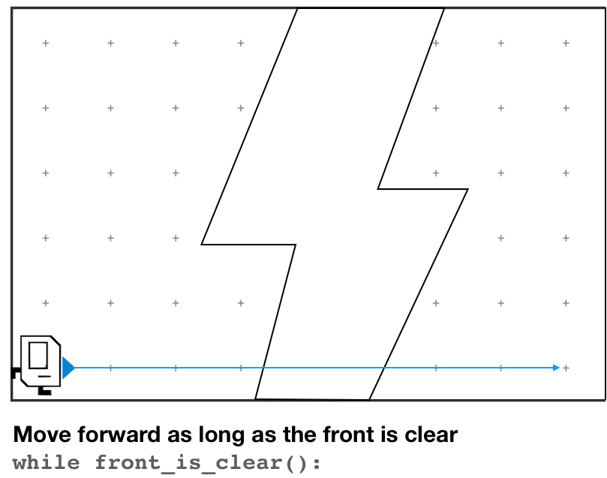
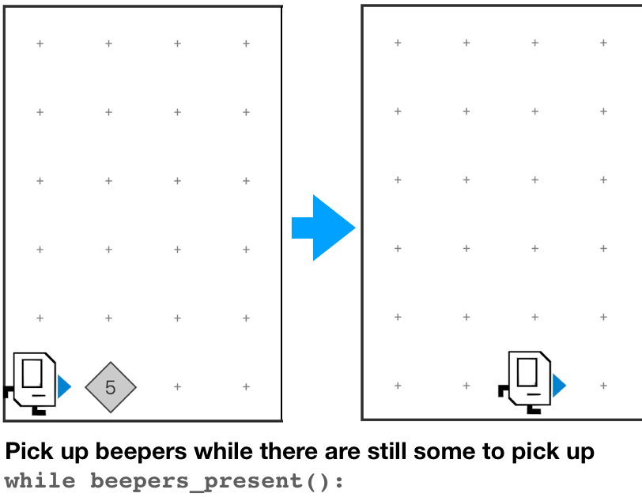
Control flow
if
if/else
for
Do something until condition is no longer true.
while

Slide 24
Control flow
if
no
Do you have a backup plan?
yes
if/else
yes
Is it a one-off?
for
yes
Do you know how many times you need to do it?
no
while
no

Slide 25
Decomposition

Slide 26
Decomposition
Define your function like this:
def function_name():
<write code here>
And call it like this:
function_name()

Slide 27
Decomposition
More of an art than a science.
Functions should be short and read like English.
If you repeat things (or find yourself hitting copy/paste), take a step back.
Top-down programming & the leap of faith.

Slide 28
Decomposition
def main():
turn_left()
turn_left()
turn_left()
turn_left()
turn_left()
turn_left()
turn_left()
turn_left()
turn_left()
turn_left()
turn_left()
turn_left()

Slide 29
Decomposition
def main():
turn_left()
turn_left()
turn_left()
turn_left()
turn_left()
turn_left()
turn_left()
turn_left()
turn_left()
turn_left()
turn_left()
turn_left()
def main():
spin()
spin()
spin()
def spin():
turn_left()
turn_left()
turn_left()
turn_left()
Notes:
Does this code do the same thing?
Is this code easier to read/understand?
Is this code easier to write?

Slide 30
Pre/Post conditions
Each helper function defines a contract.

Slide 31
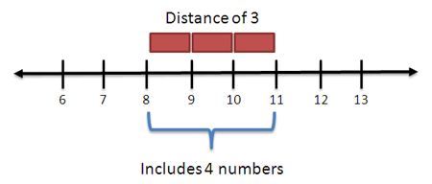
Fencepost problem

Slide 32
Hospital Karel

Slide 33
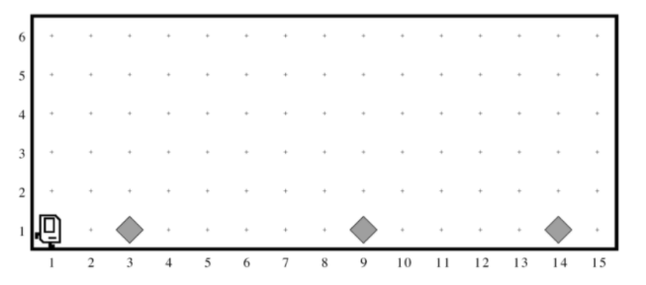
Example precondition

Slide 34
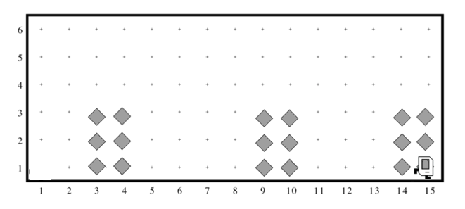
Example postcondition

Slide 35
More thoughts

Slide 36
Getting started
Setting up your environment is hard.
You only have to do this once.

Slide 37
Karel
Visual = tangible. Run/watch to understand what you’re code is doing.
Constraints because of narrow language → Creativity!
Algorithmically challenging!
Edge conditions.

Slide 38
Follow-ups from questions
Notes:
Notes added in response to questions from section.

Slide 39
Python style
PEP 8 style guide: https://peps.python.org/pep-0008/ is a great resource!
It recommends snake_case over camelCase.
“Function and variable names should be lowercase, with words separated by underscores as necessary to improve readability.”
e.g., def build_hospital()

