Slide 1
Welcome to Section
Week 3 - Fly me to the moon Mars
Slides created by
Cameron Mohne and Maggie Lee
Notes:
Hey all, welcome back to section! It is week 3 and today, we’ll be taking our minds and code to outer space!

Slide 2
Agenda
01
02
Check-in
Recap
03
04
To Mars!!!
To Infinity & Beyond
How are all of you doing?
Revisiting lecture content
Section Problem #1
Section Problem #2
Notes:
On today’s agenda, we of course have a lovely check-in to see how you all are doing; this week, we’ll be doing a recap over some of the Python that we’ve learned as well as covering a tiiiiny bit of new stuff; from there, we will be taking our first space stop at Mars for our first section problem; following Mars, we’ll be taking stops at all of the other planets in our system if we have time. You’ll see what I’m talking about shortly!

Slide 3
Check-in
Welcome back to another week of Code in Place section!
I hope you all are doing well! Hopefully CiP hasn’t been stressful.
Let’s do a quick check-in question! (Feel free to answer in the chat!)
Feel free to answer any of the following:
If you could teach Karel ONE more command, what would it be?
What is your favorite food?
What is a hobby of yours that you do in your free time?
Notes:
Social Time [5 minutes]

Slide 4
Recap
Revisiting variables
Notes:
Brief conceptual review [2-3 minutes]

Slide 5
Defining and Using Variables
Defining Variables
We define variables by writing the variable’s name, followed by an equals sign, and then what we want to store inside.
var_name = value
Using variables
When we use the variable’s name—unless we are changing its value—we essentially open the “suitcase” to use what’s inside.
print(var_name) sum = num1 + num2

Slide 6
Variable Types
Types
Example Types
Casting
Variables have types. These types are what differentiates letters and numbers to our computers.
Strings: Words/Sentences
Ints: Integers; numbers without decimals
Floats: Any other number that isn’t an integer
Sometimes, we can change from one variable type to another via typecasting. For example, we may have a number represented as a string, and we need to cast it to be a number so we can do math with it!

Slide 7
Numbers
Rounding
While we didn’t cover this in lecture yet, it may be relevant in the future! There is a round(float, num_decimals) function which lets us round a floating point number to a certain amount of decimals! For example: 19.724555555 -> 19.725 by using round(19.724555555, 3).
Notes:
(NOT COVERED IN LECTURE, PLEASE COVER FOR THE PROBLEMS SINCE WE USE IT)

Slide 8
Before We Start...
Are there any questions?

Slide 9
Section Problem #1: To Mars
Notes:
Teaching Mars Weight [10-20 minutes]

Slide 10
Storytime
Notes:
A while back, NASA made history with the first controlled flight on another planet. Its latest Mars Rover, Perseverance, has onboard a 50cm high helicopter called Ingenuity. Ingenuity made its third flight, during which it flew faster and further than it had on any of its test flights on Earth. Interestingly, Ingenuity uses Python for some of its flight modeling software!

Slide 11
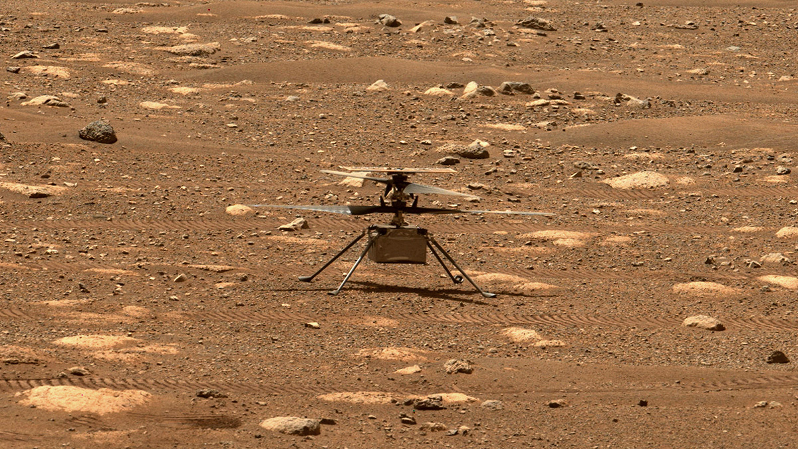
Section Problem #1: To Mars!!!
One of the things that NASA engineers need to account for is the fact that due to the weaker gravity on Mars, an Earthling's weight on Mars is 37.8% of their weight on Earth.
Write a Python program that prompts an Earthling to enter their weight on Earth and prints their calculated weight on Mars.

Slide 12
Section Problem #1: End Goal
100
Sample Input
Enter a weight on Earth: ↓ Enter a weight on Earth: 100
* User input is italicized and bolded for visual clarity *
Sample Output
The equivalent weight on Mars: 37.8
37.8
Notes:
Here’s an example input and output of our program. We should be prompted for a weight, if we put in, say 100 pounds or kilograms for an Earth weight, you choose, we should get out 37.8 of that respected unit in terms of a weight on Mars.

Slide 13
Pre-Code Discussion
Inputs, Constants, & Types (Also, questions if you have them!!!)
Notes:
(OPTIONALLY)
Take a few minutes to review the input function with students. They used it on an assignment last week, so it is not new, but it is important in this problem and the next problem so good to make sure students understand the function.
Review constants - when to use them and how to use them. Ask students what should be used as a constant in this problem.
Spend a few minutes discussing types. What type would weight normally be? What type would input return? What type is the constant we have? How can we get weight and constant to be the same type so that we can do arithmetic?
Questions

Slide 14
Let’s Code!
For this activity, you’ll be working in breakout rooms with each other
100
37.8

Slide 15
Section Problem #2: To Infinity & Beyond
Notes:
Teaching Planetary Weights [20 minutes]

Slide 16
Section Problem #2: To Infinity & Beyond
Mars is not the only planet in our solar system with its own unique gravity. In fact, each planet has a different gravitational constant, which affects how much an object would weigh on that planet.

Slide 17
Section Problem #2: To Infinity & Beyond
Write a Python program that prompts an Earthling to enter their weight on Earth and then to enter the name of a planet in our solar system. The program should print the equivalent weight on that planet. * You can assume that the user will always type in a planet with the first letter capitalized and you do not need to worry about the case where they type in something other than one of the above planets. *
CAMERON
MAGGIE

Slide 18
Section Problem #2: To Infinity & Beyond
Here’s a list of constants for each planet’s gravity compared to Earth's:
Mercury: 37.6%
Venus: 88.9%
Mars: 37.8%
Jupiter: 236.0%
Saturn: 108.1%
Uranus: 81.5%
Neptune: 114.0%
CAMERON
MAGGIE

Slide 19
Section Problem #2: End Goals
120
Sample Input
Enter a weight on Earth: ↓ (Input 1) Enter a weight on Earth: 120 ↓ Enter a planet: ↓ (Input 2) Enter a planet: Mars
* User input is italicized and bolded for visual clarity *
Sample Output
The equivalent weight on Mars: 45.36
45.36
Notes:
Here’s one example run of our new program. Though it is almost functionally equivalent to the previous program, that it isn’t necessarily the case.

Slide 20
Section Problem #2: End Goals
120
Full Run
Enter a weight on Earth: 120 Enter a planet: Mars The equivalent weight on Mars: 45.36
* User input is italicized and bolded for visual clarity *
45.36
Notes:
Here’s one example run of our new program. Though it is almost functionally equivalent to the previous program, that it isn’t necessarily the case.

Slide 21
Section Problem #2: End Goals
150
Sample Input
Enter a weight on Earth: ↓ (Input 1) Enter a weight on Earth: 150 ↓ Enter a planet: ↓ (Input 2) Enter a planet: Jupiter
* User input is italicized and bolded for visual clarity *
Sample Output
The equivalent weight on Jupiter: 354.0
354.0
Notes:
Here is one example of how this program is different from section problem #1. It is robust enough (or flexible enough) to take in a completely different planet!

Slide 22
Section Problem #2: End Goals
120
Full Run
Enter a weight on Earth: 150 Enter a planet: Jupiter The equivalent weight on Jupiter: 354.0
* User input is italicized and bolded for visual clarity *
354.0
Notes:
Here’s one example run of our new program. Though it is almost functionally equivalent to the previous program, that it isn’t necessarily the case.

Slide 23
Pre-Code Discussion
What’s different? (Also, questions if you have them!!!)
Notes:
Ask students what is different in this problem from the previous problem. Just in english, not in code. Write down a list of these. (5 mins max)
Will we need to store additional constants? If so, which ones?
Will we need any additional variables? If so, what variables will we need?
Questions?

Slide 24
Let’s Code!
For this activity, we’ll break out again, and then come back together!

