Slide 1
DRAM BRING UP
CONFIGURATION
Chia-Liang Hung
alexhung@realtek.com
www.realtek.com
-<number>-
Copyright © 2013 Realtek Semiconductor Corp.

Slide 2
Introduction
Purpose
  This document will introduce how to use pre-calibration tool to figure out DRAM parameters
Preparation
  Documents
    DRAM Datasheet
    ‘CPU & Memory Controller Datasheet’, Realtek
  Image
    Pre-calibration image
www.realtek.com
-<number>-
Copyright © 2013 Realtek Semiconductor Corp.

Slide 3
Outline
DRAM Configuration
  Pre-Configuration
  DDR Pad Setting
  WRITE Timing Adjustment
  READ Timing Adjustment
  Memory Test and Restore Config
www.realtek.com
-<number>-
Copyright © 2013 Realtek Semiconductor Corp.

Slide 4
Configuration Flow
Figure. DDR bring up configuration flow
Pre-Configuration
DDR Pad Setting
WRITE Timing Adjustment
READ Timing Adjustment
Memory Test & Restore Config
www.realtek.com
-<number>-
Copyright © 2013 Realtek Semiconductor Corp.

Slide 5
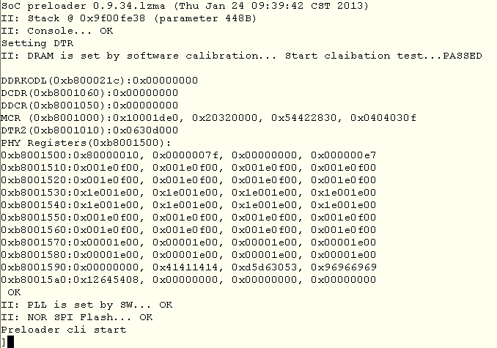
Configuration Tool
enter Preloader CLI
  press ‘.’ to trigger CLI before entry u-boot
www.realtek.com
-<number>-
Copyright © 2013 Realtek Semiconductor Corp.

Slide 6
Configuration Tool (cont.)
Using Preloader Configuration Tool
  modify configuration with dram/pll set commands
  *Note: more commands and related available value, please reference Appendix. Command List
  ‘call dram_setup’: apply modified DRAM configuration to control register and re-do calibration
  ‘call pll_setup’: apply modified PLL configuration to control register
  ‘save_para’: save current configuration back to flash
  ‘show dram_info’: show current DRAM configuration, not configuration in control register
www.realtek.com
-<number>-
Copyright © 2013 Realtek Semiconductor Corp.

Slide 7
Configuration Tool (cont.)
Frequency Modification
  Before DRAM bring up, DRAM frequency need to be check
  If frequency need to be modified, using pll set command
  and the do following steps to apply
    apply PLL configuration: ‘call pll_setup’
    apply DRAM configuration: ‘call dram_setup’
[ Related Commands]
get pll mem_clk
get pll cpu_clk
get pll lx_clk
get pll dsp_clk *if DSP exist
Note: unit is MHZ
[ Related Commands]
set pll clock <cpu_clk> <mem_clk> <lx_clk>
set pll clock <cpu_clk> <dsp_clk><mem_clk> <lx_clk> *if DSP exist
Note: unit is MHZ
Note: CPU, DSP, memory and LX related frequency could be found in CPU & Memory Controller Datasheet or Appendix . Suggested PLL Range
www.realtek.com
-<number>-
Copyright © 2013 Realtek Semiconductor Corp.

Slide 8
Pre-Configuration
Step 1-1: Config DRAM Size and Bus Width
Pre-Configuration
[ Related Commands]
set dram buswidth <value>
set dram size <value>
DDR Pad Setting
WRITE Timing Adjustment
READ Timing Adjustment
Memory Test & Restore Config
Example 1-1:
DDR3 NANYA NT5CB128MHP: 256MB Bus Width=16
Using preloader CLI commands “set dram buswidth 16 “
“set dram size 256 “
www.realtek.com
-<number>-
Copyright © 2013 Realtek Semiconductor Corp.

Slide 9
Pre-Configuration (cont.)
[ Related Commands]
set dram tcas <value>
set dram twr <value>
set dram tcwl <value>
set dram trtp <value>
set dram twtr <value>
set dram trefi <value>
set dram trefi_unit <value>
set dram trp <value>
set dram trcd <value>
set dram trrd <value>
set dram tfawg <value>
set dram trfc <value>
set dram tras <value>
* unit is tCLK
Step 1-2: Config DRAM AC Timing
  DTR0: tCAS, tWR, tCWL, tRTP, tWTR, tREFI
  DTR1: tRP, tRCD, tRRD, tFAWG
  DTR2: tRFC, tRAS
*Note: 1. pre-calibration tool will apply a safe DTR
configuration, or user can find out better
parameters according to DRAM datasheet
2. please reference next page for how to find
those parameters
Example 1-2: If DRAM frequency is 300MHz, 1 tCLK= 3.3ns
A. tRRD: according to spec, tRRD minimum requirement is 7.5ns
tRRD = 3 tCLK = 10ns > 7.5 ns
Using preloader CLI commands “set dram trrd 3 “
B. tREFI: according to spec, tREFI minimum requirement is 7.8us
If using tREFI = 3072 tCLK = 12*256 tCLK= 10.1 us > 7.8 us
Using preloader CLI commands “set dram trefi 12 “ and “set dram trefi_unit 256”
www.realtek.com
-<number>-
Copyright © 2013 Realtek Semiconductor Corp.

Slide 10
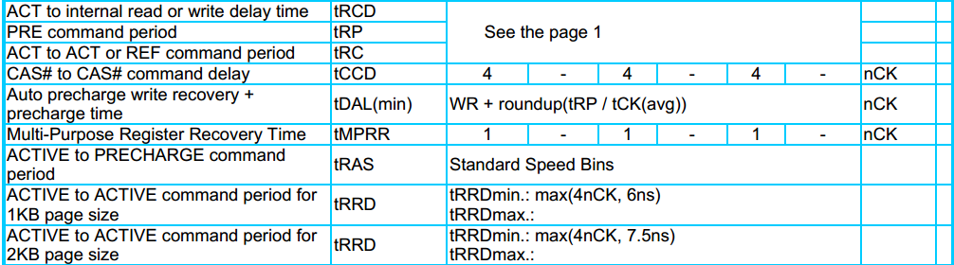
Pre-Configuration (cont.)
How to find DTR parameters requirement in DRAM Datasheet?
1. find AC Timing Table in DRAM datasheet
2. Using DTR related parameter as keyword
3. Find the requirement value here according to different frequency
4. Notice the units
(Source is from NANYA DRAM DataSheet
Note: While DRAM frequency has been modified, DRAM AC Timing should be re-verified and configured.
www.realtek.com
-<number>-
Copyright © 2013 Realtek Semiconductor Corp.

Slide 11
DDR Pad Setting
Step 2-1: Check signals amplitude and dc level
  WRITE: measure point is DRAM side
  READ: measure point is Chip Side
Pre-Configuration
DDR Pad Setting
WRITE Timing Adjustment
Measure Point for WRITE
READ Timing Adjustment
Chip
DRAM
Memory Test & Restore Config
Measure Point for READ
Figure. DRAM Signal Measure Point
[ Related Commands]
Continuous Read/Write:
call read_pattern <times>
call write_pattern <times> <pattern>
Single Read/Write:
lw <addr>
sw <addr> <value>
*Note: Those commands are applied to perform pure READ/WRITE
www.realtek.com
-<number>-
Copyright © 2013 Realtek Semiconductor Corp.

Slide 12
DDR Pad Setting (cont.)
Step 2-2: if signals are below or above requirement, use command to change termination resistance value and re-check.
  Chip side
    ODT (On-Die-Terminate)
    OCD (On-Chip-Driver)
  DRAM side
    ODT and Dynamic ODT (Rtt_WR, DDR3 only)
    Driving strength
[ Related Commands]
Modify Chip side ODT/OCD:
set dram ctl_odt_ocd <odt> <ocd>
Modify DRAM side ODT/OCD:
set dram mrs_odt <value>
set dram mrs_rtt_wr <value> *only for DDR3
set dram drv_strength <value>
* unit is ohm
*Note: suggest to modify ODT first and then OCD
www.realtek.com
-<number>-
Copyright © 2013 Realtek Semiconductor Corp.

Slide 13
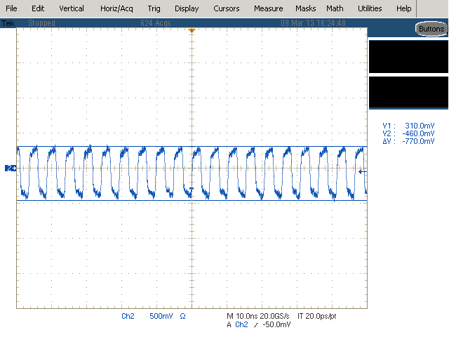
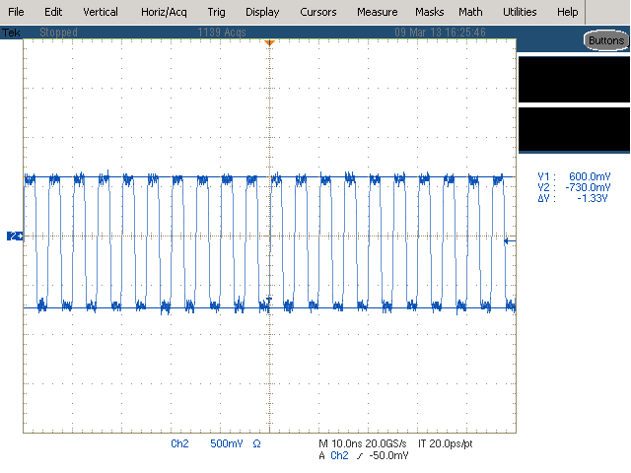
DDR Pad Setting (cont.)
Example 2-1: CLK signal with/without DDR pad setting
  Using preloader CLI command “set dram ctl_odt_ocd 75 60”
odt: disabled
ocd: disabled
odt: 75 ohm
ocd: 60 ohm
*Note: Suggest Singal should be large than 1.1 V
www.realtek.com
-<number>-
Copyright © 2013 Realtek Semiconductor Corp.

Slide 14
WRITE Timing Adjustment
Pre-Configuration
Step 3: Do WRITE Delay Timing Adjustment
  DQS and Data signal alignment
  CLK and DQS signal alignment
  CLK and commands signal alignment
DDR Pad Setting
WRITE Timing Adjustment
READ Timing Adjustment
Memory Test & Restore Config
Chip
DRAM
TX CLK
CLK
[ Related Commands]
set dram tx_clk_phs_delay <value>
WRITE
ADDR
[ Related Commands]
set dram clkm_delay <value>
DQS
DQS
DQn
D0
D1
DQn
[ Related Commands]
set dram clkm90_delay <value>
set dram dq_wr_delay_(0~15) <value>
www.realtek.com
-<number>-
Copyright © 2013 Realtek Semiconductor Corp.

Slide 15
WRITE Timing Adjustment (cont.)
Step 3-1: DQS and Data signal alignment
  Verified signals: DQS and DQn
  < buswidth is 8-bits, DQ0~DQ7, buswidth is 16-bits, DQ0~DQ15 >
    * Note: At least, the longest and shortest DQ signal in PCB board should be verified
  Verified Timing Parameters
[ Related Commands]
DQS:
set dram clkm_delay <value>
DQn :
set dram clkm90_delay <value>
set dram dq_wr_delay_(0~15) <value>
DRAM Timing | Required (DDR3-800) |  | Measured
 | min | Max
DQ0~15 input setup time (tDS) | 125ps | -
DQ0~15 input hold time (tDH) | 150ps | -
*Note: In DRAM datasheet, please find required timing parameters according to different frequency
www.realtek.com
-<number>-
Copyright © 2013 Realtek Semiconductor Corp.

Slide 16
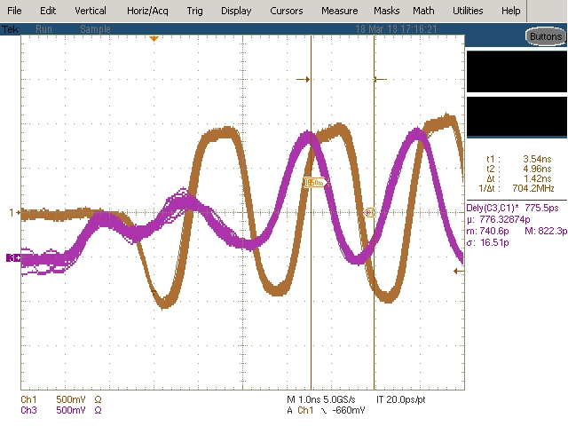

WRITE Timing Adjustment (cont.)
Example 3-1
  Using preloader CLI command
  “set dram clkm_delay 0x5“
  and apply with “call dram_setup“
  Re-check waveform, DQS signal delays about 168 ps
  (tDH: 776 ps->944 ps)
  1 delay tap is about 30~40 ps
776 ps
DQS0
DQ4
delay DQS0 signal
DQS0
DQ4
944 ps
www.realtek.com
-<number>-
Copyright © 2013 Realtek Semiconductor Corp.

Slide 17
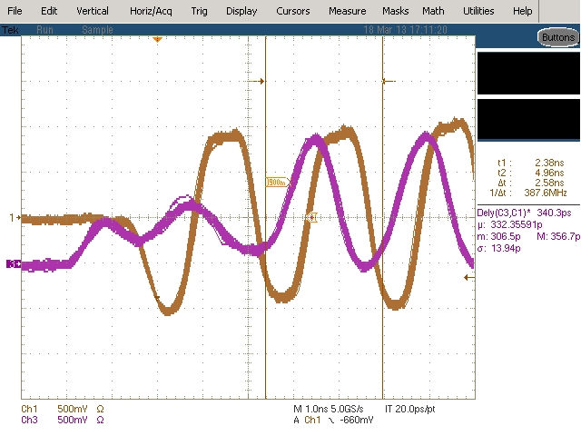
WRITE Timing Adjustment (cont.)
Example 3-2: tDS, tDH measurement in DRAM 400MHz
DRAM Timing | Required (DDR3-800) |  | Measured
 | min | Max
DQ4 input setup time (tDS) | 125ps | - | 332ps
DQ4 input hold time (tDH) | 150ps | - | 776ps
www.realtek.com
-<number>-
Copyright © 2013 Realtek Semiconductor Corp.

Slide 18
WRITE Timing Adjustment (cont.)
  Step 3-2: CLK and DQS signal alignment
  Verified signals: CLK and DQS
  Verified timing parameters
[ Related Commands]
set dram tx_clk_phs_delay <value>
DRAM Timing | Required (DDR3-800) |  | Measured
 | min | Max
DQS latching rising transitions to associated clock edge (tDQSS) | 0.25 tCK | 0.25 tCK
DQS falling edge to CK setup time (tDSS) | 0.2 tCK | -
DQS falling edge hold time from CK (tDSH) | 0.2 tCK | -
DQS input HIGH pulse width (tDQSH) | 0.45 tCK | 0.55 tCK
DQS input LOW pulse width (tDQSL) | 0.45 tCK | 0.55 tCK
*Note: Please find required timing parameters according to different frequency
www.realtek.com
-<number>-
Copyright © 2013 Realtek Semiconductor Corp.

Slide 19
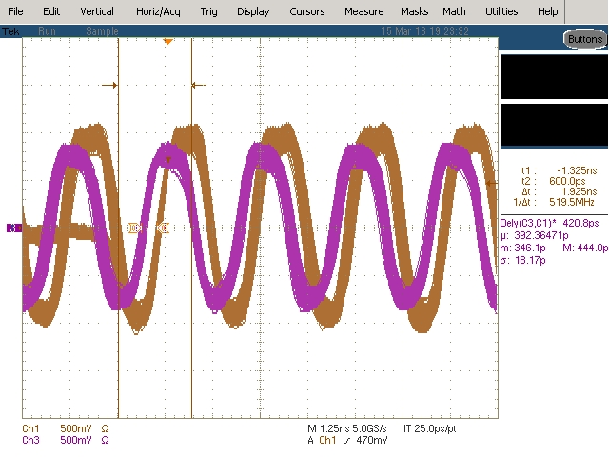
WRITE Timing Adjustment (cont.)
Example 3-3: tDQSS measurement in DRAM 400MHz
DQS0
CK
tDQSS should be within ¼ tCLK = 625 ps
www.realtek.com
-<number>-
Copyright © 2013 Realtek Semiconductor Corp.

Slide 20
WRITE Timing Adjustment (cont.)
  Step 3-3: CLK and Commands signal alignment
  Verified signals: CLK and commands signals (RAS#, CAS#, CS# and )
  Verified Timing Parameters
[ Related Commands]
set dram tx_clk_phs_delay <value>
DRAM Timing | Required (DDR3-800) |  | Measured
 | min | Max
RAS# setup time (tIS) | 350 ps | -
RAS# hold time (tIH) | 275 ps | -
CAS# setup time (tIS) | 350 ps | -
CAS# hold time (tIH) | 275 ps | -
CS# setup time (tIS) | 350 ps | -
CS# hold time (tIH) | 275 ps | -
WE# setup time (tIS) | 350 ps | -
WE# hold time (tIH) | 275 ps | -
www.realtek.com
-<number>-
Copyright © 2013 Realtek Semiconductor Corp.

Slide 21
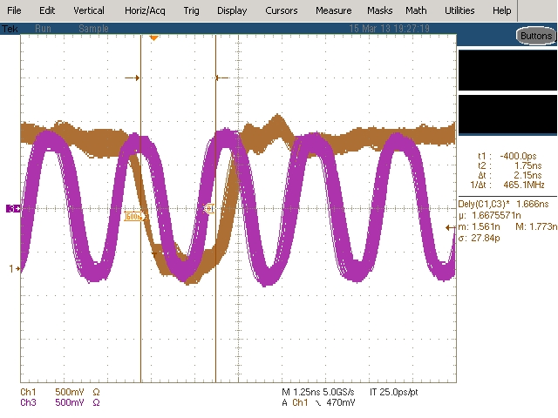
WRITE Timing Adjustment (cont.)
Example 3-4: tIS measurement in DRAM 400MHz for CAS#
CAS#
CK
Command signals setup time value is 350 ps
www.realtek.com
-<number>-
Copyright © 2013 Realtek Semiconductor Corp.

Slide 22
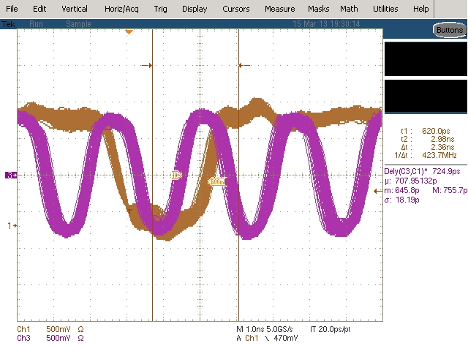
WRITE Timing Adjustment (cont.)
Example 3-4: tIH measurement in DRAM 400MHz for CAS#
CAS#
CK
Command signals hold time is 350 ps
www.realtek.com
-<number>-
Copyright © 2013 Realtek Semiconductor Corp.

Slide 23
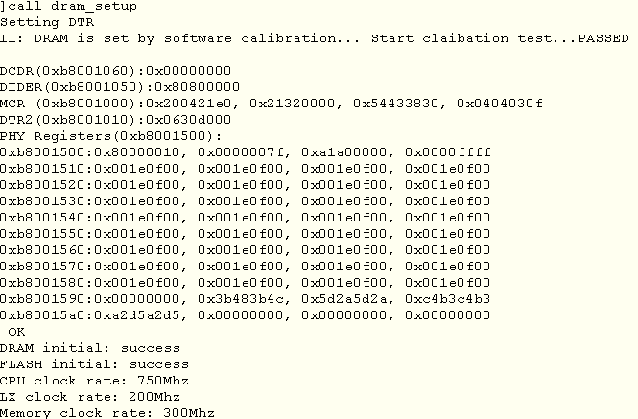
READ Timing Adjustment
Step 4-1: Apply configuration and do software calibration
with “call dram_setup” and check result is success
Pre-Configuration
DDR Pad Setting
WRITE Timing Adjustment
READ Timing Adjustment
Memory Test & Restore Config
1. check result is success here
2. check frequency is correct
www.realtek.com
-<number>-
Copyright © 2013 Realtek Semiconductor Corp.

Slide 24
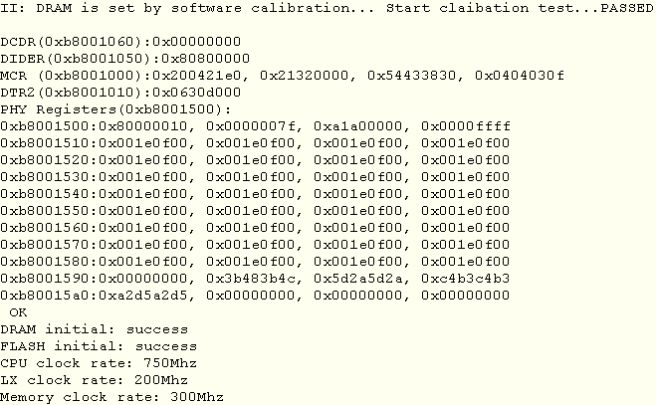
READ Timing Adjustment (Cont.)
Step 4-2: check READ Window result
Expected DQ READ Window
DDR frequency = 100 MHz
=> 0x001E0F00
DDR frequency = 200 MHz
=> 0x001E0F00
DDR frequency = 300 MHz
=> 0x001E0F00
DDR frequency = 400 MHz
=> 0x00150F00
READ Window information
[ Related Commands]
set dram dqs0_en_hclk/dqs1_en_hclk <value>
set dram dqs0_en_tap/dqs1_en_tap <value>
set dram dqs0_group_tap/dqs1_group_tap <value>
www.realtek.com
-<number>-
Copyright © 2013 Realtek Semiconductor Corp.

Slide 25
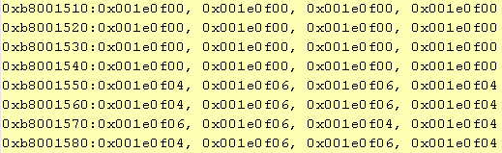
READ Timing Adjustment (cont.)
Example 4-1 : DQn Falling Edge Result is not start from 0
using commands “set dram dqs0_en_hclk 0x1”
“set dram dqs1_en_hclk 0x1”
  “set dram dqs0_en_tap 0x7 “
  “set dram dqs1_en_tap 0x7”
  And do “call dram_setup” to apply
www.realtek.com
-<number>-
Copyright © 2013 Realtek Semiconductor Corp.

Slide 26
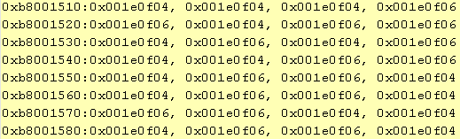
READ Timing Adjustment (cont.)
Example 4-2: DQn both rising and Falling Edge Result is not start from 0
  using commands “set dram dqs0_group_tap 4”
  “set dram dqs0_group_tap 4”
  And do “call dram_setup” to apply
www.realtek.com
-<number>-
Copyright © 2013 Realtek Semiconductor Corp.

Slide 27
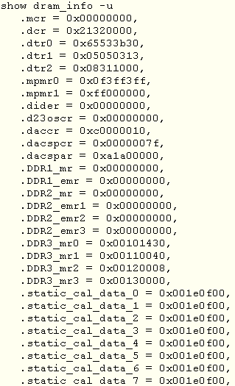
Memory Test & Restore Config
Step 5-1: restore current DRAM parameters
show dram_info -u
Pre-Configuration
DDR Pad Setting
WRITE Timing Adjustment
READ Timing Adjustment
Memory Test & Restore Config
www.realtek.com
-<number>-
Copyright © 2013 Realtek Semiconductor Corp.

Slide 28
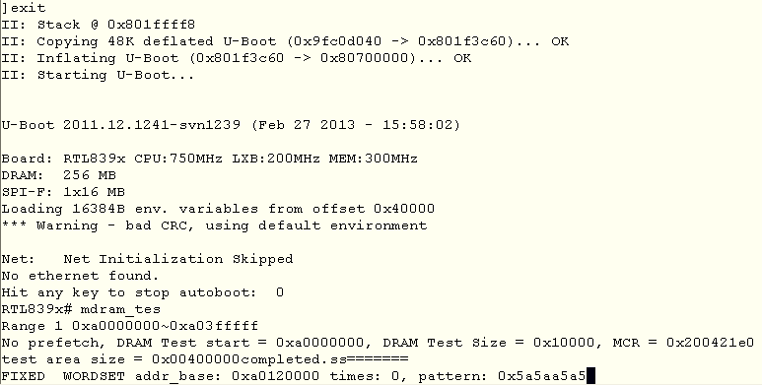
Memory Test & Restore Config (cont.)
Step 5-2: Using command “exit” to enter u-Boot and do memory test by u-Boot command “mdram_test”
1. “exit” to enter u-Boot
2. check frequency and size
2. “mdram_test” to do memory test
www.realtek.com
-<number>-
Copyright © 2013 Realtek Semiconductor Corp.

Slide 29
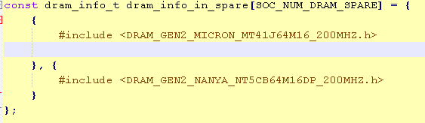
Memory Test & Restore Config (cont.)
Step 5-3: If memory test is passed
  copy previous DRAM parameters in step 5-1, and paste to soc_init_parameters.c to replace original parameters
soc_init_parameters.c
1. Comment this line
2. Paste DRAM dump parameters here
3. Suggest to record DRAM frequency as a comment
www.realtek.com
-<number>-
Copyright © 2013 Realtek Semiconductor Corp.

Slide 30
Appendix. Command List
commands | available value | unit
set dram size <value> | 32/64/128/256/512/1024 | MB
set dram buswidth <value> | 8/16 | bits
set dram ctl_odt_ocd <value> | ODT: 24/25/30/40/50/60/75/80/100/150/160/200 OCD: 48/50/60/80/100/120/150/160/200/300/320/400 | Ohm
set dram tx_clk_phs_delay <value> | 0~31 | Taps
set dram clkm_delay <value> | 0~31 | Taps
set dram clkm90_delay <value> | 0~31 | Taps
set dram dq_wr_delay_(0~15) <value> | 0~31 | Taps
set dram dqm0/dqm1 <value> | 0~31 | Taps
set dram mrs_odt <value> | DDR2: 0/50/75/150, DDR3: 0/20/30/40/60/120 * 0 for disable | Ohm
set dram mrs_rtt_wr <value> | DDR3: 0/60/120, 0 for disable | Ohm
set dram mrs_drv_strength <value> | DDR2: 0: normal, 1: reduce DDR3: 0: 40 ohm, 1: 34 ohm | N/A
www.realtek.com
-<number>-
Copyright © 2013 Realtek Semiconductor Corp.

Slide 31
Appendix. Command List (cont.)
commands | available value | unit
set dram dqs0_en_hclk <value> set dram dqs1_en_hclk <value> | 0: disable, 1: enable | N/A
set dram dqs0_en_tap <value> set dram dqs1_en_tap <value> | 0~31 | Taps
set dram dqs0_group_tap <value> set dram dqs1_group_tap <value> | 0~31 | Taps
call dram_setup | N/A | N/A
show <dram_info|pll_info> [-u|-p|-v] | -p: preloader type, -u: TCL type, -v: verbose | N/A
show init_result | N/A | N/A
call write_pattern <times> <pattern> | times: <integer>, ex: 10000 pattern: <4 bytes string in Hex>, ex: 0xFF00FF00 | N/A
call read_pattern <times> | times: <integer>, ex: 10000 | N/A
get <dram|pll> <parameter> |  | N/A
set pll clock <cpu-clk> <mem-clk> <lx-clk> set pll clock <cpu-clk> <dsp-clk> <mem-clk> <lx-clk> * if DSP exist | Reference to Appendix. Suggested PLL Range | MHz
www.realtek.com
-<number>-
Copyright © 2013 Realtek Semiconductor Corp.

Slide 32
Appendix. Command List (cont.)
commands | available value | unit
set dram tcas <value> | 2~11 | tCLK
set dram twr <value> set dram tcwl <value> | 1~8 | tCLK
set dram trtp <value> set dram twtr <value> | 1~16 | tCLK
set dram trp <value> set dram trcd <value> set dram trrd <value> set dram tfawg <value> | 1~32 | tCLK
set dram trefi <value> | 1~16 | tCLK
set dram trefi_unit <value> | 32/64/128/256/512/1024/2048/4096 | tCLK
set dram trfc <value> | 1~256 | tCLK
set dram tras <value> | 1~64 | tCLK
www.realtek.com
-<number>-
Copyright © 2013 Realtek Semiconductor Corp.

Slide 33
Appendix. Suggested PLL range
Apollo
  CPU: 500~675 MHz, DSP: 500~550 MHz, Memory:100~400 MHz, LX: 200 MHz
  * Note: each frequency step is 25MHz
839x, 835x
  CPU: 400~750 MHz, Memory:100~400, LX: 50~200 MHz
  *Note: CPU, LX: each frequency step is 50MHz
  Memory: each frequency step is 25MHz
838x, 833x
  CPU: 300, 500 MHz, Memory: 193, 300 MHz, LX: 200 MHz
www.realtek.com
-<number>-
Copyright © 2013 Realtek Semiconductor Corp.

