Slide 1
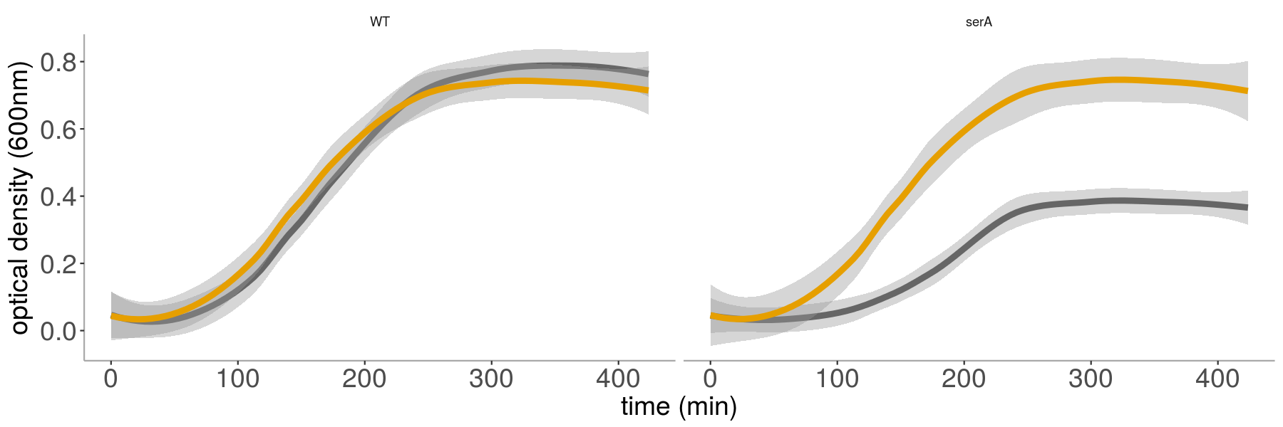
Serine deamination is active but not required in rich media
wild-type
serA sdaCB
sdaCB
serA
What is the benefit / physiological role of sdaCB?

Slide 2
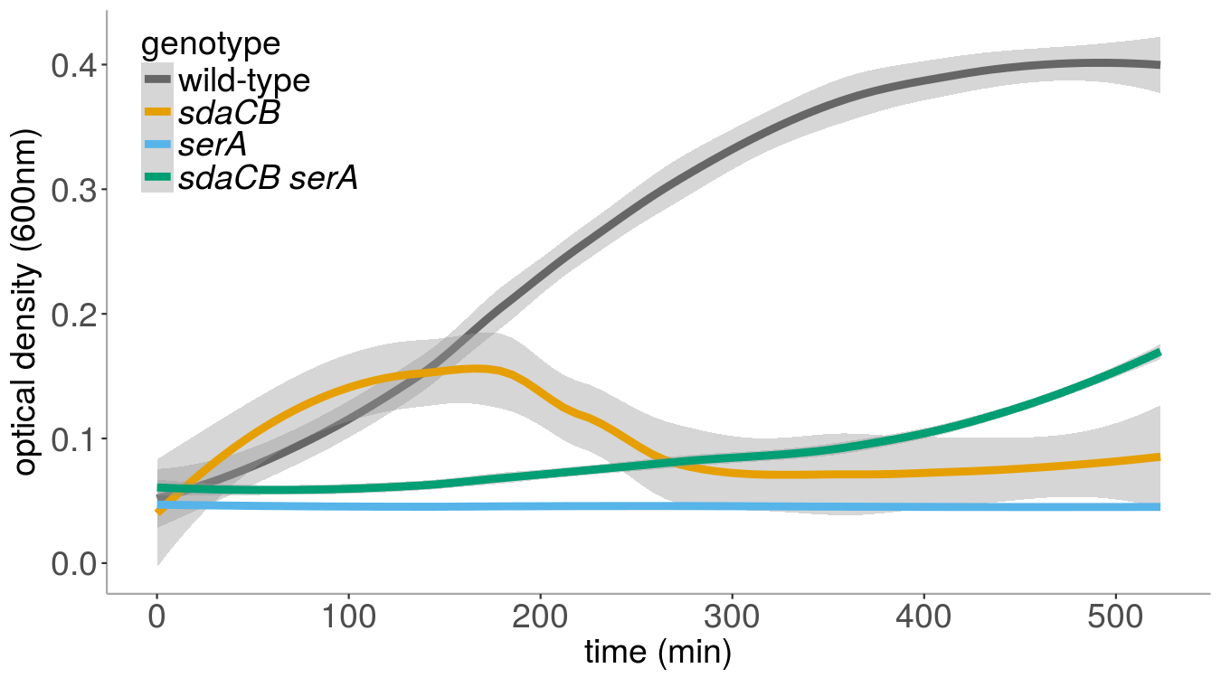
sdaCB mutant cells lyse upon glucose depletion
Glucose reduced from 0.5% to 0.025%, no serine

Slide 3
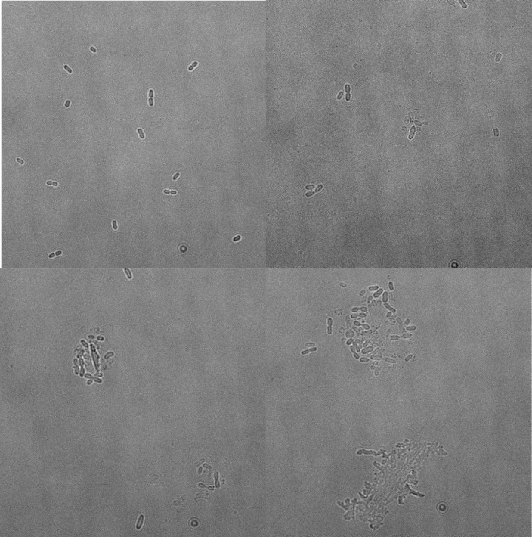
sdaCB mutant cells lyse upon glucose depletion
Glucose reduced from 0.5% to 0.025%, no serine
wild-type
sdaCB
sdaCB
sdaCB
Thanks, Heungwon!

Slide 4
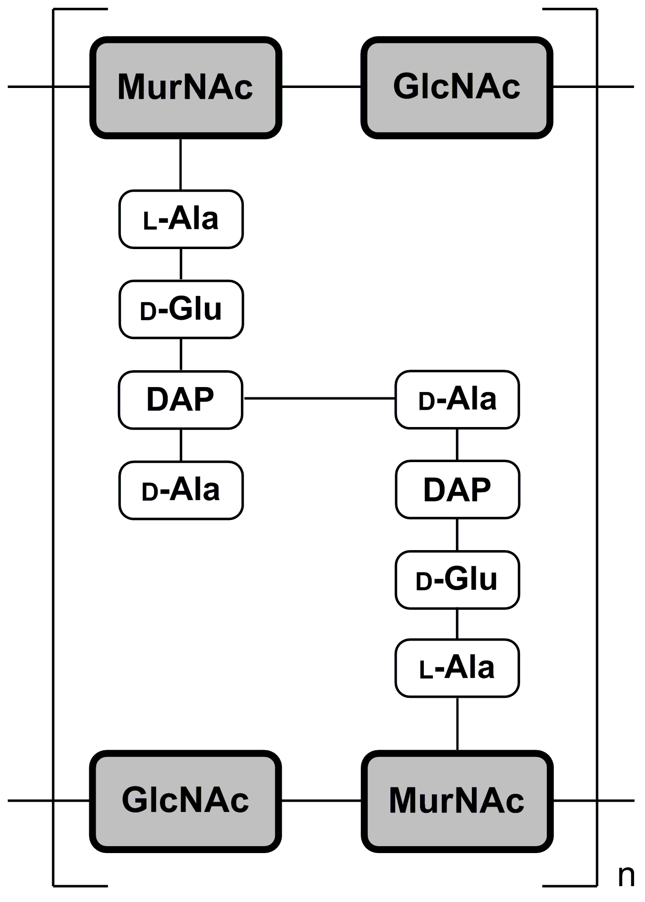
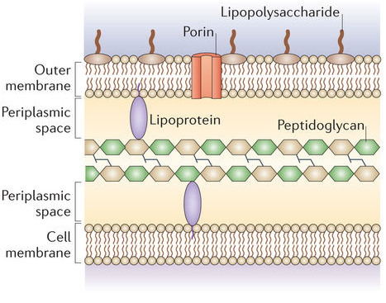
Are sdaCB mutant cells unable to produce peptidoglycan upon glucose depletion?
sdaCB is rescued by adding extra alanine

Slide 5
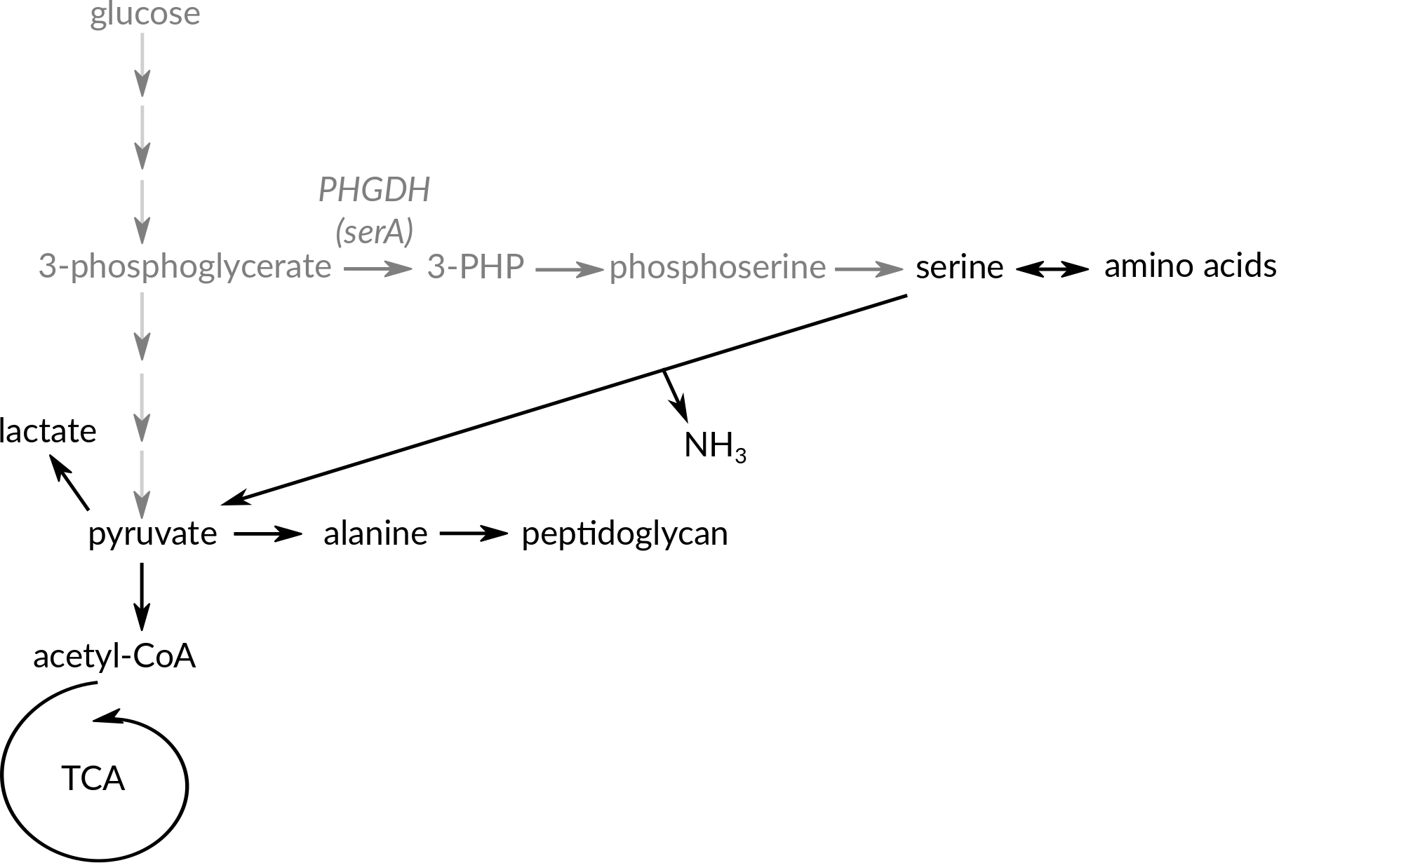
Possibility #1: sdaCB is required for alanine production in the absence of glucose

Slide 6
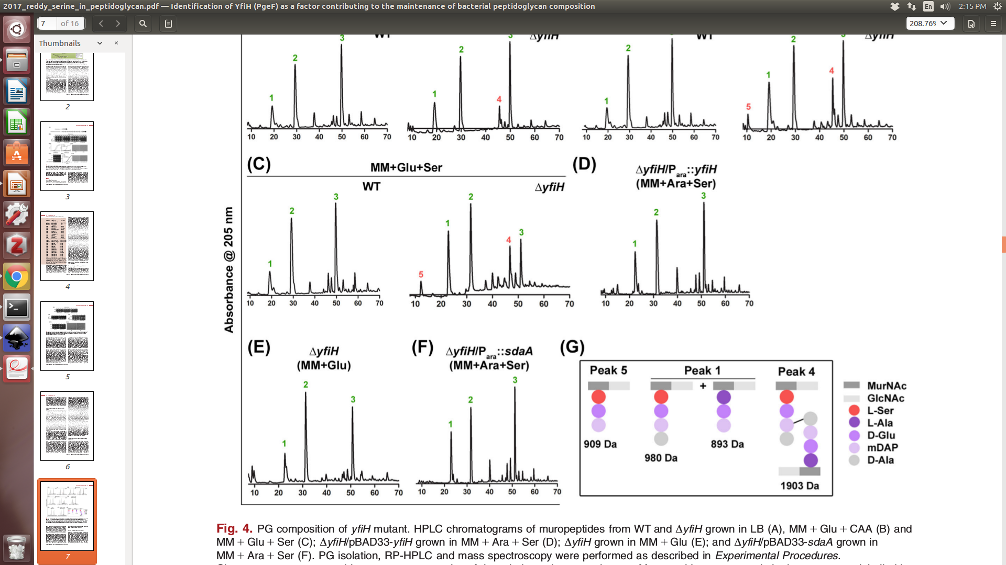
Serine can be accidentally incorporated into peptidoglycan when serine/alanine ratio is high
Parveen & Reddy (2017) J Bacteriol

Slide 7
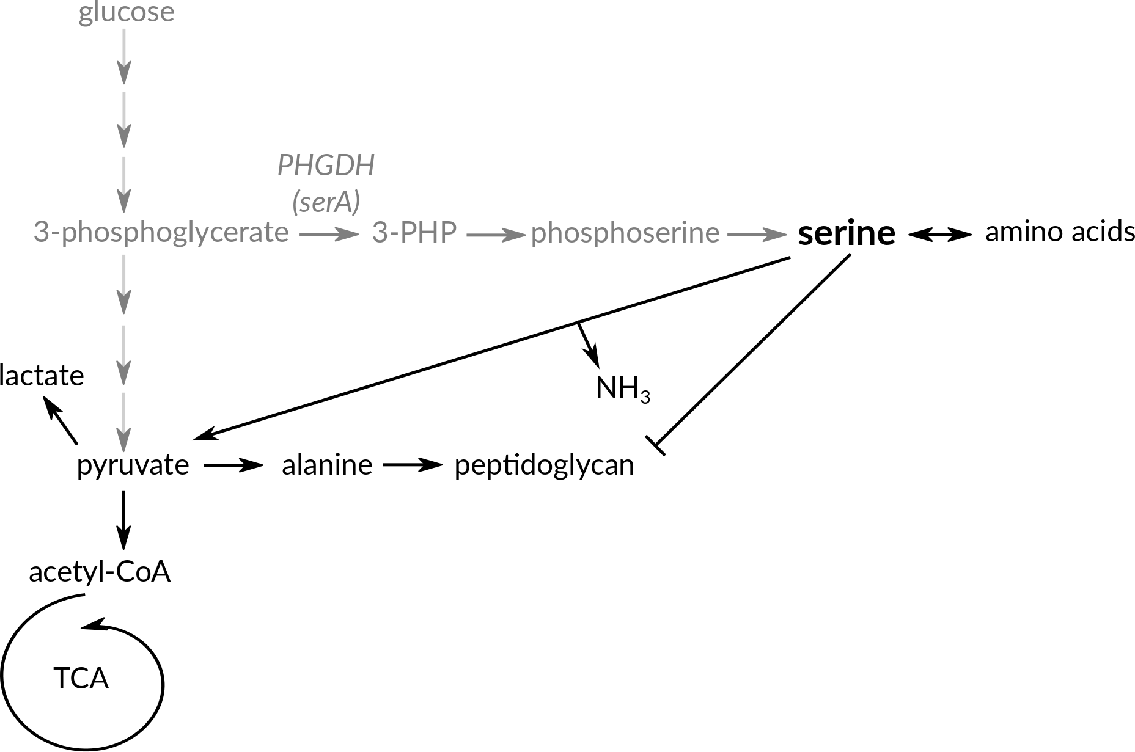
Possibility #2: sdaCB is required to prevent incorporation of serine into peptidoglycan

Slide 8
Is sdaCB required to generate peptidoglycan precursors and/or keep serine levels low?
Compare WT vs. sdaCB susceptibility to β-lactam antibiotics
Characterize stress response & induction of alternative serine synthesis pathways by RNA-seq
Measure intracellular serine levels by HPLC
Analyze peptidoglycan composition by HPLC

