Slide 1


Best location to open a car wash centre in Toronto
MURALI KRISHNAN SAMPATH

Slide 2
Introduction
Starting a car wash business can be interesting, and profitable business. For opening a car wash centre the existing car wash centres need to be analysed thoroughly. Because there are car wash centres already located all over the city. To decide the best location, The following steps to needs to be executed to find the best location.
Find the existing car wash centres in the entire Toronto city.
Find the boroughs which has dense population and less car wash centres.
Explore the nearby venues of the existing car wash centres and find which is the better location for new car wash centre.

Slide 3
Data acquisition and cleaning
a) Toronto city neighborhood information is scraped from this link https://en.wikipedia.org/wiki/List_of_postal_codes_of_Canada:_M
b) The boroughs which has more population is gathered from https://en.wikipedia.org/wiki/Demographics_of_Toronto.
c) Geographical information is required to explore the neighborhoods. This is information taken from Geospatial_Coordinates.csv
d) Using Foursquare API calls to get the nearest venues**(Car wash center)** of neighborhoods.
Duplicate/unnecessary values has been removed from the data.
After cleaning the data, There were 191 unique car wash centres and 3065 nearby venues of these car wash centres within 10km radius has been taken out for further calculation.

Slide 4
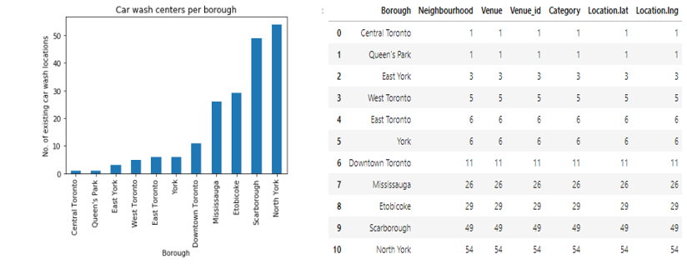
Methodology
The analysis has been done on the prepared data to find the best car wash location.
The unique car wash centres have been grouped based on boroughs to see the number of car wash centre per borough. The below image shows the car wash centres per borough.

Slide 5
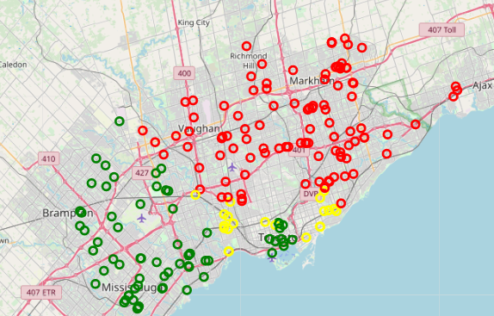

Map of the existing car wash centre by borough
In the map,
1. North York and Scarborough are marked in Red colour
2. Downtown toronto, Etobicoke, Mississauga are marked in Green colour.
3. Others are marked in Yellow colour.
As per the map and chart, The Etobicoke, Downtown toronto, Mississauga boroughs have less car wash centres and more population.

Slide 6
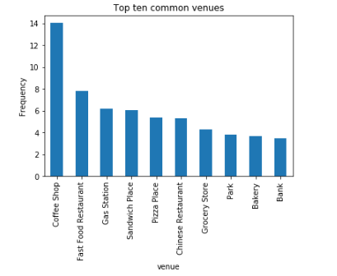
Common venues near the car wash centre:
For opening a carwash centre, it’s important to understand the commonality of the existing car wash centre locations.
The figure shows the top ten common venues of existing car wash centres
KMeans algorithm also confirms the same.

Slide 7
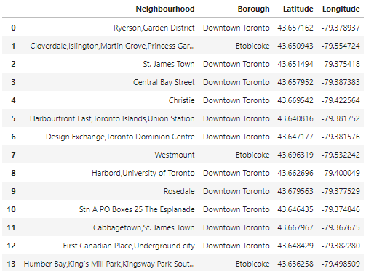
Results
Neighbourhoods with less/no car wash centres:
The shown neighbourhoods don’t have any car wash centres. Its suggested for the stakeholders to pick location from one of these neighbourhoods which has more common venues mentioned in the above slide.

Slide 8
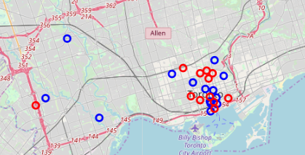
Selected neighbourhoods and near by car wash centres
In map,
The selected neighbourhoods are marked in blue.
The near by car wash centres are marked in red.

Slide 9
Future Directions
The further analysis can be done on the type of car wash centres, ratings, price. There are many types of car wash centres, (i.e.) Self-service car wash, Tunnel car washes, Automotive car wash, Hand wash service, Bikini car wash etc.
The analysis can be carried based on the types of car wash centre, user ratings, price etc. Since the foursquare API response doesn’t have any information or less information for these features, the analysis couldn’t be done. When this information is available, we can further enhance the results.

Slide 10
Conclusion
In this study, I have analysed the entire Toronto city car wash centres to find the best location for the new car wash centre. The top nearby venues have been identified near the existing carwash locations to find exactly where the car wash centres are located.
After identifying the common locations near the car wash centres, the neighbourhoods of Etobicoke, Downtown toronto and Mississauga which have very less car wash centres have been identified and selected for opening the new car wash centre.
As part of the study, I tried to identify the car wash centre types, price etc, which I felt very essential for the analysis, But I couldn’t able to get the proper information, so I left that work for future.

