Slide 1
Europe Energy 2019 Report
Michał Król
2022-05-13

Slide 2
Summary
The data for this report comes from World Energy Consumption dataset
The report focuses on countries in Europe, in the year 2019
Areas of focus are primary energy, electricity and their sources

Slide 3
Methodology
Data for analysis came from World Energy Consumption dataset, https://www.kaggle.com/datasets/pralabhpoudel/world-energy-consumption
The collected data was processed to improve the quality and alter formatting
From many available years, countries, data measures and categories of energy sources, data of interest was selected and extracted
The extracted data was presented with a dashboard

Slide 4
Results - dashboard
The dashboard available under the url below splits the findings into three categories: primary energy, electricity and shares of sources of power.
https://public.tableau.com/views/EuropeEnergy2019/Story1?:language=en-US&publish=yes&:display_count=n&:origin=viz_share_link

Slide 5
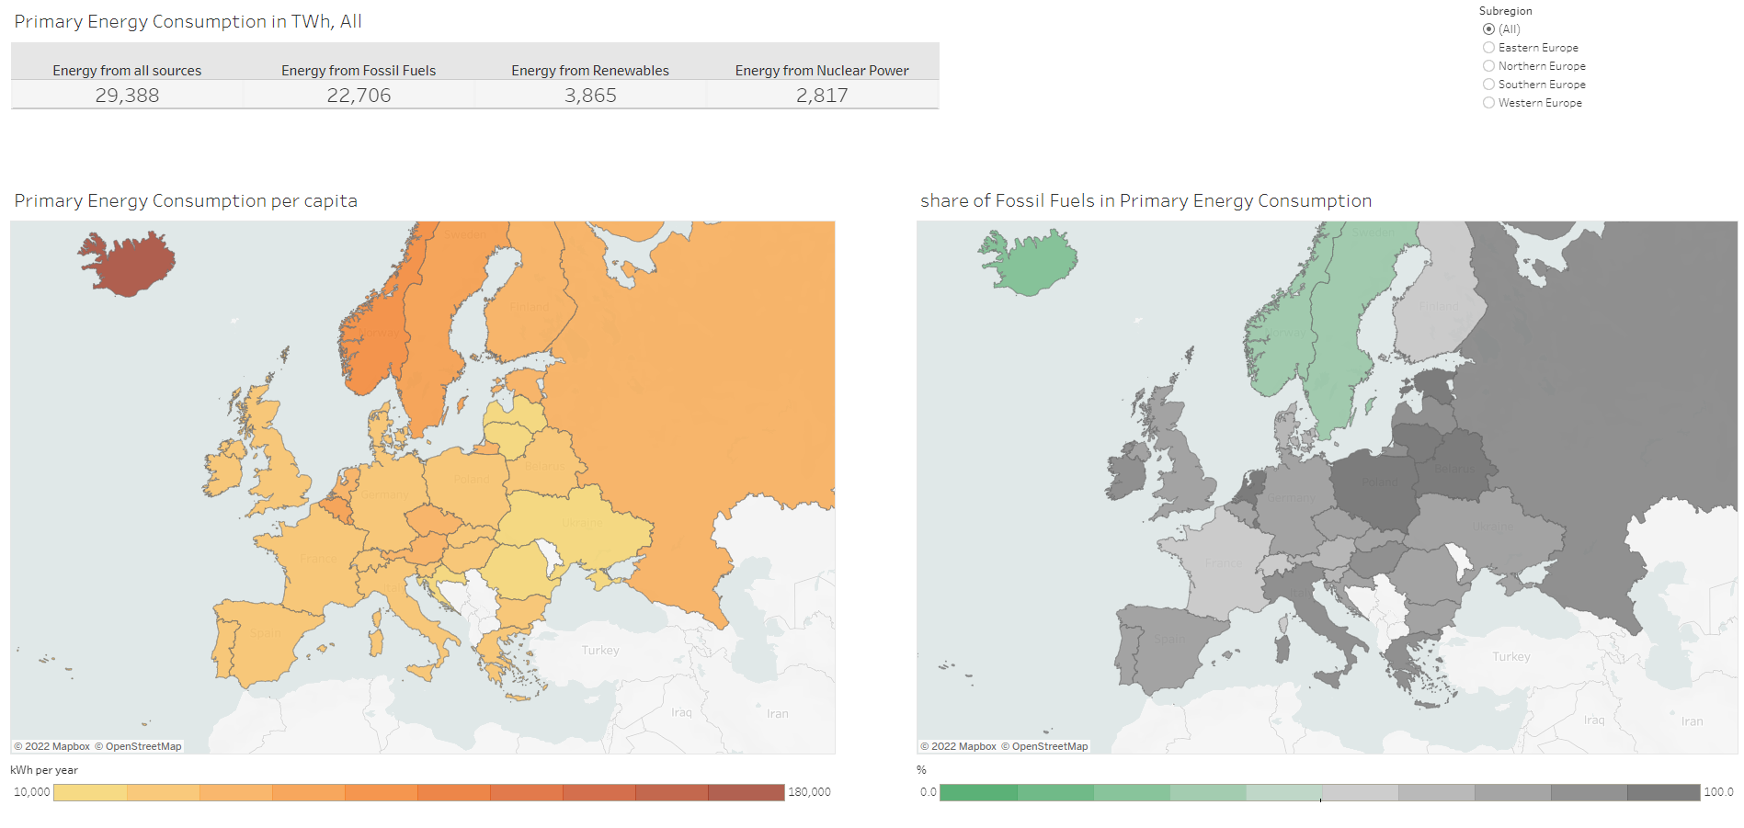
Results - dashboard: primary energy

Slide 6
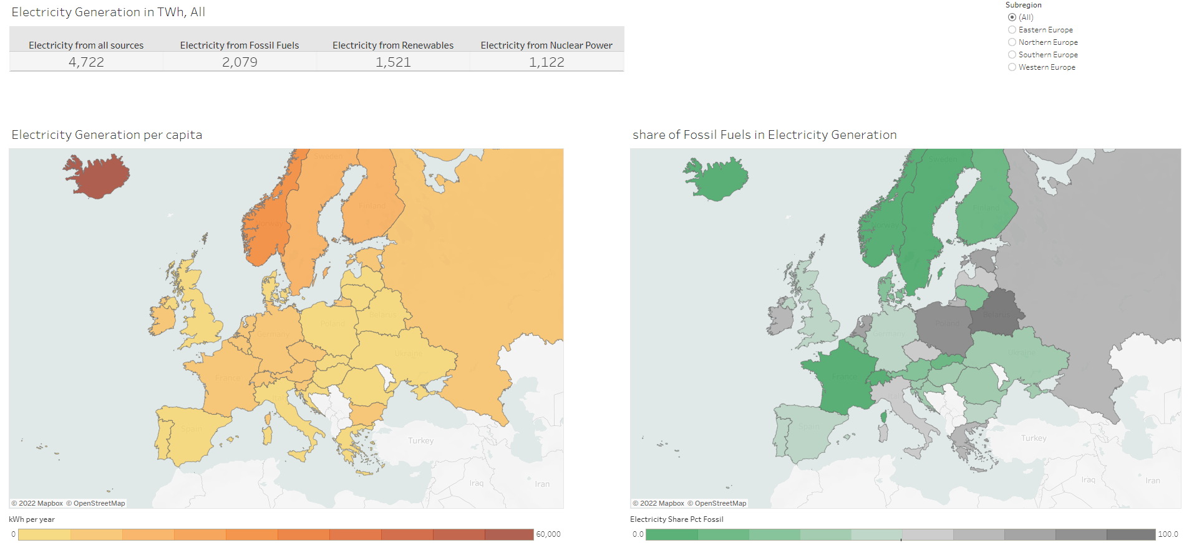
Results - dashboard: electricity

Slide 7
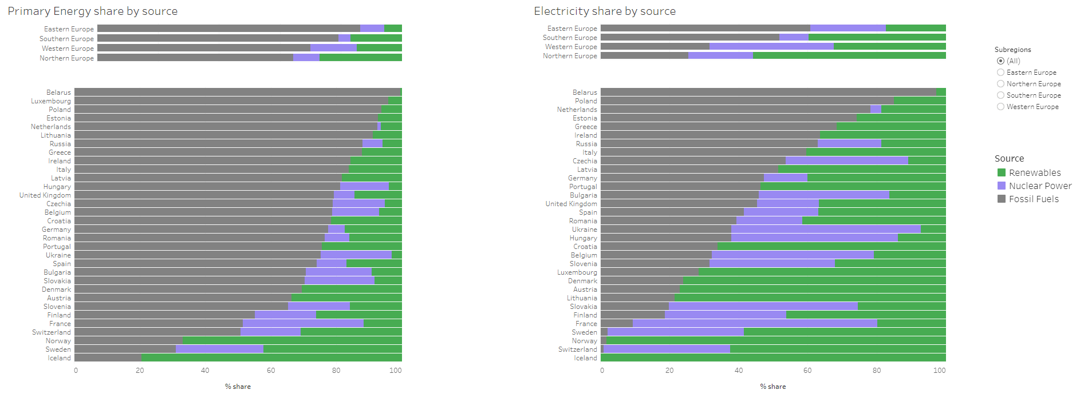
Results - dashboard: share of sources

Slide 8
Findings - primary energy
In 2019, whole Europe consumed almost 30 000 tera-Watt-hours of primary energy (energy harvested directly from natural resources)
Majority of this energy came from fossil fuels
Highest share of fossil fuels in energy consumption was observed in Eastern Europe (86 %), the lowest in Northern Europe (64 %)
There is a clear correlation between latitude and energy consumption per capita, which can be explained by higher power consumption in winter due to lower temperatures

Slide 9
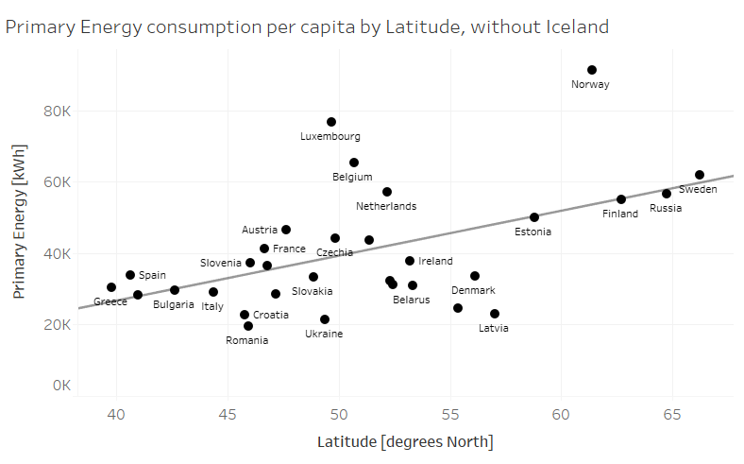
Findings - primary energy

Slide 10
Findings - electricity
In 2019, whole Europe generated about 5000 tera-Watt-hours of electricity
In total, almost half of this electricity came from fossil fuels
Highest share of fossil fuels in electricity generation was observed in Eastern Europe (61 %), the lowest in Northern Europe (24 %)
Most countries in Eastern Europe heavily rely on nuclear power
Countries in Southern Europe seem to be most averse to nuclear power

Slide 11
Findings - electricity
In 2019, whole Europe generated about 5000 tera-Watt-hours of electricity
In total, almost half of this electricity came from fossil fuels
Highest share of fossil fuels in electricity generation was observed in Eastern Europe (61 %), the lowest in Northern Europe (24 %)
Most countries in Eastern Europe heavily rely on nuclear power
Countries in Southern Europe seem to be most averse to nuclear power

