Slide 1
Workshop: Programming With Dyalog APL
ECUST 上海, July 5th 2018
Morten Kromberg CXO, Dyalog Ltd.
(based on work by Jay Foad, Roger Hui & John Scholes)

Slide 2
Agenda
Morning
Verify APL Installations – or see http://tryapl.org
Download course materials from
https://github.com/mkromberg/ECUST2018
A few slides: Introduction to APL
Exercises until Lunch
After Lunch
A quick look at tools for
Importing Data from Excel
Charts
Review of MatLab code (SA_Cal) converted to APL
Gitte + Morten depart for airport around 2PM

Slide 3
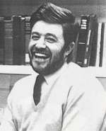
History of APL
Canadian of Norwegian Descent
Born on a small farm in Alberta (Canada)
Finished one-room school after 9th grade and worked on the farm
Army 1942, Flight Engineer in Air Force from 1943
Almost finished High School in the service
Promised his officers and mates that he would pursue an academic career after the war
B.A. from Queens University, Kingston Ontario
Ken didn’t know there was such a thing as University before he joined the army!
Kenneth E. Iverson 1920-2004
APL Workshop, ECUST July 5th 2018
Notes:
Enjoyed teaching his mates math in the armed forces

Slide 4
Nothing on this slide in China

Slide 5
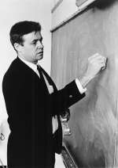
History of APL, continued
Doctoral work at Harvard with Aiken and Leontief
Taught at Harvard for 6 years,
frustrated with inadequacies of mathematical notation
Developed ”Iverson Notation” in response
Published ”A Programming Language” in 1962
Failed to get tenure at Harvard; moved to IBM
Used APL for modelling and teaching
First APL Interpreter in 1966
IBM Fellow in 1970
J (”rationalised APL”) from ca. 1989
ACM Turing award in 1979:
“For his pioneering effort in programming languages and mathematical notation resulting in what the
computing field now knows as APL, for his contributions to the implementation of interactive systems, to educational uses of APL, and to programming language theory and practice.”
Notes:
Leontied was awarded the Nobel Prize for Economics in …?

Slide 6











Syntaxes of Mathematics
Problems:
- Wide variety of syntactical forms
- Strange and inconsistent precedence rules - Things get worse when you deal with matrices See http://www.jsoftware.com/papers/EvalOrder.htm
APL Workshop, ECUST July 5th 2018

Slide 7
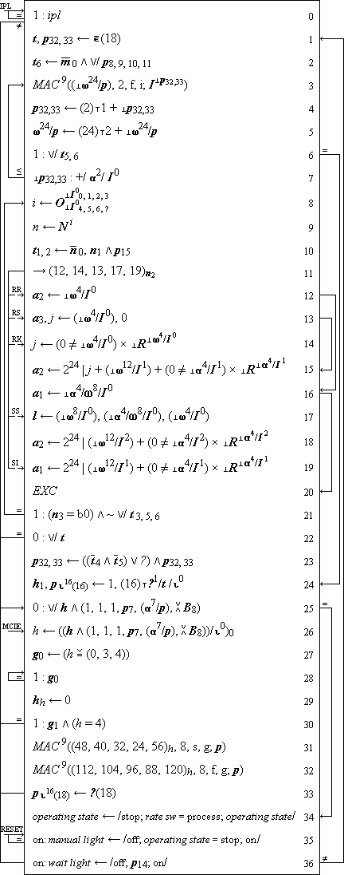
Iverson Notation: Description of IBM\360

Slide 8
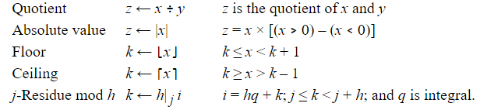
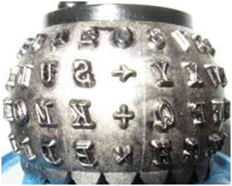
Slide 8: Lucky Linearization
The 5: Ken Iverson, Adin Falkoff, Larry Breed, Dick Lathwell, Roger Moore. Operated by “Quaker Consensus”.
APL Workshop, ECUST July 5th 2018

Slide 9
A Programming Language (for Mathematics)
a×b
Mat1 +.× Mat2
*x
f g x
(f+g) x
x÷y
(3○x)*2
b⍟a
+/4×⍳6 ×/4×⍳6
a*÷n
(2×a)÷⍨(-b)(+,-)0.5*⍨(b*2)-4×a×c
APL Workshop, ECUST July 5th 2018

Slide 10
Exercises
The folder "Exercises" contains numbered files, starting with "00-syntax.txt"
We will do one exercise at a time, followed by a discussion. For each line in the file:
Enter the expression, but ...
BEFORE you hit <enter>, try to predict the result
When you are surprised, think about it
Remember: You can get help for APL symbols by hovering over the "language bar" or putting the cursor on a symbol and hitting F1

Slide 11
Saving Your Work
Historically, APL users have saved workspaces containing code and data as a single file
Similar to an Excel Spreadsheet
Takes a ”snapshot of the VM”
Beware: also saves the execution stack if there is one
Save your work using )save /path/mywsname[.dws]
Load it again with )load /path/mywsname
You can extract named objects from a workspace: )copy /path/mywsname foo goo x y
Saved workspaces can have a ”latent expression” ⎕LX, which is executed when the workspace is loaded, unless you )xload /path/mywsname
APL Workshop, ECUST July 5th 2018

Slide 12
Saving Your Work, continued
In the last few years, it has become more popular to use Unicode text files (and SVN/GIT), especially for source code
You can save a fn/var, namespace or class using]save (]save is a ”user command” - written in APL): ]save name /path/name[.dyalog] (it is customary to use the same name for the file)
You can bring it back into the active workspace using ]load /path/name ]load /path/*
If you edit objects that were ]loaded, the system will offer to update the file each time you make a change
From version 15.0, the interpreter (editor) knows how to open and view source files without user commands.
APL Workshop, ECUST July 5th 2018

Slide 13
APL vs MatLab – Differences (1/2)
APL X ← 1 0 3 Y ← 10 1 2
X ÷ 10 0.1 0 0.3
X ÷ Y 0.1 0 1.5
X ⌹ Y
0.13333
MatLab
X = [1,0,3] Y = [10,1,2]
X / 10 0.1 0 0.3
X / Y 0.13333
X ./ Y 0.1 0 1.5
In APL, ÷ always divides an element in the left argument with an element of the right argument
In MatLab, / changes meaning depending on the shape of the arguments.

Slide 14
APL vs MatLab – Differences (2/2)
APL X ← 1 0 3 Y ← 10 1 2 X × 10 10 0 30
X × Y 10 0 6
X +.× Y 16
MatLab
X = [1,0,3] Y = [10,1,2] X * 10 10 0 30
X * Y [error]
X .* Y 10 0 6
X * Y' 16
In APL, × works like +-÷! and ALL the "scalar functions"
In MatLab, * changes meaning depending on the shape of the arguments – and in a different way from how / changes.

Slide 15
APL vs. MatLab
APL was invented between 1960-1966
MatLab 1965-1970
(both have developed a lot since then)
APL is simple and regular
MatLab has retained some of the irregularities of Math.
*In my opinion*, this makes MatLab
Less surprising to the beginner
Messy when things get complicated
MatLab is a good choice if there is already a module which solves your problem
If you have to write your own algorithms, APL may be cleaner and faster – and help you think about the problem
It is *much* easier to deploy solutions in APL than MatLab

Slide 16
Reading APL
CB←{⍵[1+(⍴⍵)|X∘.+X←(⍳⍺)-1]}
Imagine arguments: 8 CB ' ⎕'
APL Workshop, ECUST July 5th 2018

Slide 17
Reading APL
What does this function do?
{(~R∊R∘.×R)/R←1↓⍳⍵}

Slide 18
Multi-Line dfns
)ed sign ⍝ to start the editor
sign←{
⍵<0:'negative'
⍵>0:'positive'
'zero'
}
sign 1 positive

Slide 19
Procedures / Tradfns
Monadic:
∇ R←Sum X
[1] R←+/X
∇
Dyadic:
∇ R←A MatMult B
[1] R←A+.×B
∇
Niladic:
∇ Run
[1] ⎕←'Boo Hiss!'
∇

Slide 20
Procedures / Tradfns
”Ambi-valent” (+ use a control structure)
∇ R←{Window} Sum X
[1] :If 0=⎕NC 'Window' ⋄ R←+/X
[2] :Else ⋄ R←Window +/ X
[3] :EndIf
∇

Slide 21
Procedures / Tradfns
Name Elements of Right Argument
+ Local Variable
∇ r←Round (n decimals);base
[1] base←10*decimals
[2] r←(⌊0.5+n×base)÷base
∇

