Slide 1

Classifying nba all-stars
Data Science 5K Final Project
Collaboration space, Alexandria, VA
October 2016

Slide 2
overview
background
Selecting NBA All-Stars has been a sacred process for NBA fans around the globe. The event, often taking place in February, aims to put the NBA’s best on the court together for a fun, yet somewhat competitive game. The process for selecting All-Stars, though, has been extremely subjective, with fans voting for 10 players and coaches selecting the other 14.
Objective
The goal of this project was to develop a model that could predict the probability of an NBA player being chosen as an All-Star. This project seeks to do that by moving past traditional counting statistics (points, assists, blocks, etc.) and model the probability of All-Star game participation based on advanced player statistics.
Data
Compiled from basketball-reference.com, the data spans the 2015-2016 and 2016-2017 seasons and includes both counting and advanced statistics for all players.

Slide 3
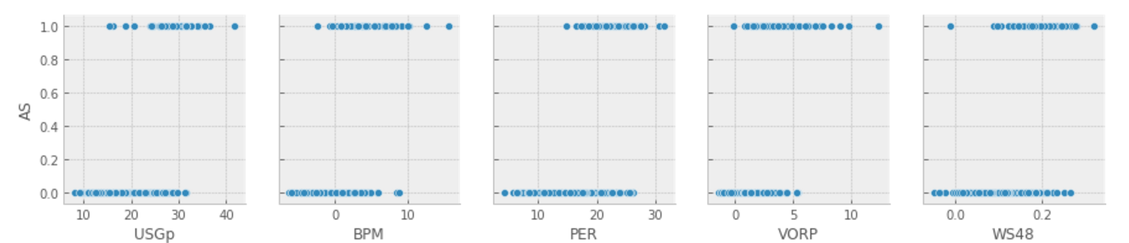
Exploratory data analysis
Looking through the summary statistics of the player data from all NBA players and the All-Stars, it was evident that these two groups of players could be easily segmented using advanced statistics like Usage %, Box Plus/Minus, Player Efficiency Rating, Value Over Replacement Player, and Win Shares / 48 minutes.
Player Type | USG % | BPM | PER | VORP | WS48
All Star | 28.46 | 4.77 | 23.00 | 4.44 | 0.18
NBA | 19.33 | -0.05 | 14.75 | 1.10 | 0.10

Slide 4
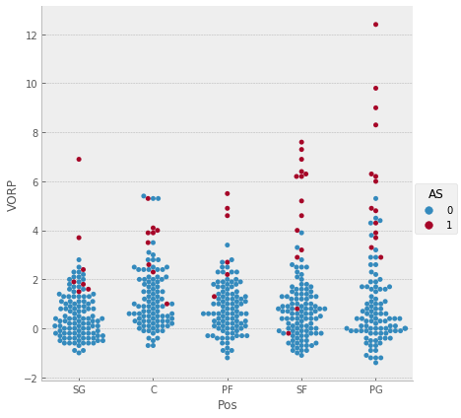
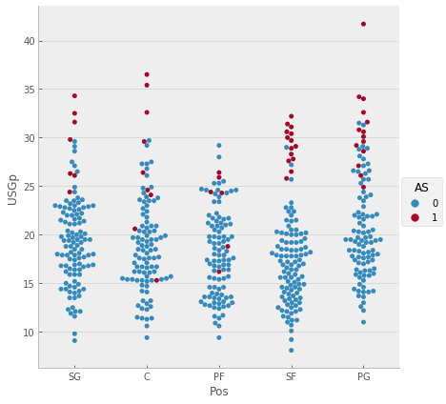
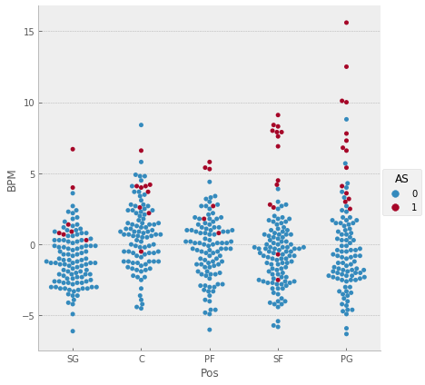
Exploratory data analysis
Value Over Replacement Player
Usage Percentage
Box Plus/Minus

Slide 5
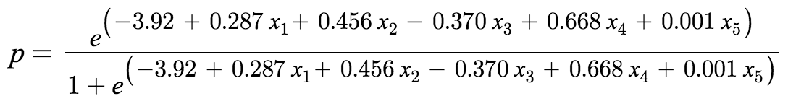
results
This Logistic Regression model takes five inputs to predict the probability of a player being designated as an All-Star. Validity and strength of the model was tested using both the accuracy score and a confusion matrix.
x₁ = USG %, x₂ = BPM, x₃ = PER, x₄ = VORP, x₅ = WS48
n = 135 | Predicted: No | Predicted: Yes
Actual: No | 128 | 0
Actual: Yes | 1 | 6
Accuracy Score: 99%

Slide 6

Model Predictions
2016 | Kobe Bryant
USG % | 32.2
BPM | -2.5
PER | 14.9
VORP | -0.2
WS48 | -0.01
All-Star Probability | 18.77%
2017 | Russell Westbrook
USG % | 41.7
BPM | 15.6
PER | 30.6
VORP | 12.4
WS48 | .224
All-Star Probability | 99.99%
2017 | John Wall
USG % | 30.6
BPM | 4.1
PER | 23.8
VORP | 4.3
WS48 | .149
All-Star Probability | 73.50%
Prediction
Actual Result

Slide 7
Future research
Training data adjustments
This model is trained on data of All-Stars chosen by both fans and coaches from the past two NBA seasons. Training on the model will internalize bias, as the fans can and have chosen players who would be considered “undeserving” of the All-Star recognition (e.g. 2016 Kobe Bryant).
Model adjustments
The Logistic Regression model is built on five advanced statistic metrics – USG%, BPM, PER, VORP, and WS48 – with not account for position played. Since All-Stars are chosen by their position in the backcourt (guards) or frontcourt (forwards and centers), a new model could be developed to account for these additional variables to choose the best players in their respective position groups.

