Slide 1
HOUSING PRICE
PREDICTION
CHANDRU.S
DS OCTOBER BATCH 2025 - 2026

Slide 2
Dataset Overview
The Housing dataset contains 545 records of residential properties with 13 features. It captures physical attributes (area, bedrooms, bathrooms, stories), amenities (air conditioning, guestroom, basement, hot water heating, parking), and location & furnishing details (mainroad access, preferred area, furnishing status). The target variable is the property price ranging from ₹1.75M to ₹13.3M. The dataset is clean with zero missing values across all columns, making it ideal for regression modeling. This balanced dataset of numerical and categorical features provides a comprehensive basis for building a predictive model that can estimate housing prices based on multiple property attributes.
545
13
0
₹4.77M
Total Records
Features
Missing Values
Avg Price
Key Columns:
price · area · bedrooms · bathrooms · stories · mainroad · guestroom · basement · hotwaterheating · airconditioning · parking · prefarea · furnishingstatus

Slide 3
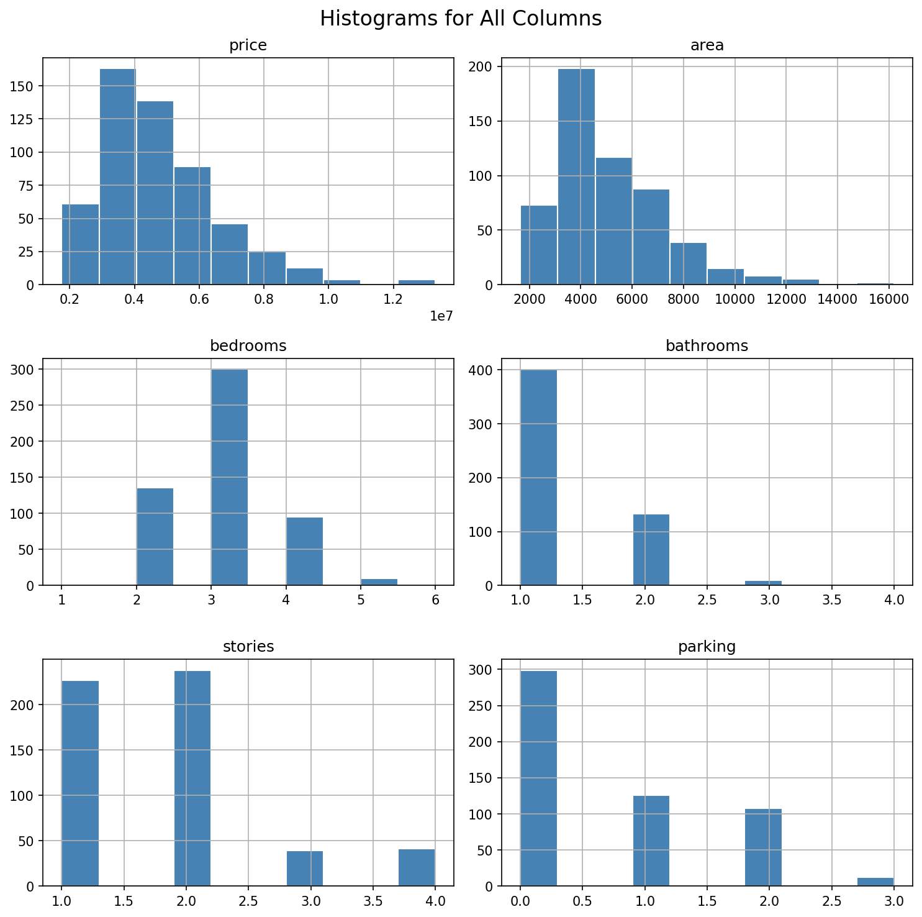
Exploratory Data Analysis
EDA was conducted to understand the distribution of features, identify relationships, and prepare data for modelling. Histograms revealed that price and area are approximately right-skewed, while discrete features like bedrooms and bathrooms cluster at low values. The majority of properties have 2–3 bedrooms and 1 bathroom. Area spans from 1,650 to 16,200 sq ft with an average of ~5,150. Price ranges widely from ₹1.75M to ₹13.3M with a mean of ₹4.77M. Categorical features such as mainroad access, airconditioning, and preferred area show notable influence on price, validated through correlation analysis. The histogram grid provided a comprehensive snapshot of feature distributions across the entire dataset.
1,650–16,200 Area (sqft)
₹1.75M–₹13.3M Price Range
1–4 Bedrooms Range

Slide 4
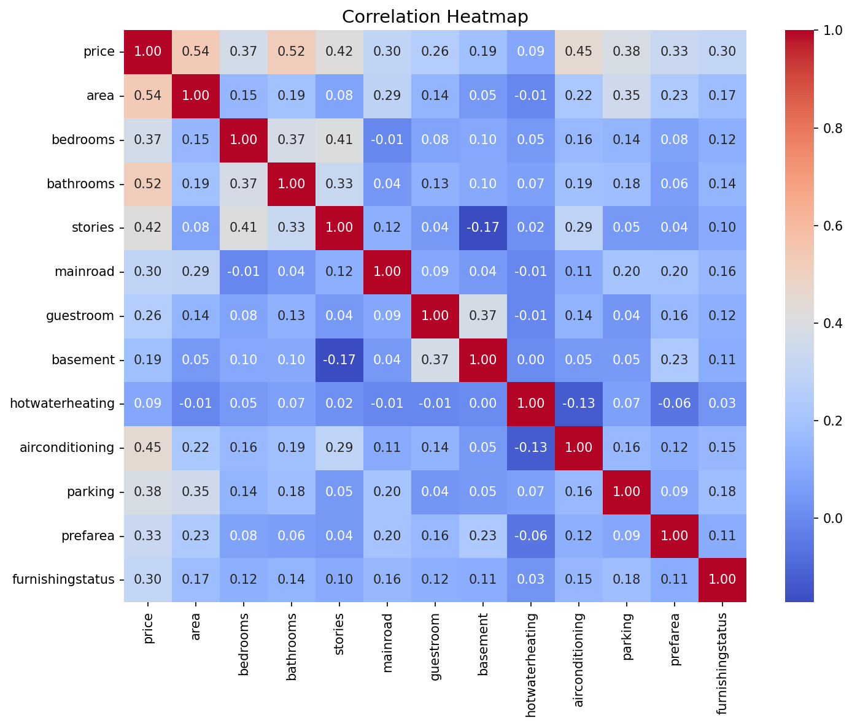
Correlation Heatmap
Top Correlations with Price
Area
0.536
Bathrooms
0.518
Air Conditioning
0.453
Stories
0.421
Parking
0.384
Bedrooms
0.366
Pref Area
0.330
Hot Water Htg
0.093

Slide 5
Data Preprocessing
Before feeding data into the machine learning model, several preprocessing steps were applied. Binary categorical columns (mainroad, guestroom, basement, hotwaterheating, airconditioning, prefarea) were encoded by replacing 'yes' with 1 and 'no' with 0. The furnishingstatus column with three categories (unfurnished, semi-furnished, furnished) was encoded as 0, 1, and 2 respectively. StandardScaler from scikit-learn was applied to normalize the continuous columns — price and area — transforming them to zero mean and unit variance. This ensures that features with large numerical ranges do not dominate the regression model. The resulting dataset had all features as numeric types (float64 and int64), making it fully compatible with the LinearRegression estimator. No imputation was needed as the dataset had no missing values.
1
2
3
4
Binary Encoding
Ordinal Encoding
Standard Scaling
Train-Test Split
yes/no → 1/0 for 6 columns
furnishingstatus → 0, 1, 2
price & area normalized (μ=0, σ=1)
80% train / 20% test (random_state=42)

Slide 6
Model: Linear Regression
Linear Regression from scikit-learn was selected as the predictive model for housing prices. This algorithm learns a linear relationship between the 12 input features and the scaled price. The model was trained on 80% of the data (436 samples) and evaluated on the remaining 20% (109 samples). The training used the Ordinary Least Squares (OLS) method to minimize the sum of squared residuals. Each feature was assigned a coefficient — bathrooms had the highest positive coefficient (0.587), followed by airconditioning (0.420) and hotwaterheating (0.368), indicating these features most strongly push predicted price upward. Area contributed 0.274, confirming its importance. The model intercept was -1.969, consistent with the standardized price scale. The final model achieved an R² score of 64.95%.
Top Feature Coefficients
Bathrooms
0.587
Air Conditioning
0.420
Hot Water Htg
0.368
Pref Area
0.337
Area
0.274
Model Configuration
Stories
0.217
Algorithm: LinearRegression (OLS) | Test Size: 20% | random_state: 42
Features: 12 | Training Samples: 436 | Test Samples: 109

Slide 7
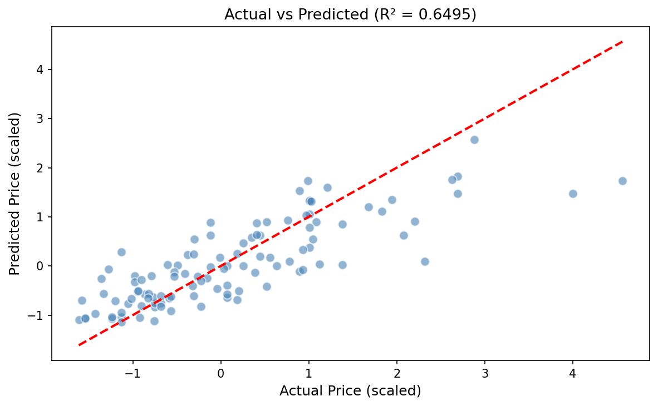
Model Results & Evaluation
64.95%
0.5243
0.7123
R² Score
MAE
RMSE
The Linear Regression model achieved an R² score of 64.95%, explaining ~65% of variance in housing prices. The Mean Absolute Error (MAE) of 0.524 and RMSE of 0.712 are in scaled units (StandardScaler applied to price). The scatter plot of actual vs. predicted values shows a reasonable linear trend hugging the 45° reference line, with moderate scatter indicating the model captures the dominant pricing factors while leaving room for improvement with more complex algorithms. Features like bathrooms, airconditioning, and area are the strongest predictors. The model performs reliably in mid-range price segments but shows higher error at extreme values, a typical characteristic of linear models on real estate data.

Slide 8
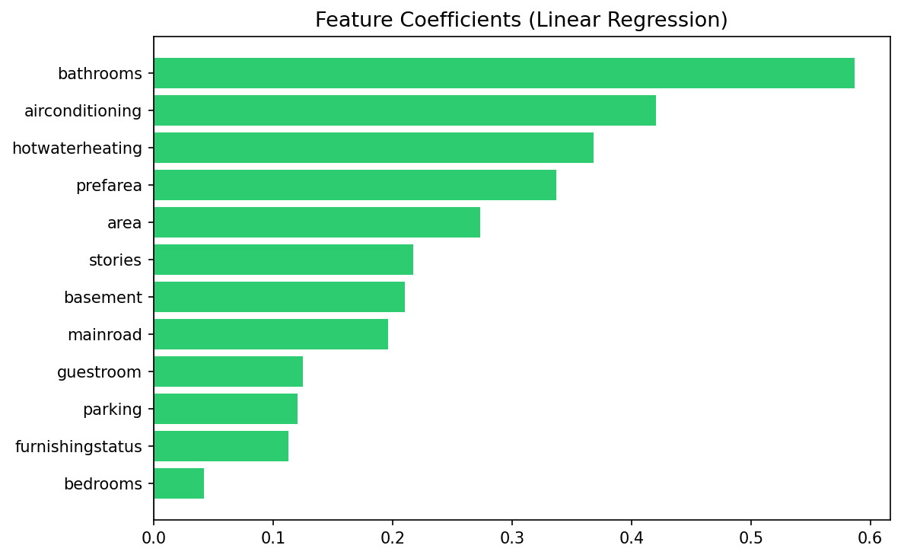
Feature Importance
All 12 features carry positive coefficients, meaning they each contribute positively to the predicted price. Bathrooms (0.587) is the single strongest predictor, underscoring buyer preference for sanitation facilities. Air conditioning (0.420) is second, reflecting premium valuation of comfort amenities. Hot water heating (0.368) and preferred area (0.337) follow closely. Physical dimensions like area (0.274) and stories (0.217) also matter. Parking and guestroom contribute modestly. Furnishing status and bedrooms have the smallest positive coefficients, suggesting they are less decisive factors once other amenities are accounted for. No feature negatively impacts the price in this linear model.

Slide 9
Conclusion & Future Scope
The Housing Price Prediction project successfully demonstrated an end-to-end machine learning workflow — from raw data ingestion and EDA to preprocessing, model training, and evaluation. The Linear Regression model achieved an R² of 64.95%, validating that property attributes can meaningfully predict prices. Key drivers identified were bathrooms, air conditioning, hot water heating, and preferred area. The dataset's completeness (zero missing values) facilitated clean preprocessing. Future enhancements could include trying ensemble models (Random Forest, XGBoost), feature engineering (price-per-sqft), hyperparameter tuning, cross-validation, and incorporating external factors like neighborhood crime rates or school ratings to push model accuracy beyond 80%.
Top Predictor
Clean Data
Bathrooms
0 Missing Values

