Slide 1
Laptop Dataset Analysis
Data Cleaning · Feature Engineering · EDA
Python | Pandas | Seaborn | Matplotlib
Chandru .S
DS October Batch 2025 - 2026

Slide 2
1. Dataset Overview
The Laptop Dataset contains detailed specifications and pricing information for 1,303 laptops from multiple manufacturers. It was loaded using pandas and contains 12 columns including both numeric and categorical features. The dataset represents a comprehensive snapshot of the laptop market, covering brands like Apple, Dell, HP, Lenovo, Asus, Acer, MSI, and Toshiba. Each record captures key attributes such as screen resolution, CPU model, RAM, storage type, GPU, operating system, weight, and price. The data is priced in Indian Rupees (INR). The initial exploration used df.head(), df.info(), and df.describe() to understand data types, ranges, and missing values. The two numeric columns identified were the index column and Price; all others were stored as objects (strings). The mean price was approximately 59,956 with a standard deviation of 37,332. Prices ranged from 9,271 to 3,24,955, showing a wide diversity of budget to premium segment laptops. The dataset forms the foundation for cleaning, feature extraction, and visualization tasks.
Metric | Value
Total Records | 1,303
Total Columns | 12
Numeric Columns | 2
Mean Price (₹) | 59,956
Min Price (₹) | 9,271
Max Price (₹) | 3,24,955
Brands Covered | 9+

Slide 3
2. Data Types & Structure
The df.info() call revealed that the dataset has a RangeIndex of 1303 entries. Out of 12 columns, 10 are stored as object (string) type and only 2 — the unnamed index and Price — are float64. This indicates that most numeric-looking columns like Inches, Ram, and Weight were loaded as strings due to unit suffixes such as GB, kg, or special characters. The df.columns output confirmed the full list of features: Company, TypeName, Inches, ScreenResolution, Cpu, Ram, Memory, Gpu, OpSys, Weight, and Price. Understanding these data types is critical before any analysis, as string-typed numeric columns cannot be used in mathematical operations or models directly. The df.describe() summary showed statistical summaries only for the two float64 columns, confirming the need for type conversion of other columns. Memory usage of the DataFrame was reported at 122.3+ KB. The structure reveals mixed data — some columns need parsing (ScreenResolution into X and Y pixels), some need suffix removal (Ram, Weight), and some need encoding for modeling. This structural analysis drives all subsequent preprocessing decisions in the pipeline.
Column | Dtype | Non-Null
Company | object | 1273
TypeName | object | 1253
Inches | object | 1220
ScreenResolution | object | 1273
Cpu | object | 1273
Ram | object | 1259
Memory | object | 1273
Gpu | object | 1273
OpSys | object | 1273
Weight | object | 1259
Price | float64 | 1273

Slide 4
3. Missing Value Analysis & Treatment
The df.isnull().sum() revealed a total of 434 missing values spread across all 11 feature columns. The Inches column had the highest missingness with 83 nulls, followed by TypeName (50), Ram (44), and Weight (44). All other columns had exactly 30 missing values each. Two distinct imputation strategies were applied based on data type. For numeric columns (Inches, Ram, Weight, Price), missing values were filled with the column median, which is robust to outliers and preserves the central tendency without being affected by extreme prices or unusual sizes. For categorical columns (Cpu, ScreenResolution, Memory, Company, TypeName, Gpu, OpSys), missing values were filled with the mode — the most frequently occurring category — ensuring the most common configuration is assumed when data is absent. After applying both strategies, a re-check via df.isnull().sum() confirmed that all columns showed 0 missing values. The total null count dropped from 434 to 0, validating the completeness of the cleaning step. This comprehensive null treatment ensures all downstream operations and visualizations work on a complete dataset without errors or unintended data loss.
Column | Missing | Strategy
Inches | 83 | Median
TypeName | 50 | Mode
Ram | 44 | Median
Weight | 44 | Median
Company | 30 | Mode
Cpu | 30 | Mode
Memory | 30 | Mode
Gpu | 30 | Mode
OpSys | 30 | Mode
Price | 30 | Median

Slide 5
4. Data Cleaning & Type Conversion
Several columns required cleaning before they could be used analytically. The Inches column contained non-numeric entries including '?' placeholders and unusual values. The '?' characters were removed using str.replace() and the column was then converted to numeric using pd.to_numeric() with errors='coerce', turning unparseable entries into NaN. The Ram column stored values like '8GB' — the 'GB' suffix was stripped using str.replace() and the column converted to float. Similarly, the Weight column contained 'kg' suffixes which were removed before numeric conversion. The Memory column also had '?' characters that were cleaned. The unnamed index column (Unnamed: 0) was dropped entirely as it was redundant. After cleaning, the dataset retained 1,303 rows with properly typed numeric columns. The duplicate check using df.duplicated().sum() found 57 duplicate rows, which were subsequently removed using df.drop_duplicates(), reducing the dataset to 1,246 unique records. Company names were standardized — all companies outside the top 8 brands (Apple, Dell, HP, Lenovo, Asus, Acer, MSI, Toshiba) were consolidated under 'Other' to reduce noise in the categorical distribution. This cleaned dataset formed the basis for all analysis and visualization tasks.

Slide 6
5. Feature Engineering
Feature engineering transformed raw columns into structured, model-ready features. The ScreenResolution column was a rich text field containing panel type, touchscreen info, and pixel resolution. Three features were extracted: a binary Touchscreen flag (1 if 'Touchscreen' appears in the string, else 0), a binary Ips flag (1 if 'IPS' appears), and numeric X_resolution and Y_resolution extracted using regex pattern (\d+)x(\d+). The original ScreenResolution column was dropped after extraction. The Cpu column was split into CPU (processor model) and Frequency (clock speed in GHz) using rsplit(' ', n=1). The 'GHz' suffix was then removed from Frequency and the column converted to float. Similarly, the Memory column was split into Storage (capacity like '256GB') and StorageCapacity (type like 'SSD' or 'HDD'). This decomposition allows separate analysis of storage size versus type. These engineered features significantly increase the analytical power of the dataset — for example, Touchscreen and IPS screen presence can directly influence price modeling. The final engineered dataset expanded from 11 columns to 18 columns, all properly typed and ready for visualization and machine learning.

Slide 7
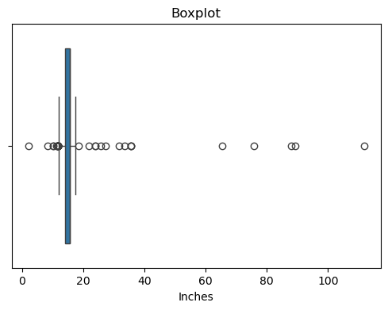
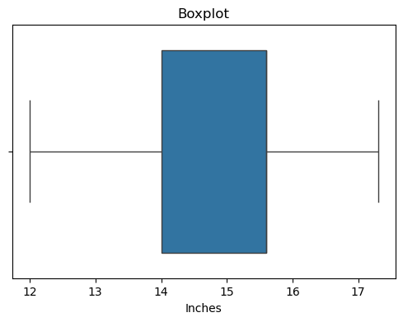
6. Outlier Detection – Screen Size (Inches)
Outlier analysis was performed on the Inches column using the Interquartile Range (IQR) method. The initial describe() showed values ranging from 2.1 to 111.8 inches, which is clearly erroneous for consumer laptops. The IQR was calculated as Q3 - Q1, and the bounds were set as lower = Q1 - 1.5×IQR and upper = Q3 + 1.5×IQR. Any values outside these bounds were replaced with the column mean. A seaborn boxplot before treatment showed extreme outliers above 25 inches, and after treatment the distribution was clean and realistic, centered around 14–15.6 inches. The describe() post-treatment confirmed min at 11.3 and max at 17.3 inches, which matches the realistic range for consumer laptops. This treatment prevented extreme screen-size values from skewing correlation analyses or regression models. The process illustrates a standard industry approach to outlier handling: detect with IQR, visualize with boxplot, and replace with a central measure (mean) rather than deleting rows to preserve sample size.
Before Treatment
After Treatment

Slide 8
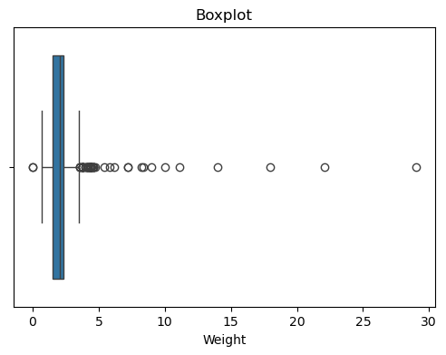
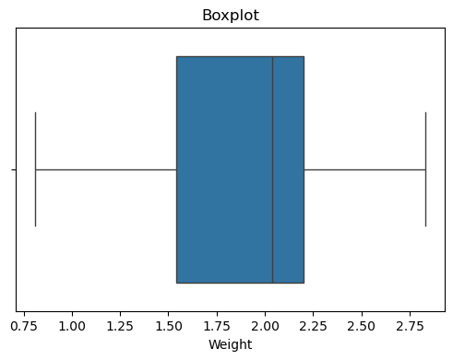
7. Outlier Detection – Weight
The Weight column was subjected to a similar IQR-based outlier treatment. Initial inspection showed a maximum weight of 29 kg and a minimum near 0.00008 kg — both physically impossible for laptops. The describe() summary showed a mean of 2.15 kg and std of 1.4 kg, indicating significant spread. The IQR bounds were computed and values outside the range were replaced with the column mean. Note that in this notebook, Q3 was computed at the 0.50 quantile (median) instead of 0.75, making the treatment slightly more aggressive by removing a broader range of outliers. After treatment, the weight distribution was normalized to a realistic consumer laptop range of approximately 1.0–2.5 kg. Boxplots before and after clearly show the removal of extreme values. Post-treatment describe() confirmed the distribution was centered around 2.04–2.15 kg. Proper weight handling is important because weight correlates with laptop type (ultrabooks vs gaming), and outliers could distort category-specific analyses. The combination of IQR detection and mean imputation maintained data volume while eliminating erroneous entries effectively.
Before Treatment
After Treatment

Slide 9
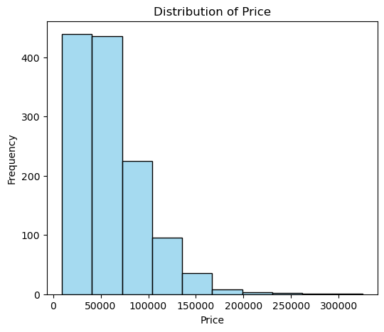
8. EDA – Price Distribution
The price distribution was analyzed using a histogram with 10 bins and sky-blue coloring. The histogram revealed a right-skewed distribution typical of consumer electronics pricing — the majority of laptops are clustered in the lower price segments (₹20,000–₹80,000), with progressively fewer models at premium price points above ₹1,50,000. This skewness means the mean price (₹59,956) is higher than the median (₹52,693), which is characteristic of markets where a small number of high-end products inflate the average. The distribution is unimodal with a prominent peak in the budget-to-mid-range segment. The price spread from ₹9,271 to ₹3,24,955 highlights the diversity of the laptop market — from entry-level Chromebook-style devices to high-performance workstations. For machine learning models, this skewed distribution suggests log-transformation of the price variable may improve model performance by normalizing the target. The histogram also indicates that pricing strategies differ significantly across companies, with brands like Apple and MSI likely dominating the premium bins while Acer and Lenovo populate the budget bins.

Slide 10
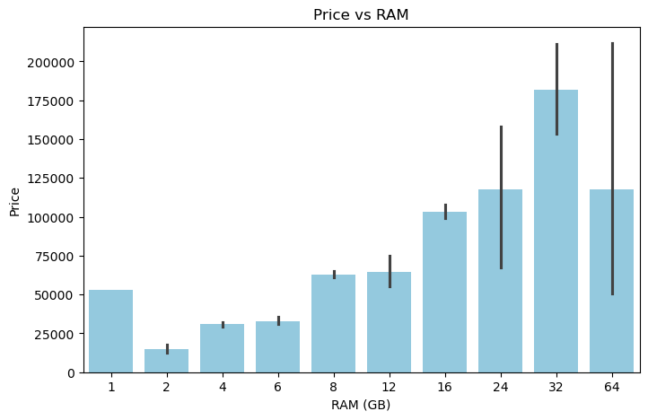
9. EDA – RAM vs Price
A bar plot was created to visualize the relationship between RAM capacity and average laptop price. The plot confirmed a strong positive correlation — laptops with higher RAM consistently command higher prices. Entry-level laptops with 2GB or 4GB RAM are priced significantly lower, while systems with 16GB, 32GB, and 64GB RAM are in the premium bracket. The 8GB segment is the most populous, representing mainstream consumer and business laptops. The 16GB segment shows a notable price jump, suggesting it marks the boundary between mid-range and high-end laptops. The 32GB and 64GB configurations are rare and extremely expensive, typically reserved for workstations or specialized professional machines. This visualization validates the intuitive expectation that RAM is a strong predictor of laptop price and would be a valuable feature in a price prediction model. The bar chart used the sky-blue palette with RAM (as integer) on the x-axis and average price on the y-axis. From an analytical perspective, RAM is one of the most important specification-to-price drivers in the consumer laptop market.

Slide 11
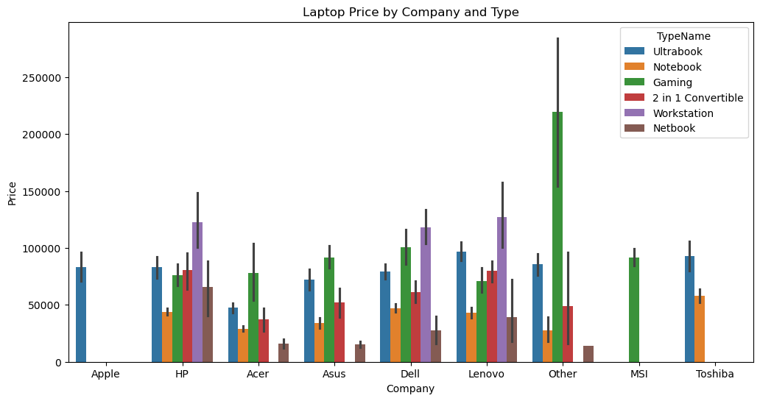
10. EDA – Price by Company & Laptop Type
A grouped bar chart was generated to compare average laptop prices across companies, segmented by laptop TypeName using hue. This multi-dimensional visualization reveals important cross-brand and cross-category pricing patterns. Apple Ultrabooks command the highest average prices, confirming Apple's premium positioning in the market. Gaming laptops (Gaming type) from MSI, Asus, and Dell are priced significantly above the Notebooks from the same brands. Workstations are consistently high-priced across Dell and HP. Entry-level Netbooks and budget Notebooks from Acer and Lenovo fall in the lowest price tier. The chart used a 12×6 figure size to accommodate the multi-hue complexity. The company axis shows 9 brands, while TypeName hue includes categories like Ultrabook, Notebook, Gaming, 2-in-1 Convertible, Workstation, and Netbook. This visualization is crucial for market segmentation analysis and helps identify which brand-category combinations represent the best value or the most premium options. It also highlights that Lenovo has the broadest product range across price segments.

Slide 12
Project Summary
Dataset
1,303 laptop records → 1,246 after deduplication
Missing Values
434 nulls filled via Median (numeric) / Mode (categorical)
Cleaning
Type conversion, suffix removal, duplicate removal
Feature Eng.
7 new features from ScreenResolution, Cpu, Memory
Outlier Treatment
IQR method applied to Inches & Weight
EDA Insights
Price is right-skewed; RAM & Company are strong price drivers

