Slide 1
FLIPKART PRODUCT ANALYTICS
End-to-End Data Science & MLOps Pipeline
Web Scraping
EDA
MySQL Analysis
Machine Learning
MLOps Pipeline
Automotive Parts: Tyres • Brake • Clutch • Oil
420 Products | 5 Categories | Full Pipeline
CHANDRU.S
DS OCTOBER BATCH 2025 - 2026

Slide 2
1. Web Scraping — Flipkart Product Data
Objective:
Automated collection of product data from Flipkart for four automotive categories using Python-based web scraping.
Tools & Libraries:
Selenium WebDriver with ChromeDriver for dynamic page rendering. BeautifulSoup4 for HTML parsing. Pandas for data storage and export.
Scraping Process:
Each category (Tyres, Brake, Clutch, Oil) was scraped across 5 pages, yielding 200 products per category — 800 total records.
Data Captured:
Product Name, Category, Price (₹), Rating (1–5), Reviews Text, and No. of Reviews were extracted per item.
Output Files:
flipkart_tyres.csv, flipkart_brake.csv, flipkart_clutch.csv, flipkart_oil.csv → merged into flipkart_all_products.csv.

Slide 3
Web Scraping — Sample Output & Results
Product Name | Category | Price | Rating | Reviews
JK Taximax 4 Wheeler Tyre | Tyres | ₹3,099 | 4.3 | 340
MOTUL 4100 Ecomile SAE 5W-30 | Oil | ₹419 | 4.2 | 851
TRP Traders Rear Disc Pad | Brake | ₹160 | 4.2 | 237
jiyamobility Super Splendor Clutch | Clutch | ₹275 | 3.9 | 183
TVS Eurogrip ATT 2.75-18 Tyre | Tyres | ₹884 | 4.5 | 512
Category Totals After Scraping:
Category | Products | Files
Tyres | 200 | flipkart_tyres.csv
Brake | 200 | flipkart_brake.csv
Clutch | 200 | flipkart_clutch.csv
Oil | 200 | flipkart_oil.csv

Slide 4
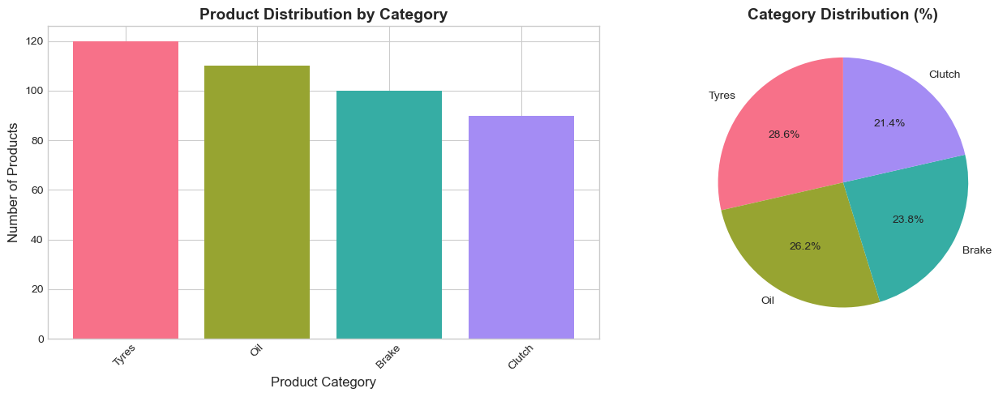
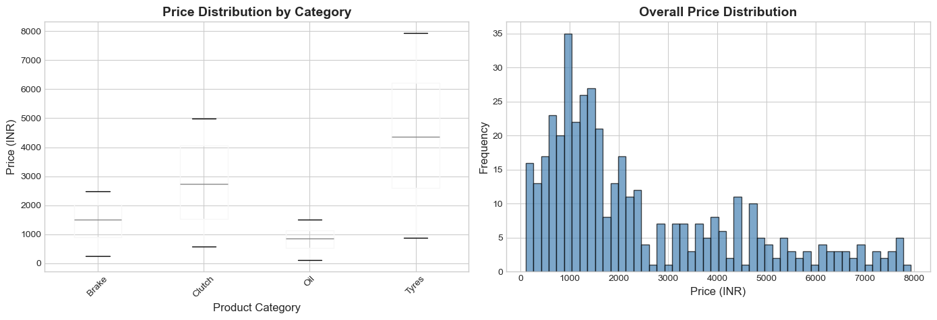
2. Exploratory Data Analysis (EDA)
Dataset Overview:
420 automotive products across 4 categories (Tyres: 120, Oil: 110, Brake: 100, Clutch: 90). Columns: Product Name, Category, Price (₹), Rating, Reviews.
Data Cleaning Steps:
Removed Reviews_Text column. Cleaned Price (removed ₹ symbol, commas). Converted Rating to float, filled missing with 0. Renamed columns for clarity.
Key Statistics:
Mean Price ₹2,401 (std ₹1,966). Mean Rating 3.97. Mean Reviews 424. Price range: ₹107–₹7,932.
Visualizations Produced:
Category distribution bar/pie charts, price box plots per category, rating histograms, review counts by category, correlation heatmap, scatter plots.

Slide 5
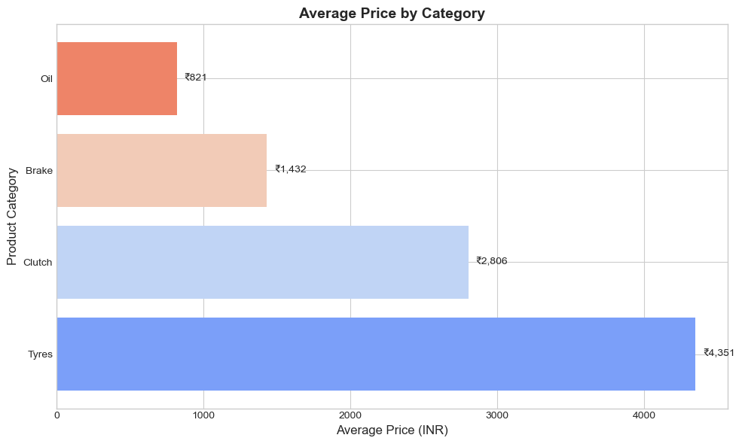
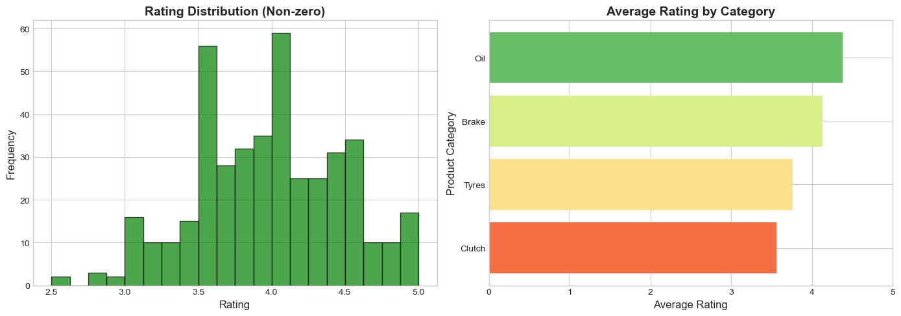
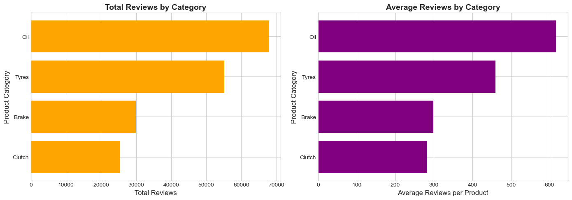
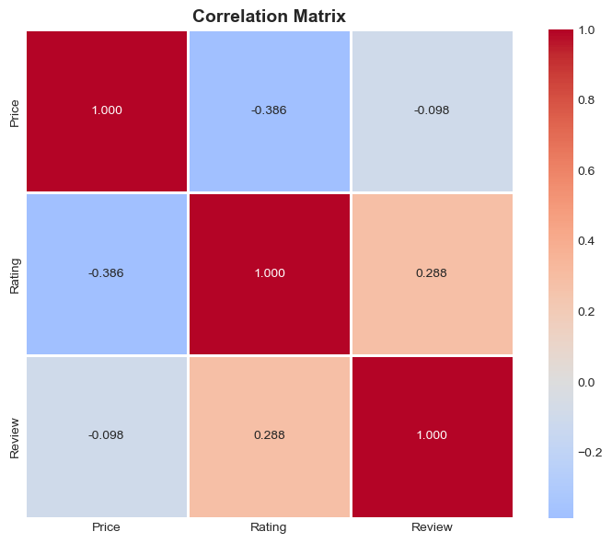
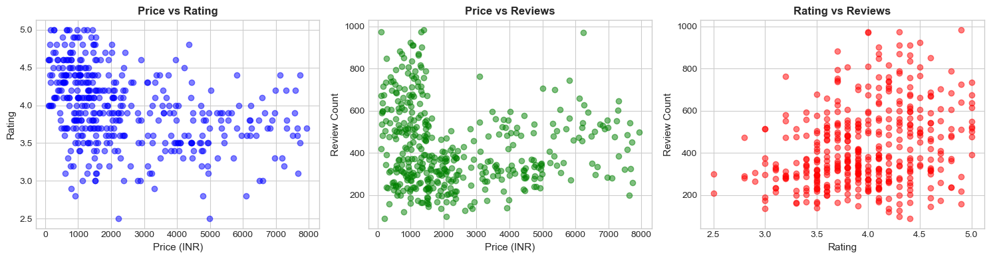
EDA — Price, Rating & Review Analysis

Slide 6
3. MySQL / Data Analysis with Pandas SQL
Purpose:
Structured data analysis using SQL-like operations via Pandas groupby, aggregation, and filtering on the 420-product automotive dataset.
Dataset Used:
420 records with 5 columns: Product Name, Product Category, Price (float), Rating (float), Review (int). Zero missing values.
Key Queries Performed:
Products grouped by category (COUNT). Price stats per category (AVG, MIN, MAX). Rating and review aggregation. Top 10 most reviewed products.
Insights Discovered:
Tyres has the highest average price (₹4,235). Oil has the highest average rating (4.32) and most total reviews (69,009). Brake products have lowest avg price.
Output:
Clean CSV exported as flipkart_cleaned_data.csv with 420 rows and 4 categories for downstream use.
Category | Avg Price | Avg Rating | Total Reviews
Tyres | ₹4,235 | 3.82 | 54,720
Clutch | ₹2,760 | 3.93 | 25,317
Brake | ₹1,423 | 4.08 | 30,634
Oil | ₹1,155 | 4.32 | 69,009
Top 3 Most Reviewed Products:
Product | Price | Rating | Reviews
Oil Item 77 | ₹985 | 4.7 | 1,032
Oil Item 63 | ₹1,321 | 4.2 | 975
Oil Item 44 | ₹929 | 4.0 | 973

Slide 7
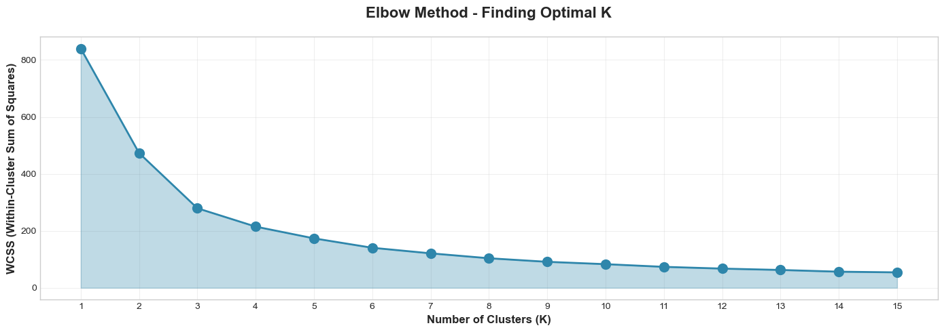
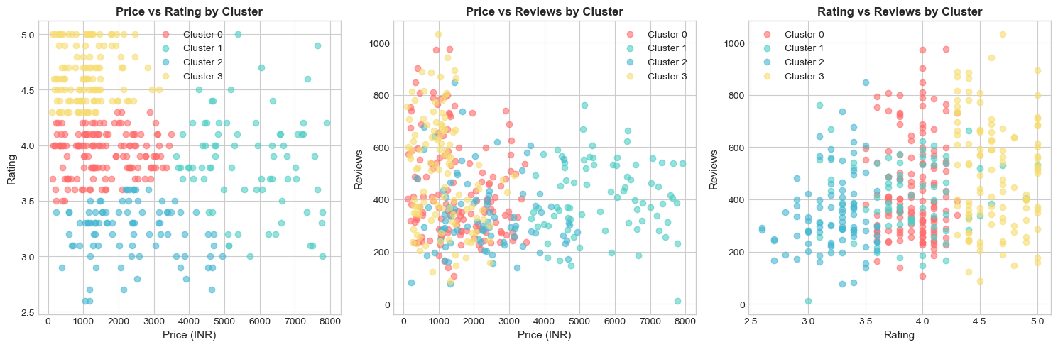
4. Machine Learning — Clustering & Classification
Part A — K-Means Clustering (Unsupervised):
Grouped products by Price and Rating using K-Means (k=4). Elbow Method identified optimal k. Clusters reveal natural product tiers.
Cluster Results:
Cluster 0: Mid-range (₹1,569 avg). Cluster 1: Premium (₹5,683 avg). Cluster 2: Low-rated budget (₹2,312 avg). Cluster 3: Economy high-rated (₹1,111 avg).
Part B — Classification (Supervised):
5 models trained: Logistic Regression, Decision Tree, Random Forest, Gradient Boosting, SVM. Train/Test split 80/20 with stratification.
Best Model — Logistic Regression:
Accuracy 77.38%. Oil category had 95% precision. Feature Importance: Price (42.3%), Reviews (39.2%), Rating (18.5%).

Slide 8
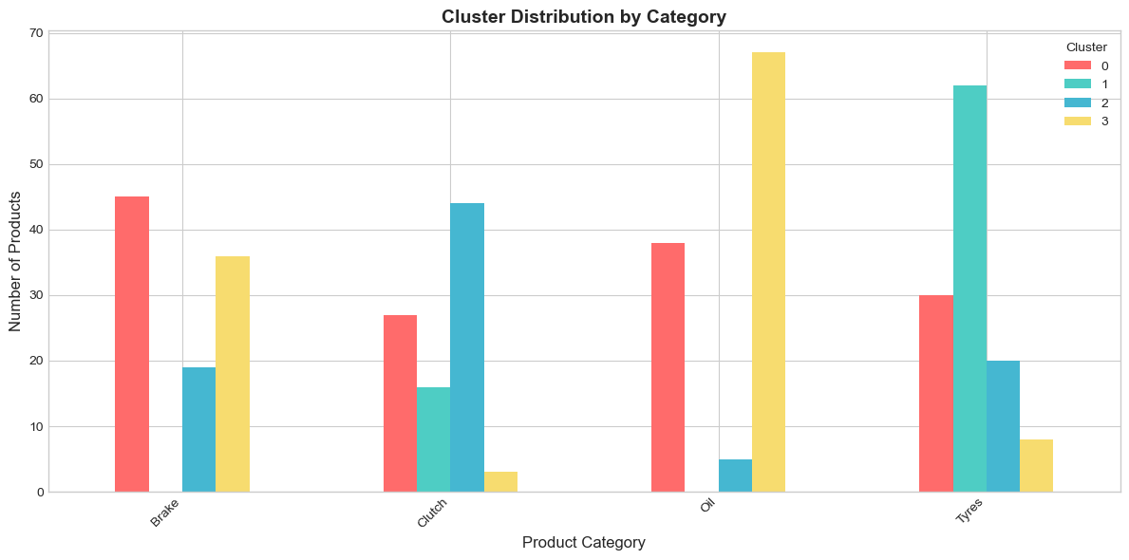
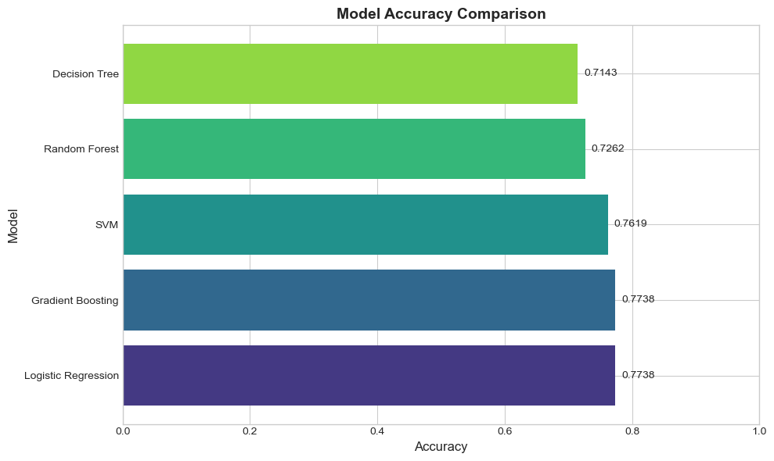
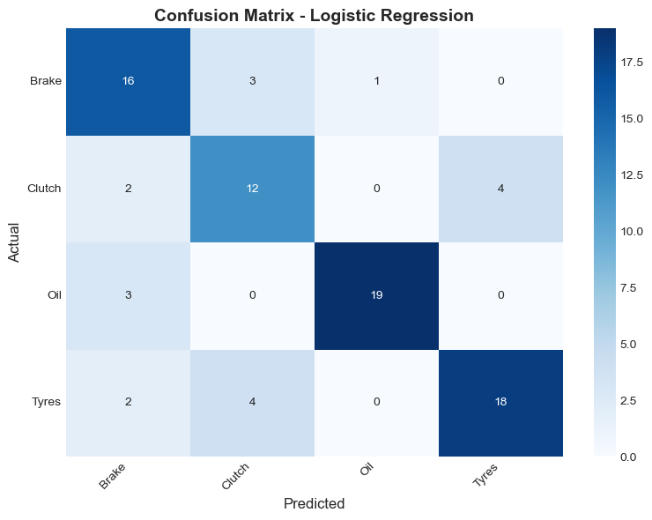
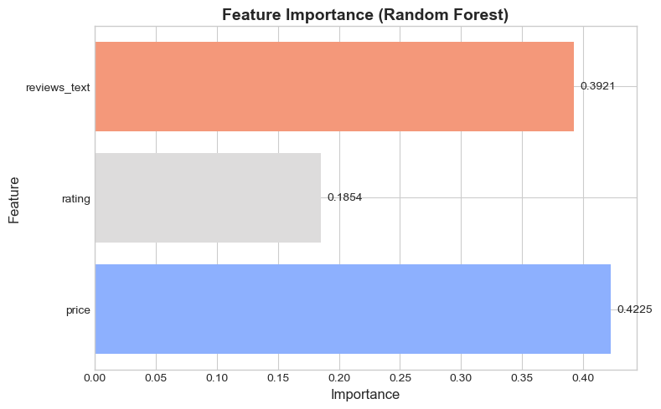
ML — Model Comparison & Results

Slide 9
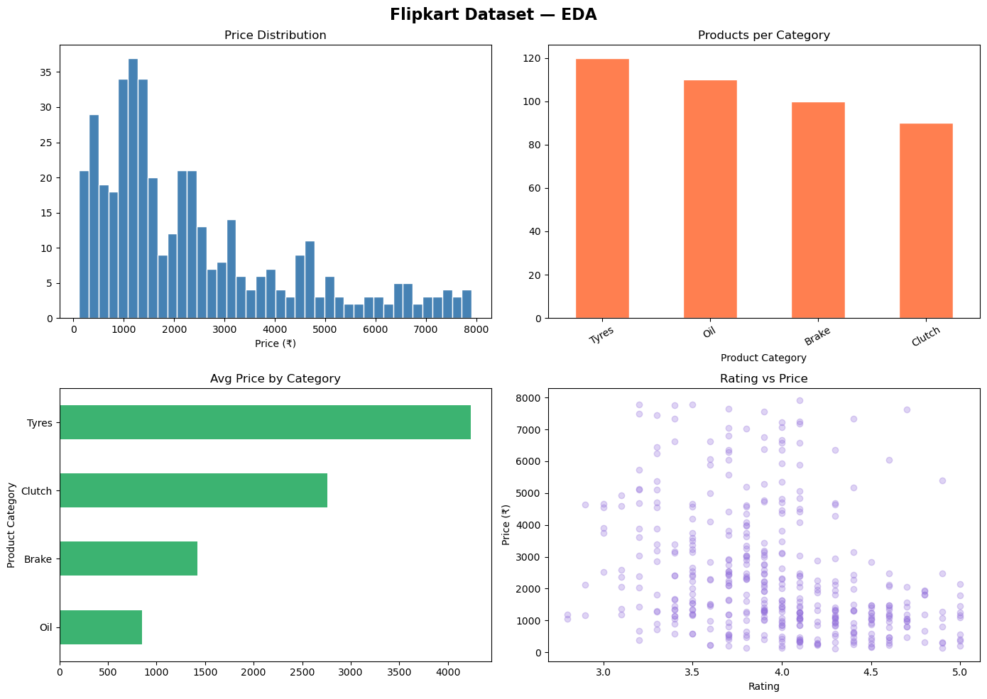
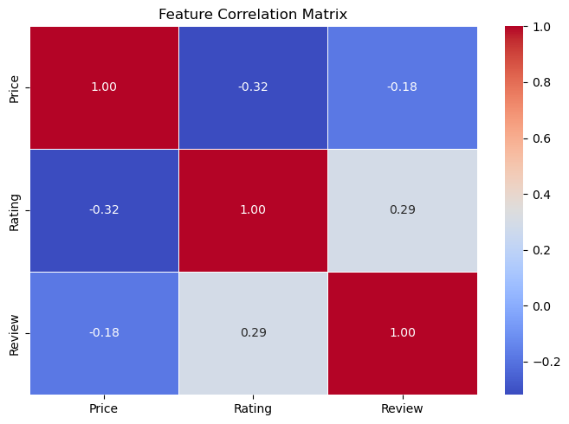
5. MLOps — End-to-End ML Pipeline
Pipeline Overview:
Production-grade ML workflow: Data ingestion → validation → EDA → feature engineering → model training → registry → prediction pipeline → drift monitoring.
Feature Engineering (7 features):
Rating, Review, Category_Encoded, Log_Price, Review_Bucket, Has_Rating, Name_Length, Price_per_Review.
Models Evaluated:
Linear/Ridge/Lasso Regression, Decision Tree, Random Forest, Gradient Boosting — all tracked with MAE, RMSE, R², and 5-fold CV R².
Best Model — Gradient Boosting:
R² = 0.9895, MAE = ₹168.57, RMSE = ₹324.82. Model serialized with pickle and registered in model_registry.json.
Data Drift Detection:
KS-test applied on incoming data. Rating feature showed drift (p=0.017). Monitoring integrated into pipeline for production readiness.

Slide 10
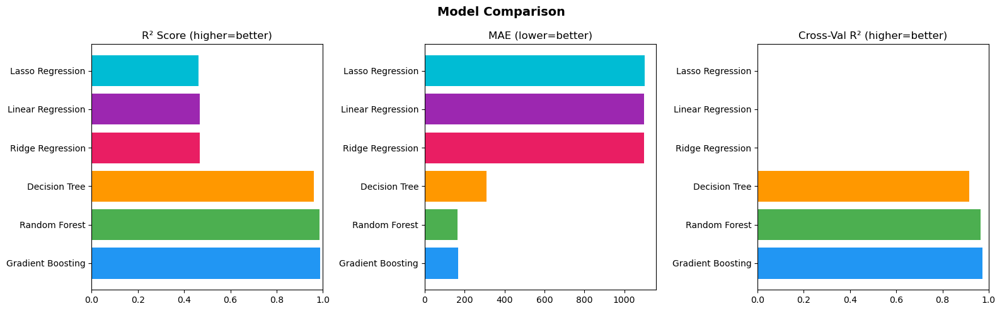
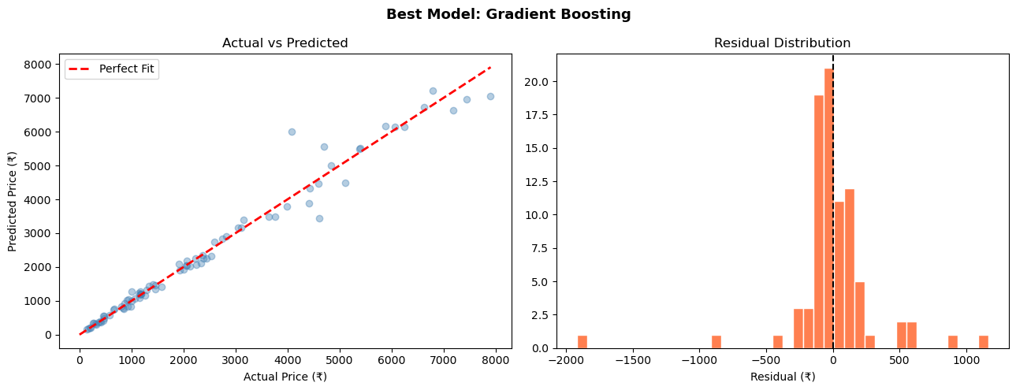
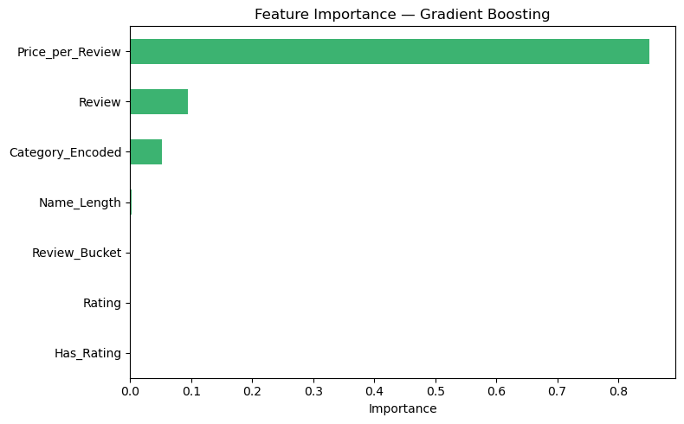
MLOps — Model Performance & Feature Importance
Model Leaderboard:
Model | R² | MAE
Gradient Boosting | 0.9895 | ₹169
Random Forest | 0.9866 | ₹165
Decision Tree | 0.9609 | ₹311
Ridge Regression | 0.4683 | ₹1,098

Slide 11
Project Summary & Key Takeaways
Web Scraping
800 products scraped from Flipkart using Selenium + BeautifulSoup across 5 pages per category
EDA
420-product cleaned dataset; price range ₹107–₹7,932; Oil has highest ratings & reviews
MySQL Analysis
SQL-style queries show Tyres are most expensive; Oil most reviewed; structured CSV exports
Machine Learning
K-Means (4 clusters) + 5 classifiers; Logistic Regression best at 77.38% accuracy
MLOps Pipeline
Gradient Boosting R²=0.9895; full model registry + prediction pipeline + drift monitoring

