Slide 1

SQL
Monika Książkiewicz
E-mail: ksiazkiewiczmonika@gmail.com

Slide 2
The simulations presented in the presentation are intended to demonstrate skills The presentation contain simulations on a sample databese and solutions of SQL HackerRank challenges using MS SQL Server

Slide 3
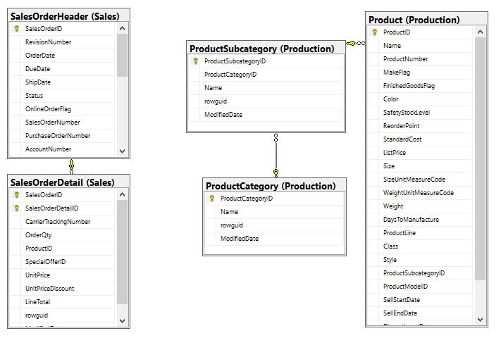
Tables from AdventureWorks2017 database used to the presentaton

Slide 4

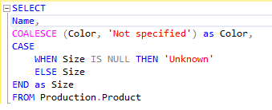
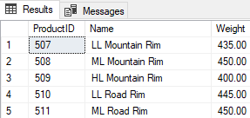
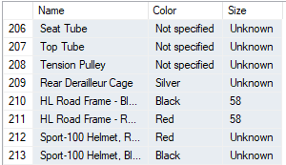
Show products whose weight is known
Remove nulls from product data

Slide 5




Update the StandardCost of products in the 'Road Bikes' product subcategory. Increase the StandardCost by 15% for all products in this subcategory.
BEFORE UPDATE
AFTER UPDATE

Slide 6
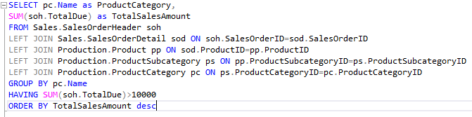
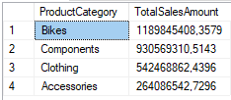
List the total sales amount for each product category where the total sales amount is greater than $10,000. Include the product category name and the total sales amount in your result.

Slide 7
HackerRank Challenges

Slide 8
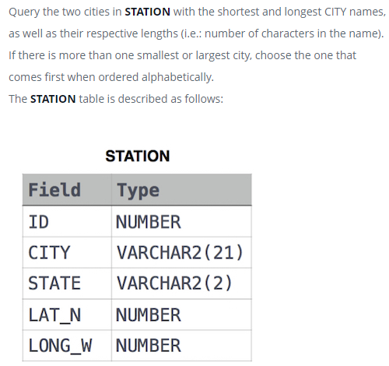

Problem
Solution
SELECT TOP 1 city, LEN(CITY) FROM STATION ORDER BY LEN(CITY) asc, city;
SELECT TOP 1 city, LEN(CITY) FROM STATION ORDER BY LEN(CITY) desc, city;

Slide 9
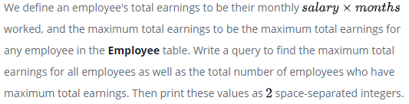
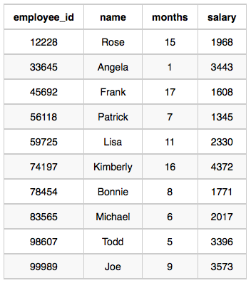

SELECT TOP 1 (SALARY * MONTHS), COUNT (*) FROM EMPLOYEE GROUP BY (SALARY * MONTHS) ORDER BY (SALARY * MONTHS) DESC;

Slide 10
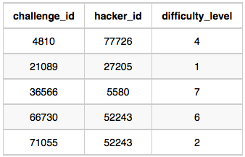
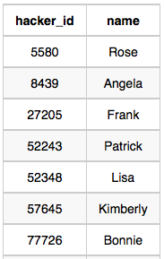
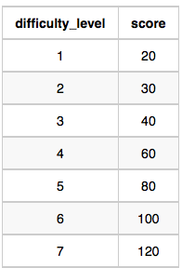
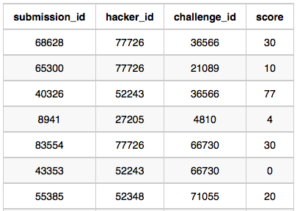
Write a query to print the respective hacker_id and name of hackers who achieved full scores for more than one challenge. Order your output in descending order by the total number of challenges in which the hacker earned a full score. If more than one hacker received full scores in same number of challenges, then sort them by ascending hacker_id.
Challenges Table:
Hackers Table:
Difficulty Table:
Submissions table:

Slide 11
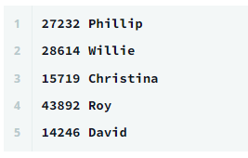
SELECT h.hacker_id, h.name FROM hackers h JOIN submissions s ON h.hacker_id=s.hacker_id JOIN challenges c ON s.challenge_id=c.challenge_id JOIN difficulty d ON c.difficulty_level=d.difficulty_level WHERE s.score=d.score GROUP BY h.hacker_id, h.name HAVING COUNT(s.hacker_id)>1 ORDER BY COUNT(s.hacker_id) desc, h.hacker_id

