Slide 1
SQL CAPSTONE PROJECT
Presented By:
Manish Kumar Singh
S7616

Slide 2
CONTENTS
Introduction
Tools Used
Required Analysis
Data Wrangling
Feature Engineering
Product Analysis
Sales Analysis
Customer Analysis
Recommendation

Slide 3
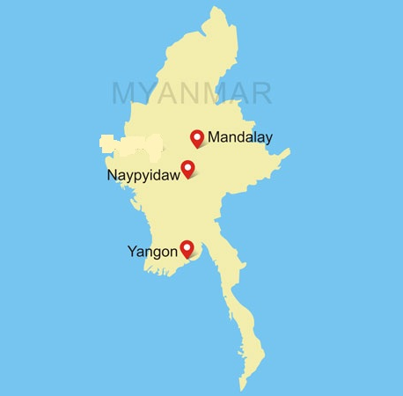
INTRODUCTION
In this project, we shall analyze the sales performance in the months of January, February and March of three stores branches A, B and C situated in cities Yangon, Mandalay and Naypyidaw respectively in Myanmar. We will use Amazon Sales dataset for this analysis. This dataset consists of 17 columns and 1000 rows.

Slide 4
TOOLS USED
MySQL Workbench
Microsoft Word

Slide 5
Analysis required
This sales data required analysis on three major domains:
Product Analysis: This analysis is to understand different product lines, their performances and required improvement
Sales Analysis: This analysis examines the sales trends of product lines. It helps in developing effective strategy to increase revenue.
Customer Analysis: This analysis covers different customer segments, purchase and rating trends

Slide 6
DATA WRANGLING
Steps followed:
Create a table in MySQL Workbench
Import the CSV file into the table
Check for any NULL values if any present in the dataset.

Slide 7
Feature Engineering
In this step we have altered the table and added three new columns as follows:
timeofday: to give insights of sales during Morning, Afternoon and Evening.
Dayname: to determine the busiest day of the week for each branch.
Monthname: to determine which month of the year generates the highest profit and sales.

Slide 8
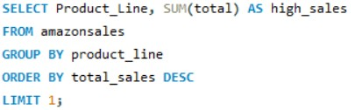

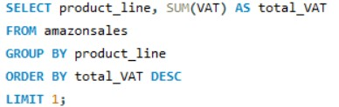

PRODUCT ANALYSIS
There are 6 distinct product lines namely Health and Beauty, Electronic Accessories, Home and Lifestyles, Sports and Travel, Food and Beverages and Fashion Accessories.
Food and Beverages generated the highest revenue of $56,144.844
Food and Beverages has also incurred highest VAT of $2,673.56

Slide 9
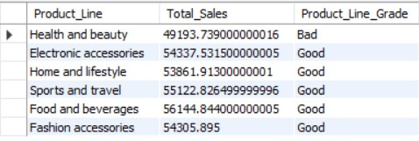
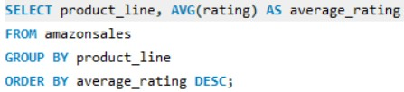
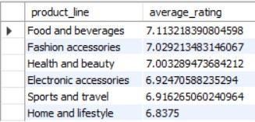
PRODUCT ANALYSIS
Health and Beauty, was the only product with below average sales figure of $49,193.739
Food and Beverages have earned the highest rating among all with an average rating of 7.1 whereas Home and Lifestyle segment has the lowest rating with average rating of 6.8.

Slide 10


SALES ANALYSIS
The most preferred payment method is E-Wallet out of three payment methods with pay count of 345
Month of January has generated highest revenue of $1,16,291.86 with February having the lowest revenue of $97,219.37 among the first three months of the year.

Slide 11
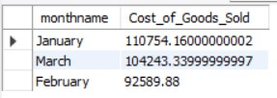
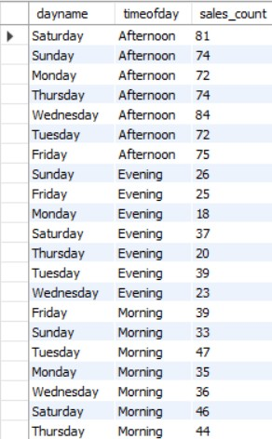

Sales analysis
Cost of Goods Sold attained its peak value of $1,10,754.16 in January
Naypyitaw has generated the highest revenue of $1,10,568 and Mandalay was the lowest with $1,06,197
Afternoon is the most preferred shopping time of the day with Sales Count of 532

Slide 12



CUSTOMER ANALYSIS
There are two distinct Customer types: Members and Normal.
Members has the highest purchase frequency and they have also contributed to the highest overall revenue of $1,64,223 and as well as highest VAT Payment of $7,820
Female customers have higher shopping count than male customers

Slide 13
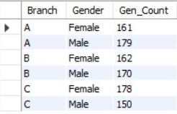
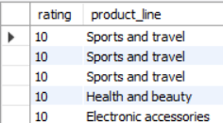
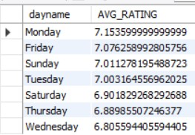
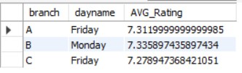
Customer analysis
Branch C has recorded highest female customers whereas Branch A has recorded highest male customers.
Customers have given their highest rating of 10 to three product lines: Sports and Travel, Health and Beauty and Electronic Accessories
Monday has recorded the highest average rating of 7.15 among all the days in the week.
Branches A and C have recorded their highest average rating on Friday whereas for Branch B it was during Monday.

Slide 14
RECOMMENDATIONS
All three branches need better advertising strategy for the Product Line Health and Beauty.
Ensure adequate inventory for the product line Food and Beverages to ensure there is no inadequacy during time of high demand.
Introspection needed about the quality of products being offered under the product line Home and Lifestyle to improve ratings.
Mandalay’s branch needs to maintain more inventory and provide offers to boost their sales performance.
Branches need to know about which product lines most preferred by customers when they shop in the evening, so that they can provide end-of-the-day offers. A customer feedback or survey can help in this regard.
Branches need to focus upon how they can bring more male customers by advertising their most preferred product line.
Stores also need to focus on the normal customer types as their revenue share is quite less as compared to the members.

Slide 15
Thank you

