Slide 1
ANALYSIS OF MAVEN MOVIES DATABASE
BY:
MANISH KUMAR SINGH
S7616

Slide 2
OBJECTIVE
To analyze rental trends, identify popular films, and assess store performance using the Maven Movies Sakila database.
1. Rental Trends:
Analyze the monthly rental trends over the available data period.
Determine the peak rental hours in a day based on rental transactions.
2. Film Popularity:
Identify the top 10 most rented films.
Determine which film categories have the highest number of rentals.
3. Store Performance:
Identify which store generates the highest rental revenue.
Determine the distribution of rentals by staff members to assess performance.

Slide 3
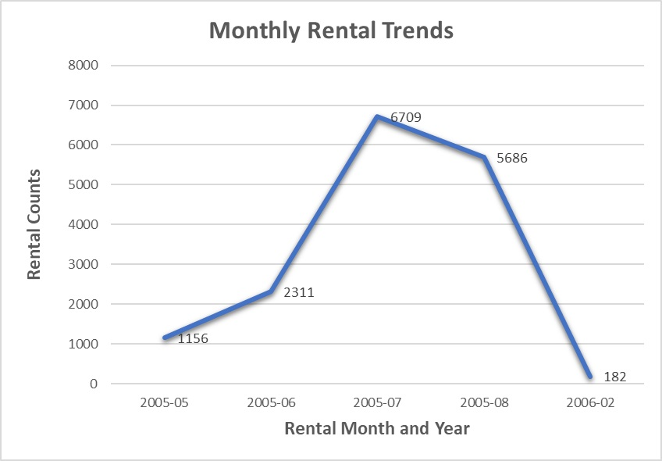
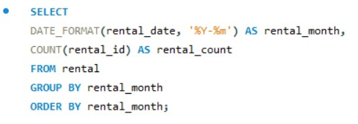
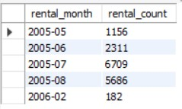
1.1 Analyzing the monthly rental trends over the available data period
SQL Query:
Output:

Slide 4
INSIGHTS
Consistent increase in the rentals between May and July 2005.
Peak Rental count of 6709 in the month of July whereas February being the lowest month with rental count of 182.
Dip in rentals can be attributed to change in people’s taste over a period of time.
RECOMMENDATIONS
1. Peak rental periods require adequate inventory and staffing management.
2. We have to be updated with changing demands of people with time.
3. Surveys and feedbacks can be done to know current taste of customers.

Slide 5
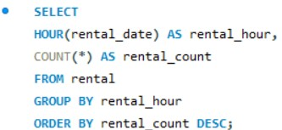
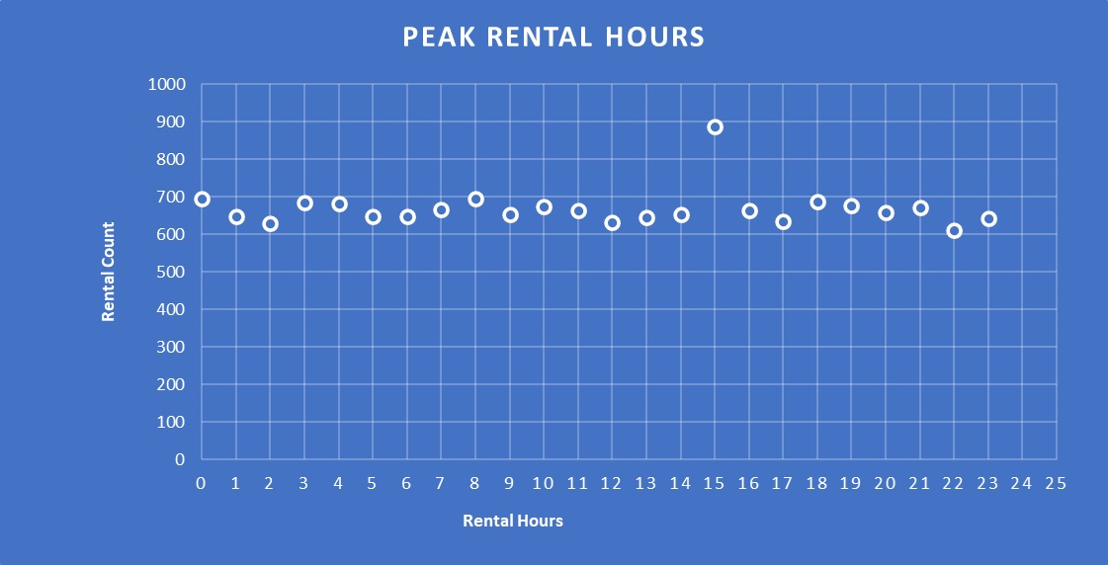
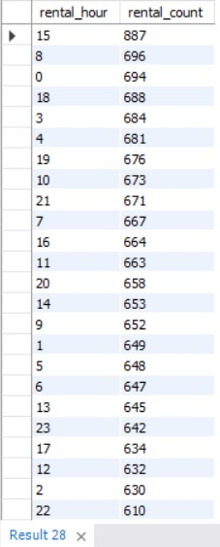
1.2 Determine the peak rental hours in a day based on rental transactions.
SQL Query:
Output:

Slide 6
INSIGHTS
RECOMMENDATIONS
Rentals peak at 3:00 pm shows highest customers activity.
Rental activity is lowest at 5 pm and 10 pm.
There is a consistent increase in renting between 5 am and 10 am
Staff need to ensure there is adequate inventory during the peak hours.
Low renting activity post 5 pm shows customers have a lack of option to chose from therefore better scheduling required during the above said time slot.
Take feedback from customers and implement what is necessary .

Slide 7
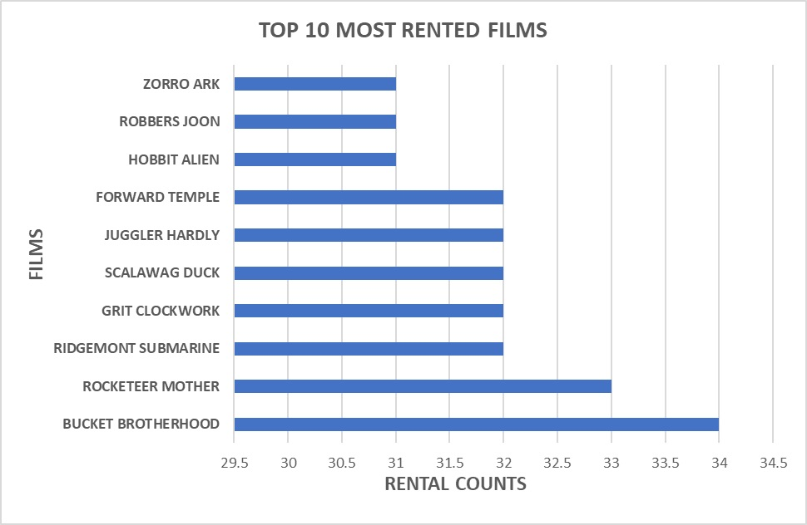
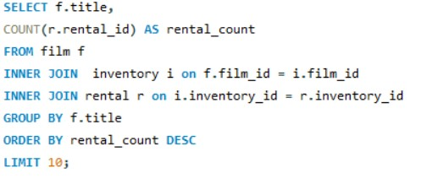
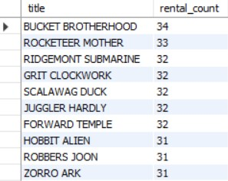
2.1 Identify the top 10 most rented films.
SQL Query:
Output:

Slide 8
INSIGHTS
RECOMMENDATIONS
Zorro Ark, Robbers Joon and Hobbit Alien are the least rented movies.
Rocketeer Mother and Bucket Brotherhood are the most rented movies.
Top rented choices show a preference for action adventure and comedy genre among customers.
Ensure sufficient inventories of top rented movies especially in action adventure genre.
Promote top ten movies in the most sought after genre through advertisement.
Devise effective marketing strategy and feedbacks.

Slide 9
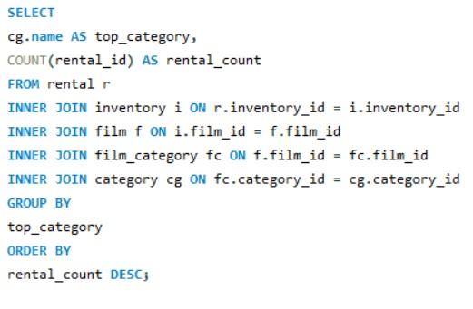
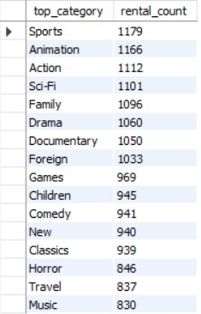
2.2 Determine which film categories have the highest number of rentals.
SQL Query:
Output:

Slide 10
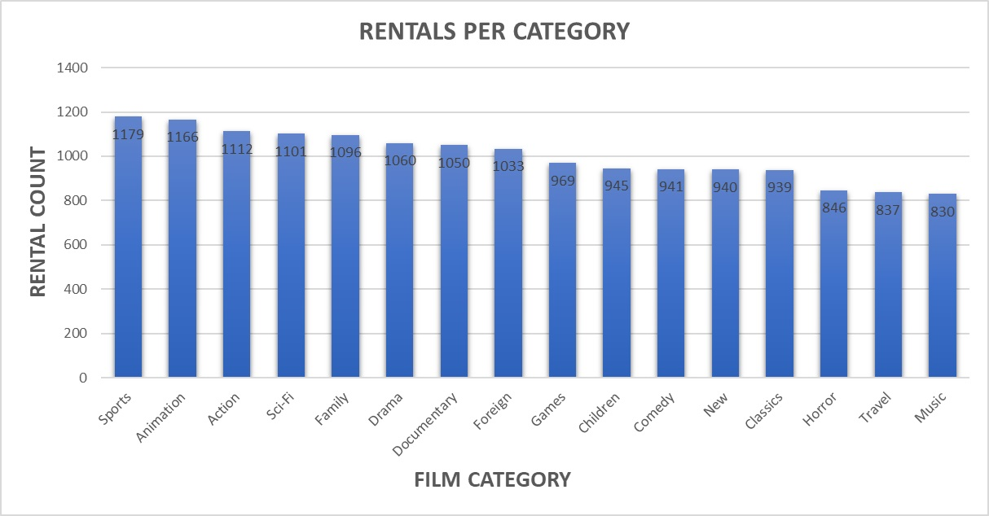
INSIGHTS | RECOMMENDATION
Sports and Animations are most rented genre which shows that most of the customers are teenagers and youth. | Increase the stocks of most sought after genre films to meet customers demand
Horror and Music are amongst the least preferred genre which shows interest of customers fading away in these movies. | Targeted marketing campaigns have to be carried out to bring customers back to lesser favoured genres.

Slide 11
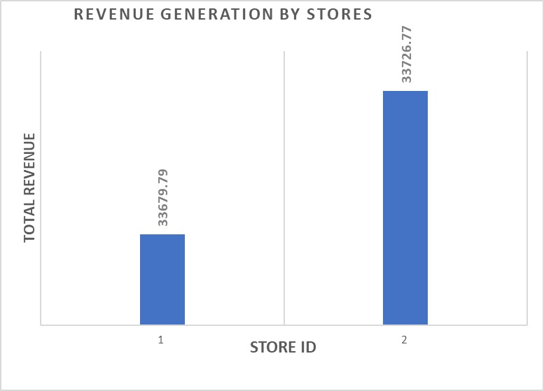
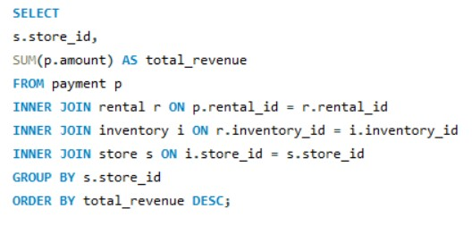

3.1 Identify which store generates the highest rental revenue.
SQL Query:
Output:

Slide 12
INSIGHTS
RECOMMENDATIONS
Total Revenue generated by Store 1 is $33679.99 and Store 2 is $33726.77 respectively.
High revenue shows better rental operation management by the staff by considering factors such as customer base size and pricing strategies
Implement marketing strategies such loyalty customer vouchers and discounts.
Implement promotional strategies based on popular films in order to obtain high rental drives.

Slide 13
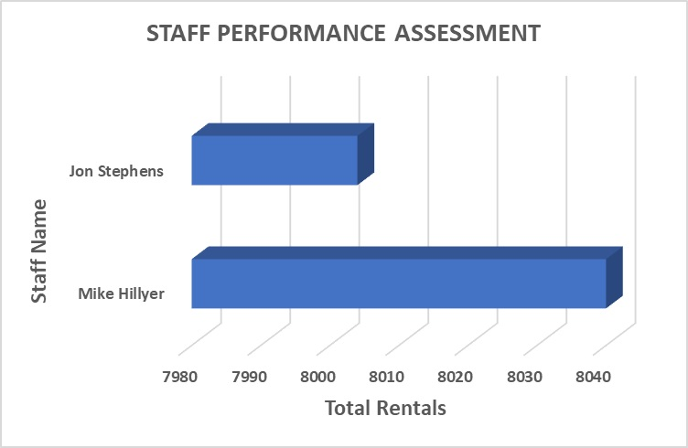
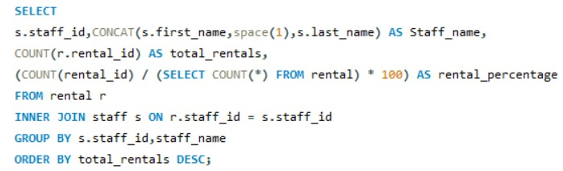

3.2 Determine the distribution of rentals by staff members to assess performance.
SQL Query:
Output:

Slide 14
INSIGHTS
RECOMMENDATIONS
Mike Hillyer has shows better rental records than Jon Stephens
Jon Stephens needs to be retrained with updated marketing strategies as well as he should be offered incentives for higher sales.

