Slide 1

Machine Learning Models for Water quality prediction
Maruthamuthu Kanagarathinam Sowmeya
Shriya Rajendra Gawade
Nikhil Sriram Budamaguntala
Besjana Muraku

Slide 2
Table of contents
Project Goal
Understanding the Data
Missing data correlation
Data Cleaning
Choosing imputation and balancing models
Prediction Models
Naïve Bayes
KNN
Decision Tree
Random Forest
ANN
Bagging Classifier
Bagging Classifier + SVM
Results

Slide 3
Project Goal
~50% of rivers and over a 1/3 lakes in U.S are contaminated
​The goal of this project is to provide actionable insight into Water Quality.
We predict quality of water is 'good' or 'poor'.

Slide 4
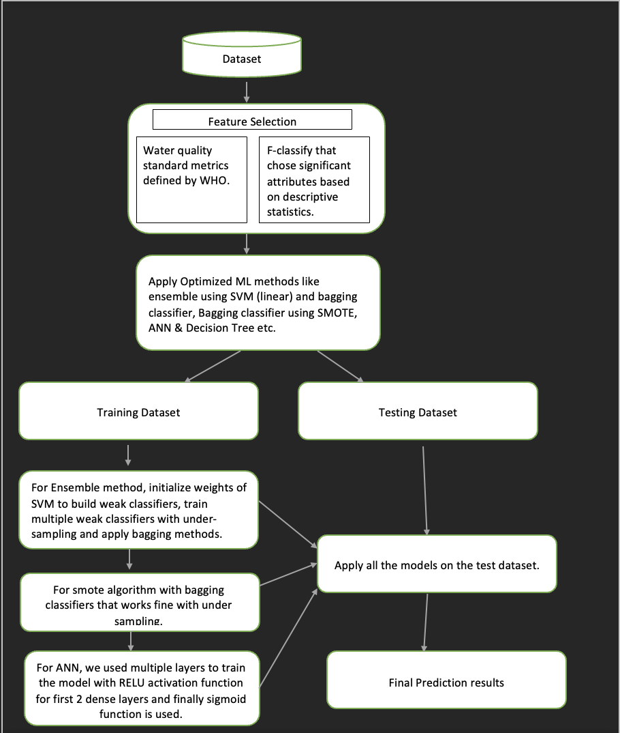
Project workflow

Slide 5
Understanding the data
Dataset Description
18148 observations with 48 variables.
Handling Missing Values
Handling outliers
Selecting Important features on basis of domain knowledge
Defining a Target Variable
Defining Train and Test set

Slide 6

Understanding the data – Important Features
‘Water Quality’ standard given by US EPA(Environmental Protection Agency)
If Dissolved Oxygen < 6 &
6.5 <= PH <= 8.0 &
Salinity < 7 &
NH3 < 0.2
Total Kjeldahl Nitrogen < 1 &
NO2 < 1 &
NO3 < 10 &
Total Nitrogen < 10 &
Total Phosphate <10 &
Bioloxd < 5 &
Alakinity < 200
Then it’s a GOOD else POOR WATER.

Slide 7
Understanding the data –Handling Missing Values
Denoising Auto Encoder
Neural network-based
Soft Impute
Matrix factorization-based
KNN Impute
imputes missing values by finding the k-nearest neighbors to the incomplete data
Method | RMSE
Denoising Auto Encoder | 2.2
Soft Impute | 0.0
KNN Impute | 0.0

Slide 8
Imbalanced Target Class Issue
SMOTE
It involves generating synthetic samples of the minority class by interpolating between similar samples. This helps to increase the number of minority class samples and balance the class distribution in the dataset
Undersampling
This method involves randomly removing samples from the majority class until the class distribution becomes more balanced.

Slide 9
Predicting models
Model | Naive Bayes | KNN | Random Forest | Decision Tree | ANN | Bagging | Bagging +SVM
Accuracy | 0.801 | 0.939 | 0.999 | 0.998 | 0.950 | 0.998 | 0.905
F1 score | 0.364 | 0.562 | 0.992 | 0.984 | 0.980 | 0.100 | 0.950

Slide 10
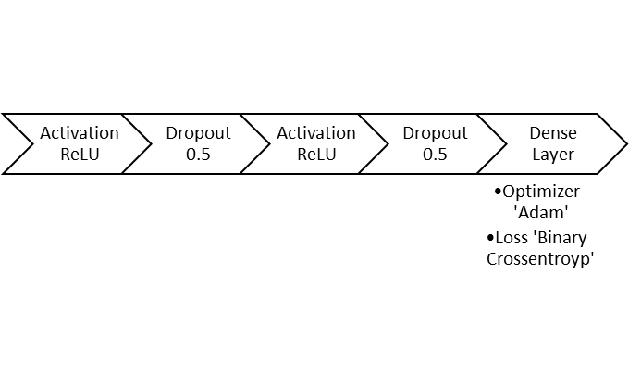
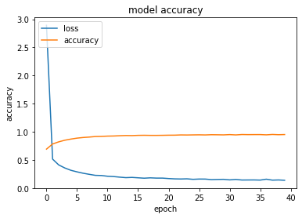
Artificial Neural Network

Slide 11
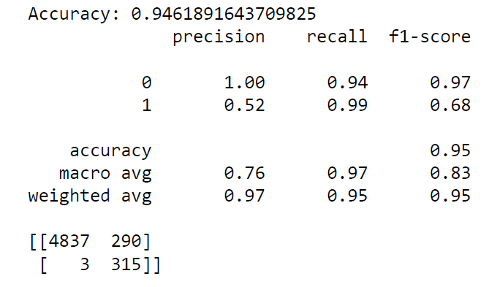
PREDICTION MODELS – Lesson Learned
Issues with: Missing Values & Imbalanced Dataset still effected the results of the Classification Models
These Models perform better on predicting if the quality of water is poor.
The evaluation results of ANN:

Slide 12
Results
Overall, We have gained an accuracy of 95% by using ANN(Artificial Neural Network). Hence, we are in good space with the pre-processing of data points as explained above to predict the quality of water using different machine learning models.
Notes:
For every additional level of education, the insurance costs would reduce by $100/yr. → offering tuition reimbursement or scholarships to higher ed would not be worth. Education costs are way higher than $100/year
Yearly physical increase annual costs by 139
Location type – rural would have $10 less dollars than urban per year, not worth pursuing
With 84% accuracy, we can say that

Slide 13
Thank you!
Questions?

