Slide 1
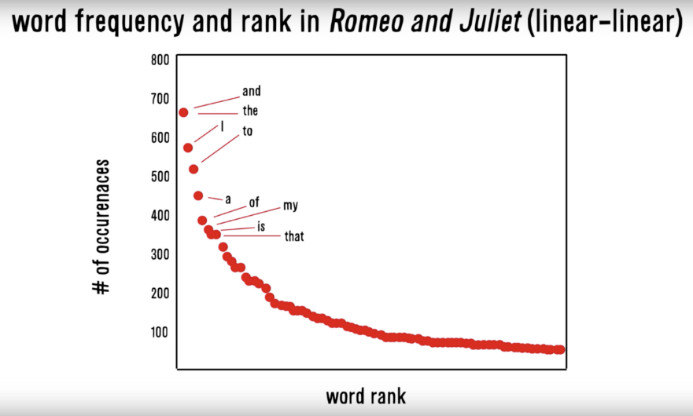
Zipf’s Law: Our words are less diverse than we think
Many words in natural language but also a steep decline in actual usage.
Follows a predictable pattern.

Slide 2
Why do we see Zipf’s law in linguistics?
Principle of Least Effort Theory
Humans will choose a path of least resistance
Humans seek to minimize effort for a task
Therefore, even if we know 000s of words, we will use as few as possible to communicate.

Slide 3
Polarity
To what extent is a document positive or negative.

Slide 4
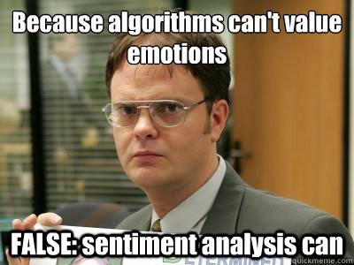
Let’s see if we can do it

Slide 5
How would you rate the polarity?
I loathe Aldi.
loathe
-1

Slide 6
How would you rate the polarity?
I love Carrefour. They are the best.
love
best
+2

Slide 7
How would you rate the polarity?
I like shopping at Migros but hate the location.
like
hate
+1 -1 = 0

Slide 8
How did you do that?
-1
I loathe Aldi.
I love Carrefour. They are the best.
I like shopping at Migros but hate the location.
+2
+1
-1
0
You know groups of positive and negative words. These could be called a polarity lexicon

Slide 9
Simple Sentiment Polarity
Zipf’s Law
Many words in natural language but there is steep decline in everyday usage. Follows a predictable pattern.

Slide 10
Simple Sentiment Polarity
Lexicon
Because of Zipf’s Law you can have pos/neg lexicons that do not encompass all possible terms.
library(qdap)
polarity()
library(sentimentr) # same methodology as qdap
sentiment_by()
library(tidytext) & library(dplyr)
inner_join()

Slide 11

Differences between Polarity & Emotion
Polarity isn’t an emotion
Surprise is an emotion
Some emotions can be positive & negative
Surprise! You won the lottery!!

Slide 12
Differences between Polarity & Emotion
Polarity isn’t an emotion
Surprise is an emotion
Some emotions can be positive & negative
Surprise! You were hit by a bus!!

Slide 13
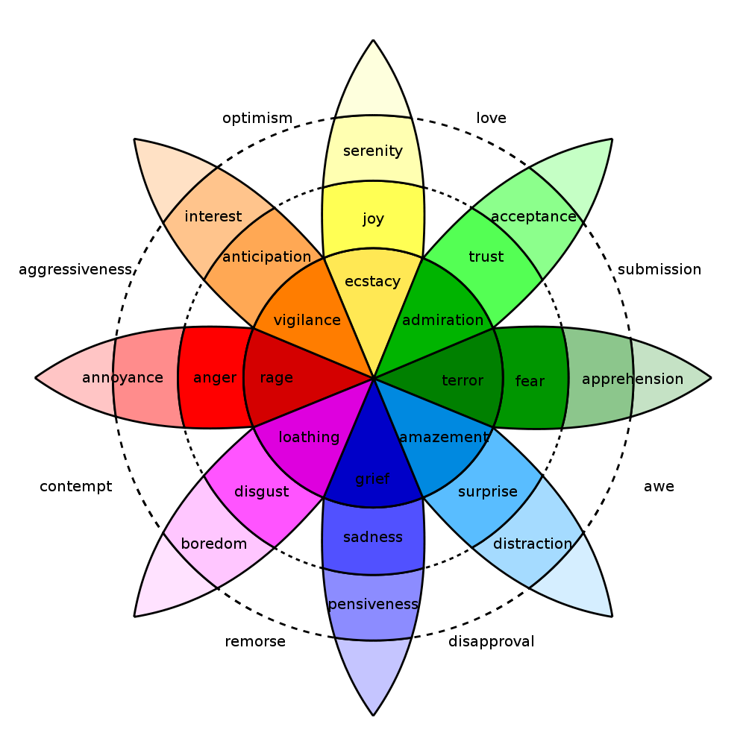
In reality sentiment is more complex.
Many Many Emoji

Slide 14
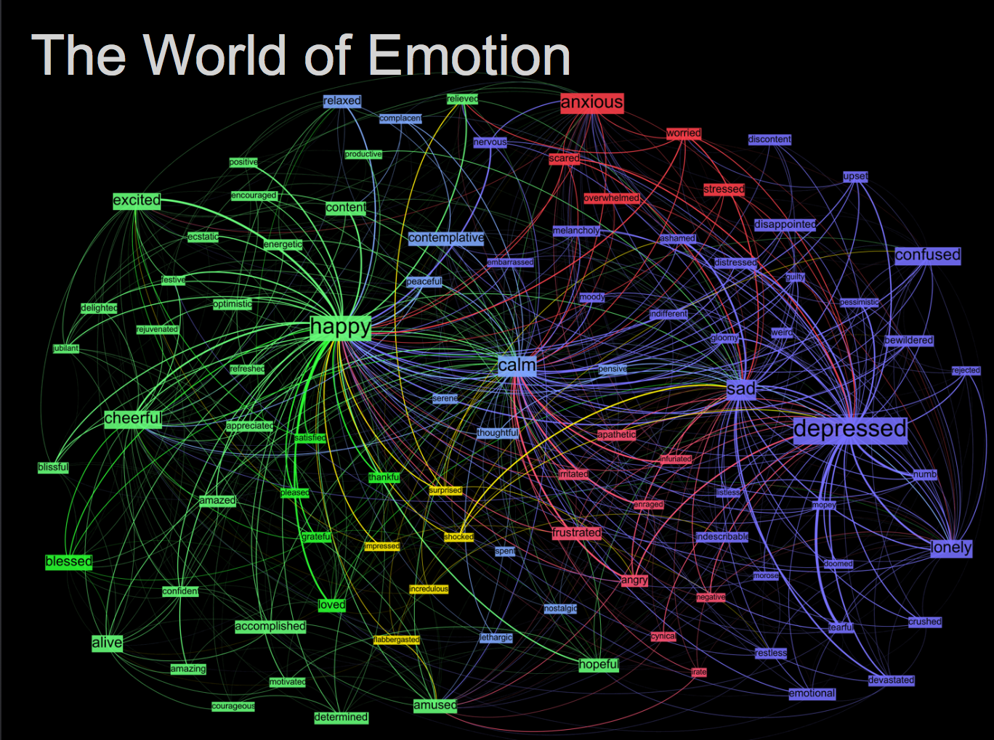
Kanjoya’s Experience Corpus

Slide 15
Tidy Data Formats are structured differently
Tidy Form (Triplet, Dense Data)
Document Term Matrix
Document | Term | count
Tweet1 | Term2 | 1
Twee1 | term3 | 1
Tweet2 | Term2 | 1
Tweet3 | Term… | 3
Tweet… | Term… | 1
Tweet… | Term_n | 1
Tweet_n | Term… | 1
 | Term1 | Term2 | Term3 | … | Term_n
Tweet1 | 0 | 1 | 1 | 0 | 0
Tweet2 | 0 | 1 | 0 | 0 | 0
Tweet3 | 0 | 0 | 0 | 3 | 0
… | 0 | 0 | 0 | 1 | 1
Tweet_n | 0 | 0 | 0 | 1 | 0
Sparse Data: Memory used to hold 0s
Dense Data: Efficient in Memory

Slide 16

The pipe operator…%>%

Slide 17
Tidy data uses %>% to forward objects
In the “tidyverse” code is structured so it is more easily read using the %>%. The data format is a tibble usually not a data frame.
mtcars
mtcars %>% group_by(cyl)
mtcars %>% group_by(cyl) %>% mutate(rank = min_rank(desc(mpg)))
This reads as “Using the mtcars object then group by the cyl vector then mutate a new variable called rank.

Slide 18

In this exercise we will examine 565 News Articles
Not by news channel but overall how can we measure emotional words. You could perform this analysis by news channel looking for biases in subjects but its not the point of our script.
From a business perspective, marketers will often measure sentiment before, during and after different campaigns. Some investor theses assert sentiment regarding companies can be a way to identify opportunities. Human resources and operations will use sentiment on employee and customer surveys.

Slide 19
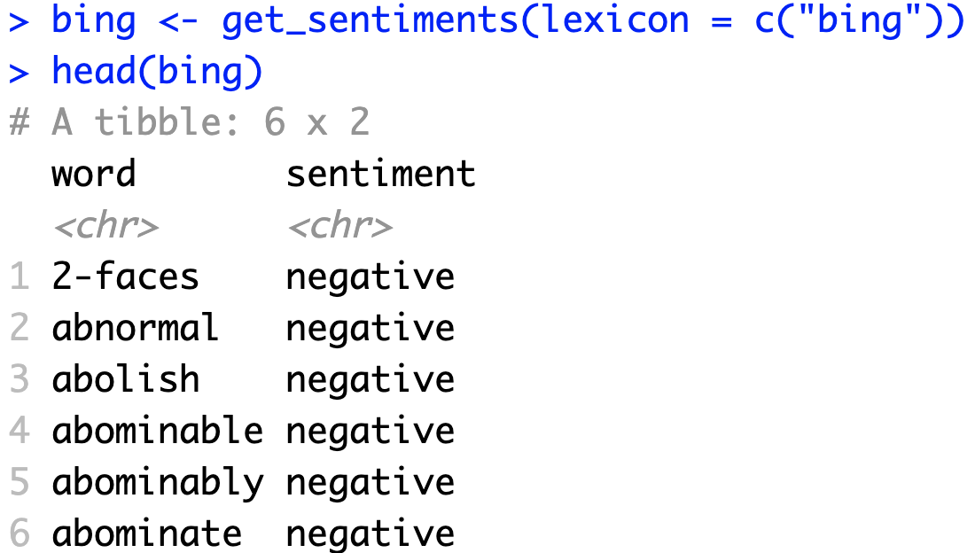
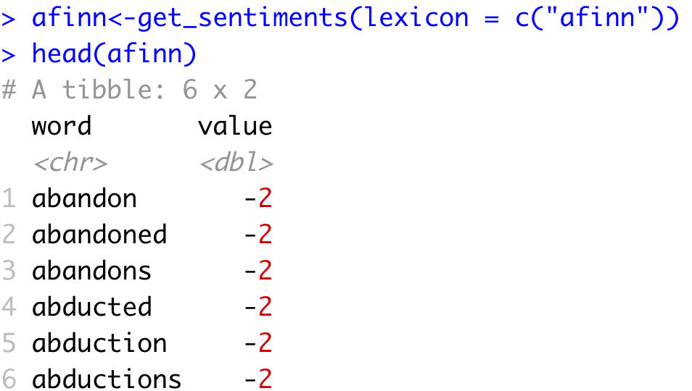
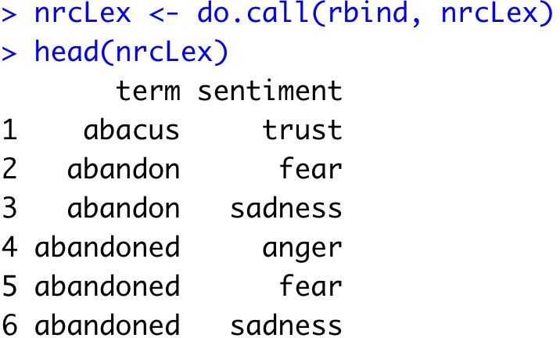
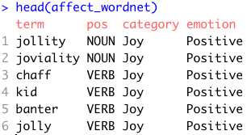
Sentiment the Tidy Way uses joins with existing lexicons
6782 Words
2477 Words
4463 Words
1519 Words

Slide 20
Tidy can seem complicated but not impossible.
The pipe operator
%>%
Forwards an object so the code is easy to understand & concise.
all.sentiment <- all.tidy %>%
inner_join(nrc.lexicon) %>%
count(tweet,sentiment) %>%
spread(tweet, n, fill = 0)
Sentiment
words
Text
inner_join()

Slide 21
Starting with a DTM, its straightforward
# DTM
txtDTM <- DocumentTermMatrix(txtCorpus)
# Tidy
tidyCorp <- tidy(txtDTM)
# Get bing lexicon
bing <- get_sentiments(lexicon = c("bing"))
# Perform Inner Join
bingSent<-inner_join(tidyCorp,
bing, by=c('term'='word'))
DTM is from the “tm” library
Easy way to make it into a tibble.
Text to Analyze
Bing Lexicon
* Due to some changes, the first time you use a sentiment lexicon, you will be asked to download. This is due to licensing.

Slide 22

Get in touch with our feelings…
Open E_tidy_sentimentAnalysis.R

Slide 23
Let’s recreate Plutchik’s Wheel of Emotions
Back to the script!

