Slide 1
Text Mining

Slide 2
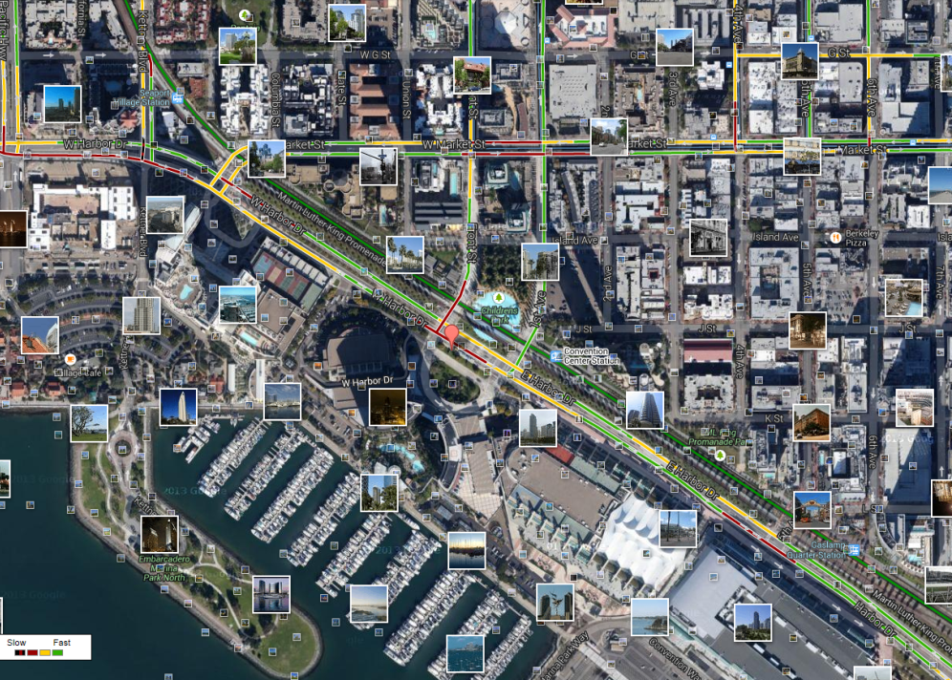
What is Text Mining?
Before Text Mining
Extract new insights from text
Let’s you drink from a fire hose of information
Language is hard; many unsolved problems
Unstructured
Expression is individualistic
Multi-language/cultural implications

Slide 3
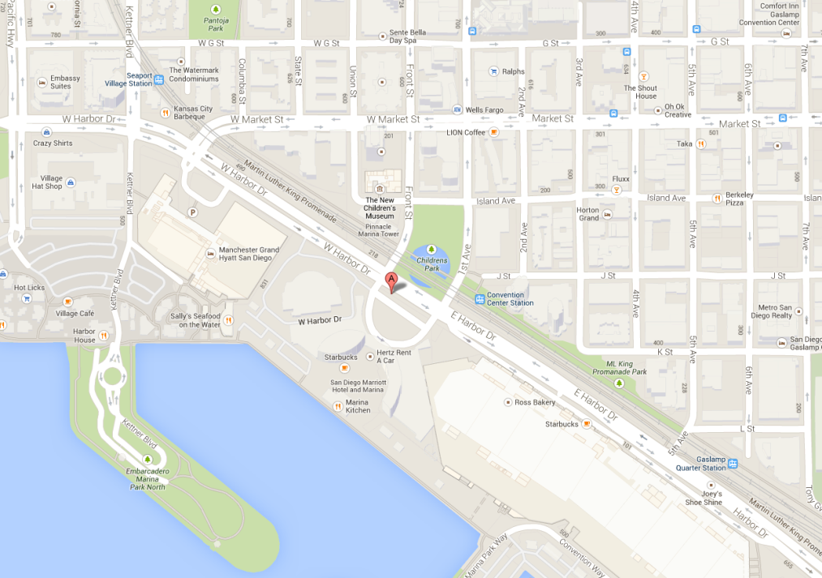
What is Text Mining?
After Text Mining
Extract new insights from text
Let’s you drink from a fire hose of information
Language is hard; many unsolved problems
Unstructured
Expression is individualistic
Multi-language/cultural implications

Slide 4
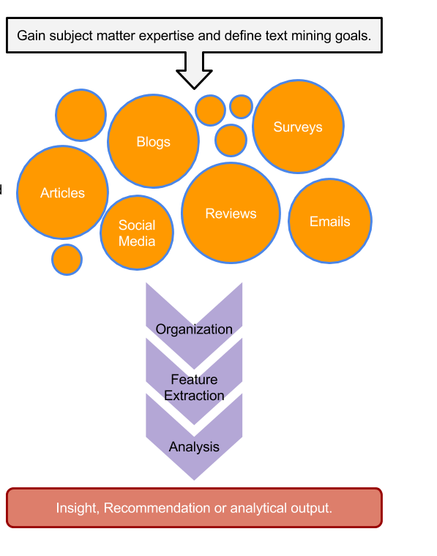
TM Project Workflow
Unorganized State
Natural Language Processing & Analysis
Organized State

Slide 5

A safe/supportive learning environment
This text has never been read. “Keyboard Courage” is rampant which may entail some less than ideal topics.
Twitter is a realistic Natural Language Channel
It is a great place to get topics, and messy challenging data.
As a safe learning environment, no offense is intended, merely exposure to a real data set. If offended, please reach out and I will get you additional data sets.
#%@*!!!

Slide 6
Let’s Practice Review!
A_more_string_manipulation.R
B_real_text_Search_Manipulation.R

Slide 7

R for Cleaning Steps
Tomorrow I’m going to have a nice glass of Chardonnay and wind down with a good book in the corner of the county :-)
Remove Punctuation
Remove extra white space
Remove Numbers
Make Lower Case
Remove “stop” words
blogs
reviews
articles
tomorrow going nice glass chardonnay wind down good book corner county

Slide 8
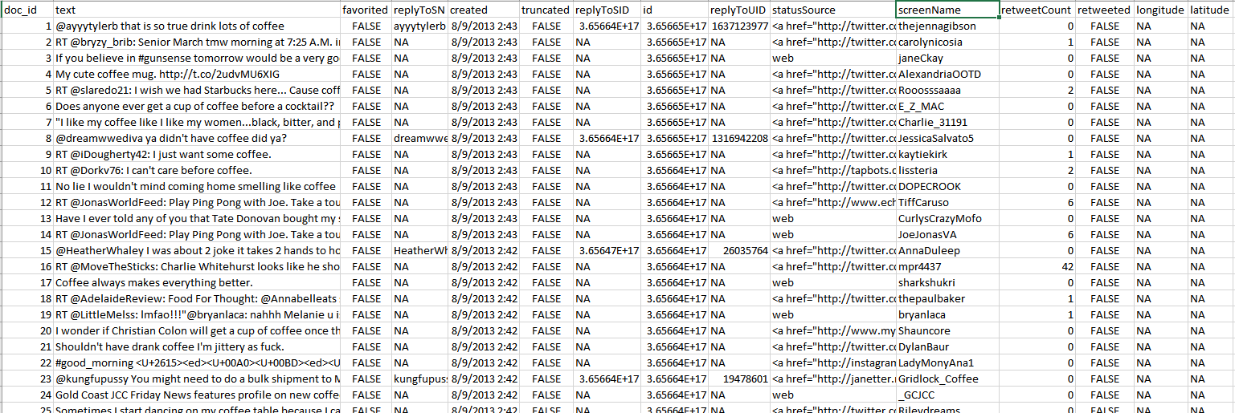
Meta Example
'$doc_id'
'$text'
META: $favorited, $created …
ID is for organization
Text is the information we want to examine
Meta adds context to our observations.

Slide 9
For Bag of Words, how is data organized?
Term Document Matrix
Document Term Matrix
 | Tweet1 | Tweet2 | Tweet3 | Tweet4 | … | Tweet_n
Term1 | 0 | 0 | 0 | 0 | 0 | 0
Term2 | 1 | 1 | 0 | 0 | 0 | 0
Term3 | 1 | 0 | 0 | 2 | 0 | 0
… | 0 | 0 | 3 | 0 | 1 | 1
Term_n | 0 | 0 | 0 | 1 | 1 | 0
 | Term1 | Term2 | Term3 | … | Term_n
Tweet1 | 0 | 1 | 1 | 0 | 0
Tweet2 | 0 | 1 | 0 | 0 | 0
Tweet3 | 0 | 0 | 0 | 3 | 0
… | 0 | 0 | 0 | 1 | 1
Tweet_n | 0 | 0 | 0 | 1 | 0
Code to Create the DTM/TDM and change to a matrix
Why are DTM & TDM Sparse? What do they represent?
txtDtm<-DocumentTermMatrix(txtCorpus)
txtTdm<-TermDocumentMatrix(txtCorpus)
txtDtmM<-as.matrix(txtDtm)
txtTdmM<-as.matrix(txtTdm)
??
The matrices are sparse (many 0’s) so additional steps may be needed to extract information.

Slide 10
Let’s Practice Review!
C_text_organization.R

