Slide 1
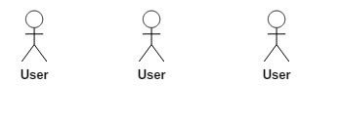
s
Internet
Airline Management System
Cross Cutting Concerns
Logging, Exception, Session Handling
Security Layer
Spring Security
CSV Files
Presentation Layer
AngularJs, HTML5, CSS3
Country
Airport
Runway
Restful Web Services
Java, Spring MVC Rest Service, Spring IOC
Business Services
Java, Spring IOC
Data Access Layer
Java, Spring JDBC Template
MySQL For Excel
Export, Import
MySQL

