Slide 1
R for Excel Users
We Are Glad You’re Here!
Notes:
Welcome/introductions & introduce D3 Training Unit
New employees had orientation earlier in the morning – this one provides more specifics around what was covered then as well as D3-specific information (like community pages, meetings, etc.)
Slides with links will be shared after

Slide 2
For the BACs…
You are probably better than me at communicating. Please provide feedback for this to be better.
There are no dumb questions, we are all learning and we want to get better.
If you are struggling, let me know! (Or a buddy, yeah that’s it, a buddy)

Slide 3
Agenda
Introduction to R (What is R?, and Why Use R?)
R is Interpretive (what is that?!)
A Brief Tour of Rstudio
Playing with Vectors, Matrices, and Data Frames
Merging 2 Datasets
Making Pretty Plots
Wrap up And questions

Slide 4

What is ?
R is a statistical analysis software, that grew out of the S language developed at Bell Labs.
In their own words: R is a language and environment for statistical computing and graphics.
R provides a wide variety of statistical (linear and nonlinear modelling, classical statistical tests, time-series analysis, classification, clustering, …) and graphical techniques, and is highly extensible.
In my own words: It’s a programming language that has much of the same functionality as excel, but enough new and enhanced features that make it one of the two primary languages of D³.

Slide 5
Why ?
Excel is a work horse of a program, extremely powerful and many at Allstate have been taught to use it in school and on the job.
However, Excel has limitations:
Excel can not handle large amounts of data gracefully
This leads to using smaller subsets of data than ideal cases (1 year vs. 5 year view, or 1 state vs. 50 states.)
Merging datasets yields bulky excel files with many tabs and (V)LOOKUPs
An Excel project usually includes many tabs in a single file, and navigation is unpleasant
R handles all of these problems, and offers additional features.
It’s easier to track formulas that were used and sharing work can be more seamless.

Slide 6
Getting Started w/ R and RStudio

Slide 7

Getting Started
R is what is called an ‘interpretive’ language.
What’s ‘interpretive’?
It means we can run our commands, step by step
Our commands do not have to be compiled (turned into machine language)
Pro: Softer Learning Curve; Con: Not as Fast as Compiled Code
Pros win for now.

Slide 8
How can you get R Studio?
You can download R Studio locally: https://www.rstudio.com/products/rstudio/download/#download
And you’ll need R:
https://cran.r-project.org/bin/windows/base/old/3.2.4/
We also placed a .zip file, and 3 .csv files here:
https://allconnect.allstate.com/community/QR_and_A_Live/Documents/RStudio_R_tiny/

Slide 9
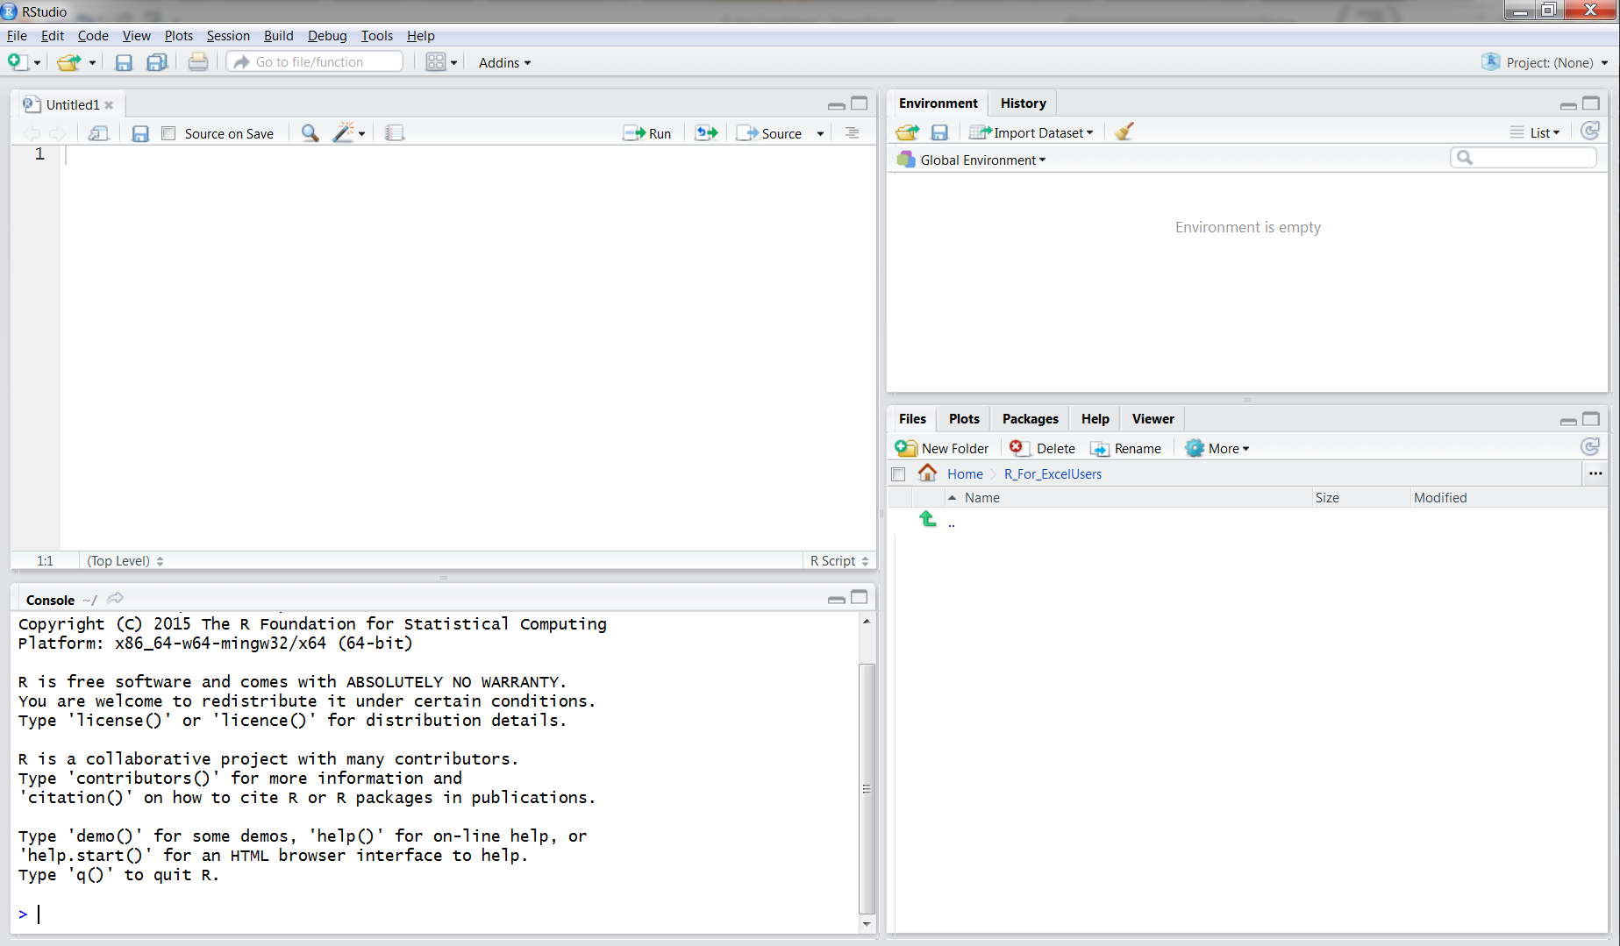
RStudio
It’s a helpful way to use and develop our R code
4
1
2
3
Notes:
‘1’ shows the untitled file we are composing our commands in
‘2’ is called the console, we can see our commands being entered here, or we can execute commands down here
‘3’ is our current directory and shows our files and folders in this directory.
‘4’ is called the environment panel. This shows all of the data and information we have loaded into memory here.

Slide 10
RStudio
This is what an empty R file looks like.
We can type commands and hit ctrl-enter to ask R to actually do them.
Let’s try A<- 1
1

Slide 11
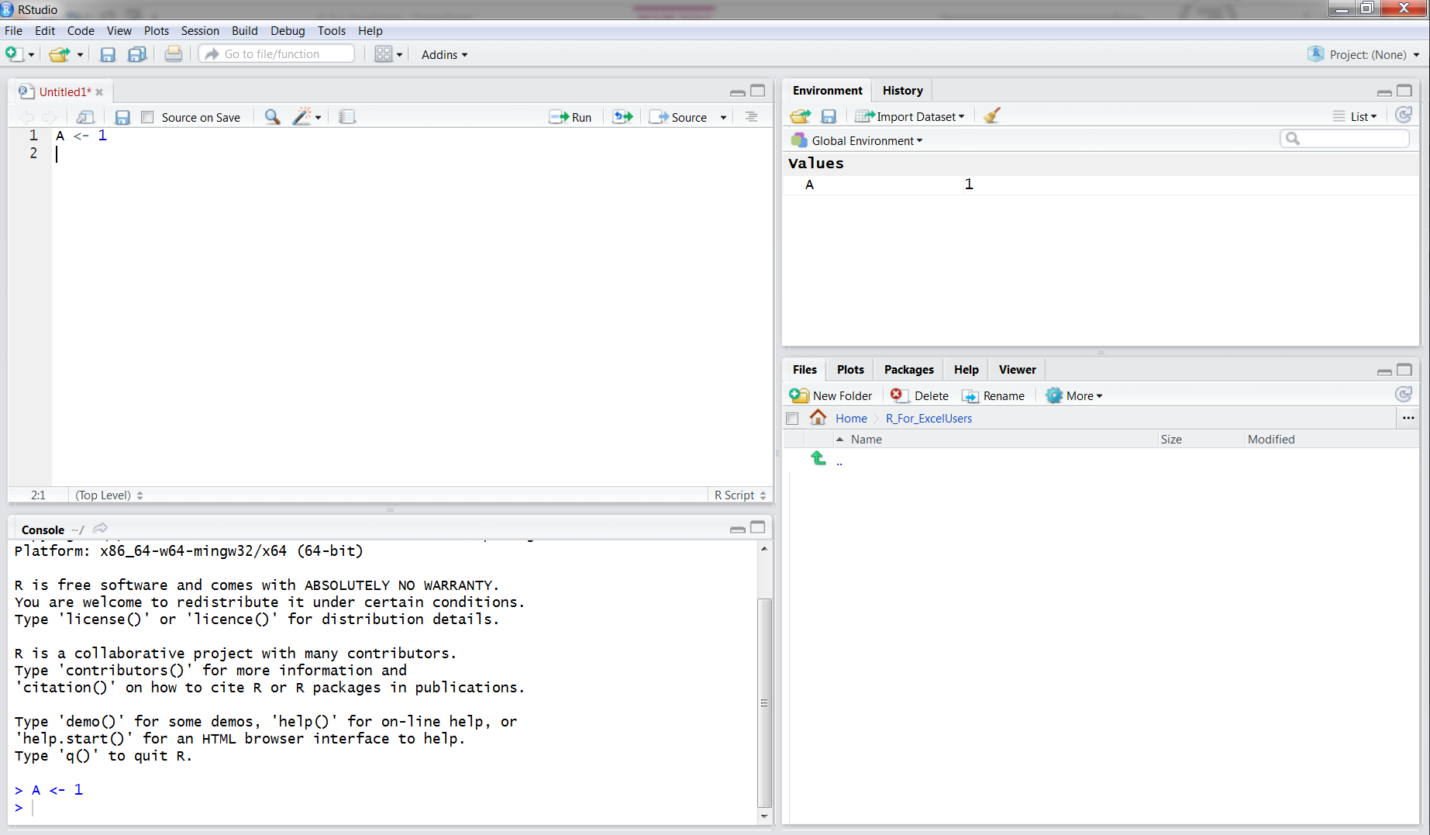
Wow a lot of things just happened!
File name turns red because we have not saved our work
Console shows the command we just ran
Environment panel shows that we now have a new value ‘A’ and A’s value is 1.
Let’s save our work using ctrl-s and call it tutorial.R

Slide 12
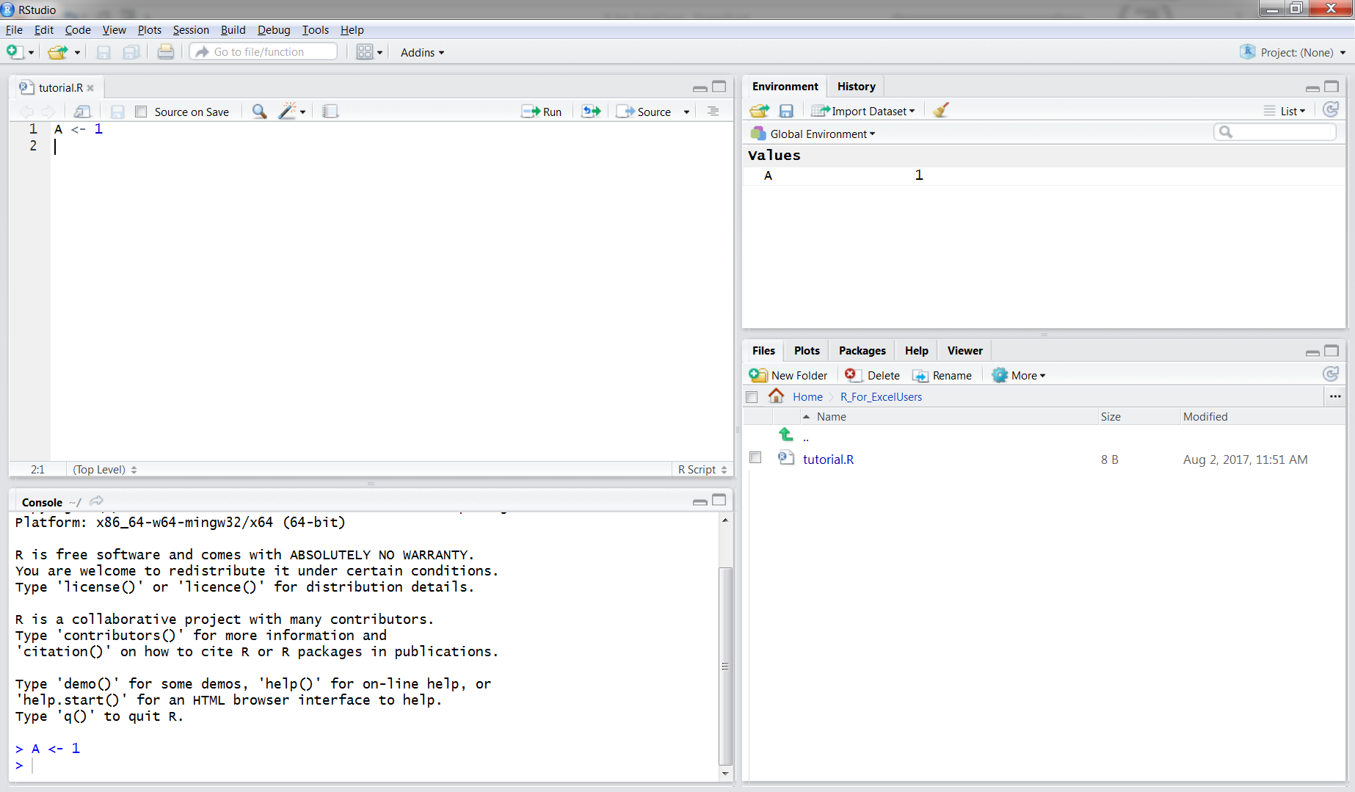
RStudio
We can see our file now says tutorial.R and is no longer red.
We can also see that tutorial.R is in our file space.

Slide 13
Playing with Vectors

Slide 14
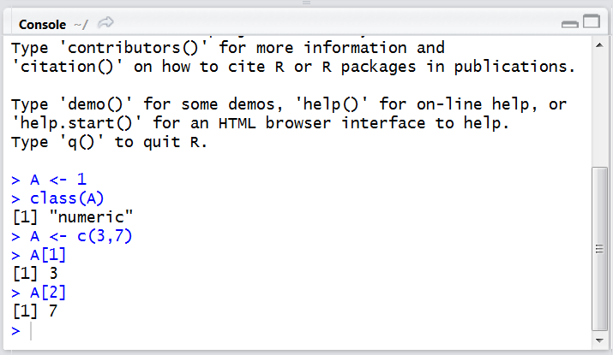
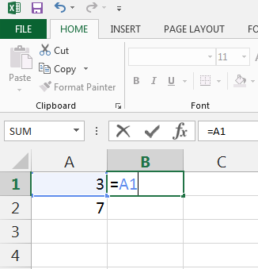
R Stores Values in Vectors
When we executed A <- 1 we created a ‘numeric’ type vector called A with value 1.
We can think of vectors as a group of cells in Excel.
We can make a vector with more entries using A <- c(3,7).
The ‘c’ tells R we have a group of entries coming.
‘A’ now has two entries 3 and 7.
We can access them individually using A[1] and A[2]
A[1] is 3 (try this in the console!)
A[2] is 7
This is very similar to Excel and how we access individual cells

Slide 15
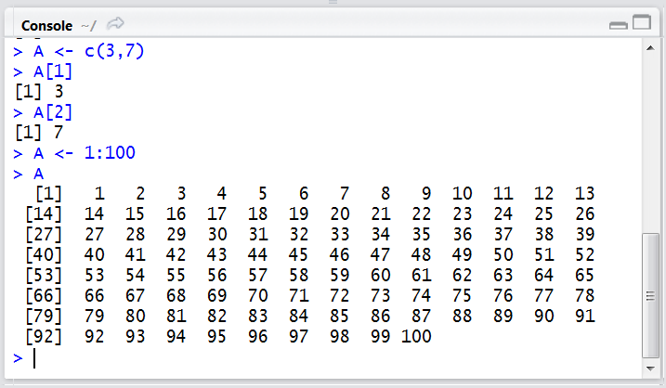
Vectors
If we want to store a sequence of numbers (e.g. 1,2,3,4,5, …, 100) in A
We don’t have to type all those numbers, the command A <- 1:100 does this for us
We can see all of the values of A:
The [14] shows us the next output is the 14th value of A and it is 14, same for [27], and [40] etc.

Slide 16
Let’s Get A Little More Excel-ly.

Slide 17
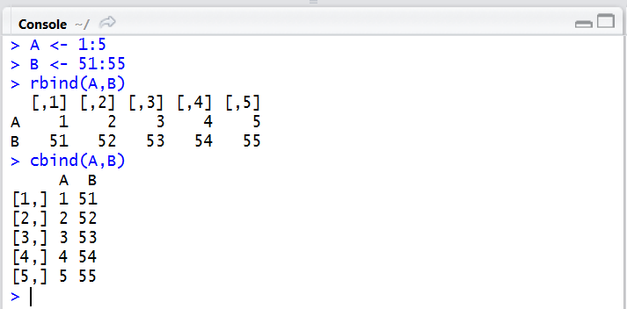
Let’s Combine Two Vectors
A <- 1:5
B <- 51:55
We can combine them in two ways, using a column bind (cbind) or row bind (rbind).
When we column bind, each column is A or B. When we row bind, each row is A or B.
Let’s make C <- cbind(A, B).

Slide 18
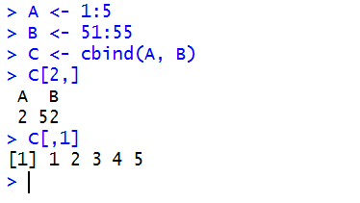
Two Vectors bound together Make a Matrix
C is now a Matrix
The 2nd row of C can be seen using C[2,]
The 1st column of C can be seen using C[,1]

Slide 19
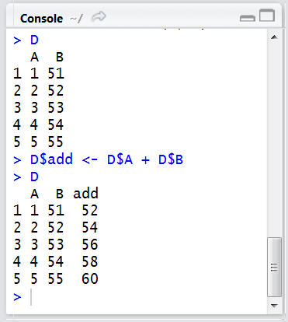
Let’s Make A Data Frame (Spreadsheet)
This is when things start to look a lot like excel (finally!)
Try D <- data.frame(A, B)
D now has columns A, and B
Let’s make a new column, ‘add’, in D that’s A + B.
D$add <- D$A + D$B
This is like excel’s, add two cells together, and fill down.
We can see ‘add’, using D$add, OR D[,”add”]

Slide 20
Column Changes
We don’t have to just use ‘+’ we can use the obvious, +, -, /, *
If we need excel’s IF, we can use ifelse(condition, value_1, value_2)

Slide 21
Let’s Get Into Data – Really Excel-ly

Slide 22
Working With Data Organized With a Common Identifier
I have downloaded baseball data from http://www.seanlahman.com/baseball-archive/statistics/
Baseball, like Allstate, generates a lot of data.
The data is broken into several files including:
Master.csv, Batting.csv
Pitching.csv, Salaries.csv
Answering a question about Salaries of Left Handed Pitchers we need to combine several files together. (Master, Pitching and Salaries)
Using a common identifier: ‘playerID’

Slide 23
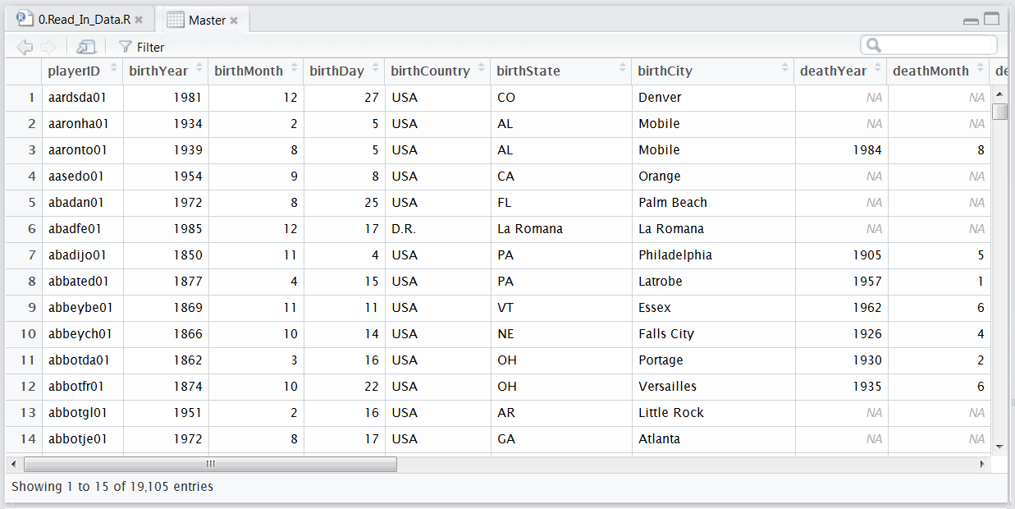
Reading in A File in R And Looking At It
Master <- read.csv(“Your_Path/Master.csv”)
Where Your_Path is the Path to Master.csv.
From my domino session: “/mnt/Master.csv”
Let’s take a peak in Master, using ‘View(Master)’

Slide 24
Missing Values (an interesting aside)
We can see deathYear is NA for many of the baseball players.
This likely means the player is not dead.
If we do the calculation:
Master$Age_At_Death <- Master$deathYear – Master$birthYear
Master$Age_At_Death is NA for all players not dead yet
Most calculations involving an NA will be NA. (As an aside, what else could NA – 1983 be?)

Slide 25
Let’s Combine Salaries and Master
Salaries <- read.csv(“Path/Salaries.csv”)
Salary has one row per player, per year.
Master <- read.csv(“Path/Master.csv”)
Master has one row per player
Data <- merge(Master, Salaries, by=“playerID”)
Merge is R’s answer to excel’s VLOOKUP.
Data will have one row per player, per year
Important: Data will not have a row where there was not a match between Salary and/or Master.

Slide 26
Let’s Combine Data and Pitching
Pitching <- read.csv(“Path/Pitching.csv”)
Data <- merge(Data, Pitching, by=c(“playerID”, “yearID”))
We need two ‘by’ values, because each row in both file is unique by player-year
We now have Data which contains:
Pitching information, Birth year, Salary information.
This would have taken a bunch of VLOOKUPs and multiple Excel tabs
In R two commands brings everything together

Slide 27
Making Pretty Plots

Slide 28
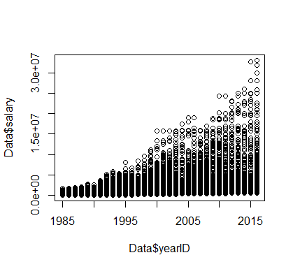
R Makes Plots, But They’re Not Pretty.
We can plot pitcher’s salaries vs. calendar year using plot(Data$yearID, Data$salary)
Oh, it’s worse than I could have imagined!
Let’s make that look a bit lot nicer.
While seeing ALL of the data is good, summarizing it looks necessary.
Let’s find the average salary of pitchers by year.
Notes:
Let’s ask, ‘how bad is this plot?’ What things are missing that should be present?
e.g. Title, meaningful axis labels, scientific notation is bad for business, is the salary actually on the rise?

Slide 29
Aggregate Is A Lot Like Excel’s Pivot Tables
Let’s Try This: Agg <- aggregate(data=Data, salary ~ yearID, mean)
Let’s go step by step:
data=Data : “Summarize data, from our data frame, Data”
salary ~ yearID: “Summarize how salary changed as a function of YearID”
mean: “When you group by yearID, take the mean of salary”
This is similar to an Excel pivot table of average salaries by year.

Slide 30
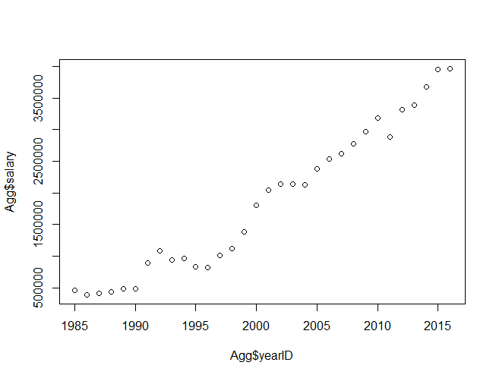
Aggregate Cleans Up The Plot, But It’s Still Really Ugly
plot(Agg$yearID, Agg$salary)
It’s clear salaries have been on the rise since 1985, except for 1990-1996, and an odd blip around 2011.
But it’s still ugly.
Let’s add a title, change the x- and y-axes
And change the open circles to a line.

Slide 31
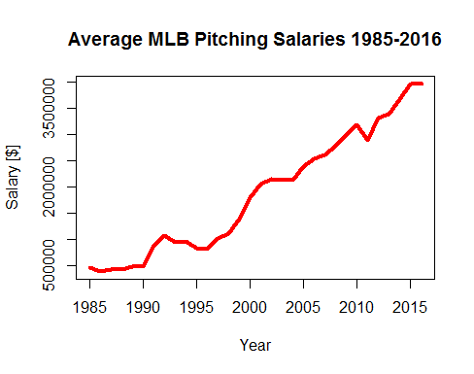
Tidy Up The Plot
plot(Agg$yearID, Agg$salary, main=“Average MLB Pitching Salaries 1985-2016”,
xlab= “Year”,
ylab=“Salary [$]”,
type = ‘l’,
lwd=4,
col=‘red’)

Slide 32
Let’s show Right vs. Left Handed Pitching
Agg <- aggregate(data=Data, salary ~ yearID + throws, mean)
Let’s go step by step:
data=Data : “Summarize data, from our data frame, Data”
salary ~ yearID +throws: “Summarize how salary changed as a function of YearID and throwing arm”
mean: “When you group by yearID and throwing arm, take mean of salary”
This is similar to an Excel pivot table of average salaries by year and throwing

Slide 33
Left-Handed Pitchers
plot(Agg$yearID[Agg$throws == ‘L’], Agg$salary[Agg$throws == ‘L’], main=“Average MLB Pitching Salaries 1985-2016”,
xlab= “Year”,
ylab=“Salary [$]”,
type = ‘l’,
lwd=4,
col=‘red’)

Slide 34
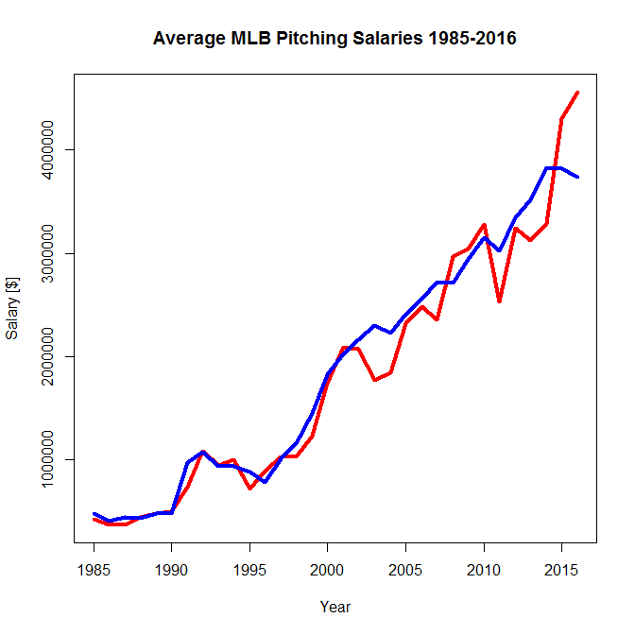
Let’s add Right Handed Pitchers
lines(
Agg$yearID[Agg$throws == 'R'], Agg$salary[Agg$throws == 'R'],
type = "l", lwd=4, col='blue')
But we can’t tell whose who! We need a legend.

Slide 35
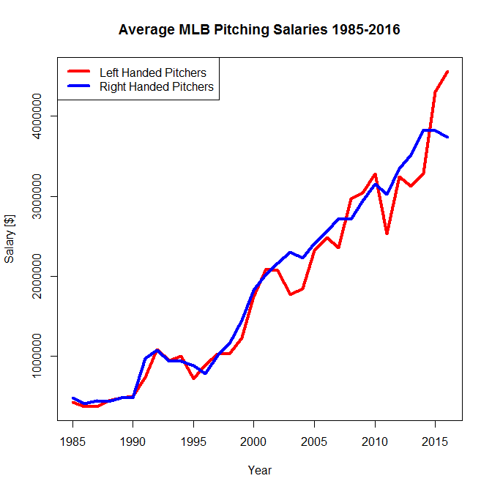
Legends
legend(
'topleft',
col=c('red', 'blue'),
legend = c('Left Handed Pitchers',
'Right Handed Pitchers'),
lwd = 4)

Slide 36
ggplot – Prettier Plots

Slide 37
ggplot is a library that adds new functionality to R
For nearly anything you can imagine, someone has built an extension to R to let you do something new.
First things first, install the package, you only have to do this once:
install.packages(‘ggplot2’)
Second things second:
library(‘ggplot2’)

Slide 38
Let’s Add In Is the Player Left or Right Handed
Agg <- aggregate(data=Data, salary ~ yearID + throws, mean)
What does this pivot table look like?

Slide 39
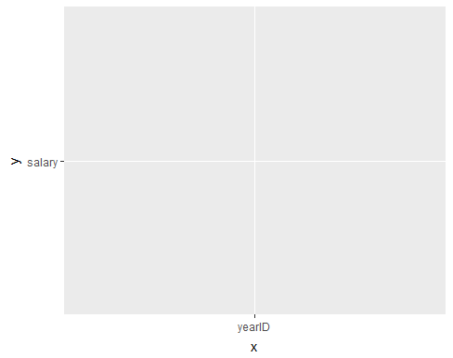
A ggplot is built up with layers
Layer 1:
p <- ggplot(aes(x=yearID, y=salary), data = Agg)
p
At this point, you’re probably saying,
“you know that last plot was not so ugly…”
Where are my points?

Slide 40
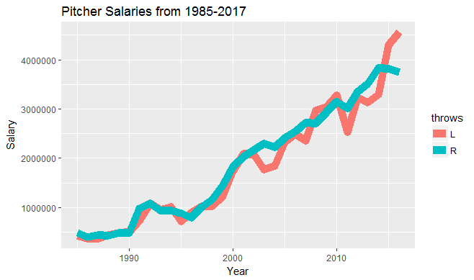
Like Ogres and Onions, ggplots have many layers
Layer 1:
p <- ggplot(aes(x=yearID, y=salary, col=Throws), data = Agg)
Layer 2:
p <- p + geom_line(lwd=4) + ylab(‘Year’) + xlab(‘Salary’) +ggtitle(“Pitcher Salaries from 1985-2017”) p

Slide 41
Let’s Wrap it Up

Slide 42
Recap
Today we used R’s data structures: vectors, matrices, and data frames
Data Frames look a lot like Excel’s spreadsheets.
Add and Fill down in excel looks like this in R D$C <- D$A + D$B
Excel’s VLOOKUP can be accomplished in R using merge
Excel’s Pivot Table functionality can be accomplished in R using aggregate
Nearly any extension to R we can imagine has been developed, and it’s free!
If you enjoyed this, and want to learn more R, let me know: bauer@allstate.com

