Slide 1

project management and comprehension tool
PREPARED BY
mrinmay

Slide 2
Agenda
01
Maven Identity
02
Maven Workflow
03
Maven In Action
04
What Is POM?
05
POM - Coordinate
06
POM - Packaging
07
POM – Inheritance
08
Archetype And Skeleton
09
Dependency Resolver
10
Dependency Scope
11
Plugin Orientation
12
Multi – Module Structure
13
Maven Goal
14
Maven Site

Slide 3
Maven Identity
Maven is a software management and comprehension tool based on the concept of Project Object Model (POM) which can manage project build, reporting, and documentation from a central piece of information.
The Maven project is hosted by the Apache Software Foundation and released on 13 July 2004.
Dependency Resolver
Multi-module Build
Consistent Project Structure
Project Generated Sites
Central JAR Repository
Parallel Build
Polyglot Build
Maven Shell / CLI

Slide 4
Maven Workflow
PREPARE
DEPENDENCY
COMPILE
TESTING
PACKAGE
DEPLOY
CLEANUP
Generate sources and resources dir.
Download JARs
Generate executable files
Execute testcases
Generate deployable artifacts
Deploy deployable artifacts.
Remove generated files.

Slide 5

Maven In Action
PCF - WS
Maven Repo
Dev - Env
Build
P
O
M
Read
1
CF Push
n
Get JAR
Check Remote Repo
OR
2
Check Local Repo
Get JAR
3
Private Antifactory
Download JAR
Local Repo

Slide 6
Who is POM?
A Project Object Model (POM) provides all the configuration. General configuration covers the project's name, its owner and its dependencies on other projects.
The Super POM provides default configuration, such as default source directories, default plugins etc.
Name and Version
Dependencies Definition
Plugins Definition
Repository Location
Multimodule Declaration
Compiler Details
Polyglot Build – YML
BOM and Transitive Definition

Slide 7

POM - Coordinate
Project coordinate defines a unique identifier for the project. It is the combination of group-id, artifact-id and version number of the project.
<groupId>
It’s reverse domain format of the application website. Also it is used for src-package structure.
www.apart.com => com.apart
<artifacId>
Arbitrary name of project (no spaces or colons). As word-separator dash (-) symbol is standard.
<version>
Version of project
Format {Major}.{Minor}.{Build Number}
Add ‘-SNAPSHOT ‘ to identify in development

Slide 8

POM - Packaging
Build type identified using the “packaging” element. It tells Maven how to build the project and copy the result into “target” folder.
<packaging>
Maven could be instructed by the either of below packaging type.
POM Type
Utilize to define parent project in multi-module project structure.
JAR Type
Utilize to define library, standalone and microservice application.
WAR Type
Utilize to define web application that could be deployed directly into application server directly.
EAR Type
Utilize for complex application that will contain both jar and war.

Slide 9


POM - Inheritance
When we declare library dependency, Maven will inject POM reference from backend.
Parent Reference
It will inherit parent POM
Module Reference
It will inherit other project POM

Slide 10
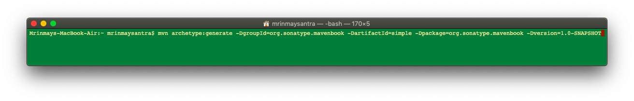
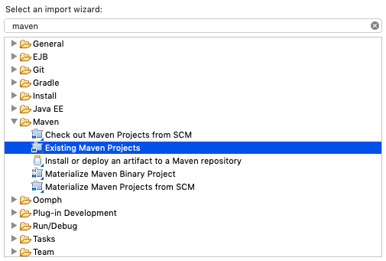
Archetype And Skeleton
Create application - skeleton
The pom.xml and all subdirectories
Project Home
src
main
java
Java sourcecode for the project
resources
Deliverable resources for the project,
such as property files
test
Testing Java sourcecode for the project
java
resources
Resources necessary for testing
target
pom.xml
Import as Maven project

Slide 11

Dependency Resolver
{groupId}/{artifactId}/{version}/{artifactId}-{version}.jar
pom.xml
Read Dependency
https://repo.maven.apache.org/maven/junit/junit/4.12/junit-4.12.jar
Get JAR
Download JAR
Maven Central Repo
${user.home}/.m2/repository/junit/junit/ 4.12/junit-4.12.jar
Get JAR
{groupId}/{artifactId}/{version}/{artifactId}-{version}.jar
Local .m2 Folder

Slide 12
Dependency Scope
Dependency scope is used to limit the transitivity of a dependency, and also to affect the classpath used for various build tasks.
compile - This is the default scope. Compile dependencies are available in all classpaths of a project. Furthermore, those dependencies are propagated to dependent projects.
provided - This is much like compile, but indicates you expect the JDK or a container to provide the dependency at runtime Like Servlet API and related Java EE APIs to scope provided because the web container provides those classes.
runtime - This scope indicates that the dependency is not required for compilation, but is for execution. It is in the runtime and test classpaths, but not the compile classpath. Like JDBC Driver.
test - This scope indicates that the dependency is not required for normal use of the application, and is only available for the test compilation and execution phases. This scope is not transitive.
system - This scope is similar to provided except that you have to provide the JAR which contains it explicitly. Like <systemPath>${java.home}/lib/rt.jar</systemPath>
import - This scope is only supported on a dependency of type POM inheritance. Like parent POM reference.

Slide 13
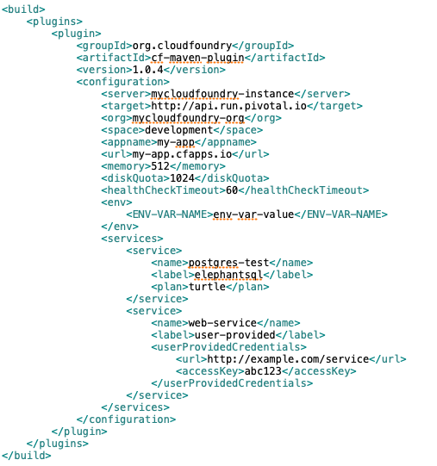
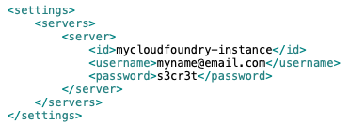
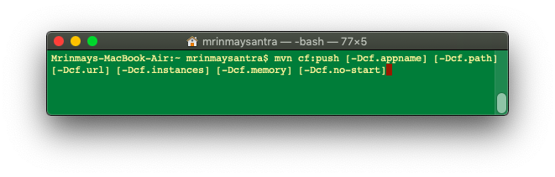
Plugin Orientation
pom.xml
Local Configuration
PCF-WS
Need to update pom.xml with PCF plugin. For PCF WS credential settings.xml needs to update accordingly
settings.xml

Slide 14
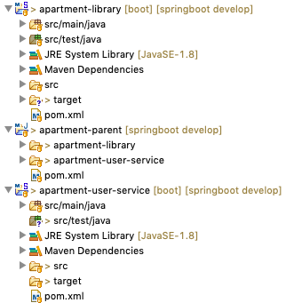
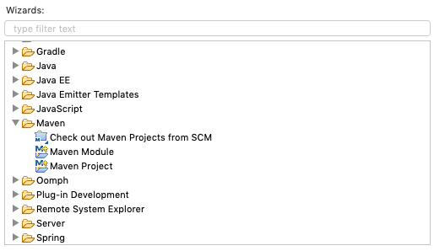


Multi – Module Structure
Parent is normal Maven Project with package type is POM
Child is Maven module with parent details
Parent is centralized control of the app.

Slide 15
Maven Goal
To invoke a Maven build you set a lifecycle “goal”
mvn install - Invokes generate* and compile, test, package, integration-test, install
mvn clean - Invokes just clean
mvn clean compile - Clean old builds and execute generate*, compile
mvn compile install - Invokes generate*, compile, test, integration-test, package, install
mvn test clean - Invokes generate*, compile, test then cleans

Slide 16
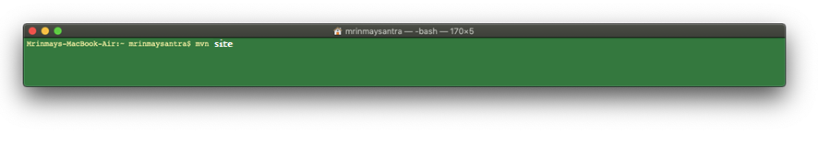
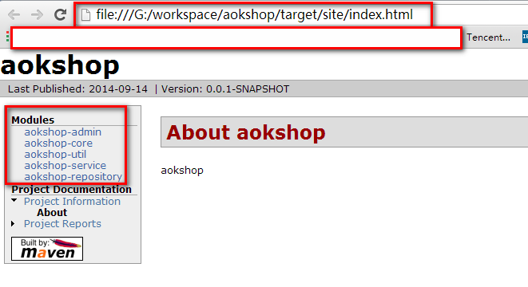
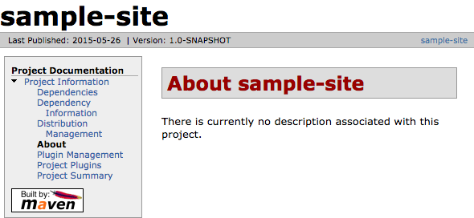
Maven Site
Neighbor defines address
Site Location
Site HTML

Slide 17

Thank you
📱9836038333
📧 mrinmay.santra@gmail.com
https://github.com/mksrepo/springboot/tree/develop

