Slide 1
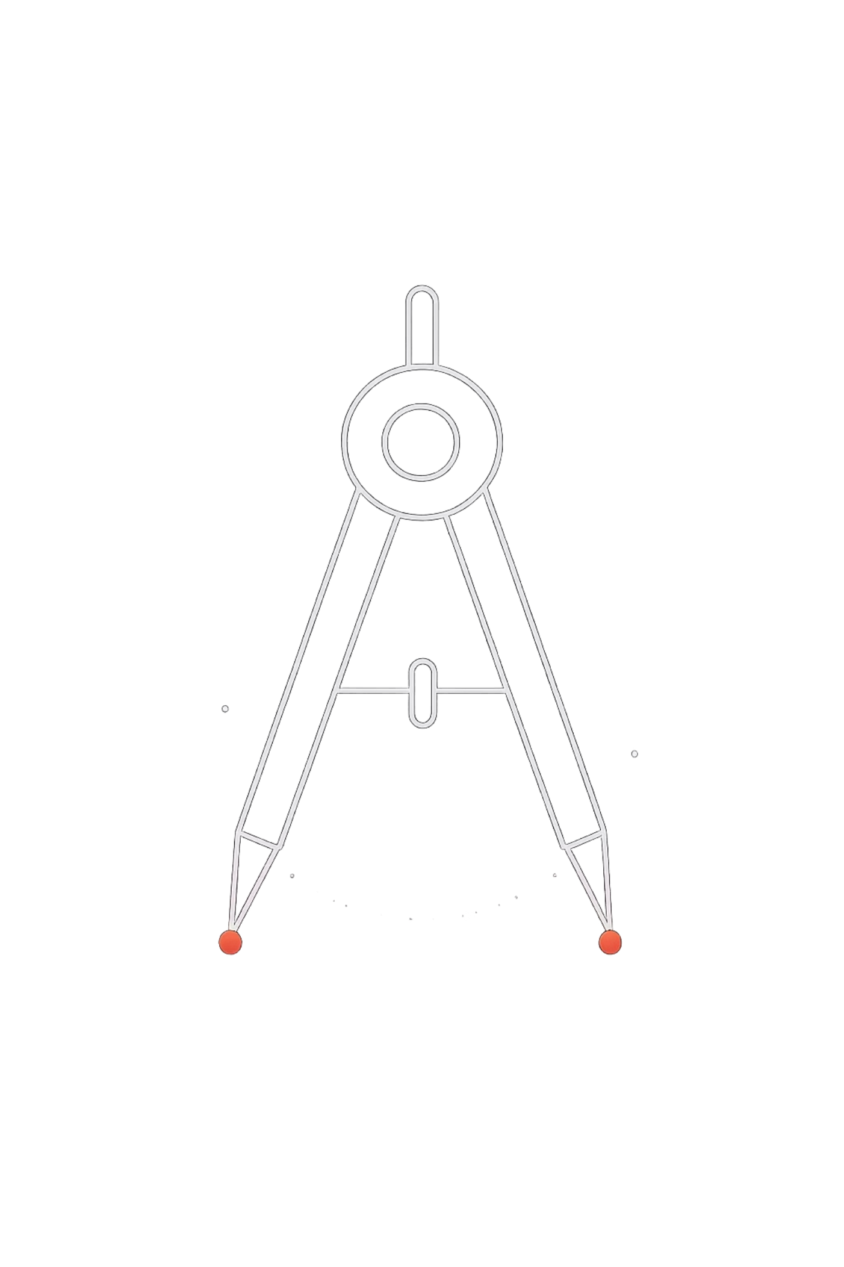
DSA FROM ZERO
Day 13 – Find Minimum Element
Learn how to scan an array and track the smallest value — a foundational technique in every programmer's toolkit. Simple logic, powerful results. 🚀

Slide 2

The Problem
Given an array of integers, find and return the smallest element.
Input Array
Expected Output
[4, 2, 7, 1, 9]
1
Task
Scan the array and identify the minimum value

Slide 3
Think Like This
Imagine you are shopping in Sarojni Nagar Market in Delhi…
Check every shop's price
Remember the lowest price so far .
Update when you find a better price.
You must look at each option — you can't skip any.
Keep track of the minimum price you’ve seen.
If a shop offers a lower price, replace your current minimum.

Slide 4

Core Idea
The algorithm is built on three simple steps that repeat until every element is visited:
Store a minimum
Compare each element
Update if smaller
Initialize min with the first element as your starting reference.
Walk through every value in the array one by one.
Whenever you find a smaller value, it becomes the new min.

Slide 5
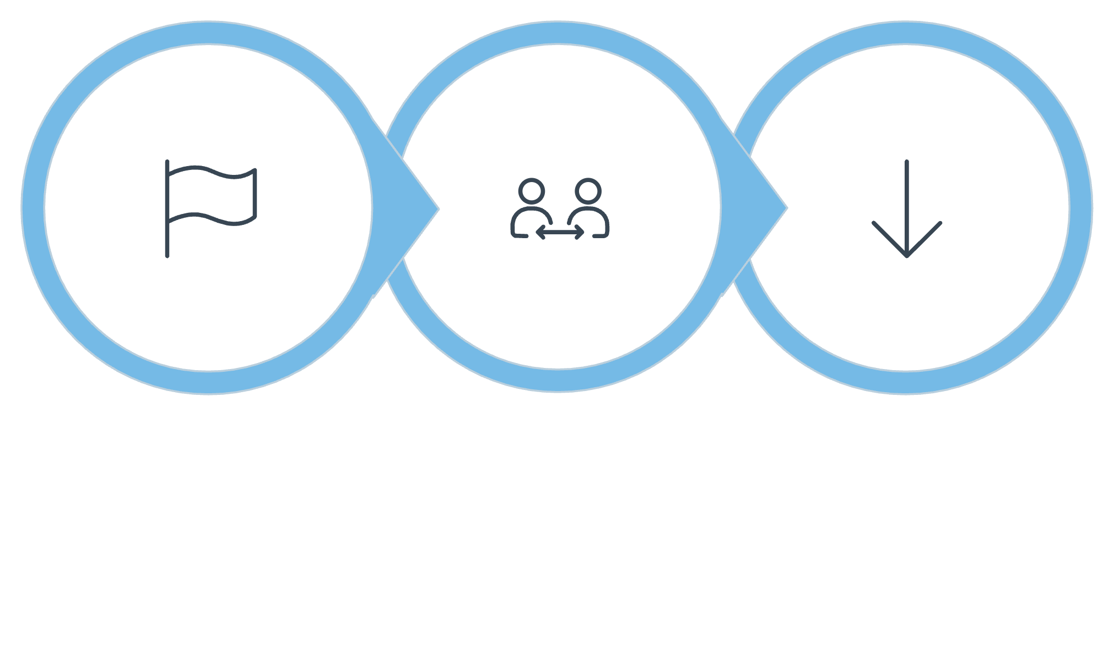
The Approach
Compare Elements
Initialize Min
Update Min
This single-pass strategy is clean and efficient — you only ever need to visit each element once, making it ideal for large arrays.

Slide 6

Dry Run — Step by Step
Let's trace through [4, 2, 7, 1, 9] manually:
Start
min = 4 First element becomes our baseline
Check 2
2 < 4 ✅ min = 2
Check 7
7 < 2 ❌ No update needed
Check 1
1 < 2 ✅ min = 1
Result
9 < 1 ❌ Final min = 1 🎉

Slide 7

The Logic in Code
The heart of this algorithm is a single if check inside a loop. Keep it simple — that's all you need.
int min = arr[0];
for (int i = 1; i < n; i++) {
if (arr[i] < min) {
min = arr[i]; // update min
}
}
// min now holds the answer
Every time arr[i] is less than min, you've found a new champion — update and keep going.

Slide 8
Complexity Analysis
O(n)
O(1)
Time Complexity
Space Complexity
We visit each element exactly once — linear time, no shortcuts needed.
Only one variable (min) is stored — no extra arrays or structures.
This is about as efficient as an algorithm can get for this problem — you must look at every element at least once, so O(n) is optimal.

Slide 9




What You Learned Today
Array Traversal
Comparison Logic
Scanning every element in order using a loop.
Using if conditions to compare values at runtime.
In-Place Optimization
Solving the problem with O(1) space — no extra memory needed.

Slide 10
🧪 Mini Challenge
Try it yourself!
Step 1
Step 2
Apply what you've learned to this new array:
min = 8
3 < 8 → min = 3
[8, 3, 5, 2, 6]
Step 3
Step 4
Trace through it step by step. What is the minimum element? Can you write the code from memory?
5 < 3? No update
2 < 3 → min = ? 🤔
💡 Hint: Start with min = 8 and compare each element one by one.

