Slide 1
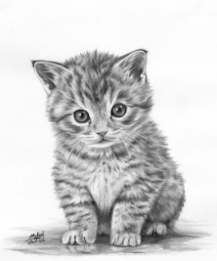
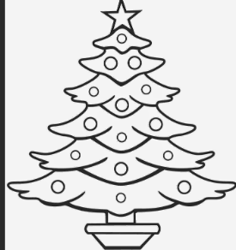

* See the picture and circle the correct letter
B | C | A
X | Y | Z
I | C | F

