Slide 1
Trustless Infrastructure for AI And
AI Marketplace
Team members:
1. Muthukumar V
2. Franklin Immanuel N

Slide 2
Trustless infrastructure for AI:
As we are living in modern world, AI technologies has gained the permanent place in our day to day life.
As we all know, to train an AI, it needs lot of data with precision and originality. So that, it could train efficiently and accurately.
But, there could also be a chance like, our personal data can be misused.
So we need a secure system to safeguard our private data. So, we need more sophisticated technology.
Blockchain is the technology that can protect our private data with tamper proof, because of it’s distributed nature.
But, how can we use blockchain for AI and ML?

Slide 3
Zero Knowledge proof and Zk-Snark:
Zero knowledge proof is one of the sophisticated method to safeguard our data more privately.
It don’t reveal anything about our private data. Instead, it creates the proof for our of personal information.
Zero knowledge proof allows one party to prove another party, that they possess some knowledge, without revealing about them.
Zk-Snark is the another version of zero knowledge proof, which will create the short proof. This short proof is used for verification in the blockchain.
Zero Knowledge Machine Learning uses this Zk-Snark proof.

Slide 4
Zero Knowledge Machine Learning:
Zero Knowledge Machine Learning is used in the blockchain for AI training.
ZKML won’t reveal any private information to public blockchain, while keeping the data privately, and train the data.
After training, it will create the ZK-Circuit proof to prove the correctness of it’s calculation.
For creating the ZK-Circuit, it uses ZK-Snark to create the proof and this proof is sent to the blockchain for verification.
Since, we cannot train the AI on the public blockchain, since it is very computationally intensive, and could lead to high gas fees.

Slide 5
Limitations of ZKML:
However, ZKML produce the short proof and it is used for verification, it is more computationally intensive to create a proof.
It depends on the data size we using, and complexity of the AI Algorithm.
And also, the person who create the proof, still they are aware of the original input. Because, in blockchain, data is not come from single person. It is the millions of users contribute their data in the form of transaction, crypto trading, etc.,
Then, how to protect the original data from unauthorized users?

Slide 6
Homomorphic Encryption:
Homomorphic encryption is the well sophisticated method to encrypt our all data into cipher texts.
It will provide provide public key for encryption and private key for decryption.
Ok. This will protect our data, then can we use this on blockchain?
But the main problem is homomorphic encryption is very computationally intensive. Because, it will perform every operation in encrypted format, without decrypting it.
Atlast, using Zk-Snark + Homomorphic encryption can be overhead to blockchain.

Slide 8
Solution:
To overcome this situation, we are come up with some new Consensus like algorithm to train the ML and AI model on blockchain, without loss of data integrity and tampering.
Algorithm we developed is similar to Proof of Stack(PoS), but with combination of Proof of Stack(PoS) and Proof of Authority(PoA).
It can be named as “Proof of Web(spider web)”.
Let’s have some example….

Slide 9
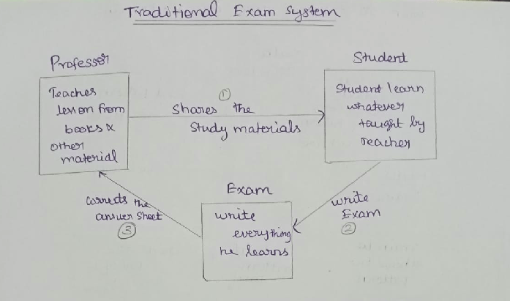

Slide 10
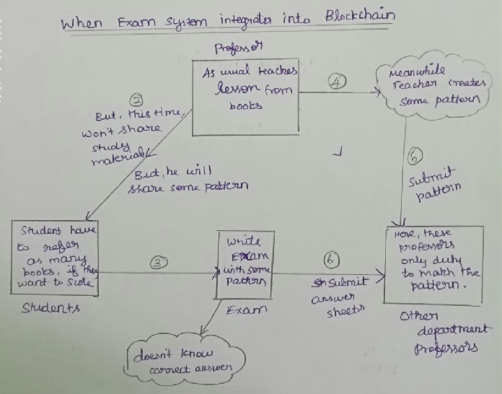

Slide 11
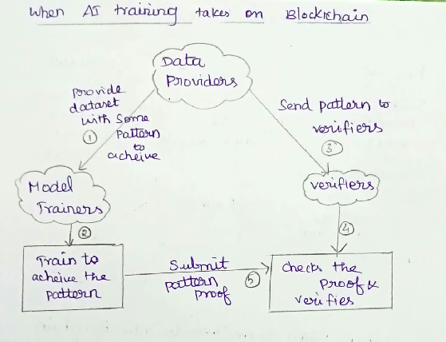

Slide 12
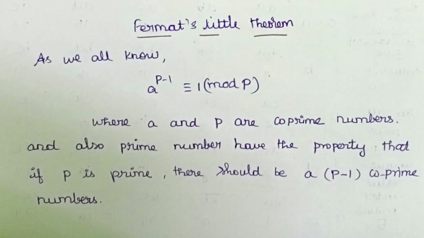

Slide 13
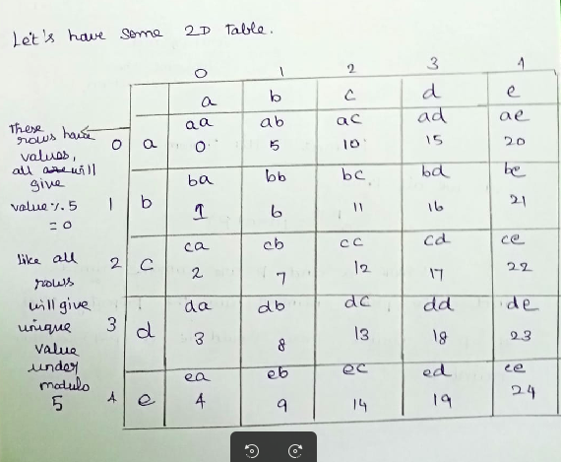
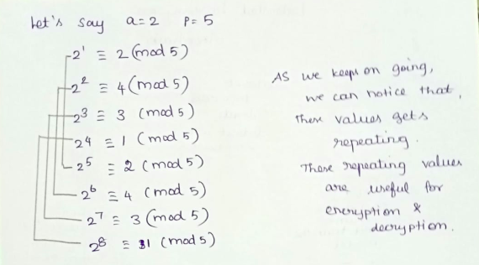

Slide 14
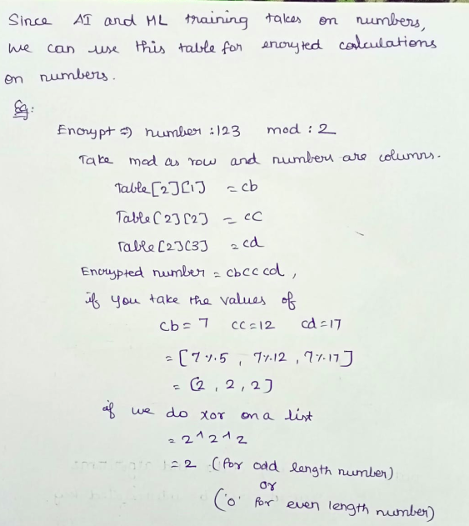

Slide 15
Process Flows:
Dataset providers noise the initial data with some equation. (eg. y = mx + c)
Dataset providers provide the initial weights value and bias value as encrypted(initially zero)
Split into chunks, and send to the peers.
Peers will train the model, and return to the dataset providers.
By the way, Consensus algorithm itself checking internally the integrity of mod values, if anything changes training will be stopped.
Finally, data providers taking aggregation of all output provided by the input.
If they want to predict,
Trained Model + Noise Equation = Output

Slide 16
Where the calculations are done?
These calculations are done by the consensus algorithm we developed.
Consensus Algorithm takes number as input and encrypt.
These encrypted numbers are only read by algorithm with the help of fermat’s table.
These fermat’s table are not same for all ML/AI training, as the data owners keeps on changing the prime numbers, these are randomly shuffled.
When we have large prime numbers, and prime factors are the mod input, it is nearly impossible to find the original numbers.
Moreover, it operates on plain numbers, inside the algorithm.
Let’s see some demo!

Slide 17
Our Algorithm is still in progress :-
It can perform all operation to some certain digits, it is not optimized for floating numbers and ‘E’ notation numbers.
It is high level language implementation. We can optimize into more efficient code by doing some bit manipulation and all.
We can make it fast by storing frequent numbers and encrypted strings in stack to reduce the access time.

Slide 18
AI Marketplace :-
We can use the existing solution for the AI marketplace.
As we are operate in private blockchain network, group of organization can contribute to generation of interrelated keys.
These interrelated keys are different and only known to those organization.
This is like having, one private key and many public keys.
Then, what is proof of web?

Slide 19
Web:-
Since all the values and keys and mod values are interrelated to each other, we can start building the blocks, which can act as a proof and also for the trained model area.
However those are encrypted inside the web blocks. The people who created the initial public keys are used to access the model and rights to transfer the ownership of the model.
The Web will looks like this..

Slide 20

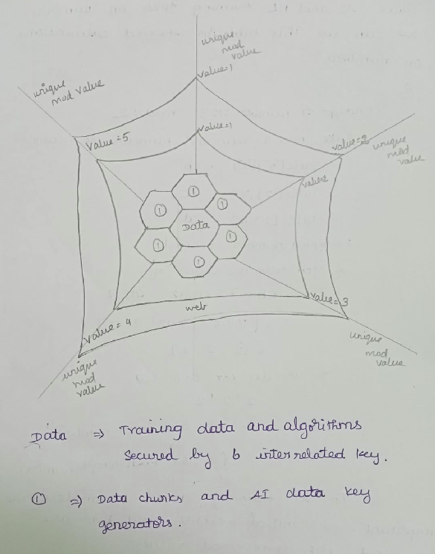

Slide 21


