Slide 1
Welcome to
Theta Game World

Slide 2
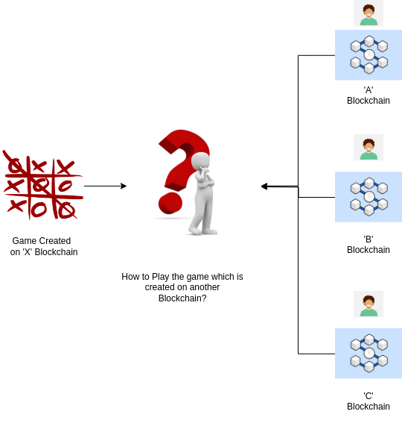

Slide 3
Our Relayer Network
Comes into picture...

Slide 4
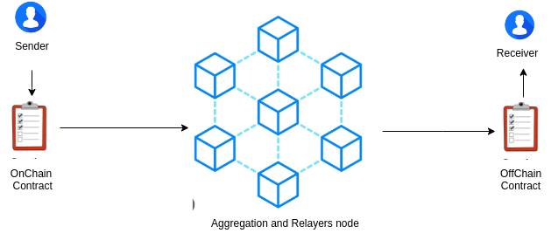

Slide 5
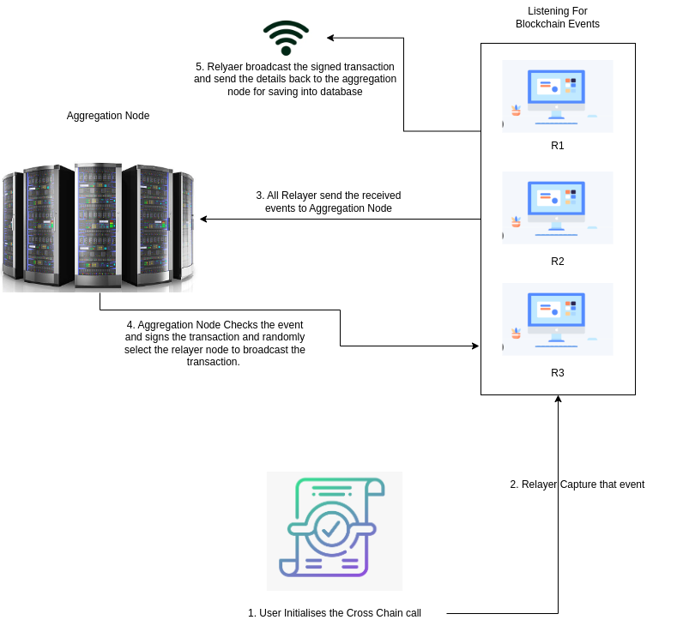

Slide 6
Demo

