Slide 1

Secure Campus Network Design
Network Topology & Component Overview

Slide 2
High-Level Network Topology Overview
This network design connects two geographically separated campuses (Main and Branch) with the following features:
- Core switching infrastructure using Cisco Catalyst 3850
- ASA 5500-X firewalls securing each campus
- Site-to-site IPsec VPN tunnel for secure inter-campus communication
- Centralized services (DHCP, DNS, FTP, SMTP, Web) in the DMZ
- Wireless LAN managed via a centralized WLC
- VLAN segmentation for Management, LAN, WLAN, and Blackhole networks

Slide 3
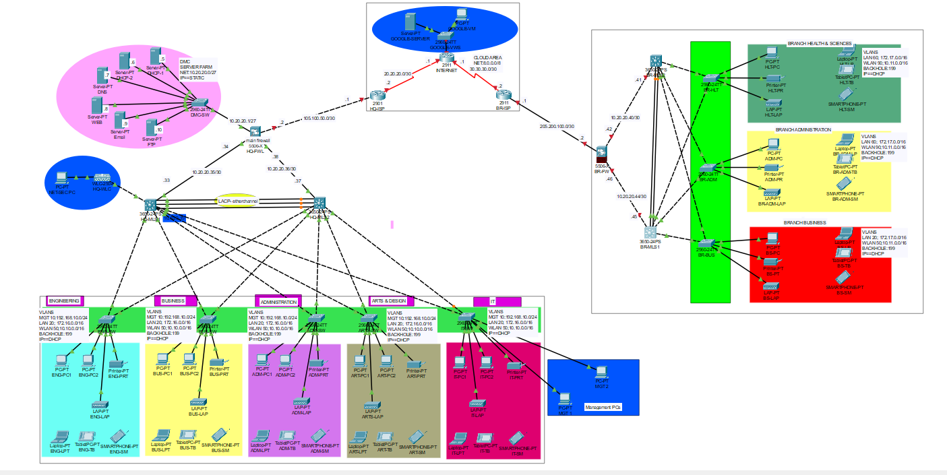

Slide 4
IP Addressing Plan & VLANs
Management: 172.16.10.0/24 (VLAN 10)
LAN: 192.168.0.0/16 (VLAN 20)
WLAN: 10.10.0.0/16 (VLAN 50)
DMZ: 10.20.20.0/27
Blackhole: VLAN 199 (for unused ports)
Public IPs:
- Main: 105.100.50.0/30
- Branch: 205.200.100.0/30

Slide 5

Key Devices per Campus
Main Campus:
- 2× Catalyst 3850 (Core)
- ASA 5506-X
- WLC + Lightweight Access Points
- Server Farm (DHCP, DNS, etc.)
Branch Campus:
- 2× Catalyst 3850 (Core)
- ASA 5506-X
- Access Switches (2960)
- Lightweight APs per department

