Slide 1
Case Study 1
Cyclistic Bike-Share Analysis
Converting Casual Riders to Members
Insights from Data & Marketing Recommendations
Presenter: Man Kit, Tsang
Date: 8 Feb 2026

Slide 2
Objective and Business Question
Objective
Designing market strategies, aiming to convert casual riders into annual members.
Business Question
How do annual members and causal riders use Cyclistic bikes differently?

Slide 3
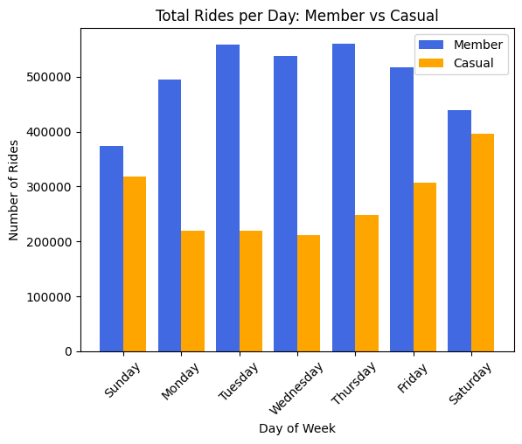
Weekly Usage Pattern – 1
Annual Members
Higher user counts on weekdays (Monday to Friday).
Suggesting they are using the bike for work commutation.
Casual Riders
User count peaks on weekdays.
Suggesting the use of bike for leisure and recreational purpose.

Slide 4
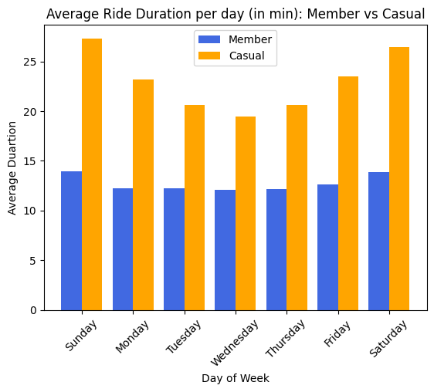
Weekly Usage Pattern – 2
Annual Members
Steady average duration throughout the whole week (approx. 15 mins).
Suggesting a fixed and stable routines.
Casual Riders
Longer average rides (up to 25 mins) and peaks on weekends.

Slide 5
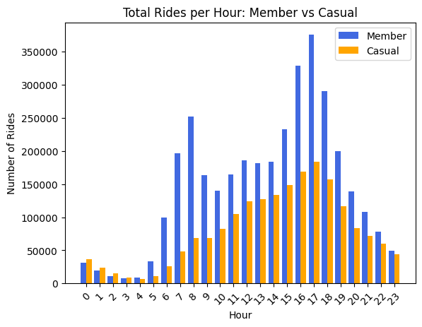
Hourly Usage Pattern
Annual Members
Distinct peaks in usage of bikes at 8am and 6pm, where aligns with standard rush hours for work commuters.
Casual Riders
A steady normal distributed usage is being presented for casual riders. This suggesting a non-work related activity.

Slide 6
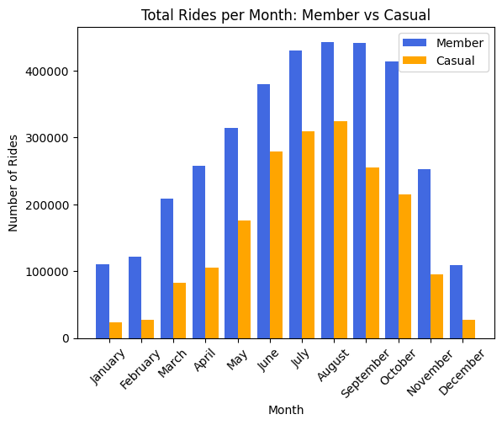
Monthly Usage Pattern
Seasonality
High number of users in summer seasons and extremely low number of users in winter.
Causal Riders Count
Causal rider numbers peak from July to August with approx. 300000 hires.

Slide 7
Key Findings
Usages of Cyclistic Bikes for different user types
Annual Members
Consistent demand and short duration per trip, with a routine-based usage during weekdays.
Casual Riders
Higher demand on weekends with a strong seasonal usages during summer season.

Slide 8
Marketing Strategies
Top 3 Recommendations
New member discount promotion event
- Promotion during July to August, targeting causal riders
Member only perks
- Encouraging sign ups for membership by offering discount rate on weekend riding
Bike reservation system
- Introducing a bike reservation for members, allowing members to book in a bike in advance, providing reliability of bike for members.

