Slide 1
Brain tumor detection
By
M K THARUMASEELAN-2018103614
S R VIVEKANANDEN-2018103626

Slide 2
INTRODUCTION
Brain and other nervous system cancer is the 10th leading cause of death, and the five-year survival rate for people with a cancerous brain is 34% for men and 36% for women. Moreover, An estimated 86,970 new cases of primary malignant and nonmalignant brain and other Central Nervous System (CNS) tumors was expected to be diagnosed in the United States in 2019 .
A brain tumor occurs when abnormal cells form within the brain . There are two main types of tumors- Malignant and Benign. Malignant brain tumors originate in the brain, grows faster and aggressively invades the surrounding tissues. It can spread to other parts of the brain and affect the central nervous system. Cancerous tumors can be divided into primary tumors, which start within the brain, and secondary tumors, which have spread from elsewhere, are known as brain metastasis tumors. On the other hand, a benign brain tumor is a mass of cells that grow relatively slowly in the brain.
Hence, early detection of brain tumors can play an indispensable role in improving the treatment possibilities, and a higher gain of survival possibility can be accomplished. But manual detection of tumors or lesions is a time consuming, challenging and burdensome task as a large number of MRI images are generated in medical routine. So it is a very extensive task to detect tumors from the human brain.

Slide 3
OBJECTIVE
huge amount of data generated by MRI scan thwarts manual classification of tumor vs non-tumor in a particular time. But it is having some limitation (i.e) accurate quantitative measurements is provided for limited number of images. Hence trusted and automatic classification scheme are essential to prevent the death rate of human.
Here automatic brain tumor detection is proposed by using Convolutional Neural Networks (CNN) classification.

Slide 4
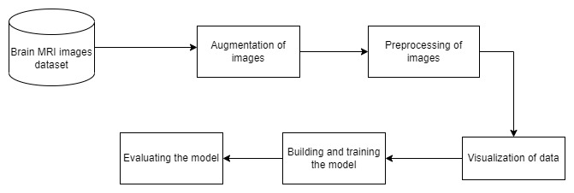
BLOCK DIAGRAM

Slide 5
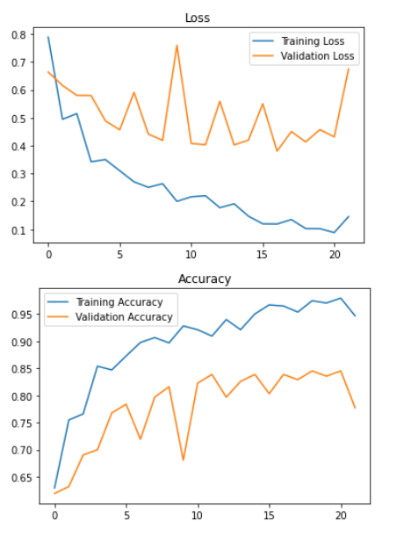
PERFORMANCE

