Slide 1
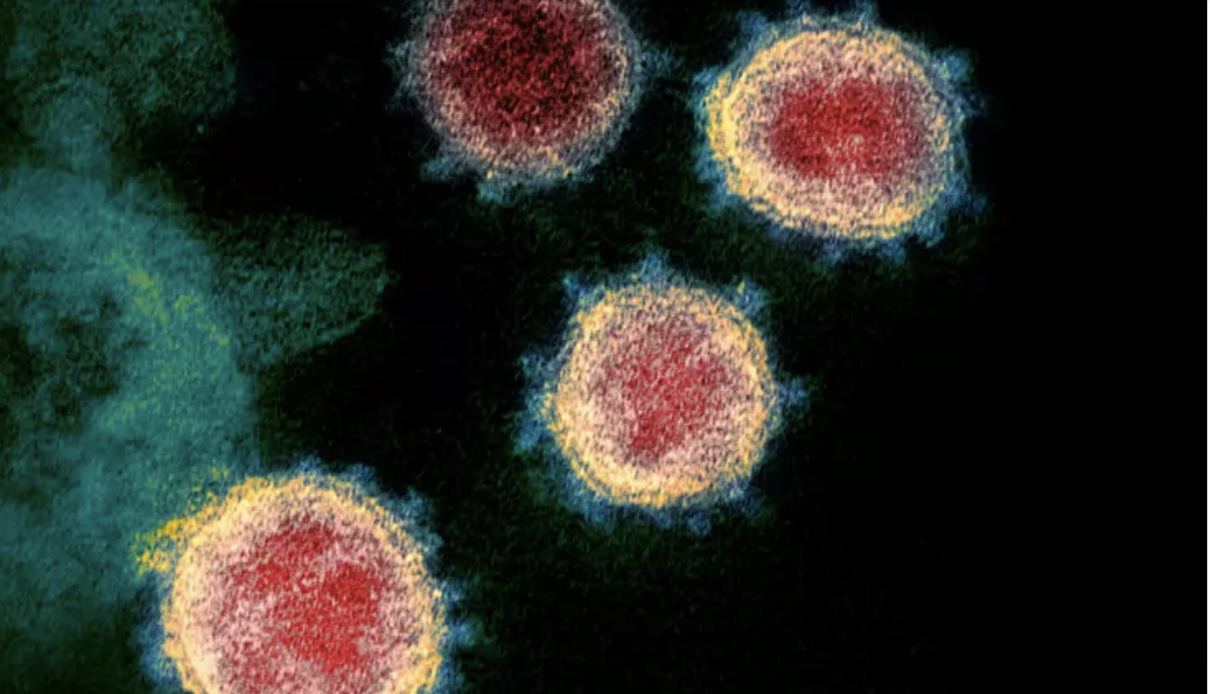
COVID-19 Predictive Analysis
Murat K. Osman
10/08/2022

Slide 2
Outline
Introduction
Analysis
Results
Conclusions and Recommendations

Slide 3
Introduction
Project background and context
The exponential rise in the number of COVID cases threatened to overwhelm health systems worldwide with a demand for hospitalization and for ICU beds far above the capacity.
Testing every case with some mild symptoms, would be impractical in the context of an overburdened health system with the potential limitation to performing tests for the detection of SARS-CoV-2
Problems you want to find answers
Based on the laboratory tests collected from the suspected cases, improve a classification model that predicts the chances of being positive/negative for covid19
What features could influence in the acceptance of patient into hospital?

Slide 4
Data Collection
Describe how data sets were collected.
The data was gathered using a combination of API queries from Hospital Israelita Albert Einstein. There are 5644 rows and 111 columns. The summary of the dataframe for nine column is shown below.
Hospital Israelita Albert Einstein API
Patient ID | Patient age quantile | SARS-Cov-2 exam result | Patient addmited to regular ward (1=yes, 0=no) | Patient addmited to semi-intensive unit (1=yes, 0=no) | Patient addmited to intensive care unit (1=yes, 0=no) | Hematocrit | Hemoglobin | Platelets

Slide 5
Analysis: Data pre-processing (Discrete Features)
There are 42 categorical values with variable 5 and less than 5.
There are several missing values, ranging from %76 to %100.
Missing values of more than 90% were removed.
As a result, 22 columns were left.

Slide 6
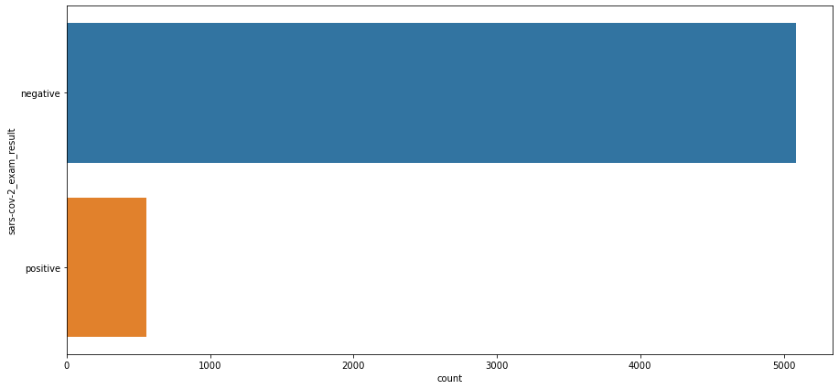
Distribution of the Variables
The number of cases of COVID reported as both positive and negative were analyzed.
Negative | 5086 | 91%
Positive | 558 | 9%

Slide 7
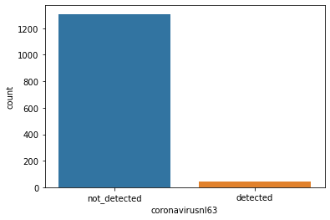
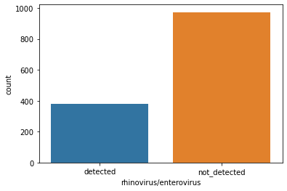
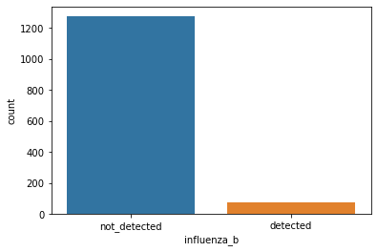
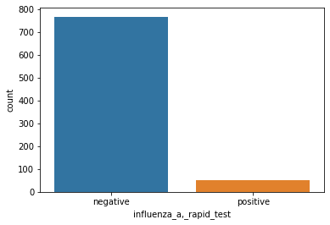
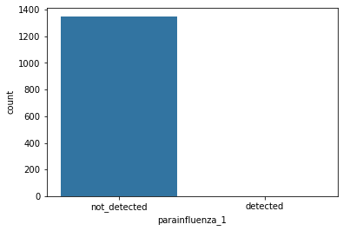
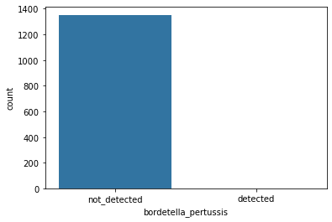
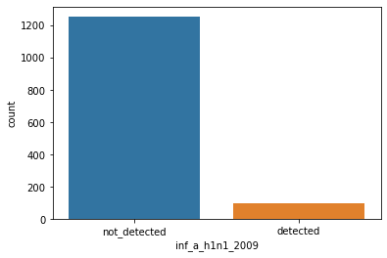
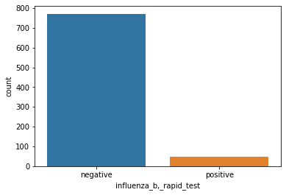
Distribution of the Variables
All the discrete features were analyzed.
Bordetella and parafiluenza_1 were never detected.
The distribution of rhinoviruses and enteroviruses between the two groups is "relatively" more equal.
Negative cases dominate significantly for other categories.

Slide 8
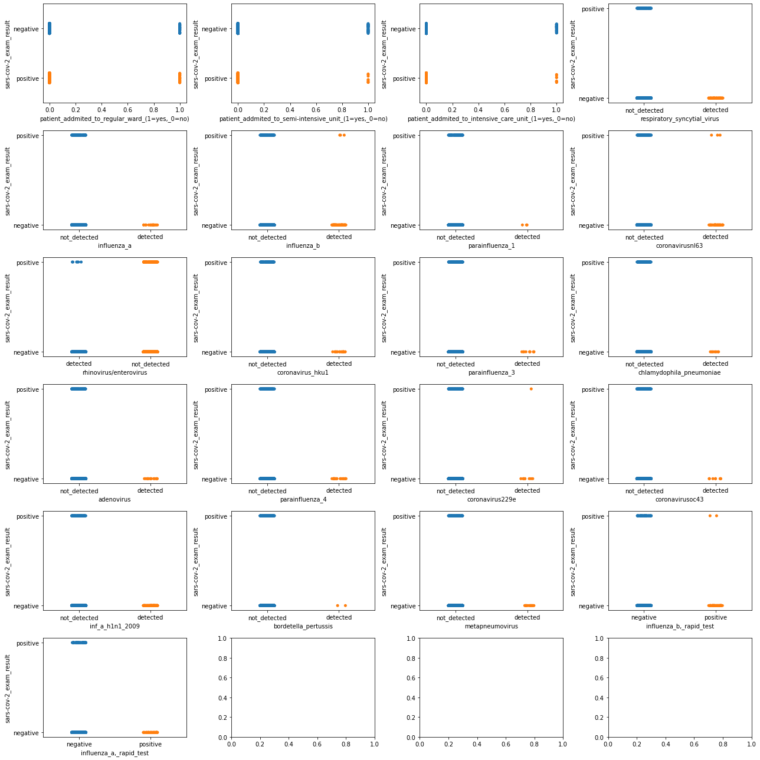
Bivariate Distributions
A stripplot is a fantastic way to demonstrate which attributes are associated with positive sars-cov-2_exam_result.
COVID results were invariably negative when some attributes such as the influenza_a, parainfluenza_1, coronavirus_hku1, rhinovirus and parainfluenza_3 were detected. These characteristics may serve as excellent indicators of a patient's absence of a COVID positive case.

Slide 9
Data pre-processing (Continuous Features)
There are several missing values, ranging from %89 to %100.
Missing values of more than 90% were removed.
As a result, 15 columns were left.

Slide 10
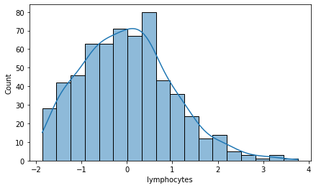
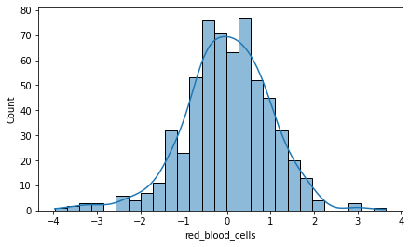
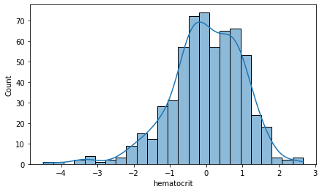
Distribution for continuous features
More of the continuous features are close to normal distribution. For example, mean_platet, red blood_cells, monocytes etc.
However, some of them are right, and some of them are left skewed. As an example, lymphocytes is right skewed, and hematocrit is left-skewed

Slide 11
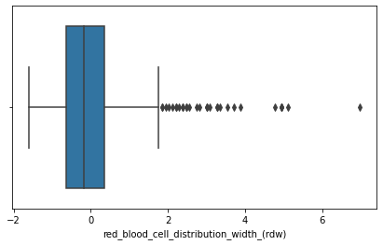
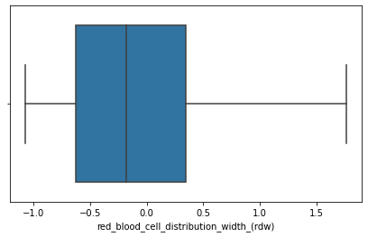
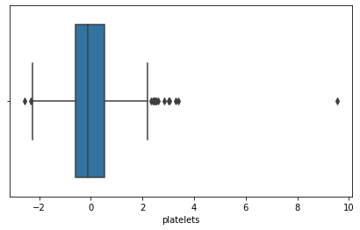
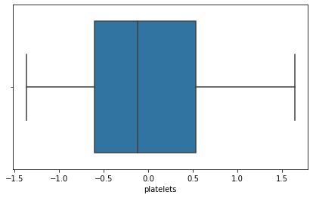
Outlier Treatment
There are a few outliers in each numerical features, except for patient age. I decided the remove the data with 95% confidence level.
Before
After

Slide 12
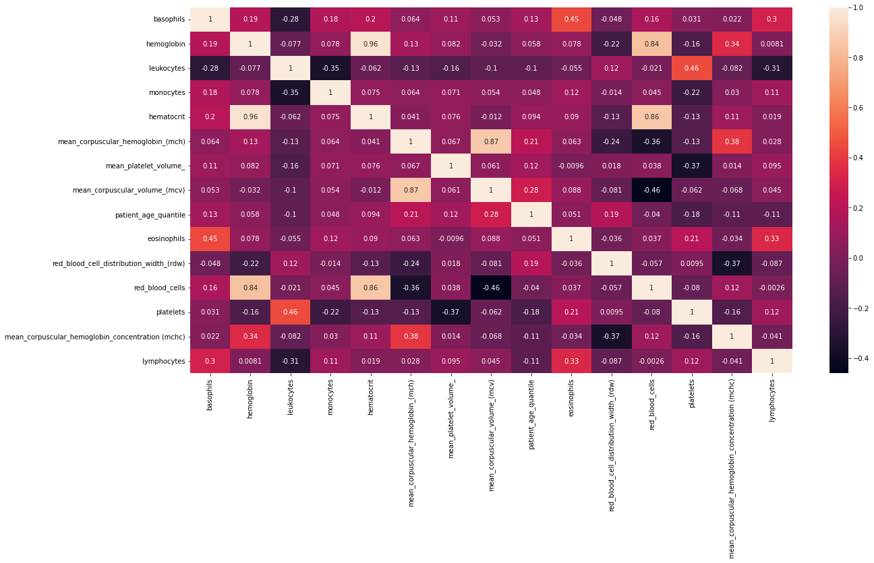
Correlation between features
Red blood cells and haemoglobin have a positive correlation of 0.86. Haemoglobin, a protein rich in iron that gives blood its red color, is found in red blood cells.
Hematocrit and haemoglobin have a positive correlation of 0.96. Red blood cell measures like haemoglobin and hematocrit identify dietary deficits, acute diseases, and long-term medical disorders.
Not : We shall be careful about the collinearity in statistics. When predictor variables in the same regression model are highly-correlated, they cannot independently predict the value of the dependent variable.
Abs values higher than 0.85 must be taken into account for collinearity.
hemoglobin and hematocrit and red_blood_cells
mean_corpuscular_volume_(mcv) and mean_corpuscular_hemoglobin_(mch)

Slide 13
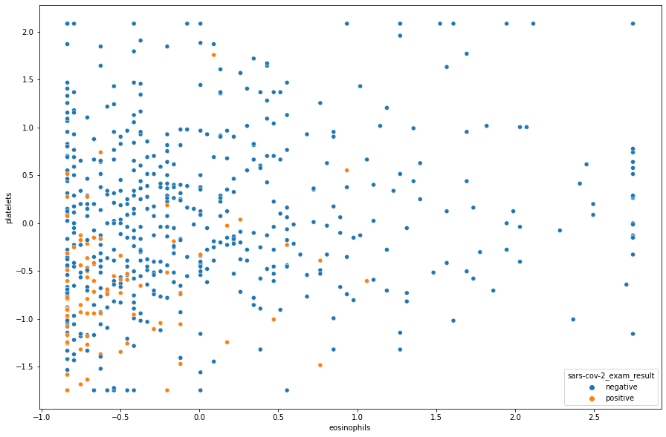
Platelets and Eosinophils
Most of the positive cases remain in the area where both platelets and eosinophils are negative.
No indication of COVID at certain areas.
Red circle stands for the area where low eosinophils and low platelets count exist.
Low platelet count is associated with increased risk of severe disease and mortality in patients with COVID-19.
Ref: Delshad, Mahda, et al. "Platelets in the perspective of COVID-19; pathophysiology of thrombocytopenia and its implication as prognostic and therapeutic opportunity." International immunopharmacology 99 (2021): 107995.
Eosinophil levels were significantly lower in patients with critical disease, when compared to those with moderate and severe diseases. Yan, Bingdi, et al. "Relationship between blood eosinophil levels and COVID-19 mortality." World Allergy Organization Journal 14.3 (2021): 100521.

Slide 14
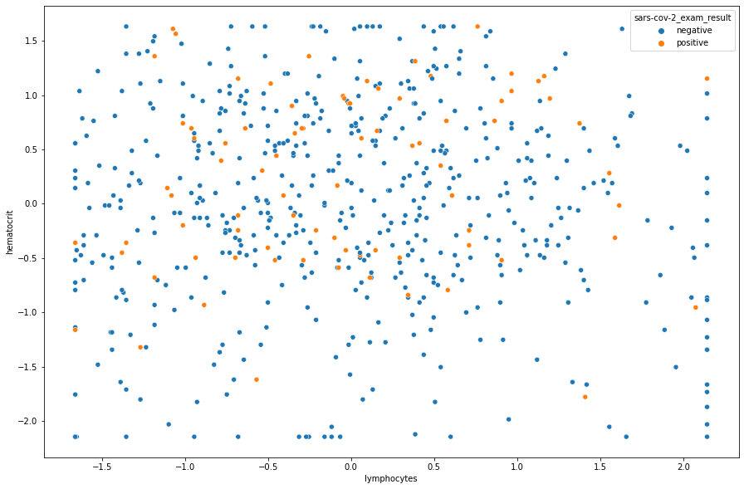
Lymphocytes and Hematocrit
These are two examples of points where both positive and negative covid instances are evenly distributed along the points.
No indication of COVID at certain areas.
Evenly distributed

Slide 15
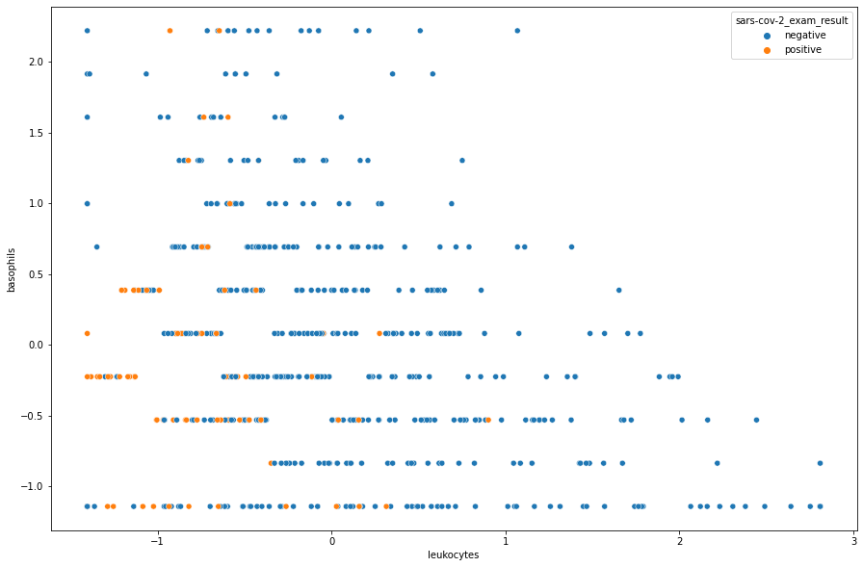
Basophils and Leukocytes
Basophils and leukocytes are not well correlated, but positive covid cases exist more in the negative leukocyte's values.
More covid cases
Previous studies in the first analysis showed significantly lower leukocyte, neutrophil and platelet counts in COVID-19 pneumonia.
Ref : Soraya, Gita Vita, and Zulvikar Syambani Ulhaq. "Crucial laboratory parameters in COVID-19 diagnosis and prognosis: an updated meta-analysis." Medicina clinica 155.4 (2020): 143-151.

Slide 16
Results: Predictive Analysis
(Classification)
 | Tr | Te | Tr | Te
 | Recall |  | Precision
SVM (RBF Kernel) | 0.83 | 0.82 | 0.87 | 0.82
Random Forest | 0.80 | 0.64 | 0.85 | 0.88
Logistic Regression | 0.63 | 0.64 | 0.96 | 0.88
Imputation was applied and multicollinearity was removed using “variance inflation factor” from the statsmodels library.
Precision-Recall Curve was used in SVM and Logistic Regression.
Tuning with best set of parameters was applied to improve overall performance.

Slide 17
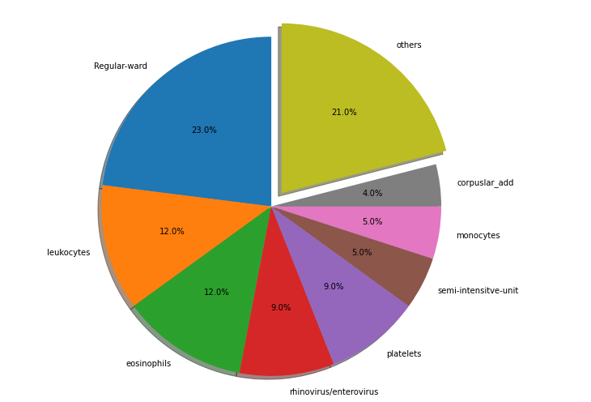
Feature importance
Observations:
Corpuslar add = mean_corpuscular_volume_(mcv)
+ mean_corpuscular_hemoglobin_(mch)
8 features cover 79 of total feature importance. Others include the rest of the features such as lymphocytes, basophils, red_blood_cells…

Slide 18
Conclusions and Recommendations
SVM with RBF kernel has good recall of 0.82 among all the models with and precision of 0.82. We recommend the deployment of this model among all other models because hospital will make right predictions as well as spend less time and budget with using this model.
We advise better data collection methods, especially in Leukocytes, eosinophils, rhinovirus, plateles and monocytes, because only a small number of features overall had missing values of less than 76 %. This caused us to train our model on sparse data and have overfitting issues with trainset frequently.

Slide 19
Thank You ☺
muratkosmanoglu@gmail.com

