Slide 1
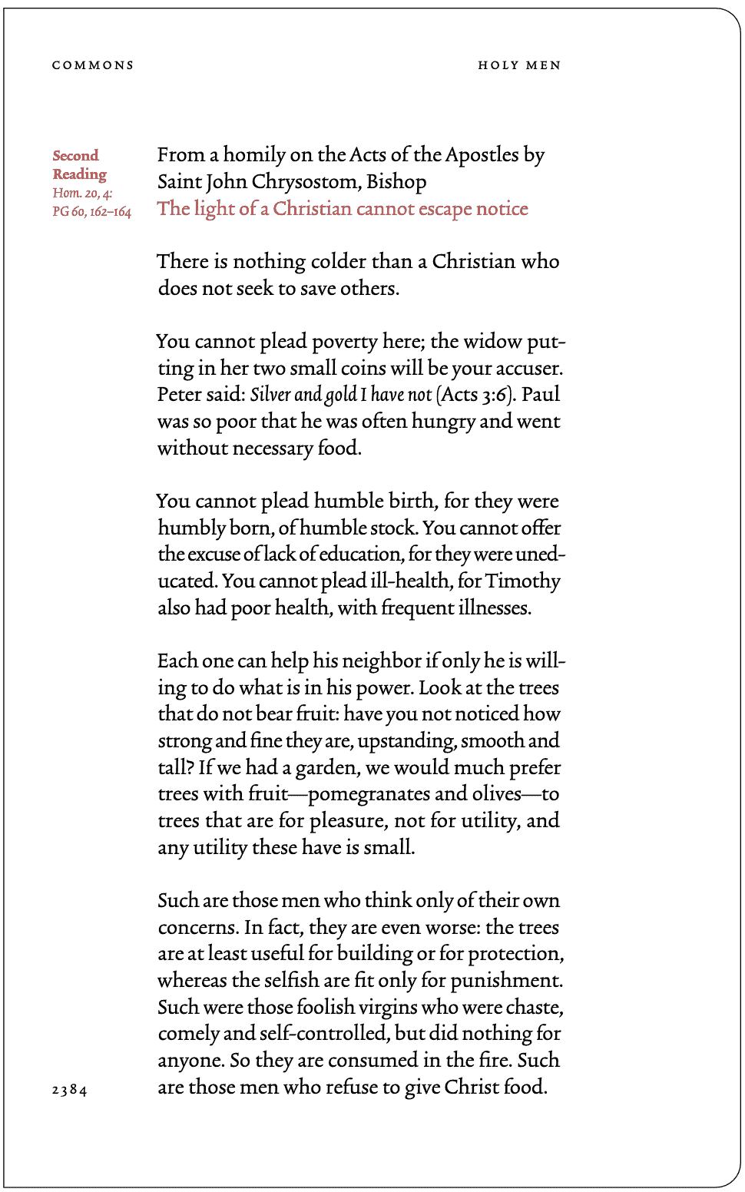
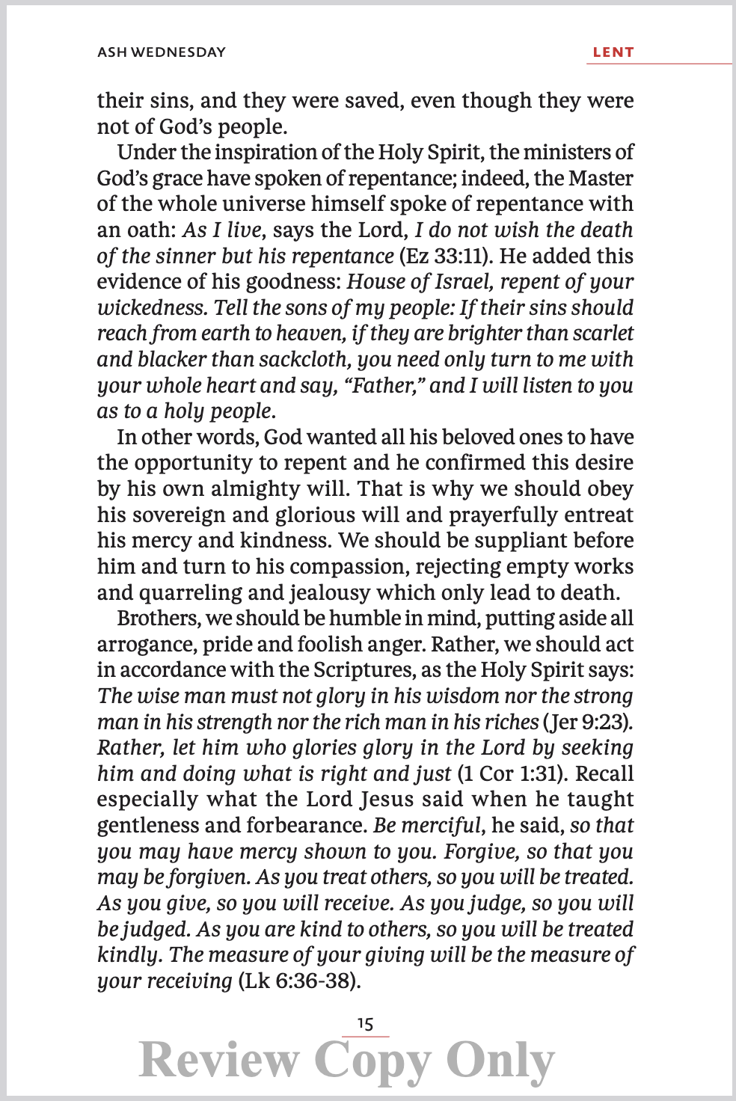
Ascension
Trim Size: 4.5" x 6.75"
Font Size: 10 pt
Margin: 40% of page
Word On Fire
Trim Size: 5" x 8"
Font Size: 11.4 pt
Margin: 56% of page

Slide 2
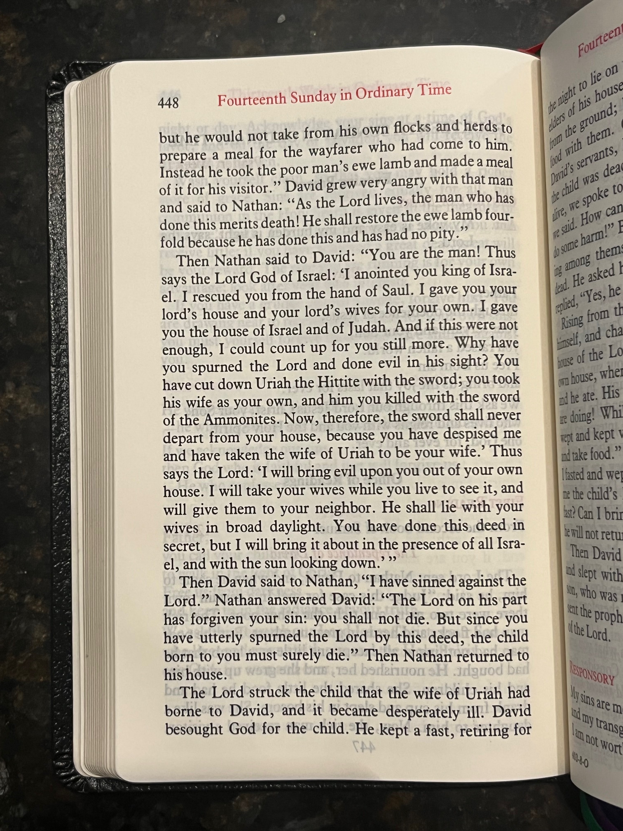
Catholic Book Publishing Co.
Trim Size: 4.75" x 7"
Font Size: 10.5 pt
Margin: ~35% of page
Ascension
Trim Size: 4.5" x 6.75"
Font Size: 10 pt
Margin: ~40% of page
Word On Fire
Trim Size: 5" x 8"
Font Size: 11.4 pt
Margin: ~55% of page

Slide 3
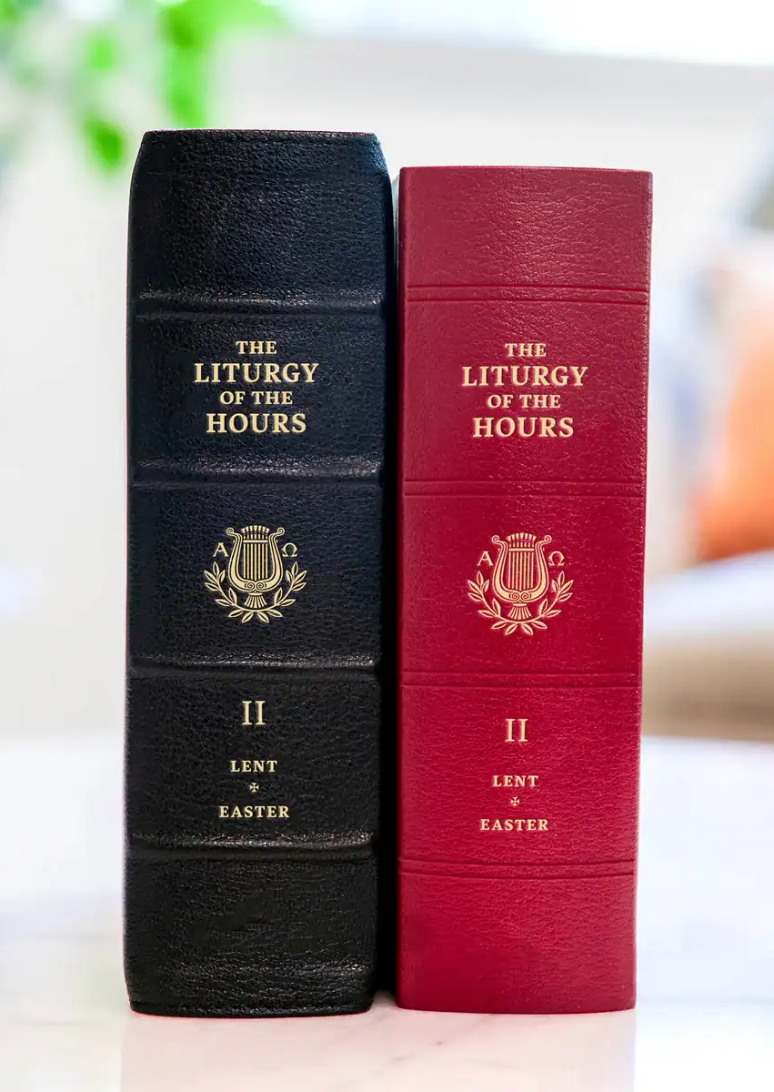


Slide 4
 | Ascension

