Slide 1
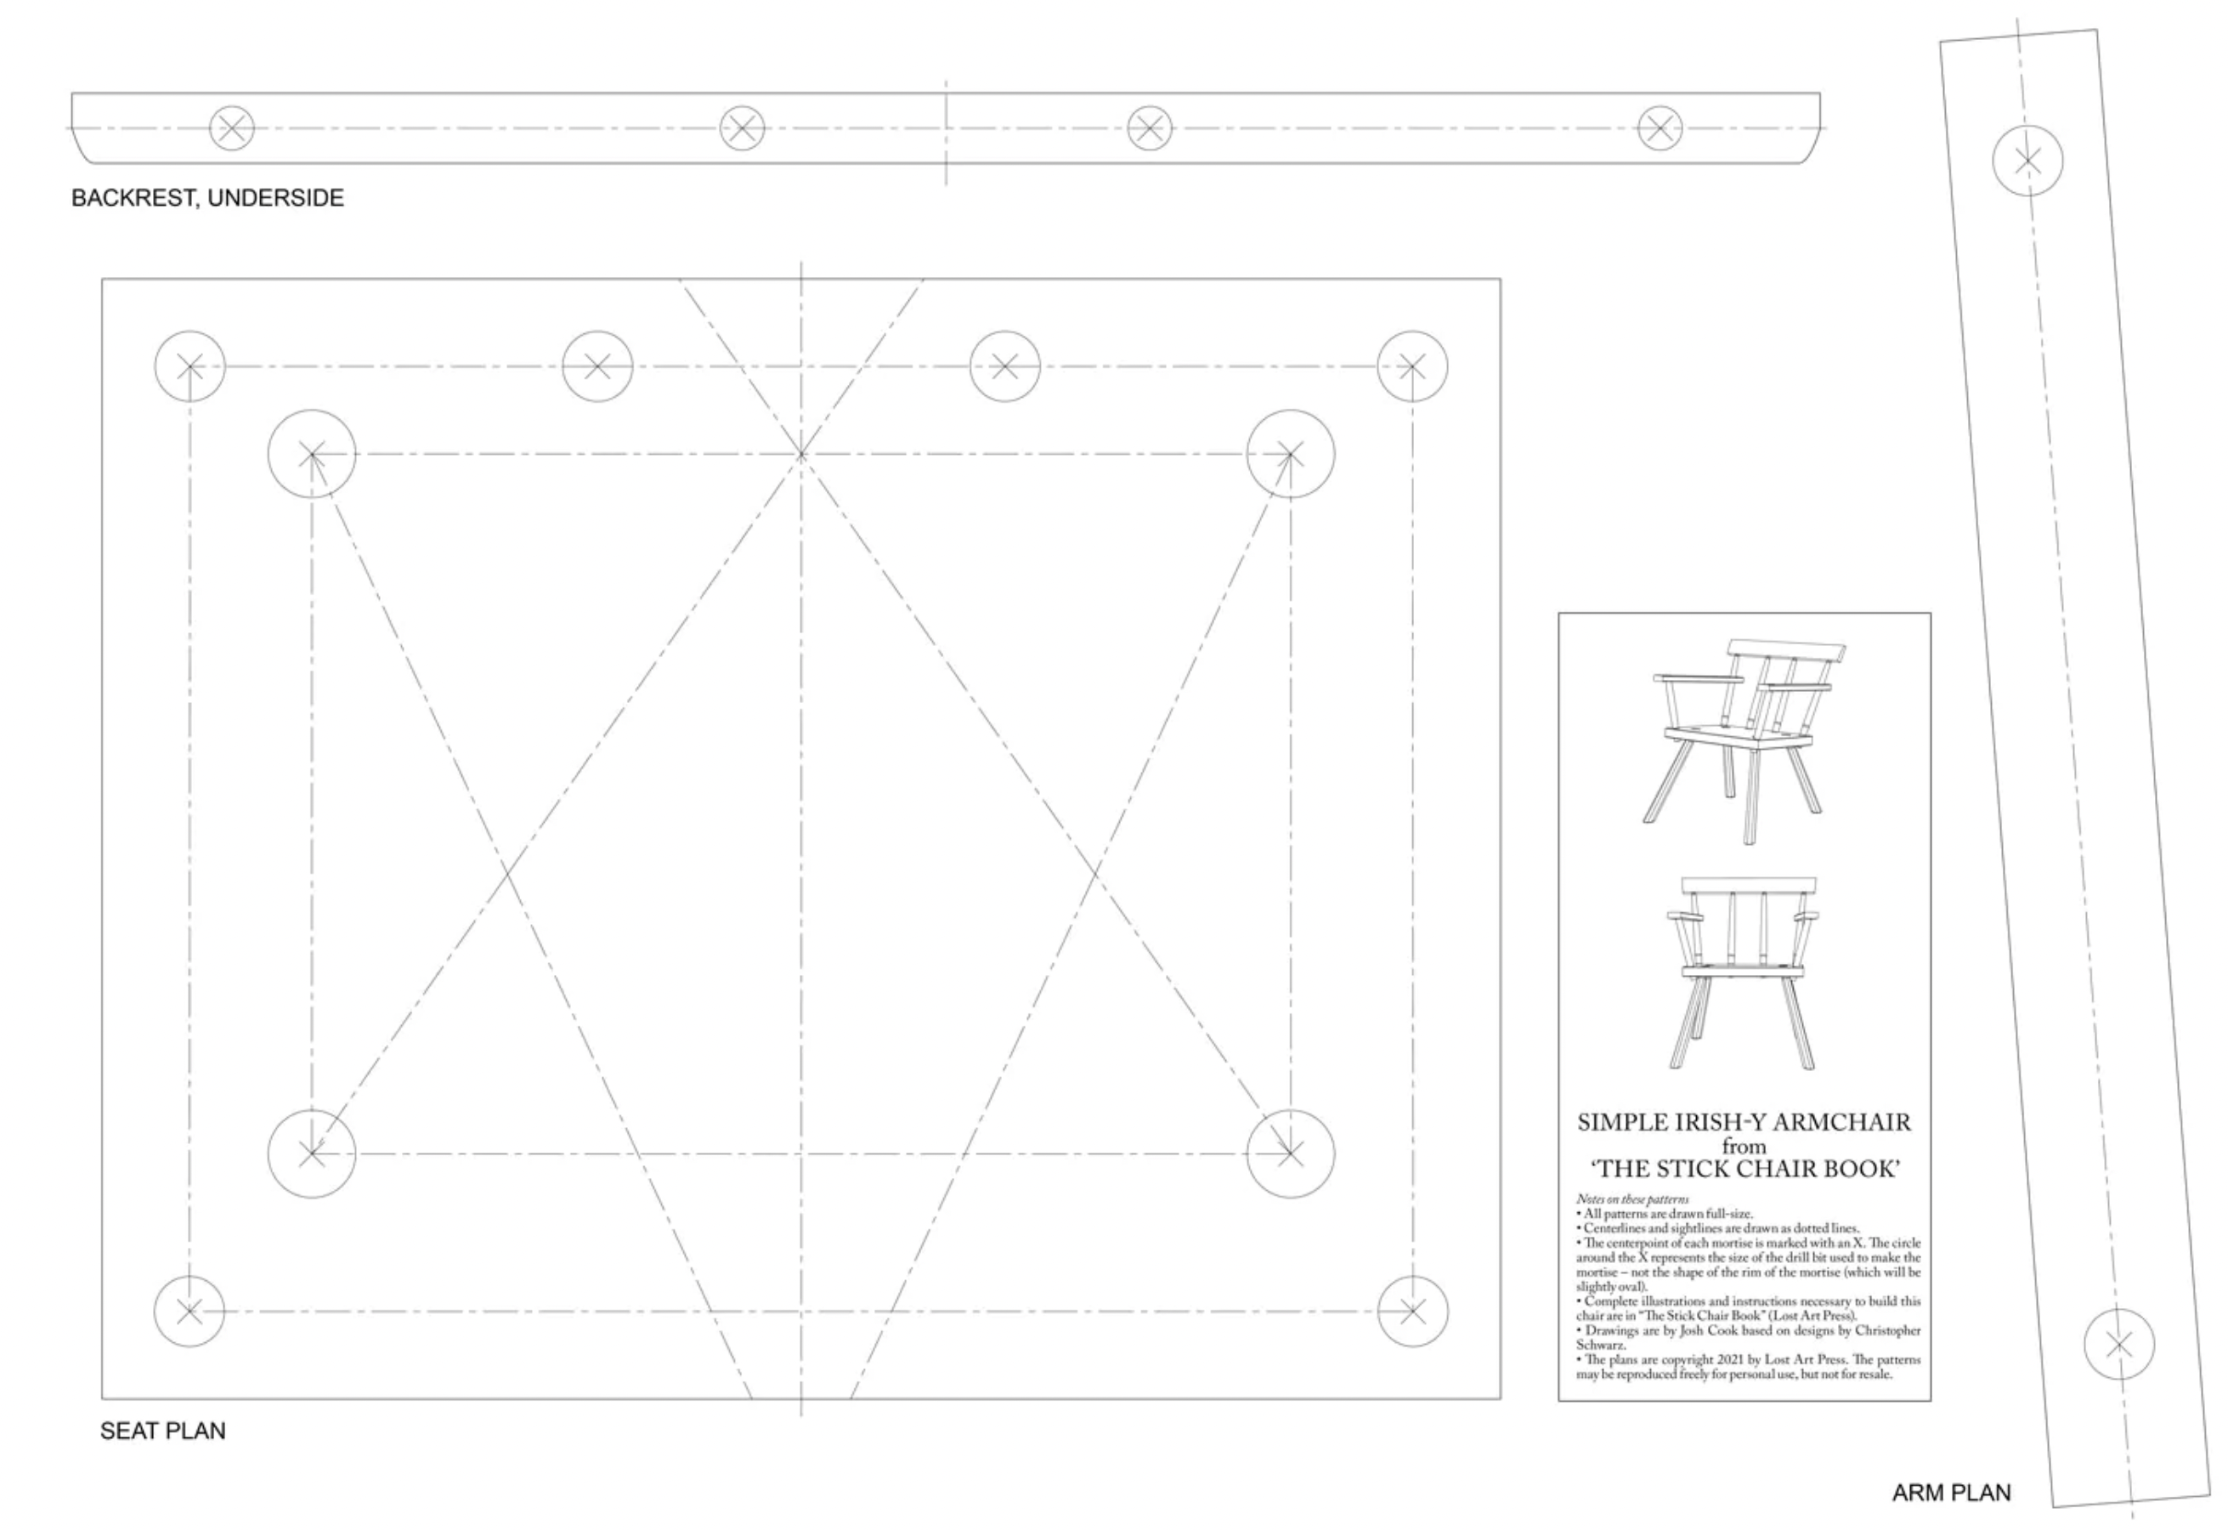
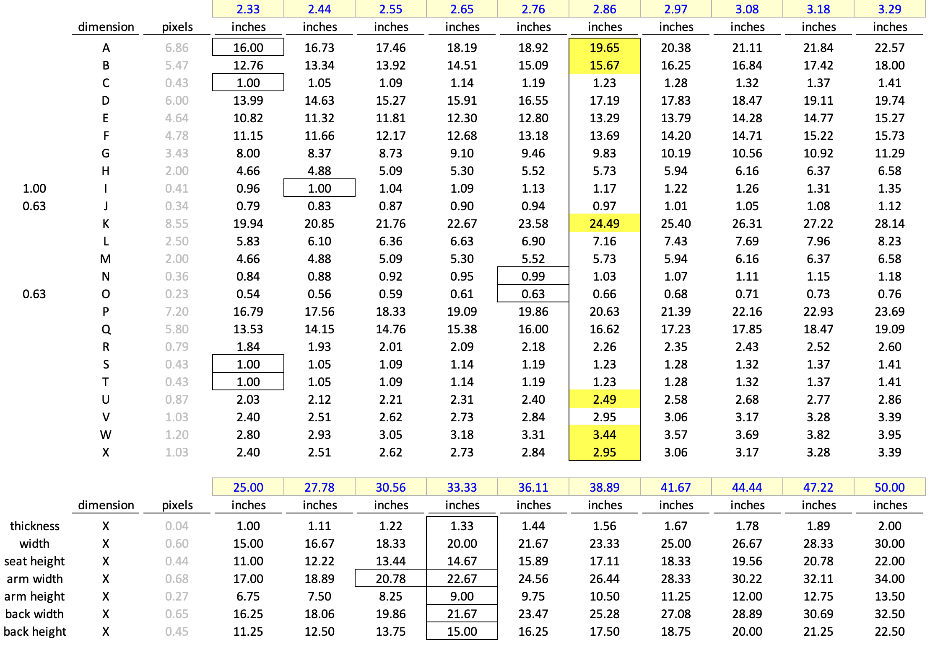
L
M
O
N
K
S
H
U
T
V
Q
P
B
E
G
F
I
X
W
C
D
J
A
R

