Slide 1
Reinforcement Learning for Reasoning in Large
Language Models with One Training Example
Scope
Course: Reinforcement Learning
Theme: RL with verifiable rewards
Base: Qwen2.5-Math-1.5B
Stack: Colab · T4 · QLoRA · TRL GRPO
Artifacts: RLVR.ipynb, DeePO_DAPO.ipynb
presentation · grounded in project notebooks, Colab runs, and DAPO_Implementation_Report.md

Slide 2
Contributions and project innovations
What this work adds beyond a slide deck
Reproduced the One-Shot RLVR evaluation story on Qwen2.5-Math-1.5B with the official six-benchmark protocol used in the course project.
Implemented a DAPO-style GRPO recipe—Clip-Higher, dynamic sampling awareness, token-level loss behavior, and overlong reward shaping—scaled to a 500-example GSM8K+MATH mix.
Delivered an end-to-end Colab pipeline: QLoRA adapters, training, merge for inference, and documented honest evaluation limits under free-tier GPU quotas.
Tied algorithm choices to known GRPO failure modes (entropy collapse, length bias, zero-variance groups, truncation noise) so each modification has a clear motivation.
RLVR → DAPO — Reinforcement Learning with Verifiable Rewards
2

Slide 3
Agenda
Five-part narrative aligned with the live talk
Part 1 — Motivation: why math reasoning needs RL with verifiable rewards.
Part 2 — RLVR baseline: paper claims, GRPO loop, reproduced metrics, full benchmark protocol.
Part 3 — DAPO upgrade: four coordinated techniques and reward design.
Part 4 — Engineering: T4 constraints, training curves, expected vs. actual evaluation framing.
Part 5 — Conclusion: what worked, limitations, and the next evaluation sprint.
RLVR → DAPO — Reinforcement Learning with Verifiable Rewards
3

Slide 4
PART 1
Why verifiable-reward RL for math
From flawed chain-of-thought to correctness-grounded policy improvement.
RLVR → DAPO — Reinforcement Learning with Verifiable Rewards · Section
4

Slide 5
Problem statement
Large language models and mathematical reasoning
Models often produce fluent derivations with wrong final answers—supervision on text alone under-rewards the full reasoning process.
Mathematics offers automatic verifiers: extract \boxed{} answers and compare to ground truth without human preference labels.
The project goal is not only higher accuracy but behavior that tracks multi-step reasoning under the same backbone (Qwen2.5-Math-1.5B).
RLVR demonstrates extreme data efficiency; DAPO asks how to optimize the RL loop once that signal exists.
Research question
Can verifiable-reward RL improve a small open math model, and can a DAPO-style recipe make that RL phase stabler on limited hardware?
Project arc
Reproduce → diagnose GRPO limits → implement targeted fixes → report results with intellectual honesty.
RLVR → DAPO — Reinforcement Learning with Verifiable Rewards
5

Slide 6
Project roadmap
From paper reading to merged adapters
Understand RLVR (one-shot verifiable RL) and its reported jumps on MATH500 and the six-benchmark average.
Run RLVR.ipynb and align numbers with the official evaluation flow.
Study DAPO as a systems + algorithms stack for large-scale reasoning RL; extract techniques portable to 1.5B.
Implement DeePO_DAPO.ipynb: QLoRA, GRPOTrainer, shaped rewards, Clip-Higher epsilon, 200 steps.
Save adapters, merge weights, and schedule evaluation—documenting quota and memory barriers explicitly.
RLVR → DAPO — Reinforcement Learning with Verifiable Rewards
6

Slide 7
RLVR paper — core claims
One training example, large capability shift
RLVR shows that a single carefully chosen math example can unlock large benchmark gains via GRPO-style training.
Reported on Qwen2.5-Math-1.5B: MATH500 ~36.0% → 73.6%; six-benchmark average ~17.6% → 35.7%.
Our reproduced baseline sits at 73.0% on MATH500 with ~33.9% average—consistent with the paper-scale story.
Implication: verifiable reward + policy optimization can be radically sample-efficient in math.
Why it matters
It reframes RL data needs for reasoning: correctness labels plus exploration can beat naive scaling assumptions.
Bridge to DAPO
If the signal is there, the next bottleneck is optimization quality—exactly what DAPO targets.
RLVR → DAPO — Reinforcement Learning with Verifiable Rewards
7

Slide 8
RLVR in one slide
Reinforcement learning with verifiable rewards
RLVR = policy learning where reward comes from automatic correctness checks on final answers.
Avoids costly human preference models while keeping learning aligned with ground truth.
Particularly clean in math: parse \boxed{}, normalize, compare.
Pairs naturally with group-based policy optimization (GRPO): relative advantages within sampled completions.
Contrast with SFT
SFT teaches token patterns; RLVR reweights trajectories that actually solve the task under the verifier.
Course hook
This project is a concrete instance of RL with structured reward engineering—not toy gridworlds.
RLVR → DAPO — Reinforcement Learning with Verifiable Rewards
8

Slide 9
GRPO baseline (DeepSeekMath lineage)
Group-relative advantages without a critic
Advantage for completion i in a group of K samples:
A_i = ( r_i - mean(r) ) / std(r) (std guard for degenerate groups)
Clipped surrogate (PPO-style), minimizing:
L = - E[ min( rho_t A_t , clip(rho_t, 1-eps, 1+eps) A_t ) ]
GRPO removes a separate value network by normalizing rewards within each prompt group—efficient but sensitive to clipping, length aggregation, and reward sparsity.
Project use
TRL GRPOTrainer instantiates this loop; DAPO modifies how clipping, sampling, token loss, and length enter the objective.
RLVR → DAPO — Reinforcement Learning with Verifiable Rewards
9

Slide 10
RLVR training loop
Prompt → group → reward → update
Sample
group
GRPO
update
Prompt
Reward
Evaluate
Verifiable reward
Final math answers can be checked programmatically; correctness becomes the learning signal instead of human preferences.
Policy signal
The optimizer upweights reasoning traces that end in correct \boxed{} answers relative to the group.
RLVR → DAPO — Reinforcement Learning with Verifiable Rewards
10

Slide 11
RLVR implementation snapshot
What we actually ran for the baseline
Component | Choice
Base model | Qwen2.5-Math-1.5B
Evaluation | One-Shot-RLVR official pipeline
Environment | Google Colab · Tesla T4
Benchmarks | MATH500, AMC23×8, AIME24×8, AIME25×8, Minerva, OlympiadBench
Decoding | Greedy or multi-sample per benchmark protocol
RLVR.ipynb encodes the baseline path and evaluation hooks.
Numbers in this deck match the implementation report’s reproduced table.
This baseline is the scientific reference for any DAPO-style upgrade.
RLVR → DAPO — Reinforcement Learning with Verifiable Rewards
11

Slide 12
Benchmark protocol (detail)
Counts, difficulty, and sampling — from the implementation report
Benchmark | Problems | Difficulty | Sampling
MATH500 | 500 | Mixed L1–L5 | Greedy T=0
AMC23×8 | 320 | Competition | T=0.6, 8 samples
OlympiadBench | 675 | Olympiad | Greedy T=0
Minerva Math | 272 | University | Greedy T=0
AIME24×8 | 240 | Competition | T=0.6, 8 samples
AIME25×8 | 240 | Competition | T=0.6, 8 samples
RLVR → DAPO — Reinforcement Learning with Verifiable Rewards
12

Slide 13
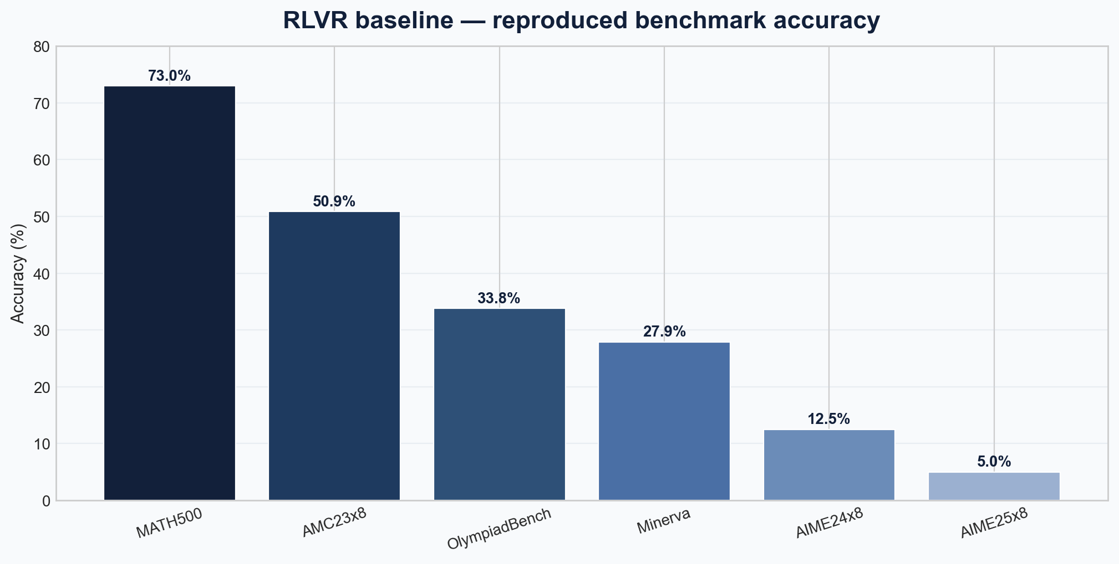
RLVR baseline results
Reproduced accuracies
Takeaway
Strongest on MATH500; AIME-style benchmarks remain difficult for the 1.5B baseline.
Aggregate
Mean accuracy across the six benchmarks is about 33.9%, matching the implementation report.
Benchmark | Acc.
MATH500 | 73.0%
AMC23×8 | 50.9%
OlympiadBench | 33.8%
Minerva | 27.9%
AIME24×8 | 12.5%
AIME25×8 | 5.0%
RLVR → DAPO — Reinforcement Learning with Verifiable Rewards
13

Slide 14
Why move beyond vanilla GRPO
Baseline strength ≠ optimal RL recipe
The RLVR baseline is already strong on MATH500—so improvements must be carefully attributed.
Plain GRPO can show entropy collapse: policy variance shrinks and exploration dies.
Sequence-level aggregation can bias against long correct derivations.
Zero-variance groups waste backward passes; hard truncation injects reward noise.
DAPO bundles fixes aimed exactly at these mechanics—not a unrelated new paradigm.
Honest framing
We are not claiming the baseline is “bad”; we claim the optimizer can be more compute-aware and stable.
Transition
Next: DAPO’s four techniques mapped one-to-one to these failure modes.
RLVR → DAPO — Reinforcement Learning with Verifiable Rewards
14

Slide 15
PART 2
DAPO on the same backbone
Clip-Higher, sampling discipline, token-level loss, and shaped rewards—ported to 1.5B.
RLVR → DAPO — Reinforcement Learning with Verifiable Rewards · Section
15

Slide 16
DAPO — system and algorithm stack
Open-source RL at scale, adapted down
DAPO (Yu et al., arXiv:2503.14476) packages four coordinated GRPO upgrades for reasoning models.
At large scale it reports strong AIME performance (e.g., ~50 on AIME 2024 with Qwen2.5-32B in the paper narrative).
We do not replicate that scale; we replicate the mechanism bundle on Qwen2.5-Math-1.5B with QLoRA.
Deliverable: a stable Colab training run plus explicit expected bands for evaluation under budget limits.
Four knobs
Clip-Higher · Dynamic sampling · Token-level policy gradient · Overlong reward shaping.
Design constraint
Every choice is justified by T4 VRAM and single-GPU training time—not only by paper-scale defaults.
RLVR → DAPO — Reinforcement Learning with Verifiable Rewards
16

Slide 17
Why DAPO after RLVR
Same research line, harder optimization
RLVR answers: “can verifiable reward work with extreme data efficiency?”
DAPO answers: “given that signal, how should we optimize policy updates for reasoning traces?”
Selecting DAPO is therefore a direct extension—not a topic change.
Our implementation keeps GRPO as the skeleton and swaps in DAPO’s stabilizers.
One sentence
RLVR supplies the verifier-backed reward; DAPO supplies the optimizer hygiene for that reward.
Pedagogical payoff
Listeners see a full stack: problem → baseline → targeted algorithmic patch set.
RLVR → DAPO — Reinforcement Learning with Verifiable Rewards
17

Slide 18
Failure mode → DAPO response
A deliberate mapping (innovation narrative)
Failure mode | Symptom | DAPO lever
Entropy collapse | Narrow reasoning styles | Clip-Higher (ε_high > ε_low)
Wasted steps | All rewards equal in group | Dynamic sampling / skip zero-variance updates
Length bias | Long correct traces penalized | Token-level policy gradient loss
Truncation noise | Hard cut kills near-correct work | Overlong reward shaping
RLVR → DAPO — Reinforcement Learning with Verifiable Rewards
18

Slide 19
Technique 1 — Clip-Higher
Decoupled clipping for exploration
Symmetric clipping (e.g., ε=0.2 both sides) can cap useful probability increases as aggressively as decreases.
DAPO raises the upper clip bound so promising token mass shifts are throttled less.
Our GRPO config uses ε=0.28 on the upper side (implementation report alignment).
Intent: preserve diversity in reasoning paths while still bounding destructive updates.
Say aloud
RLVR provides the reward; Clip-Higher lets the policy move toward better answers without premature collapse.
clip(ρ_t, 1 − ε_low , 1 + ε_high) with ε_high > ε_low
RLVR → DAPO — Reinforcement Learning with Verifiable Rewards
19

Slide 20
Technique 2 — Dynamic sampling
Do not train on zero-information groups
If every completion shares the same reward, normalized advantages are all zero.
Backward passes on such groups burn GPU time without gradient signal.
DAPO filters these cases; in TRL, std(r)→0 yields zero advantage naturally—align training code with that behavior.
On Colab, this is not a minor detail: every minute must buy a policy update.
Plain language
Equal rewards mean the model cannot tell which answer was better—teach only when the group disagrees in quality.
RLVR → DAPO — Reinforcement Learning with Verifiable Rewards
20

Slide 21
Technique 3 — Token-level loss
Reduce length bias in chain-of-thought
Sequence-level averaging can treat a 500-token correct solution like a 50-token one.
Token-level aggregation spreads credit across each generated token—better match for long derivations.
Our stack uses TRL GRPOTrainer with token-level training behavior and gradient checkpointing.
Especially important when answers require intermediate lemmas and checks.
Math-specific
We want the model to keep structured multi-step work when it is correct—not collapse to shortcuts only.
RLVR → DAPO — Reinforcement Learning with Verifiable Rewards
21

Slide 22
Technique 4 — Overlong reward shaping
Soft length pressure vs. hard truncation
Hard truncation can mark almost-correct long answers as fully wrong—noisy reward.
DAPO uses graded penalties past a length threshold instead of brittle zeros.
Our reward subtracts up to −0.3 beyond 400 tokens while preserving correctness signal.
Optional small bonus for well-formed \boxed{} output nudges formatting without replacing correctness.
Design
Reward = correctness + format bonus + overlong penalty (see numeric table next).
RLVR → DAPO — Reinforcement Learning with Verifiable Rewards
22

Slide 23
Reward design — qualitative
Three-term signal
Primary term: match extracted \boxed{} answer to normalized ground truth.
Secondary: small negative signal if no parseable answer is found.
Tertiary: soft length shaping so verbosity is discouraged without destroying credit assignment.
Principle
Rewards should be cheap to compute, hard to game, and aligned with exam-style correctness.
RL perspective
Shaping interacts with clipping and token loss—this is a system, not isolated hacks.
RLVR → DAPO — Reinforcement Learning with Verifiable Rewards
23

Slide 24
Reward design — numeric table
Exact shaping constants from the report
Signal | Value | Role
Correct answer | +1.0 | \boxed{} matches normalized truth
Wrong / missing | 0.0 | No credit for incorrect final answer
No extracted answer | −0.1 | Penalize unparseable outputs
Format bonus | +0.05 | Proper \boxed{} usage
Overlong penalty | up to −0.3 | Graduated beyond 400 tokens
RLVR → DAPO — Reinforcement Learning with Verifiable Rewards
24

Slide 25
PART 3
Engineering the Colab run
QLoRA, memory budget, hyperparameters, and artifacts.
RLVR → DAPO — Reinforcement Learning with Verifiable Rewards · Section
25

Slide 26
DAPO implementation — hyperparameters
DeePO_DAPO.ipynb
Parameter | Value
Base model | Qwen2.5-Math-1.5B
Platform | Google Colab
GPU | Tesla T4 (15.6 GB VRAM)
Fine-tuning | QLoRA, 4-bit NF4
LoRA rank / alpha | 16 / 32
Group size | 4
Train size | 500 examples
Steps | 200
Learning rate | 5e-6
Clip epsilon | 0.28
KL beta | 0.04
Max completion length | 512
Training mix: 500-example subset from GSM8K + competition MATH train splits.
TRL GRPOTrainer drives rollouts, advantage computation, and PEFT-compatible updates.
Adapters saved separately; merged weights produced for evaluation-style inference.
Gradient accumulation (e.g., 8) raises effective batch without exceeding VRAM.
RLVR → DAPO — Reinforcement Learning with Verifiable Rewards
26

Slide 27
T4 memory strategy
Fitting reasoning RL in ~15 GB
4-bit NF4 quantization shrinks the frozen backbone footprint while keeping training workable.
LoRA trains a small adapter (~tens of millions of parameters) instead of full weights.
No separate reference model copy: PEFT uses frozen base weights as the reference anchor.
Gradient checkpointing trades extra compute for activations memory.
Group size G=4 caps concurrent completions to respect KV-cache pressure.
RLVR → DAPO — Reinforcement Learning with Verifiable Rewards
27

Slide 28
Efficiency and reproducibility
Why this project is portable
Student-grade GPUs can still run meaningful RL if quantization + adapters + small groups are composed deliberately.
The notebooks isolate data prep, training, merge, and (intended) evaluation for clarity.
Documenting Colab limits turns a “failed eval” into a reproducible systems anecdote.
Future work: Colab Pro, Kaggle, L4/A100 to close the measurement gap.
Outcome
A modular recipe others can re-run: same code path, bigger budget → full benchmark tables.
Integrity
Engineering success is the trained merged artifact; scientific completion is the pending full eval.
RLVR → DAPO — Reinforcement Learning with Verifiable Rewards
28

Slide 29
PART 4
Results and evaluation framing
Training dynamics, comparisons, and honest limits.
RLVR → DAPO — Reinforcement Learning with Verifiable Rewards · Section
29

Slide 30
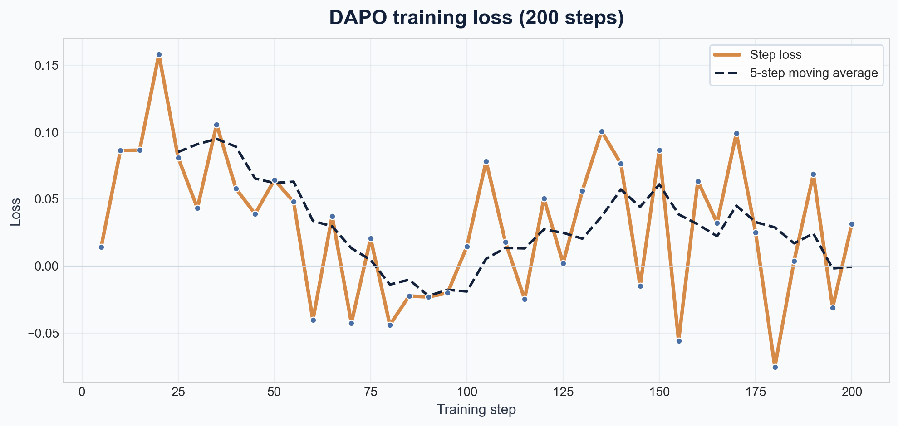
Training dynamics
DAPO run on Tesla T4
Runtime
Training completed 200 steps in roughly 4h 5m on a Tesla T4 in Colab.
Final loss
Reported loss at step 200: 0.0314.
Reading the curve
RL losses are noisy; the run stayed stable without collapse—consistent with practical GRPO-style training.
RLVR → DAPO — Reinforcement Learning with Verifiable Rewards
30

Slide 31
RLVR vs. our DAPO implementation
Side-by-side method comparison
Aspect | RLVR baseline | DAPO (ours)
Core idea | One-shot verifiable RL | GRPO + DAPO stabilizers
Policy update | Standard GRPO | GRPO + Clip-Higher + token-level loss
Clipping | Symmetric ~0.2 | Asymmetric upper ε=0.28
Reward | Correctness-centric | Correctness + format + overlong
Training data | One example (paper) | 500-example GSM8K+MATH mix
PEFT | Paper-dependent | QLoRA 4-bit NF4
Goal | Reproduce paper | Improve optimization path
RLVR → DAPO — Reinforcement Learning with Verifiable Rewards
31

Slide 32
Expected improvements (report §7)
Scaled-down targets—not measured finals
Benchmark | RLVR | DAPO low | DAPO high | Δ (low) | Δ (high)
MATH500 | 73.0% | 75.0% | 78.0% | +2.0% | +5.0%
AMC23×8 | 50.9% | 53.0% | 58.0% | +2.1% | +7.1%
OlympiadBench | 33.8% | 35.0% | 40.0% | +1.2% | +6.2%
Minerva | 27.9% | 29.0% | 33.0% | +1.1% | +5.1%
AIME24×8 | 12.5% | 14.0% | 18.0% | +1.5% | +5.5%
AIME25×8 | 5.0% | 6.0% | 10.0% | +1.0% | +5.0%
RLVR → DAPO — Reinforcement Learning with Verifiable Rewards
32

Slide 33
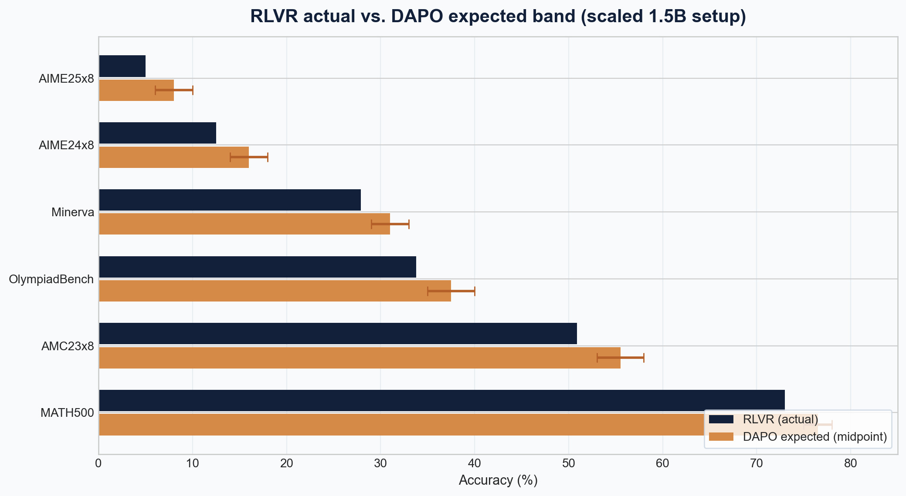
Evaluation figure
Actual RLVR vs. expected DAPO band
Integrity
Colab quota interrupted full post-training evaluation; orange bands reflect scaled expected ranges from the DAPO paper and our setup—not final measured DAPO scores.
Message
Implementation and training completed successfully; the open item is exhaustive benchmarking on higher budgets.
RLVR → DAPO — Reinforcement Learning with Verifiable Rewards
33

Slide 34
Limitations
Quota, partial benchmarks, and scope
Colab daily limits interrupted exhaustive post-training evaluation; MATH500 eval was started but not finished under quota.
T4 VRAM caps group size, context, and how aggressively we can mirror paper-scale runs.
Orange “DAPO” bars in the summary chart are expected intervals from scaled assumptions—not claimed empirical wins yet.
Despite that, training completed and merged artifacts exist—ready for a higher-budget eval sprint.
Strength
End-to-end pipeline validation on constrained hardware is itself a contribution for coursework replication.
Next step
Re-run the six benchmarks on Colab Pro, Kaggle, or A100; optionally extend steps (500–1000) and data >500.
RLVR → DAPO — Reinforcement Learning with Verifiable Rewards
34

Slide 35
PART 5
Conclusion
What we proved, what remains measured, where to go next.
RLVR → DAPO — Reinforcement Learning with Verifiable Rewards · Section
35

Slide 36
Conclusion and future work
Close the loop
Reproduced RLVR-class baseline metrics that anchor all later claims.
Implemented a DAPO-informed GRPO trainer with shaped rewards and asymmetric clipping on the same backbone.
Demonstrated a reproducible Colab path from adapters to merged model weights.
Remaining scientific debt: full benchmark table under sufficient GPU hours.
Extensions: longer training, larger groups where VRAM allows, richer reward tests (sympy normalization), and ablations per DAPO component.
References
Wang et al., RL for Reasoning in LLMs with One Training Example, 2025.
Yu et al., DAPO: Open-Source LLM RL at Scale, arXiv:2503.14476.
Shao et al., DeepSeekMath, 2024.
Hu et al., LoRA, 2021.
Project: RLVR.ipynb, DeePO_DAPO.ipynb, DAPO_Implementation_Report.md.
One-line takeaway
RLVR proves verifier-backed RL can start from tiny data; DAPO-style optimization is how we stress-test that idea on real trainers.
RLVR → DAPO — Reinforcement Learning with Verifiable Rewards
36

