Slide 1
We really know
How to learn JavaScript?
Notes:
#Introduce yourself.
Name
Location (India)
# Explain webinar topics.
#Explain What is the need of this session.
#Explain we are trying to make session more engaging by using some tools.

Slide 2
Agenda
Interactive training registration
Current learning approach
What we missed
What is wrong perceptions we have
What is the right way
Notes:
#Explain agenda as single line only.

Slide 3
Interactive Training Registration
https://goo.gl/6O5hcA
Notes:
#Guide audience to how to register for session.
# Max 5 min.

Slide 4
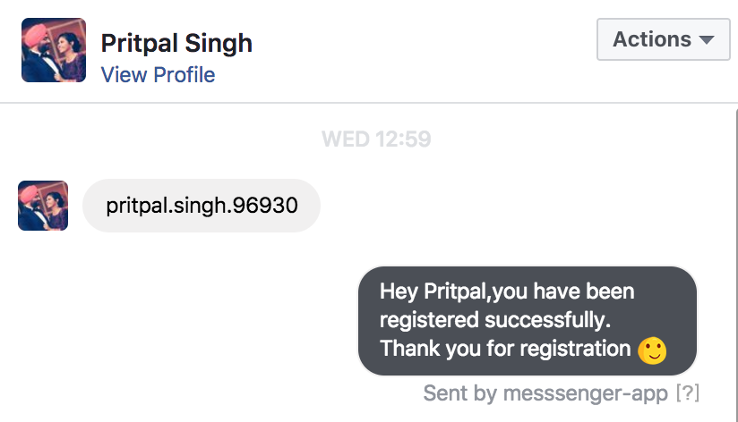
Interactive Training Registration
Notes:
# Guide audience about confirmation message.

Slide 5
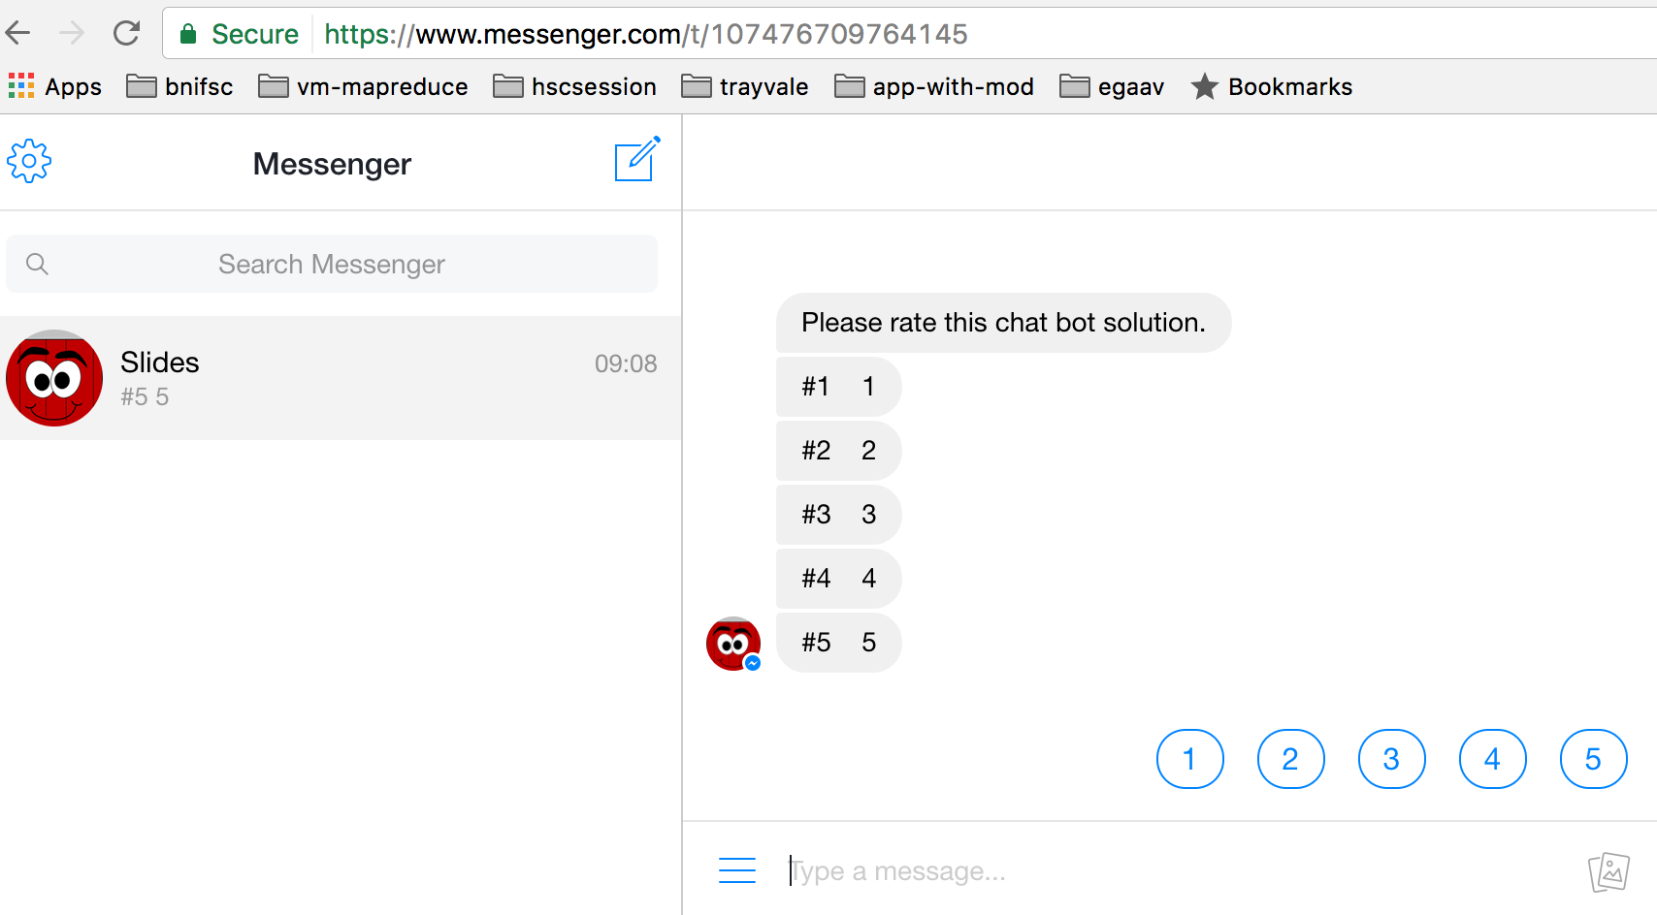
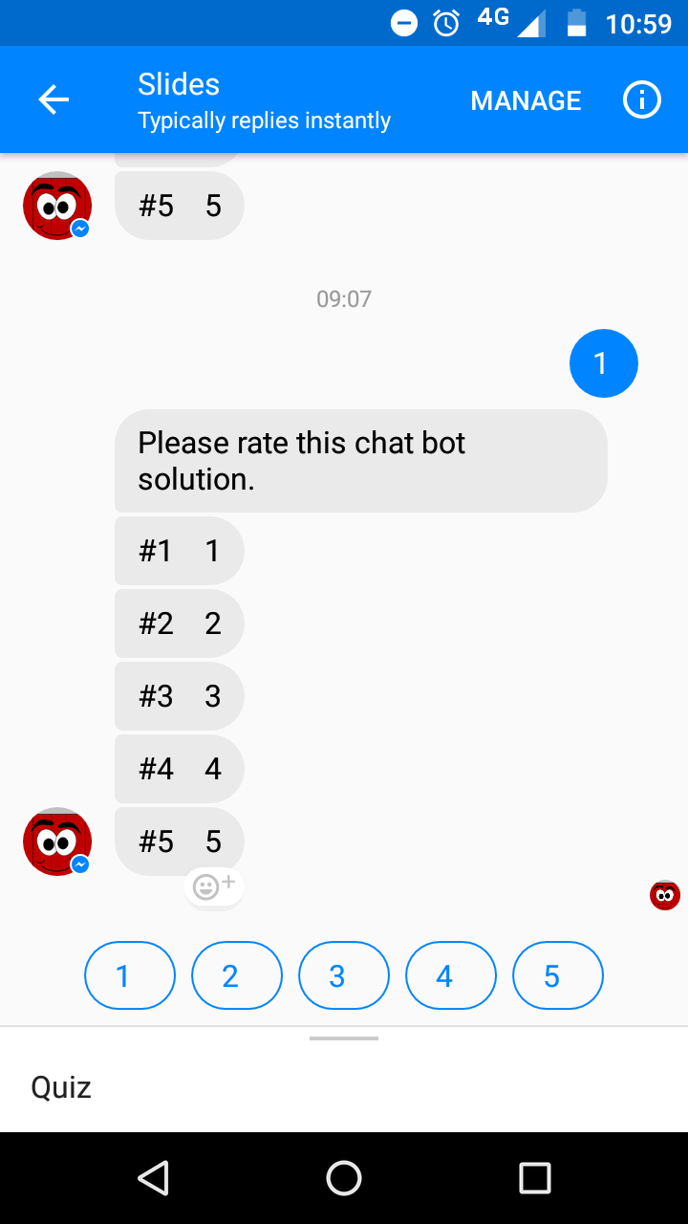
Interactive Training Registration
Notes:
#Guide audience how they can answer the questions.
# How they can leave open feedback.

Slide 6
C Syllabus
Introduction
Data types
Variables
Control statements
Function
Structure
Pointers
File Handling
Notes:
# Explain Syllabus slowly slowly
#

Slide 7
Java syllabus
Introduction
Data types
Variables
Class
Objects
Object Oriented Programming
Exception Handling
Notes:
# Explain syllabus slowly slowly

Slide 8
JavaScript syllabus
Alert
Confirm
Document.write
DOM Manipulation.
Problem Stack Overflow
Problem Stack Overflow
Problem Stack Overflow
Notes:
#Explain Syllabus slowly slowly
# Explain why we have this difference in in syllabus
This is not part of academics india.

Slide 9
C practice programs
Arithmetic operations
Print patterns
Call by Value and Call by Reference programs
Create a small program by using Structure
Create Header files
Read and Write files
Notes:
#Explain Syllabus slowly slowly
#Eplain topics in single line.

Slide 10
Java practice program
Class creation
Arithmetic operations
Print patterns
Write Object Oriented Code
Create Packages
Exception Handling.
Notes:
#Explain Syllabus slowly slowly
#Eplain topics in single line.

Slide 11
JavaScript practice program
Create alert
Create confirm
Get input from prompt
Dom manipulation
Dom events (Click, Blur, Focus )
Select element by jQuery
Stackoverflow
Notes:
#Explain Syllabus slowly slowly
#Explain why we have this type of practice program
This is not part of academics in india.
In working in life our main focus goes to how to solve this problem only.
We did not try to drill down the problem and concepts
Reason could be
We do have sufficient time.
We do not have enough resource to learn.
We do not have any mentor to guide.

Slide 12
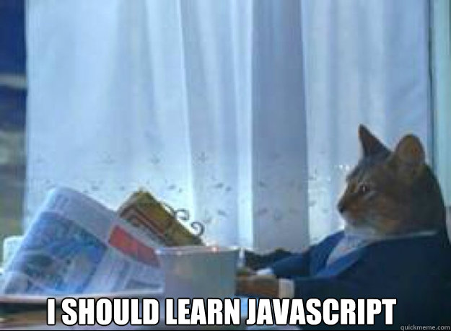
Notes:
#Explain when this feeling comes
When any ask questions
When any ask concepts
# Prepare audience for next section.

Slide 13
Are we missed something?
Notes:
#Expalin why we missed
With all above practice syllabus etc.

Slide 14
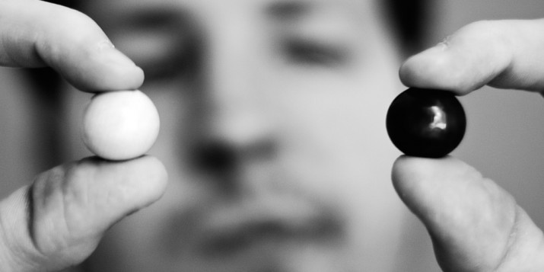
We missed
How JavaScript is different from other languages?
Notes:
#Read line first
# Explain this line in generic way
We missed the parameters to compare a languages.
How a language can be different from other.

Slide 15
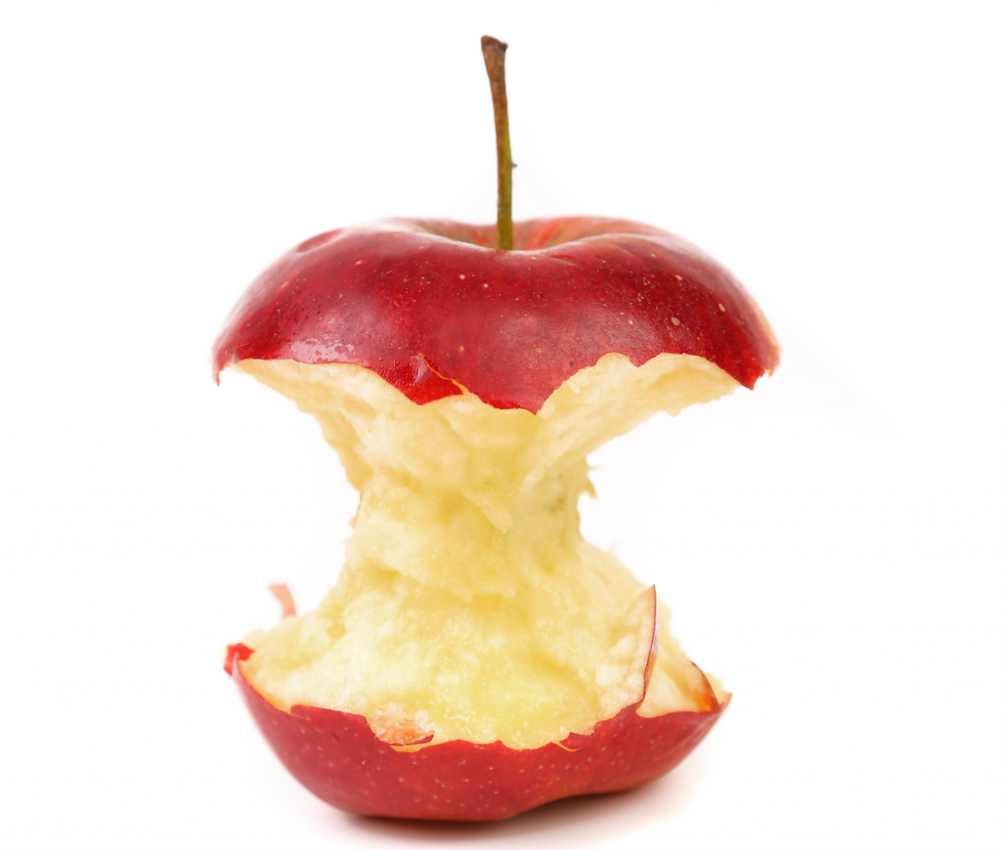
We missed
What are the core concepts of JavaScript?
Notes:
#Read line first
# Thing are inter related
We missed first point it is obvious we will miss core concepts.
We are expecting things like we learn in our last language.

Slide 16
We missed
How a primitive data type can call a method?
var str = "Are we are happy with current approach?"
str.toString()
Notes:
# Read slide line first
# We forgot to explore data types like we explores in C and Java etc.
# We forgot the concept of primitive data types and non primitive data types.

Slide 17

We missed
What is event based environment?
Notes:
# Read line first
# we forgot events totally,
#Start interaction with audience
# Ask question why we forgot this this totally as a concept?

Slide 18

We missed
What is asynchronous JavaScript?
Notes:
# Read line first
# we forgot events totally,
#Start interaction with audience
# Ask question Why we forgot asynchronous behaviour totally?
#Prepare audience for next slide.

Slide 19

We missed
What is the power of the JavaScript?
Notes:
#Prepare the audience for next slide
When we missed something it is obvious we developed some wrong perceptions
And What wrong perceptions we have.

Slide 20
What wrong perceptions we have?
Notes:
#Let explain audience wrong perception and cause of it.

Slide 21
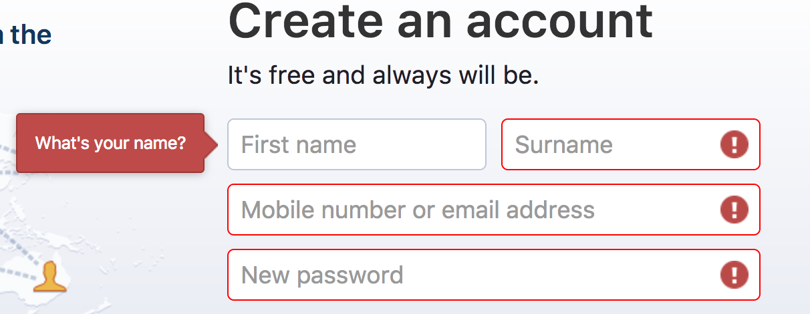
Wrong perceptions
Some peoples think it is only for Form validations.
Notes:
# Read line first
At starting of our carrier we just used for form validations that's why we are thinking it is only for form validations.
What is right thing.

Slide 22
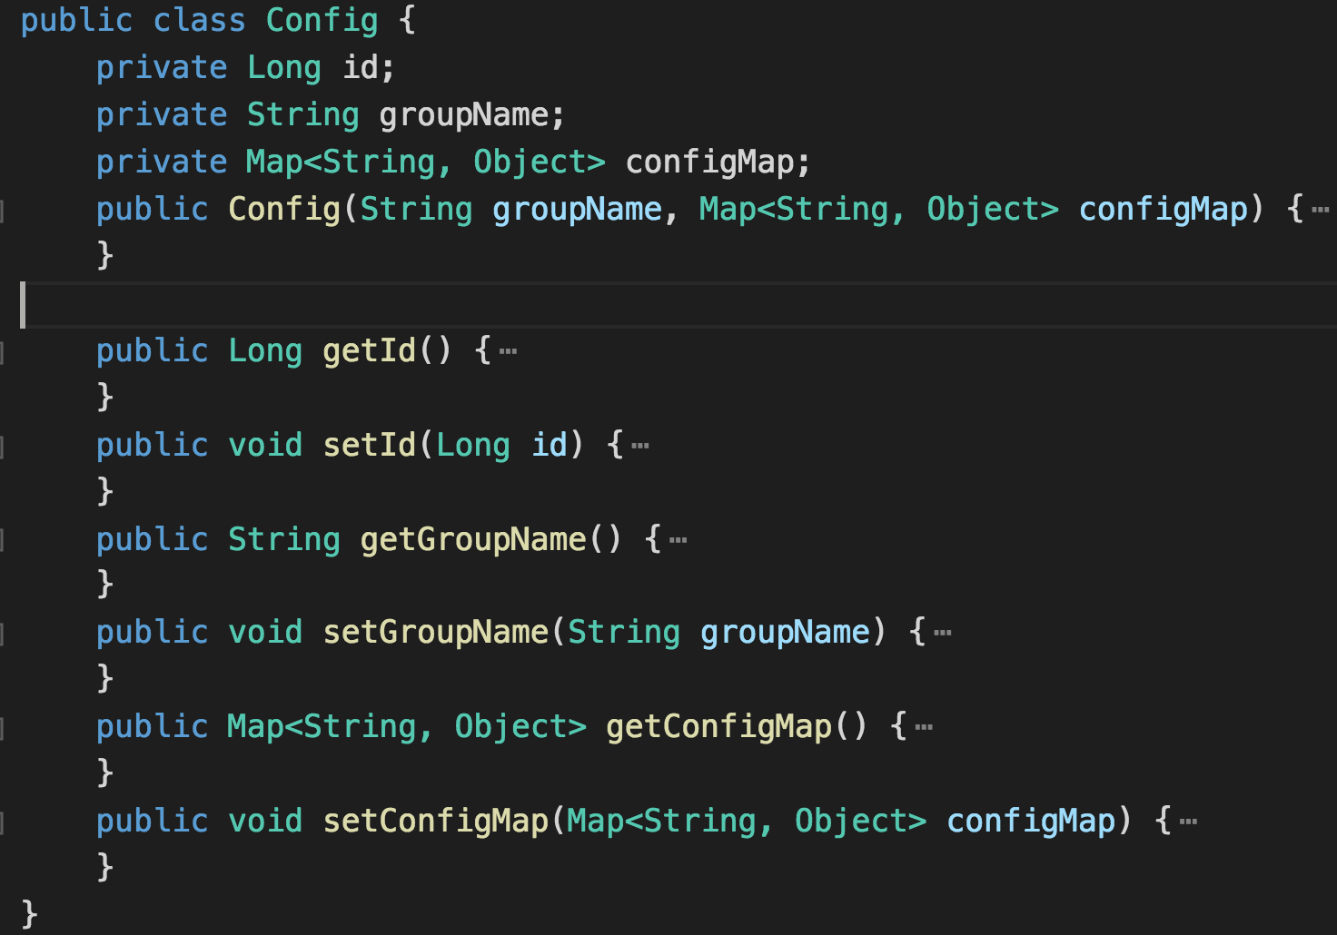
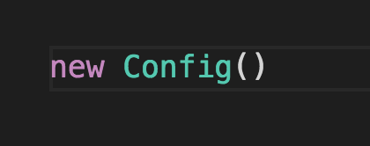
Wrong perceptions
Object only created once and can not modified.
Notes:
#Explain screen
Why this perception developed
We came from static language.
Always doing things in this way.
What is right thing.

Slide 23
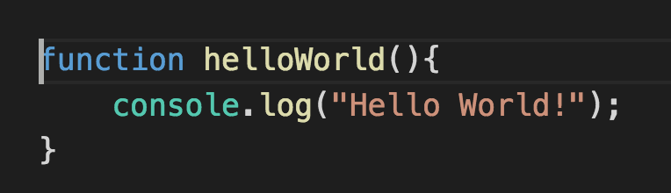
Wrong perceptions
Functions can only to call.
Notes:
#Explain screen
Why this perception developed
We came from static language.
Always doing things in this way.
What is right thing.

Slide 24
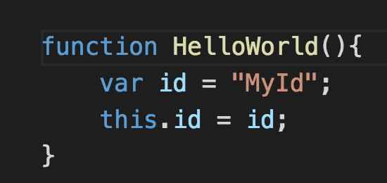
Wrong perceptions
This is a dynamic instance of current class.
Notes:
#Explain screen
Why this perception developed
We came from static language.
Always doing things in this way.
What is right thing.

Slide 25
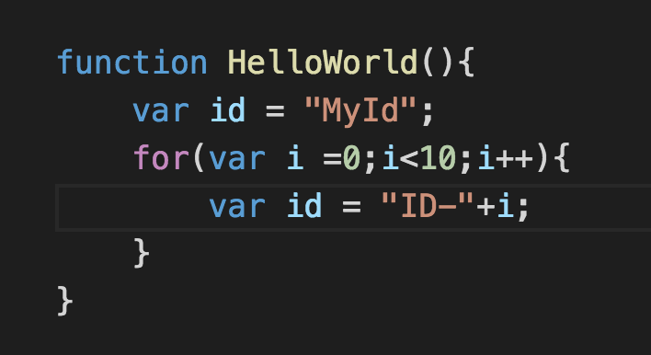
Wrong perceptions
We try to correlate Scope with other languages.
Notes:
#Explain screen
Why this perception developed
We came from static language.
Always doing things in this way.
What is right thing.

Slide 26
Wrong perceptions
We only think
class A extends B
Is inheritance
Notes:
#Explain screen
Why this perception developed
We came from static language.
Always doing things in this way.
What is right thing.
https://developer.mozilla.org/en-US/docs/Web/JavaScript/Guide/Details_of_the_Object_Model

Slide 27
Wrong perceptions
We try to implement Classical inheritance.
Notes:
#Explain screen
Why this perception developed
We came from static language.
Always doing things in this way.
What is right thing.
#Prepare audience for next slide.

Slide 28
What could be a better way?
Notes:
What could be right reading approach?
We need to correct syllabus first.
We should avoid DOM manipulation and start learning as we learn other languages .
With chrome console
Nodejs prompt
We should start exploring language features.

Slide 29
What is right way?
We need to correct syllabus first.
Notes:
# Read line first
We need to correct syllabus first because
Syllabus is foundation of any course.
You are able to set target.
We can major the things.

Slide 30
What is right way?
We should compare JavaScript with our previous language.
Notes:
# Read line first
We should compare Java script with previous language with some points like
How it runs
What environment is required to run.
How process and threads working.
How is memory management is work.
Type of language

Slide 31
Right way
We should avoid DOM manipulation when we start learning JavaScript.
Notes:
With chrome console
Nodejs prompt
Examples to demonstrate.

Slide 32
What is right way?
We should start exploring language features.
Notes:
# read line
We should explore features one by one.

Slide 33
What is right way?
We should exploring difference between classical and prototypal inheritance.
Notes:
#This is very important
https://developer.mozilla.org/en-US/docs/Web/JavaScript/Guide/Details_of_the_Object_Model
#Send feedback to the audience

Slide 34
Feedback Please

Slide 35


