Slide 1
FACEBOX
(A machine learning based facial recognition machine)
Karpagam Academy Of Higher Education

Slide 2



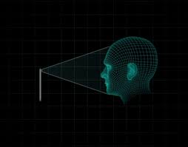


Where?
What?
How?
Why?
Where?
A machine learning based facial recognition machine.
It is based on the concept machine learning for facial recognition of people.
FACEBOX
Using the power of modern computing (machine learning)we help create a more effective and optimal environments in institutions.
How?
Schools
Universities
INTRODUCTION
Facebox is a machine that comprises of two basic components:
A simple camera
A hardware that could process and store information
Why?
Let’s understand this better using the 4 basic questions.
What?
Industries
Office

Slide 3



O U R S E R V I C E S
Attendance
Tracking
Emotion Detector
Reduce the time wasted on the tedious task on marking attendance using automation by face detection.
Keeping track of personnel during times of crisis or emergency situations.
Analyze emotional behavior of personnel to improve work/study environment.

Slide 4
ACTION PLAN
STEP
STEP
STEP
1
2
3
PLACEMENT
GET DATA
RESULT
Facebox will be placed at key locations of the institutions' workplace where many people pass through (such as the entrance or a corner ).
Using the machine learning power that we provide, it will detect the faces of the students or employees who just walked past that place.
The cameras placed at these key locations will click pictures of people passing by regularly .

Slide 5




T R A C K I N G
WHY
HOW
In a huge institution with a lot of people it is a really hard and tedious task to keep track of them during occasions.
Now it would be just as easy as a few key presses to find the activity of everyone.
WHEN
In case of times during emergencies or natural disasters the duty of the institution is to be accountable for all the people under their roof.
HOW
Our strategically placed cameras will keep log of all the personals and their movements once crossing the camera and will be automatically logged into a digital register.

Slide 6
T I M E L I N E
LOGGED AT DEPTCSE CORRIDOR 4
LOGGED AT COMPUTER LAB 2
08:45
01:00
04:30
09:10
01:50
LOGGED AT MAIN GATE 2
LOGGED AT CANTEEN 1(CANOPY)
LOGGED AT EXIT GATE 1

Slide 7

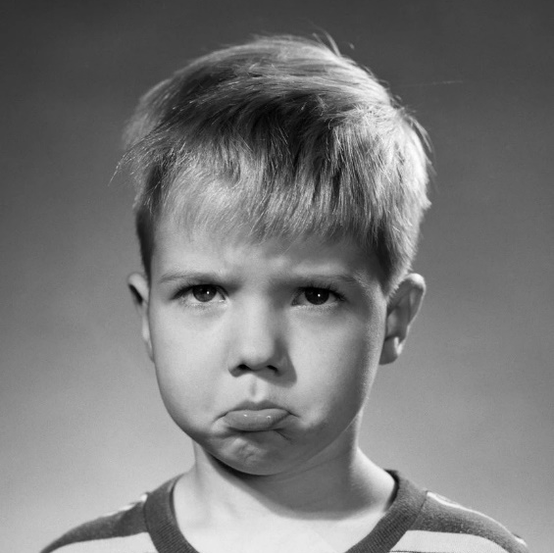
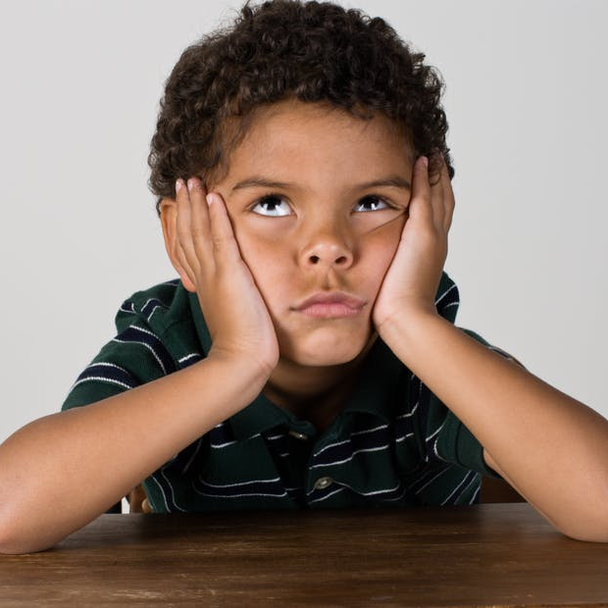

EXPRESSION DETECTION
From the dawn of facial recognition there has been continues improvements in the field of facial expression classifier which would detect the expression of individuals ex: happy, sad, tired, sleepy etc..
01
02
03
04
HAPPY
SAD
BORED
TIRED

Slide 8
E M O T I O N A N A L Y S I S
45%
25%
20%
10%
HAPPY
ATTENTIVE
BORED
IDLE
HOURS: 1, 2, 4, 7
HOURS: 1, 4, 7
HOURS: 5, 6
HOUR: 9

Slide 9



C H A N G E S
IDLE
TIRED
BORED
Recreational activities
Rescheduled Breaks
Change in curriculum or timetable

Slide 10
O B J E C T I V E S
CHANGES
TRAINING
Make changes to the model if necessary to improve accuracy.
SET UP
Train the machine learning model.
Set up the cameras at key locations as prescribed.
6
4
TEST
INSTALLATION
2
GET DATA
Test the model on a few test cases.
Installing Facebox at the institution.
Acquire dataset for the model
5
1
3

Slide 11
O B J E C T I V E S
ESTABLISH FUNCTIONALITY
SERVICE
END GOAL
Establish the model and start on day to day tasks.
Provide periodic services when necessary
Provide an efficient and optimal environment down the lane.
ANALYSYS
Regularly analyze the data and store it in the institution’s server.
9
7
10
8

Slide 12
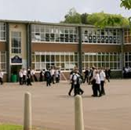
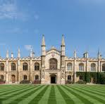
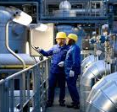
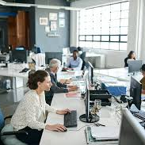
O U R C L I E N T
SCHOOLS
INDUSTRIES
OFFICES
For students
For employees
For customers

Slide 13
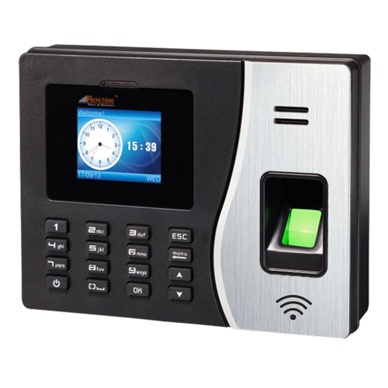
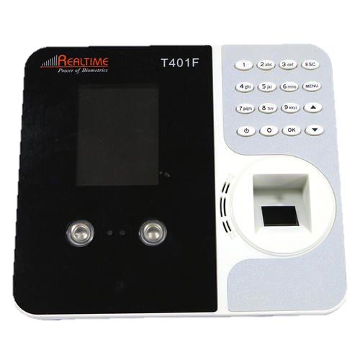
T H E N E E D
CURRENT TECHNOLOGIES
Consider the attendance machines that are currently commercially available.
Most of them use the common biometrics which is the fingerprint where everyone is lined up for their turn to use it.
There are machines that use facial recognition too but the machine is built in such a way where everyone has to do the same which is to line up and scan themselves like in the case of fingerprint.

Slide 14
T H E N E E D
FACEBOX
02
FACEBOX is seamless
01
All the current machines take you to the machine, you have to log yourself in. Where as FACEBOX takes the machine to you, it will log you.
03
Saves time
04
Provides additional features such as keeping track of personnel.

Slide 15
C O N C L U S I O N
Facebox is one time set up, easy to maintain and only requires periodic maintenance.
Using the power of modern computing this would help create a more effective and optimal environments in institutions.
As years pass more sophisticated improvements will be done in the field of machine learning and all its processes will almost be seamless in the near future.

Slide 16
T H A N K Y O U

