Slide 1
TEAM CHAKRAVYUH
Chakravyuh
Glucose Twin
A Type 2 Diabetes digital twin proof-of-concept
Team Chakravyuh · Digital Twin Challenge 2026
Synthetic data. Research demonstration.
01 / 20
Notes:
Welcome to Chakravyuh Glucose Twin, a focused digital twin proof of concept for Type 2 Diabetes. This presentation explains the healthcare question, the two input streams, the model, and the working doctor dashboard. It also shows the evidence and the limitations of the prototype. Every patient and every sensor reading in this demonstration is synthetic. The narration is computer generated, and it does not represent a team member speaking. The project does not diagnose diabetes, recommend medication, or monitor a real patient. Its purpose is to demonstrate a reproducible chain from a virtual patient record and changing sensor observations to a glucose forecast. The final submission package includes source code, generated data, model coefficients, tests, and documentation. The dashboard can run offline in a browser. We will first explain what the system predicts, then inspect the implementation and demonstrate its behavior, including the situations where it refuses to show a forecast.
Evidence: repository model/metrics.json and src/pipeline.py. CGM range context: https://www.niddk.nih.gov/health-information/professionals/diabetes-discoveries-practice/clinical-targets-for-continuous-glucose-monitoring-data. All patient data synthetic.

Slide 2
CHAKRAVYUH / GLUCOSE TWIN
A focused healthcare question
Can patient history improve short-term glucose forecasts?
Use a 3-hour observed window to forecast the next 2 hours
Support clinician review of a possible glucose excursion
02 / 20
Notes:
The healthcare use case is short-term glucose review for a virtual patient with Type 2 Diabetes. A recent glucose value alone cannot describe the entire trajectory. A rising pattern, the recent meal log, activity, and background patient characteristics can all provide context. This prototype asks whether combining those streams improves prediction inside a controlled synthetic environment. The chosen outcome is a glucose excursion, defined for this benchmark as any reading above one hundred and eighty milligrams per decilitre during the following two hours. The conventional continuous glucose monitoring range of seventy to one hundred and eighty provides context for the visualization, as described by NIDDK. These boundaries are not individualized care targets. We do not claim the system prevents complications or reduces hospital visits. Those would require clinical studies. The intended interaction is for a clinician to inspect a forecast, review the source context, and notice data-quality problems. The software stops before prescribing any action.
Evidence: repository model/metrics.json and src/pipeline.py. CGM range context: https://www.niddk.nih.gov/health-information/professionals/diabetes-discoveries-practice/clinical-targets-for-continuous-glucose-monitoring-data. All patient data synthetic.

Slide 3
CHAKRAVYUH / GLUCOSE TWIN
The prediction contract
Eight forecasts: +15, +30, …, +120 minutes
A separate score for any reading above 180 mg/dL
An excursion may already be underway at prediction time
03 / 20
Notes:
There are two distinct outputs. The regression model returns eight glucose values, one at each fifteen-minute horizon from fifteen through one hundred and twenty minutes. The classifier returns a score for whether at least one future reading will exceed the excursion threshold. These outputs answer different questions. A predicted value below the threshold at the two-hour endpoint can coexist with an alert for an earlier point within that interval. The classifier is also trained separately, so its score is not calculated by simply thresholding the regression line. A crucial limitation is that the primary event label includes excursions already in progress. Therefore, this is a two-hour forecast window, not a promise of two hours of advance warning. We report an onset-only evaluation separately, limited to windows where current glucose is at or below the threshold. That result is much weaker. Making this distinction explicit avoids presenting continuation of an existing high reading as successful early detection.
Evidence: repository model/metrics.json and src/pipeline.py. CGM range context: https://www.niddk.nih.gov/health-information/professionals/diabetes-discoveries-practice/clinical-targets-for-continuous-glucose-monitoring-data. All patient data synthetic.

Slide 4
CHAKRAVYUH / GLUCOSE TWIN
Two synthetic data streams
Static EHR: age, BMI, HbA1c, diabetes duration
Dynamic: CGM, steps, heart rate and sleep
Auxiliary meal log: carbohydrate grams already recorded
04 / 20
Notes:
The static stream contains the patient's synthetic age, body mass index, HbA1c, and years since diagnosis. The dynamic stream contains glucose observations, step counts, heart rate, and the latest sleep duration. Carbohydrate grams are a separate logged input; they are not measured or inferred by the wearable. Both streams join on the synthetic patient identifier. The repository generates ninety patients, each with seven days of fifteen-minute samples. This produces sixty thousand four hundred and eighty potential glucose observations before missing values are considered. Approximately two and a half percent of glucose values are randomly missing. The records contain no real names, addresses, identifiers, or patient histories. The simulator uses a baseline, delayed meal responses, activity and sleep effects, and noise. Those relationships were chosen to exercise the software. They were not fitted to Indian clinical data and should not be described as a validated physiological model. Synthea and real EHR integration are possible extensions, not components used here.
Evidence: repository model/metrics.json and src/pipeline.py. CGM range context: https://www.niddk.nih.gov/health-information/professionals/diabetes-discoveries-practice/clinical-targets-for-continuous-glucose-monitoring-data. All patient data synthetic.

Slide 5
CHAKRAVYUH / GLUCOSE TWIN
System architecture
Static EHR
Exported models
→
Quality + features
→
↓
Sensor history
→
Doctor dashboard
Offline Python exports coefficients and evaluation. Runtime sees only past observations.
05 / 20
Notes:
The architecture separates offline development from browser inference. Offline, the Python pipeline generates the two streams and assigns entire patients to training, validation, or test sets. It extracts historical features, fits the regression and classification models, and exports the fitted parameters and evaluation results as JSON. The browser loads a small bundle containing the fitted model and six synthetic test patients. At runtime, the replay cursor decides which observations are available. The engine receives only the history up to that cursor, combines it with the selected patient record, and checks whether the latest window is usable. It then constructs the same features as Python and computes the new forecast. The user interface displays the results and can export a case snapshot. There is no cloud inference dependency, backend database, or live hospital connection in this implementation. The architecture diagram in the submission shows the separate offline and runtime paths, along with the boundary between data available now and future labels used only for evaluation.
Evidence: repository model/metrics.json and src/pipeline.py. CGM range context: https://www.niddk.nih.gov/health-information/professionals/diabetes-discoveries-practice/clinical-targets-for-continuous-glucose-monitoring-data. All patient data synthetic.

Slide 6
CHAKRAVYUH / GLUCOSE TWIN
A patient state that updates
15 features combine EHR and recent history
A new sensor sample changes the current twin state
No future CGM values or future meals enter the features
06 / 20
Notes:
The twin state consists of the patient's static record and the latest observed sensor window. The model uses fifteen features. Glucose features include the current reading, the mean over one hour, the mean and standard deviation over three hours, and the recent thirty-minute trend. A decayed meal feature summarizes carbohydrate already logged in the past window. Additional features include steps over the last hour, current heart rate, sleep duration, and sine and cosine encodings of the time of day. The four EHR fields complete the feature vector. When a new observation arrives during replay, the historical window moves and the system recomputes the vector. This creates a dynamic virtual patient representation, although it is a limited statistical twin rather than a detailed simulation of human metabolism. A causality test changes all later observations and verifies that an earlier feature vector is unchanged. That test checks for software leakage into the future; it does not prove biological causality.
Evidence: repository model/metrics.json and src/pipeline.py. CGM range context: https://www.niddk.nih.gov/health-information/professionals/diabetes-discoveries-practice/clinical-targets-for-continuous-glucose-monitoring-data. All patient data synthetic.

Slide 7
CHAKRAVYUH / GLUCOSE TWIN
Transparent baseline models
Multi-output ridge regression for the glucose trajectory
Regularized logistic regression for excursion risk
Training-only scaling; exported coefficients for local inference
07 / 20
Notes:
The modeling stack intentionally uses transparent, compact methods. Standardization parameters come only from the training set. Ridge regression predicts all eight future glucose values. It uses an L2 penalty of twenty, with an unpenalized intercept. The event classifier is regularized logistic regression, fitted with Newton updates. We chose these methods because they are reproducible with NumPy, fast to run, and straightforward to export to JavaScript without a machine-learning server. This is a baseline implementation, not a claim that linear models are the best choice for glucose prediction. The browser applies exactly the training means, scales, coefficients, and threshold stored in the model artifact. It does not manufacture a curve from fixed dashboard values. A parity test checks that the Python and browser feature calculations agree numerically on the same history. The exported model also includes its version, feature order, horizon definitions, and empirical uncertainty widths, so a reviewer can inspect what inference actually uses.
Evidence: repository model/metrics.json and src/pipeline.py. CGM range context: https://www.niddk.nih.gov/health-information/professionals/diabetes-discoveries-practice/clinical-targets-for-continuous-glucose-monitoring-data. All patient data synthetic.

Slide 8
CHAKRAVYUH / GLUCOSE TWIN
Patient-level evaluation
54 training patients / 18 validation / 18 test
7,051 training windows / 2,311 validation / 2,303 test
Threshold and interval widths come from validation only
08 / 20
Notes:
Evaluation splits patients before extracting windows. The first fifty-four synthetic identifiers are used for training, the next eighteen for validation, and the final eighteen for testing. No patient appears in multiple splits. This prevents the model from being evaluated on another window from a person it already saw in training. Eligible windows advance by an hour and contain three hours of history followed by two hours of target readings. All future targets must be present. The validation set selects the event threshold by F1 over a fixed grid. It also supplies the absolute residual quantiles for uncertainty bands. The test set is reserved for reporting. Windows within a patient still overlap and remain correlated. To quantify regression uncertainty, the pipeline bootstraps whole test patients rather than treating every window as independent. There are only eighteen test patients and forty-nine positive test windows. Those small numbers and the shared simulator substantially limit what we can conclude, even with a correct split.
Evidence: repository model/metrics.json and src/pipeline.py. CGM range context: https://www.niddk.nih.gov/health-information/professionals/diabetes-discoveries-practice/clinical-targets-for-continuous-glucose-monitoring-data. All patient data synthetic.

Slide 9
CHAKRAVYUH / GLUCOSE TWIN
Synthetic regression results
Fusion 120-minute MAE: 13.205 mg/dL
Persistence baseline: 15.136 mg/dL
Patient-bootstrap 95% interval: 12.344–14.023 mg/dL
09 / 20
Notes:
On the frozen synthetic test set, the fusion model has a mean absolute error of thirteen point two zero five milligrams per decilitre at the two-hour horizon. Persistence, which predicts the current glucose value at every future time, has an error of fifteen point one three six. The sensor-only ablation has an error of thirteen point six two. A linear trend baseline is substantially worse at thirty point nine three two. These comparisons suggest that the combined features help regression inside this simulator. They do not show that EHR fusion improves all tasks, nor do they establish accuracy on real patients. In particular, the simulator itself uses HbA1c and BMI to influence baseline glucose, so the fusion model is structurally positioned to benefit from those fields. The bootstrap interval shown here resamples the eighteen test patients three hundred times. It reflects variability within this synthetic experiment, not uncertainty about deployment in a hospital or a different population.
Evidence: repository model/metrics.json and src/pipeline.py. CGM range context: https://www.niddk.nih.gov/health-information/professionals/diabetes-discoveries-practice/clinical-targets-for-continuous-glucose-monitoring-data. All patient data synthetic.

Slide 10
CHAKRAVYUH / GLUCOSE TWIN
Alert limitations are substantial
Fusion detects 13 of 49 positive test windows
Recall 26.5%; F1 0.394, below sensor-only F1 0.521
Onset-only: 2 of 32 detected; recall 6.25%
10 / 20
Notes:
The classification result is the main weakness of this submission. At the validation-selected threshold of sixty percent, the fusion model detects thirteen of forty-nine positive test windows and misses thirty-six. It produces four false positives. Its precision is approximately seventy-six percent, but its recall is only twenty-six and a half percent. The sensor-only classifier has a higher F1 score than fusion, and even the persistence baseline has a higher F1 score. We therefore cannot claim that adding EHR data improves event detection in this experiment. The onset-only subset is more concerning: among thirty-two future excursions starting from a current reading at or below the threshold, the classifier detects only two. This result rules out describing the present model as a reliable early-warning system. The purpose of reporting it is to make the prototype reviewable and identify the next modeling problem. Future work should emphasize onset detection, lead time, and alerts per patient-day rather than highlighting accuracy on a rare label.
Evidence: repository model/metrics.json and src/pipeline.py. CGM range context: https://www.niddk.nih.gov/health-information/professionals/diabetes-discoveries-practice/clinical-targets-for-continuous-glucose-monitoring-data. All patient data synthetic.

Slide 11
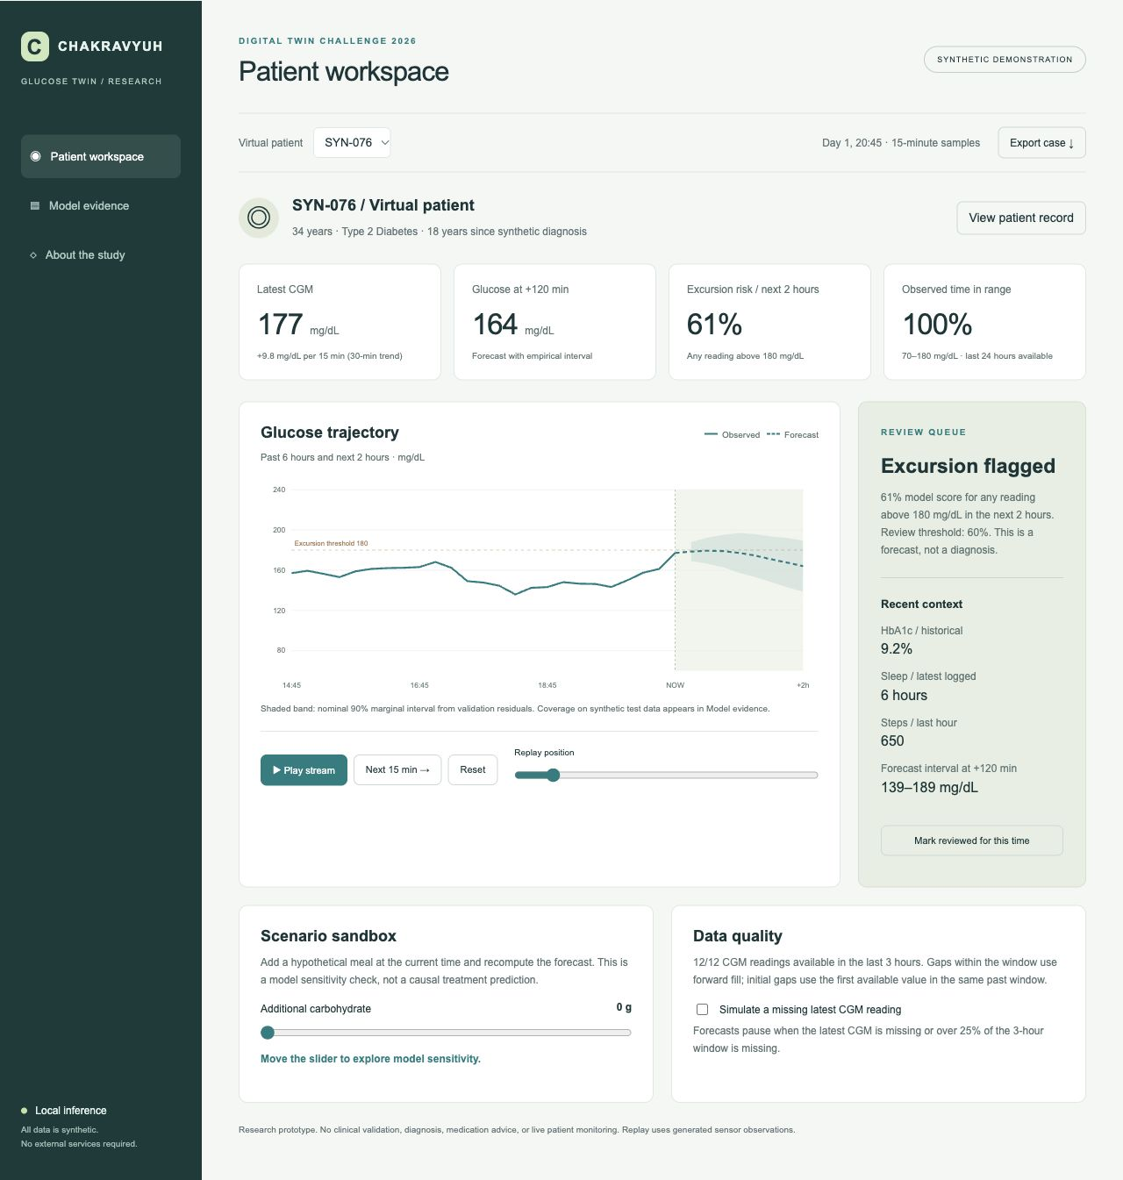
CHAKRAVYUH / GLUCOSE TWIN
Doctor dashboard demonstration
SYN-076 at Day 1, 20:45
Current 177 mg/dL; excursion score 61%
Forecast at +120 minutes: 164 mg/dL
11 / 20
Notes:
This is a captured state from the running dashboard, not a design mock-up. The selected synthetic patient is S Y N zero seven six, at day one, twenty forty-five. The current glucose value rounds to one hundred and seventy-seven, and the recent trend is rising. The classifier score rounds to sixty-one percent, which exceeds the sixty-percent review threshold. The dashboard therefore displays an excursion flag. The point forecast at the two-hour endpoint is one hundred and sixty-four. That is not a contradiction: the alert concerns any point within the next two hours, and the models are separate. The shaded forecast band communicates uncertainty. The right-hand context shows the historical HbA1c, latest sleep duration, and recent steps. This particular example demonstrates that the complete computation and review flow works. It is a deliberately selected illustration and must not replace the full test results. A reviewer can reproduce it by selecting the same patient and moving replay position to eighty-three.
Evidence: repository model/metrics.json and src/pipeline.py. CGM range context: https://www.niddk.nih.gov/health-information/professionals/diabetes-discoveries-practice/clinical-targets-for-continuous-glucose-monitoring-data. All patient data synthetic.

Slide 12
CHAKRAVYUH / GLUCOSE TWIN
Patient record and provenance
Every displayed person is a generated virtual patient
Historical EHR and sensor context remain inspectable
No live hospital, device or identity integration
12 / 20
Notes:
The patient record control reveals the static inputs behind the forecast. These include the synthetic identifier, age, body mass index, HbA1c, and disease duration. The medication context is explicitly a fixed background assumption, with no dosing model. We avoid invented real patient names or hospital affiliations because they could imply a clinical origin that the data does not have. The dashboard labels the entire experience as a synthetic demonstration. The repository data dictionary explains every field and unit, including the fifteen-minute sample index and the distinction between wearable inputs and manual meal logs. Provenance is important here because a visually plausible glucose curve can easily appear more realistic than the underlying evidence supports. In this prototype, the synthetic designation travels with the patient record and exported case. There is no login, external analytics, electronic health record connector, or wearable account authorization. The application is a local research sandbox that can be inspected without a cloud account.
Evidence: repository model/metrics.json and src/pipeline.py. CGM range context: https://www.niddk.nih.gov/health-information/professionals/diabetes-discoveries-practice/clinical-targets-for-continuous-glucose-monitoring-data. All patient data synthetic.

Slide 13
CHAKRAVYUH / GLUCOSE TWIN
Replay and state updates
Play advances one simulated 15-minute sample at a time
Step and timeline controls support repeatable inspection
Only observations up to the cursor reach the model
13 / 20
Notes:
Replay supplies the dynamic part of the demonstration. The Play stream control advances the cursor once per second, with each step representing fifteen minutes of synthetic time. This is accelerated replay, not a live sensor connection. The Next fifteen minutes button allows a reviewer to inspect one update at a time, while the timeline slider can jump to another point in the seven-day sequence. Moving the cursor changes the available history, the feature vector, the forecast, and the alert score. The runtime slices the reading array at the cursor before passing it to the inference engine. Later observations remain in the bundled dataset for replay but do not enter the current forecast. This distinction matters because the data bundle contains a complete simulated week. The implementation test verifies the historical feature boundary. For a jury demonstration, pause at the flagged example, step forward, and explain how the new reading changes the twin state. The Reset control restores the default replay position and clears scenario inputs.
Evidence: repository model/metrics.json and src/pipeline.py. CGM range context: https://www.niddk.nih.gov/health-information/professionals/diabetes-discoveries-practice/clinical-targets-for-continuous-glucose-monitoring-data. All patient data synthetic.

Slide 14
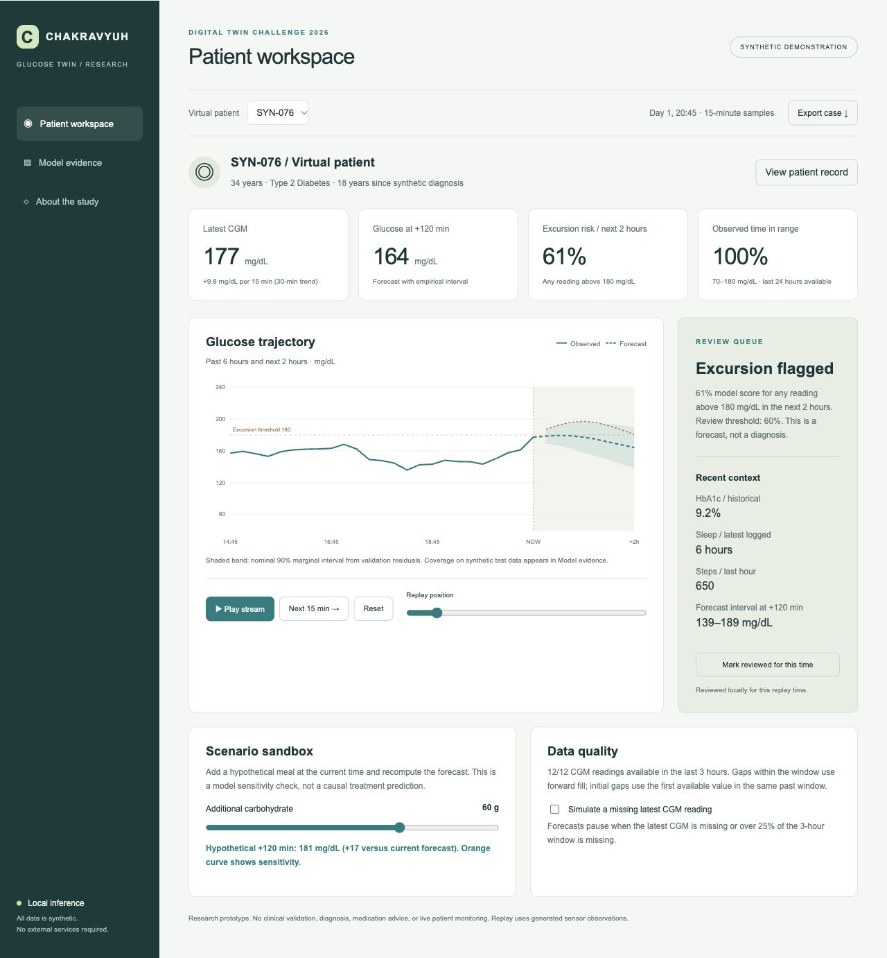
CHAKRAVYUH / GLUCOSE TWIN
Scenario sensitivity demonstration
Add 60 g of hypothetical carbohydrate at the current time
Example endpoint changes from 164 to 181 mg/dL
A feature perturbation, not a causal treatment simulation
14 / 20
Notes:
The scenario slider lets the user add hypothetical carbohydrate to the current logged interval. The engine then recomputes a second forecast with that one input changed. At the captured example, adding sixty grams shifts the two-hour endpoint from about one hundred and sixty-four to about one hundred and eighty-one, a difference of seventeen milligrams per decilitre. The orange dashed curve distinguishes this sensitivity output from the baseline forecast. The original patient data remains unchanged. This feature is useful for inspecting how the fitted model responds to an input, but it is not a causal estimate of what eating a particular meal would do to a real person. There is no validated digestion, insulin, or medication model here. The slider should not be used to choose food amounts or treatment. The product copy states that limitation next to the control. The important technical demonstration is that the same exported model reacts to a changed feature, rather than the interface drawing a predetermined alternate curve.
Evidence: repository model/metrics.json and src/pipeline.py. CGM range context: https://www.niddk.nih.gov/health-information/professionals/diabetes-discoveries-practice/clinical-targets-for-continuous-glucose-monitoring-data. All patient data synthetic.

Slide 15
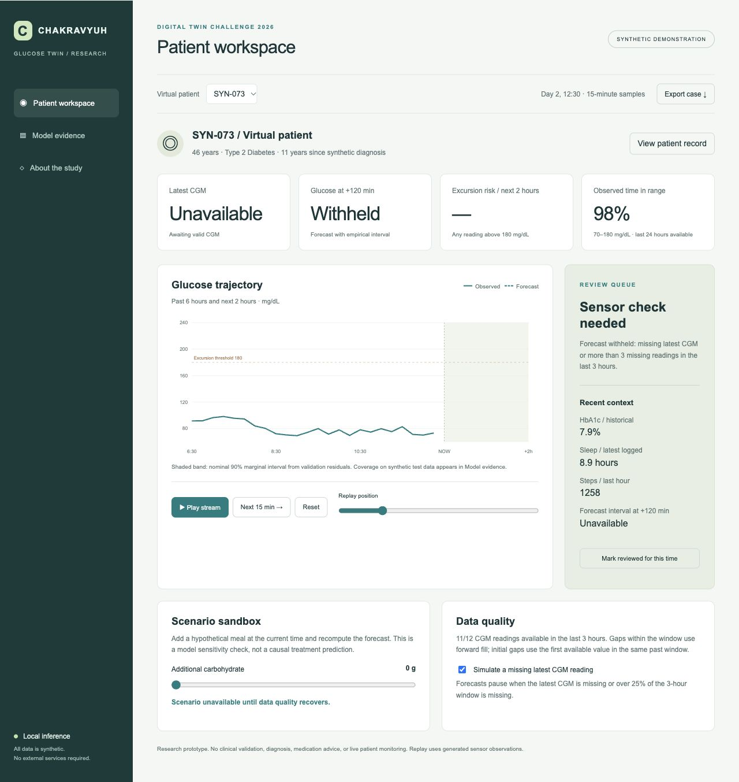
CHAKRAVYUH / GLUCOSE TWIN
Missing data changes the response
Latest CGM missing: forecast withheld
More than 3 missing values in 12 readings: withheld
Quality status remains visible to the reviewer
15 / 20
Notes:
A prediction interface should not imply confidence when the input is unavailable. To test this behavior, the dashboard includes a checkbox that simulates a missing latest CGM observation. When enabled, the latest value becomes unavailable, the forecast is withheld, and the review panel asks for a sensor check. The scenario output is also withheld. The same rule applies when more than three values are missing within the latest twelve observations. Small internal gaps use forward fill, while leading gaps use the first available value within the same historical window. That imputation is a simplifying assumption and is documented. The generated stream has regular sample times, so this version does not validate arbitrary real-world timestamp gaps or device delays. A future integration would need freshness checks, unit validation, and a more realistic missingness policy. This demonstration shows a concrete refusal path in the software. It does not imply that all unreliable inputs are detectable or that the quality rule has clinical approval.
Evidence: repository model/metrics.json and src/pipeline.py. CGM range context: https://www.niddk.nih.gov/health-information/professionals/diabetes-discoveries-practice/clinical-targets-for-continuous-glucose-monitoring-data. All patient data synthetic.

Slide 16
CHAKRAVYUH / GLUCOSE TWIN
Review and case export
A review marker belongs to one patient and replay time
Export includes the synthetic record and baseline inference
No data leaves the browser until the user downloads it
16 / 20
Notes:
The local review action records that the selected replay position has been inspected. It is a demonstration of workflow state, not a clinical sign-off or durable audit log. The marker is stored in memory and disappears when the page is reloaded. Changing patients or replay positions changes which review marker applies. The export control downloads a JSON case snapshot containing the synthetic record, the current observation, the model version, the forecast, the probability score, and the review status. It also records any scenario slider input, while clearly identifying that the prediction field contains the baseline inference. This allows reviewers to inspect a reproducible case without copying values from the screen. No case is sent to a server. In a production environment, review identity, access control, audit retention, and consent would require a separate design. They are outside this proof of concept. The present behavior is intentionally small enough to inspect directly in the JavaScript source.
Evidence: repository model/metrics.json and src/pipeline.py. CGM range context: https://www.niddk.nih.gov/health-information/professionals/diabetes-discoveries-practice/clinical-targets-for-continuous-glucose-monitoring-data. All patient data synthetic.

Slide 17
CHAKRAVYUH / GLUCOSE TWIN
Reproducible code and tests
NumPy pipeline and dependency-free browser dashboard
Seven Python tests plus JavaScript feature parity
Seed, data, coefficients and metrics ship together
17 / 20
Notes:
The source package is structured so that another team can reproduce the experiment. The Python pipeline generates the patient and sensor CSV files, constructs windows, fits the models, evaluates the test split, and writes the dashboard bundle. The random seed is fixed at twenty twenty-six. The pinned dependency is NumPy, and the dashboard uses standard HTML, CSS, and JavaScript with no build step. A reviewer can open the index file directly or run a local static HTTP server. Seven Python tests check deterministic generation, missing-data abstention, historical feature boundaries, disjoint patient sets, model dimensions, future target alignment, and sensitivity to an EHR change. The JavaScript parity test checks the browser feature vector against a saved Python fixture and verifies abstention. GitHub Actions configuration repeats these checks on a push. The repository also supplies the model card and data dictionary. These tests support software correctness for the defined schema. They do not validate a clinical outcome or replace a study on independent patient data.
Evidence: repository model/metrics.json and src/pipeline.py. CGM range context: https://www.niddk.nih.gov/health-information/professionals/diabetes-discoveries-practice/clinical-targets-for-continuous-glucose-monitoring-data. All patient data synthetic.

Slide 18
CHAKRAVYUH / GLUCOSE TWIN
Uncertainty and external validity
Nominal 90% interval: 87.67% coverage at +120 min
Training and testing share one unvalidated simulator
No clinical accuracy, fairness or outcome claims
18 / 20
Notes:
The shaded forecast interval is based on the ninetieth percentile of absolute validation residuals at each horizon. It is a marginal empirical interval, not a personalized confidence statement or a guarantee that the entire future trajectory lies within the band. On synthetic test data, the two-hour interval covers eighty-seven point six seven percent of targets, below the nominal ninety percent. That shortfall is reported instead of being hidden. There are broader limitations. Training and testing use the same generation equations. Meal timings are regular, missingness is random, and the simulator does not capture illness, stress, medication changes, or sensor drift. The cohort has no representative sampling from India and cannot support a fairness claim across Indian populations. The event score has not been calibrated on an external cohort. Even a strong synthetic result would not establish real-world safety. These limits should remain visible in the README, presentation, and demonstration so that the project is assessed as a foundational software prototype.
Evidence: repository model/metrics.json and src/pipeline.py. CGM range context: https://www.niddk.nih.gov/health-information/professionals/diabetes-discoveries-practice/clinical-targets-for-continuous-glucose-monitoring-data. All patient data synthetic.

Slide 19
CHAKRAVYUH / GLUCOSE TWIN
Next research milestones
Freeze this benchmark before further experiments
Stress-test onset detection and unfamiliar patient patterns
Plan licensed data access and clinician-led validation
19 / 20
Notes:
The next phase should begin by preserving the present test results as a frozen baseline. We should not repeatedly tune to these eighteen test patients and continue calling them unseen. A separate synthetic stress-test generator can vary meal timing, sensor failure patterns, baseline drift, and other assumptions. The event model needs particular attention because onset-only recall is very low. Future evaluation should include event-level lead time, false alerts per patient-day, subgroup performance, calibration, and comparisons against stronger time-series baselines. Access to a properly licensed, consented, or anonymized real dataset would then support external evaluation under appropriate supervision. Any patient study would require clinical collaboration and applicable ethics and governance review. The software architecture can accommodate a future ingestion layer, but that does not make it ready for live use now. The intended contribution of this version is a transparent starting point: two streams, an updating state, an executable model, an inspectable interface, and honest evidence about where the approach fails.
Evidence: repository model/metrics.json and src/pipeline.py. CGM range context: https://www.niddk.nih.gov/health-information/professionals/diabetes-discoveries-practice/clinical-targets-for-continuous-glucose-monitoring-data. All patient data synthetic.

Slide 20
CHAKRAVYUH / GLUCOSE TWIN
Submission package and team handoff
Code, data, model card, architecture and presentation
Narrated demonstration exceeds the 20-minute requirement
College, member details and submission links need final verification
20 / 20
Notes:
The submission package contains the working source, reproducible synthetic data, exported models, evaluation results, and automated checks. It also includes an architecture diagram in PDF format and this presentation in PowerPoint and PDF formats. The demonstration video combines the presentation with captured states from the functioning dashboard and synthetic narration. Before final submission, the team should rehearse the interactive steps and be able to explain the data generator, feature boundary, model choices, and limitations without relying on the recording. The team name is Chakravyuh. College or incubator information, member details, and the team leader's contact information must come from the team and cannot be invented. The public repository and video links must be accessible to the evaluation panel. The provided brief contains inconsistent shortlist counts, so the team should confirm current logistics with the organizer. This concludes the prototype walkthrough. The project demonstrates a complete computational path while making clear that reliable early-warning performance and clinical validation remain future research work.
Evidence: repository model/metrics.json and src/pipeline.py. CGM range context: https://www.niddk.nih.gov/health-information/professionals/diabetes-discoveries-practice/clinical-targets-for-continuous-glucose-monitoring-data. All patient data synthetic.

