Slide 1
SEED
GROUP 24: Luke kim, punit malpani, Sharmisha Parvathaneni, millind kurma

Slide 2
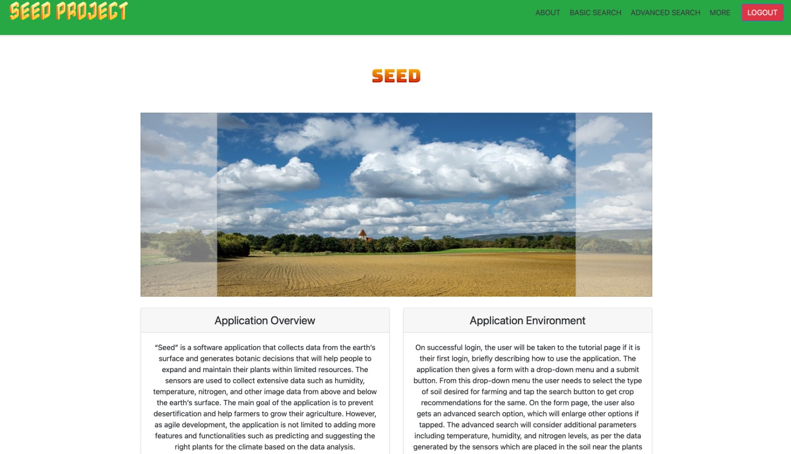
What is SEED?
SEED, a web application is created specifically to help farmers receive quick, precise results by integrating technology into the agriculture sector.

Slide 3
Features
SEED has two features:
Basic Search
Advanced Search :
Sensor Values
Image Based

Slide 4
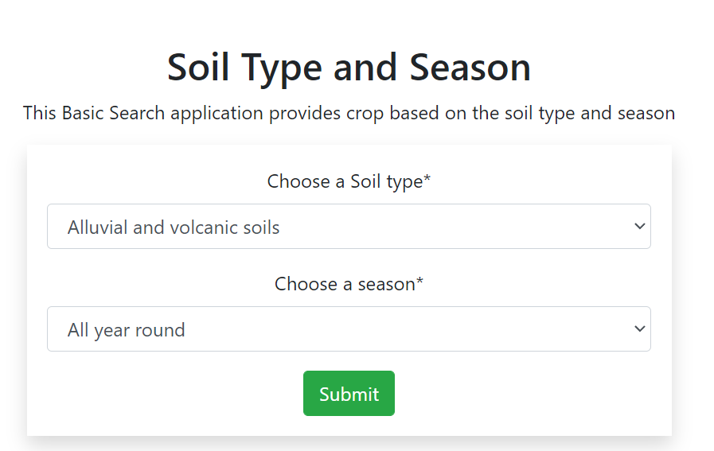
Basic search
In Basic Search, The farmer can enter type of soil and season to get the results for suggestions of which crop will have a better yield.

Slide 5
Advanced Search
Sensor Values:
The most suitable plant is identified based on sensor readings of soil acidity, temperature, and humidity.

Slide 6
Advanced Search
Image Based
The farmer will upload an image. The trained ML model predicts if the plant is disease-free or not based on the image that was uploaded.

