Slide 1
<EPAM> Cloud&DevOps Fundamentals
Final Project

Slide 2
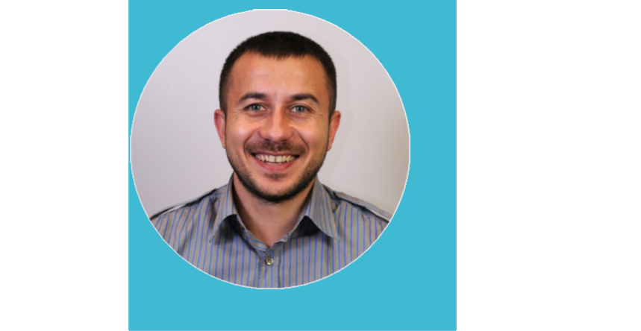
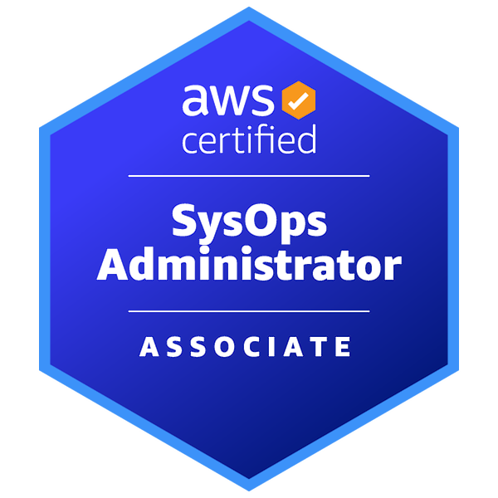
About me
In 2012 finished the National Aviation University in specialty "Administrative Management in Information Protection" and received a "Master of Science in Information Technology" degree.
More than four years working as a security systems administrator, experienced in building and supporting networks, deploying, setting up, and supporting servers (including virtual environments, VMware). Administrating Windows and Linux-based hosts.
Mykhailo Kutsybala
Mobile: +380 (95) 942 26 09
E-mail: mkutsybala@gmail.com
Skype: mkutsybala
I am actively deepening my knowledge and rising hands on experience in DevOps practices and tools.
AWS Certified SysOps Administrator – Associate

Slide 3
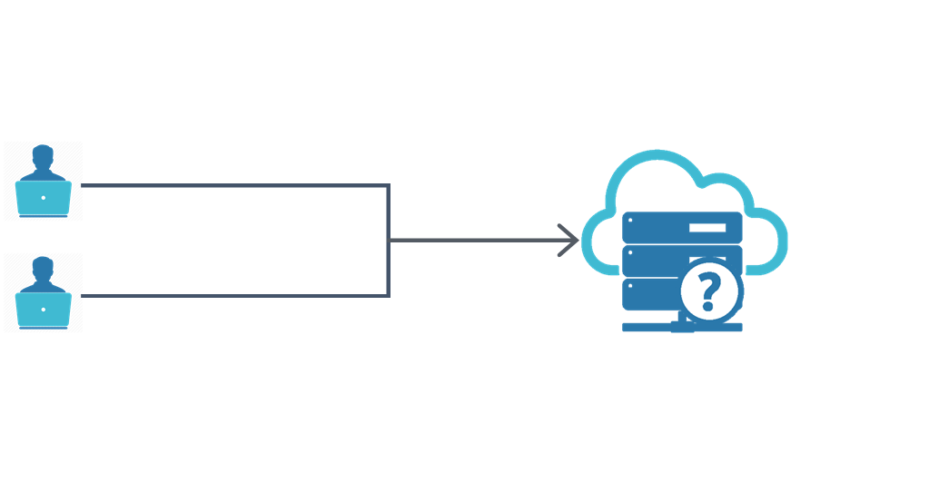
Task definition
Formulation of the problem
For the development team working on a web-based application, create functionality that provides continuous code integration and deployment to a dev environment.

Slide 4
CI/CD Pipeline for DEV environment
The task topicality and goal
Repeatable manual operations can increase the number of bugs in software and may be a cause of serious development process issues, they slow down software development.
Automation can significantly improve the code quality, speed, and efficiency of the software development process. A good solution for the problems mentioned above is the implementation of DevOps practices in the software development lifecycle.
The main goal of this project is to increase software development speed and make it more efficient and cost-optimized by applying DevOps practices and proper tools.

Slide 5
CI/CD Pipeline for DEV environment
Requirements
Store code in a repository
Work in a cloud environment
Automate build and deployment
Infrastructure as a code
Code a configuration management
Containerize workloads

Slide 6

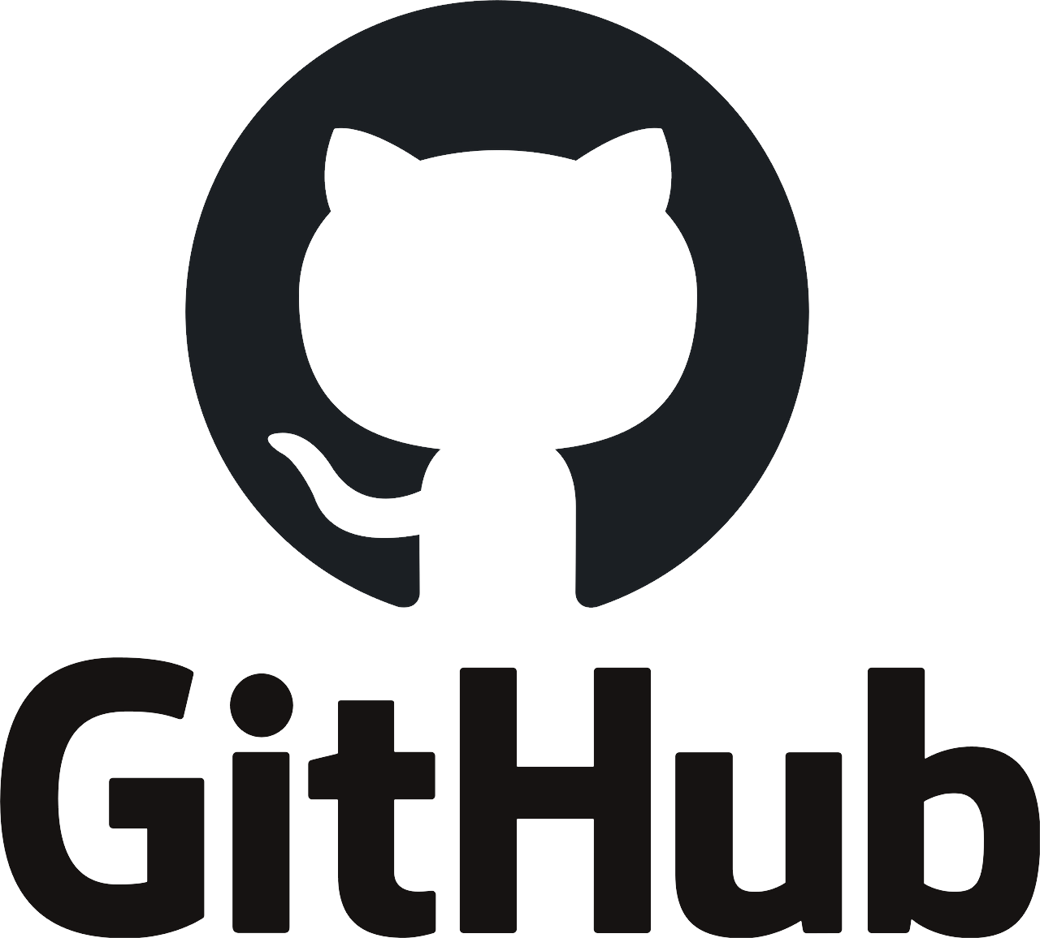
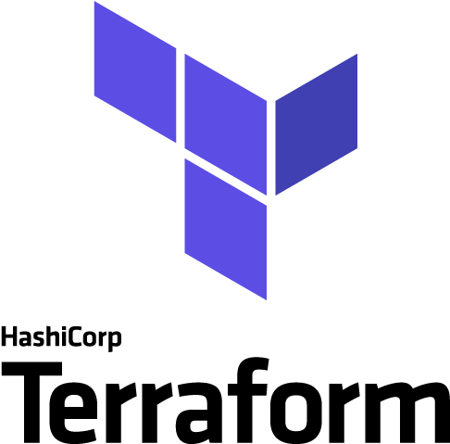
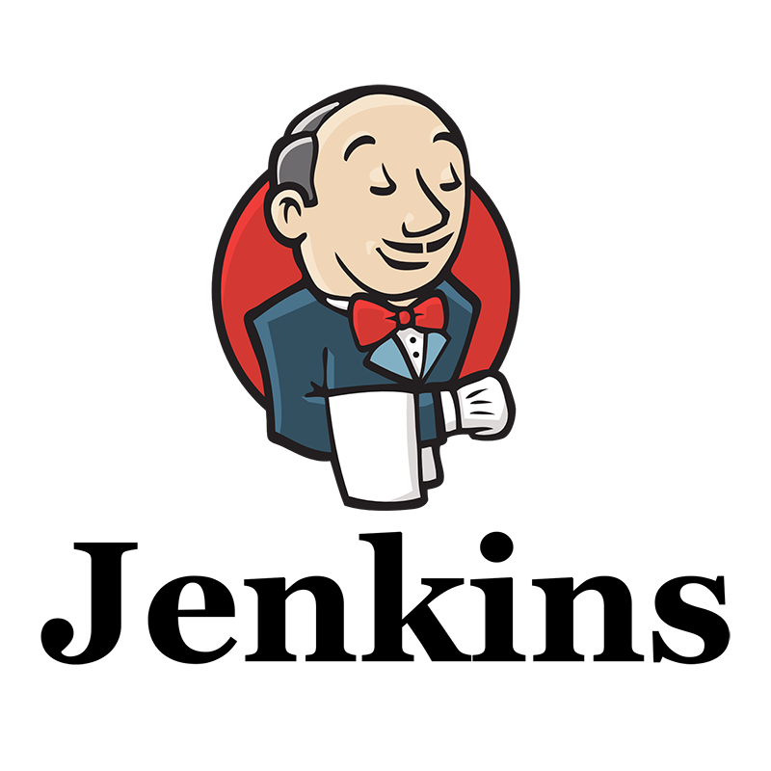

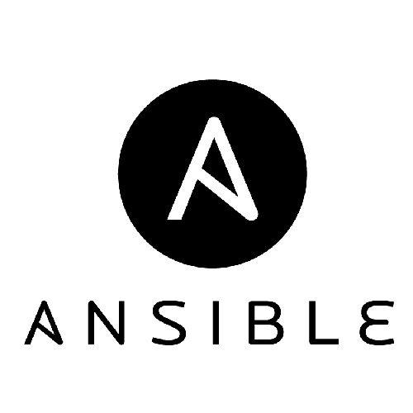
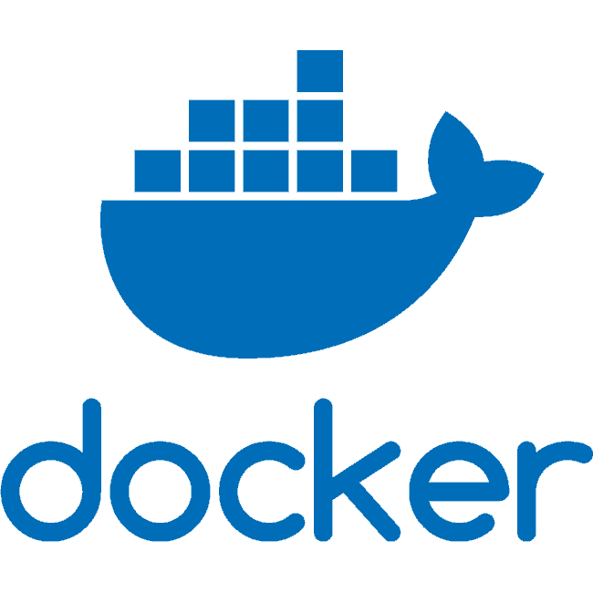
CI/CD Pipeline for DEV environment
Technologies and tools selection

Slide 7
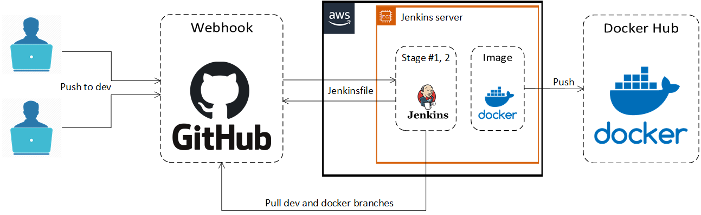
CI/CD Pipeline for DEV environment
Stage #1, #2
After pushing to the "dev" branch at the GitHub repository, a webhook triggers a Jenkins pipeline. Then Jenkins checks out Jenkinsfile from the source control repository, when pipeline configuration has been defined, stage one execution begins. At this stage, Jenkins clones the branch "dev" and copies the source code to the Docker directory. At the next stage, Jenkins pulls the "docker" branch that contains Dockerfile, creates a Docker image, and pushes the artifact to the DockerHub repository.

Slide 8
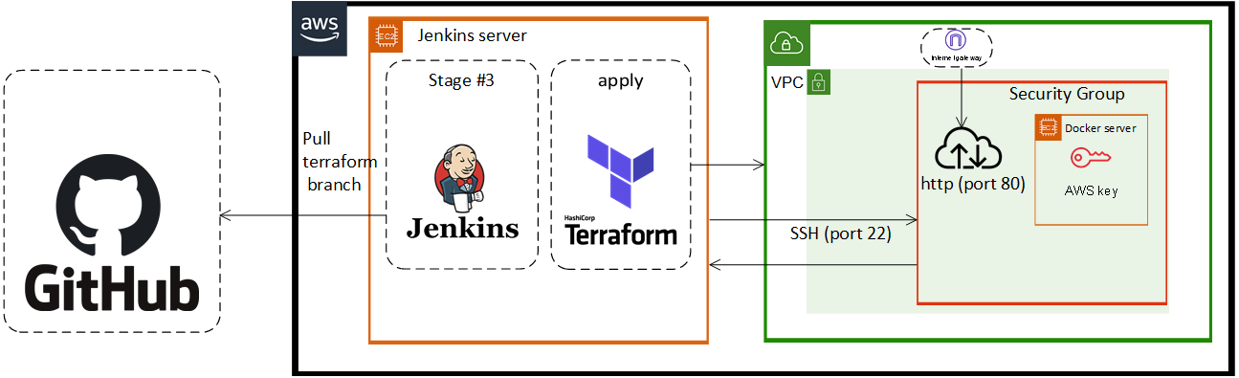
CI/CD Pipeline for DEV environment
Stage #3
At this stage, Jenkins clones the "terraform" branch, then deploys and configures an AWS infrastructure needed for running a Docker server.

Slide 9
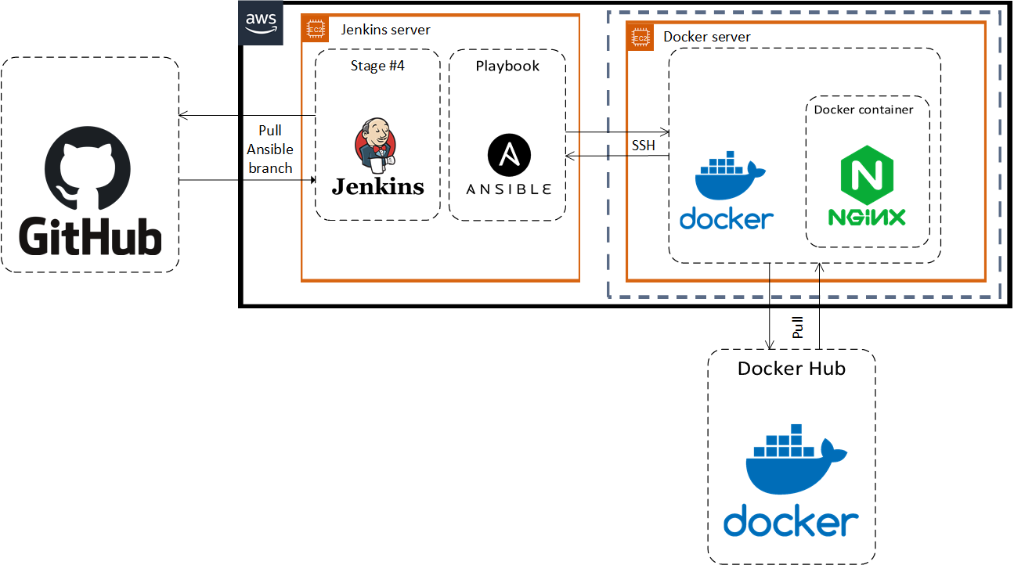
CI/CD Pipeline for DEV environment
Stage #4
In the fourth stage, Jenkins clones the "ansible" branch and runs the Ansible playbook, which installs Docker on the target server, then pull the Docker image from the DockerHub and runs a Docker container with our application. After finishing this stage we can test our application that is running by the Nginx server in a Docker container.

Slide 10
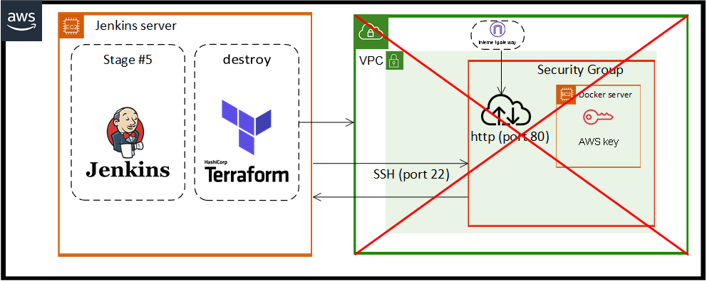
CI/CD Pipeline for DEV environment
Stage #5(optional)
When the user has finished working with the application, there is an opportunity to run the pipeline with the "destroyEnvironment" parameter enabled to delete an AWS infrastructure deployed on stage #3.

Slide 11
CI/CD Pipeline for DEV environment
Demonstration
Now let's see how it works in real life.

Slide 12
CI/CD Pipeline for DEV environment
Conclusions
In this project, modern technologies and tools were used for the task solution, which gives an opportunity effectively develop an application and try it in a real environment. Security enhancement by using AWS roles instead of permanent credentials, using remote state file storage, running build agents on separate nodes, and so on can be considered as an improvement of the project. There is a sense to implement those improvements with the project scaling out.

Slide 13
CI/CD Pipeline for DEV environment
Q & A
Q&A

Slide 14
CI/CD Pipeline for DEV environment
THANK
YOU!

