Slide 1
PRS in Finngen
Pietro della Briotta Parolo

Slide 2
Recap in time
R1 & R2 ldpred with Padraig
R3 & R4 ldpred with Pietro
R5+ PRS-CS with Pietro

Slide 3
Studies available (to be updated)
G6_ALZHEIMER | 3 | LDL-C | 1
I9_HYPTENSESS | 3 | F5_DEPRESSIO | 1
F5_BIPO | 2 | C3_PROSTATE | 1
F5_SCHZPHR | 2 | I9_STR | 1
educational_attainment | 2 | Cognitive_Performance | 1
E4_DM2 | 2 | F5_ANOREX | 1
F5_ADHD | 1 | M13_RHEUMA | 1
G6_ALS | 1 | intelligence | 1
I9_CHD | 1 | long_sleep | 1
alcohol_consumption | 1 | FEV1 | 1
L12_ATOPIC | 1 | FEV1/FVC | 1
K11_CROHN | 1 | FVC | 1
K11_IBD | 1 | Peak_expiratory_flow | 1
K11_ULCER | 1 | BMI | 1
FE | 1 | F5_PTSD | 1
J10_ASTHMA | 1 | neuroticism | 1
GE | 1 | Total-cholesterol | 1
Height | 1 | Triglycerides | 1
Cognitive_performance_meta | 1 | chronotype | 1
Haemoglobin_concentration | 1 | heart_rate | 1
HbA1c | 1 | sleepduration | 1
HDL-C | 1 | insomnia | 1
F5_AUTISM | 1 | HYPOTHYROIDISM | 1
54 studies
46 different phenotypes
30 matching phenocodes

Slide 4
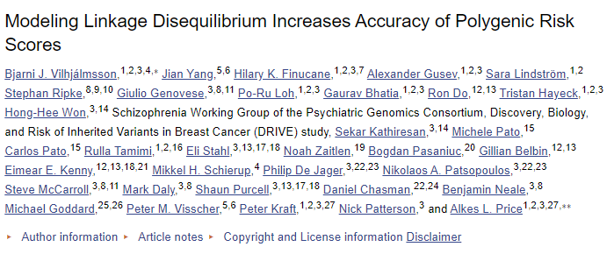
LDpred
Method that infers the posterior mean effect size of each marker by using a prior on effect sizes and LD information from an external reference panel

Slide 5
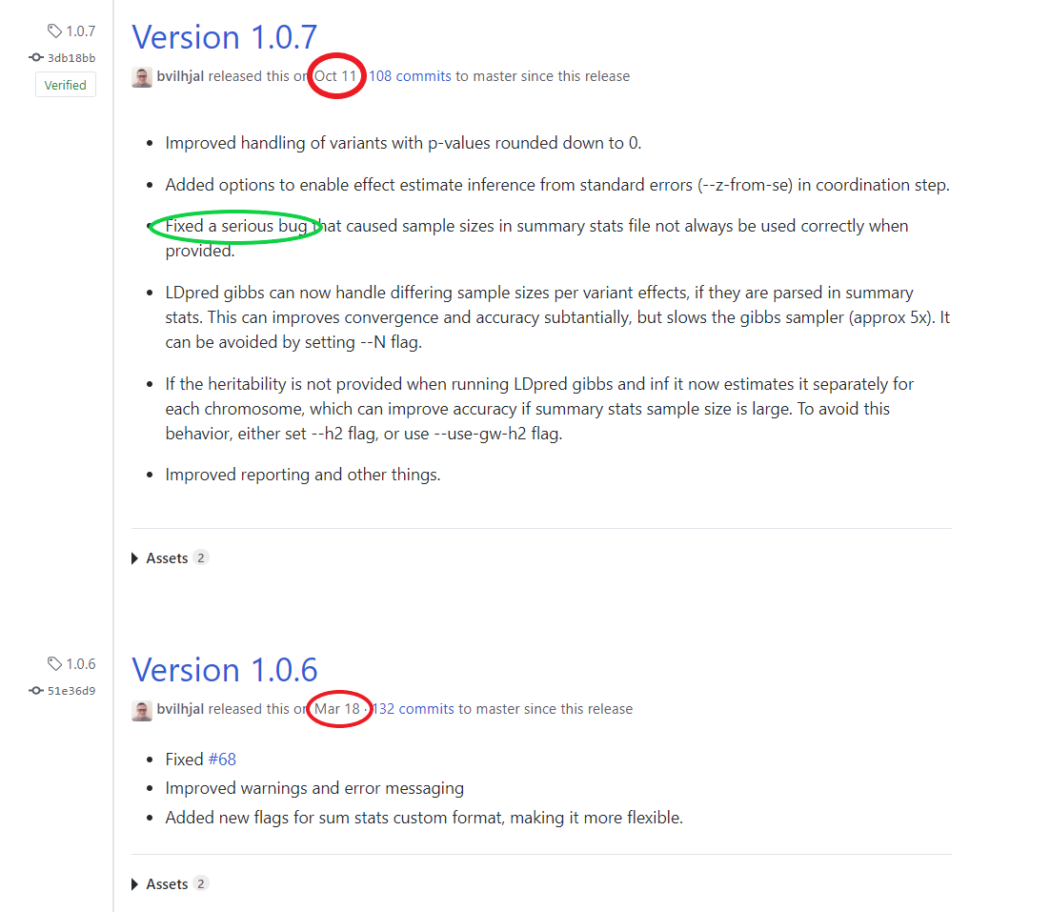
Some problems (probably solved now..)
Changes in input format requires overhaul of munging pipeline
Occasional convergence issues
Memory requirements still not solved (although not systematically tested)

Slide 6
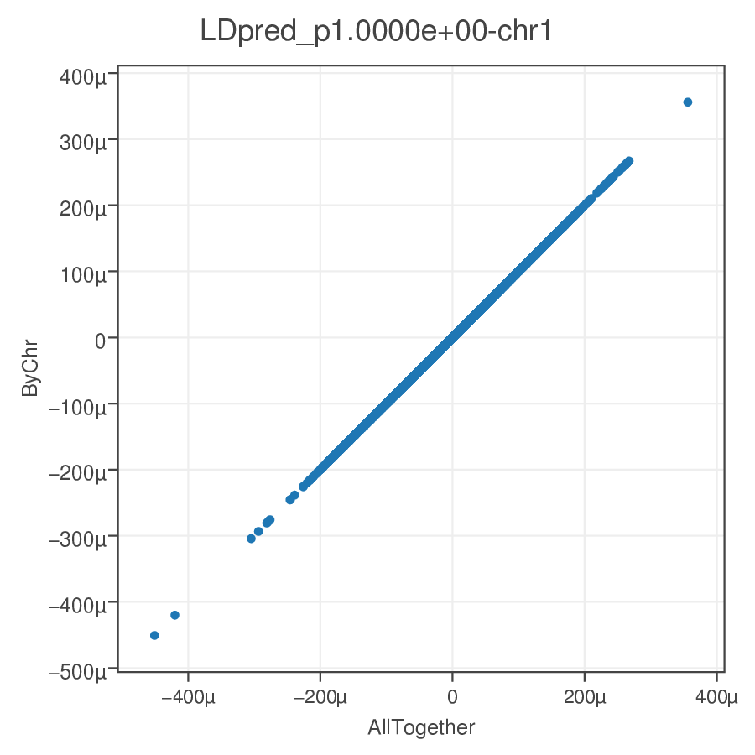
Ldpred ChrbyChr
Developped by Minxian (Wallace) Wang at Broad (https://github.com/wavefancy/)
Pros:
It works!
Can be parallelized
Little RAM usage (~1GB per chrom)
Cons:
Hackish & not maintained
Based on old ldpred
Adds extra step
More debugging

Slide 7
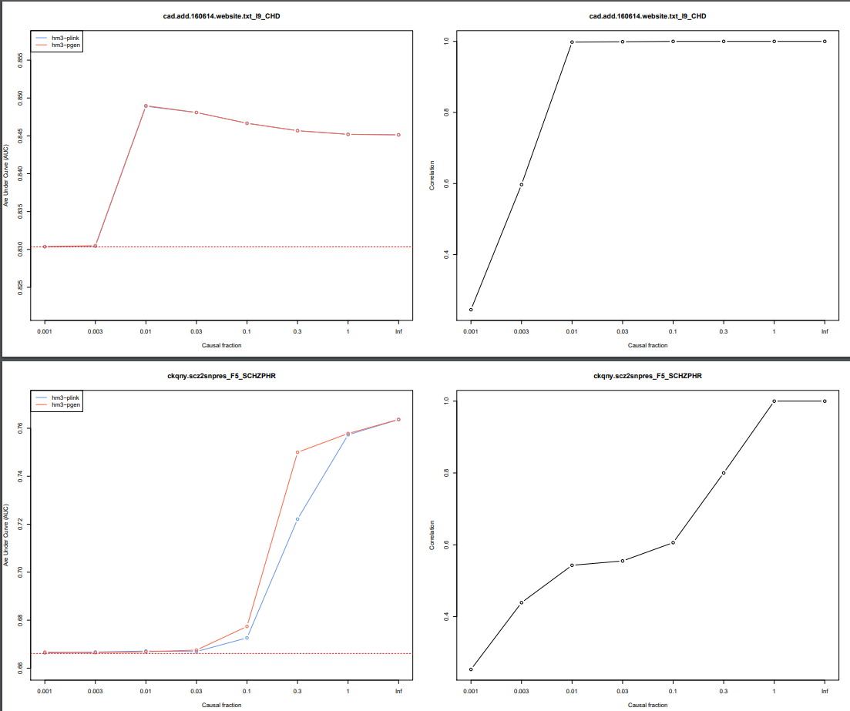
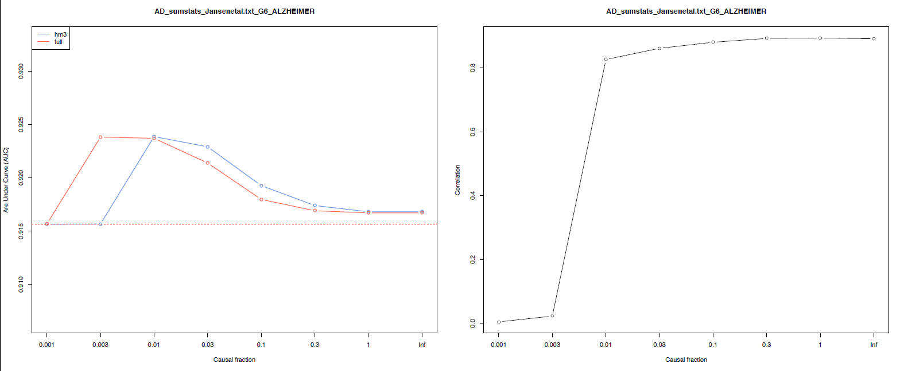
Things we tested (with no results!)
Dosages vs hard calls
All variants vs hm3 only

Slide 8
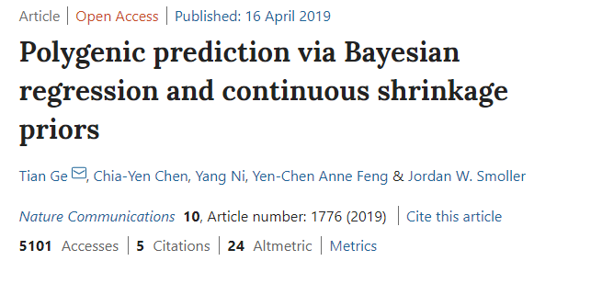
CS-PRS (Tian Ge & al)
High-dimensional Bayesian regression framework, with continuous shrinkage (CS) prior on SNP effect sizes
Aims at adaptively squelching small noisy estimates towards zero, while leaving data-supported large signals unshrunk

Slide 9
CS-PRS (Tian Ge & al)
Pros:
Runs chrom by chrom automatically
Results as good as old ldpred
Low memory requirement
Faster than ldpred
Almost plug&play + less steps
Cons:
Hdf5 structure for reference panel (1kg with hm3 snps)
Possible sensitivity to shrinkage parameter & others

Slide 10
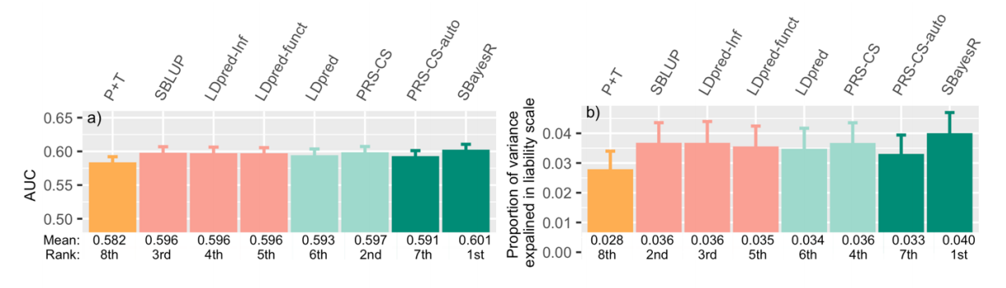
Should we change?
Are improvements really significant?
Computational costs in implementing new pipeline

Slide 11
DELIVERABLES
Scores
Survival Analysis
Cross correlation between scores and all other phenotypes
Weights

Slide 12
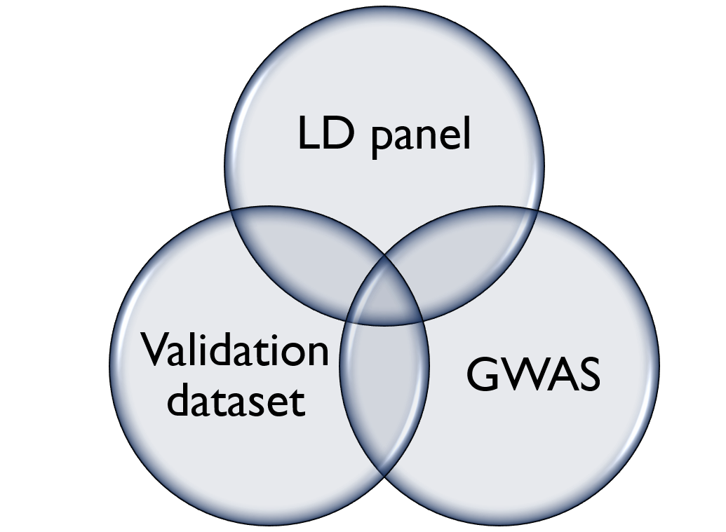
What’s New : AUTOMATIZATION
The munging pipeline is automatized
No more manual work
Data is harmonized automatically between sumstats,reference panel and finngen data
Final set of SNPs

Slide 13
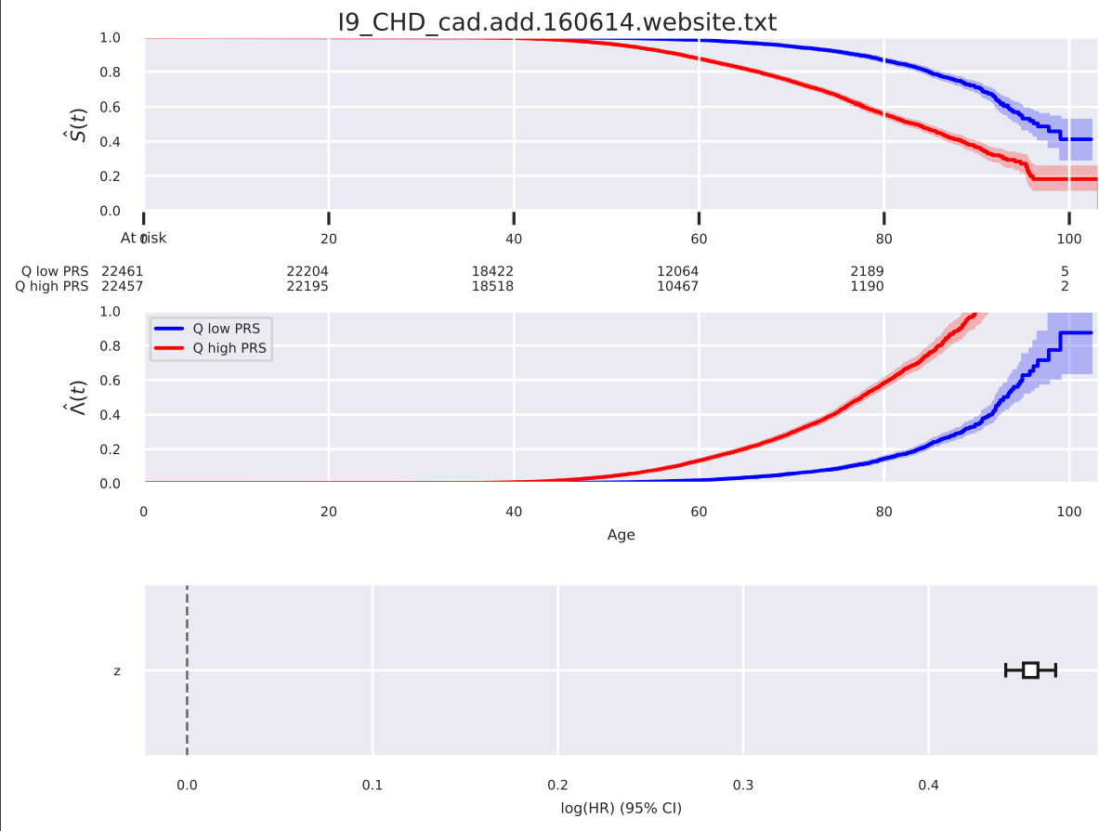
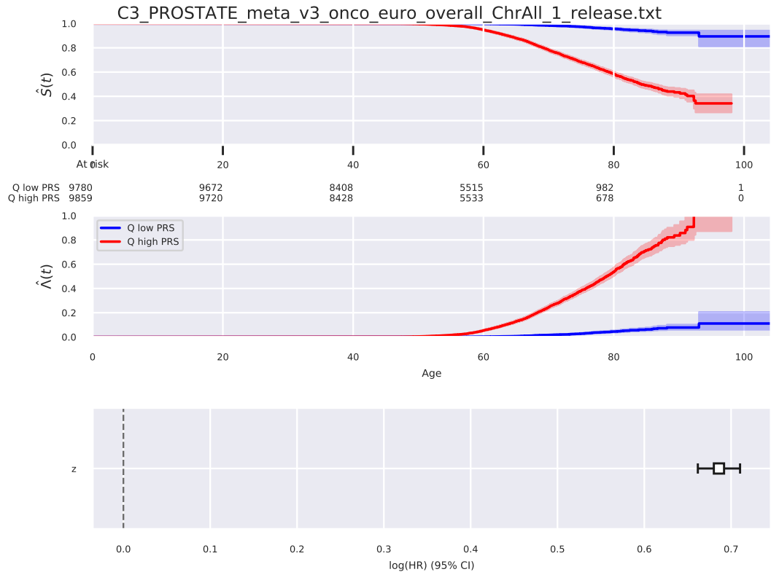
Plots! Surival analysis

Slide 14
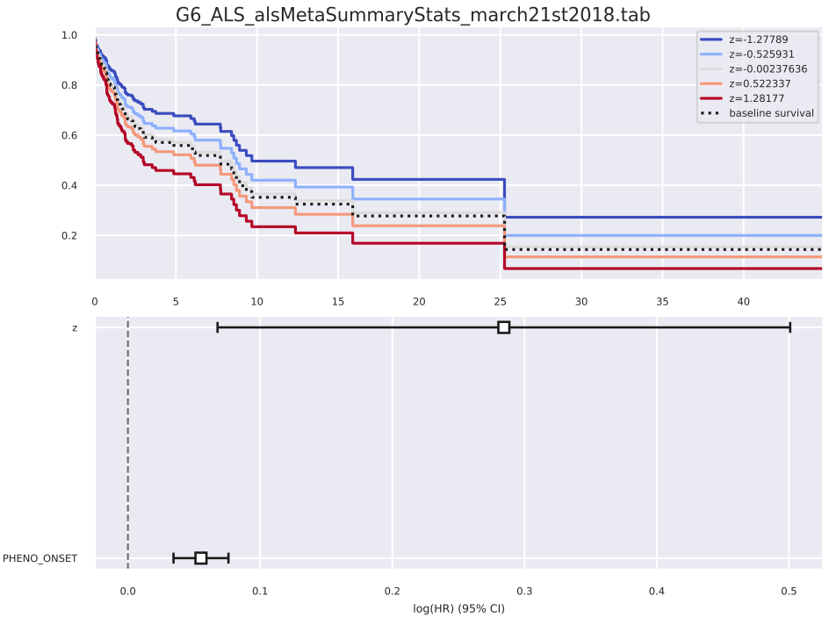
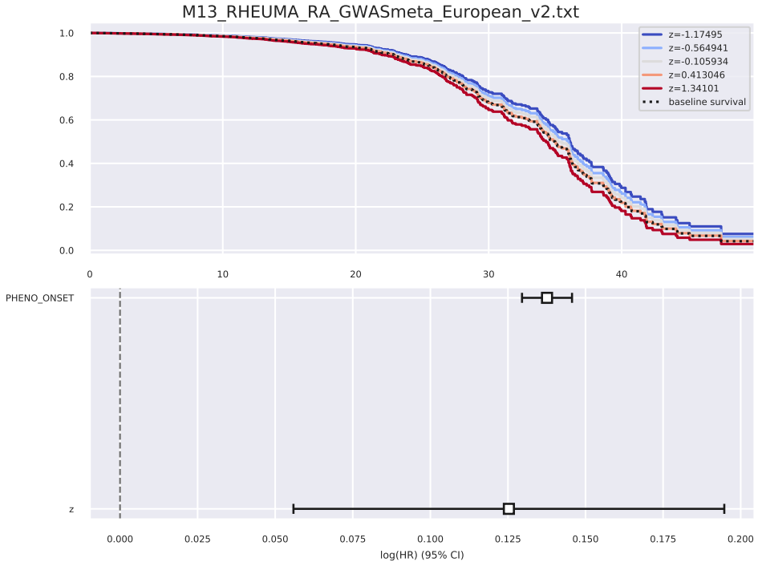
Plots! Surival/risk analysis

Slide 15
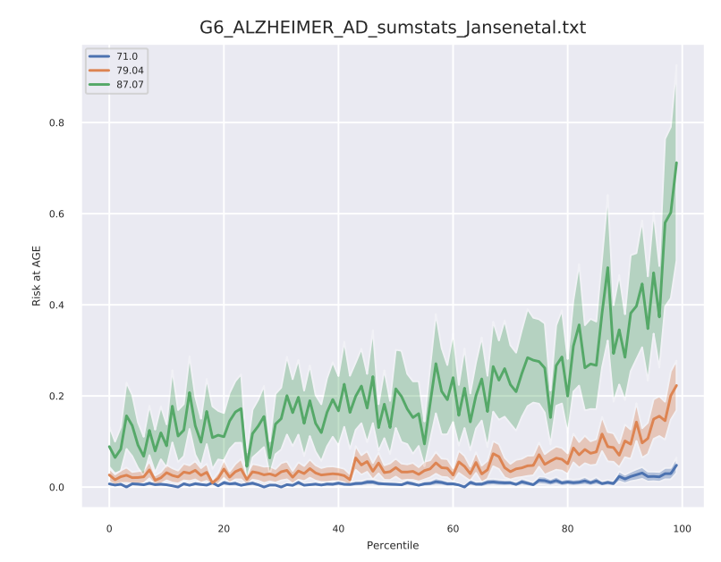
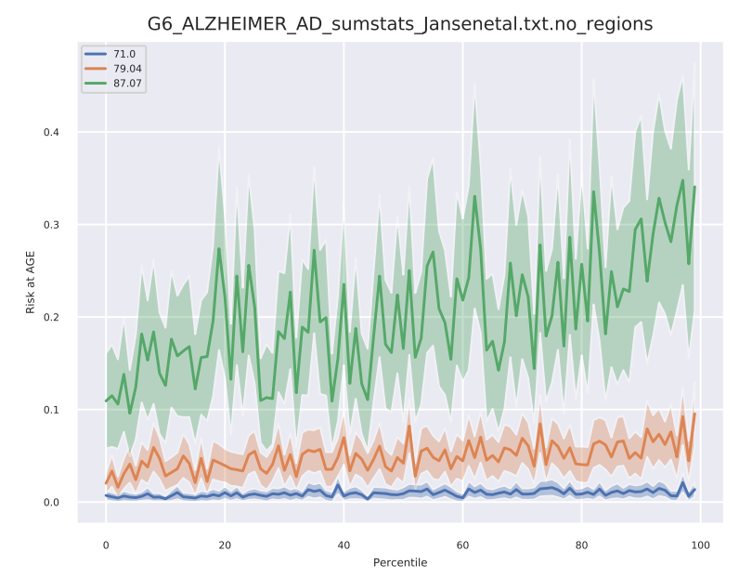
Plots! Survival analysis

Slide 16
UPDATES: CROSS CORRELATION
PHENO | beta | pval | p_R2 | pval_F | study
G6_AD_WIDE | 5.29E-01 | 3.65E-308 | 2.73E-02 | 0.00E+00 | G6_ALZHEIMER_AD_sumstats_Jansenetal.txt
M13_RHEUMA_INCLAVO | 4.34E-01 | 1.94E-304 | 8.19E-03 | 1.53E-283 | M13_RHEUMA_RA_GWASmeta_European_v2.txt
F5_MOOD | 2.50E-01 | 5.23E-304 | 7.21E-03 | 2.54E-306 | F5_DEPRESSIO_MDD2018_ex23andMe.19fields
KRA_PSY_MOOD | 2.50E-01 | 1.04E-303 | 7.20E-03 | 5.07E-306 | F5_DEPRESSIO_MDD2018_ex23andMe.19fields
DIABETES_FG | 2.26E-01 | 1.49E-301 | 7.46E-03 | 8.78E-304 | BMI_SNP_gwas_mc_merge_nogc.tbl.uniq
E4_DIABETES | 2.26E-01 | 1.39E-298 | 7.45E-03 | 8.74E-301 | BMI_SNP_gwas_mc_merge_nogc.tbl.uniq
F5_PSYCH | 1.85E-01 | 1.05E-296 | 6.49E-03 | 1.30E-298 | F5_DEPRESSIO_MDD2018_ex23andMe.19fields
RX_ANTIHYP | 1.92E-01 | 2.39E-295 | 7.08E-03 | 2.03E-297 | I9_CHD_cad.add.160614.website.txt
I9_UAP_EXNONE | 4.85E-01 | 7.69E-292 | 1.33E-02 | 1.71E-297 | I9_CHD_cad.add.160614.website.txt
From R to Python GLM
More significant results for the most part

Slide 17
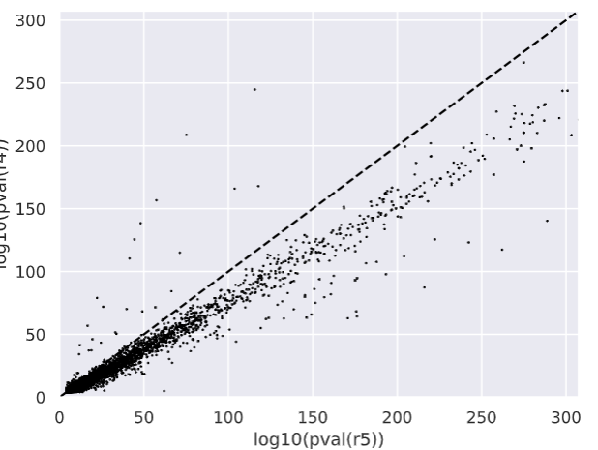
UPDATES: CROSS CORRELATION
Pheno | log(r5) | log(r4) | STUDY
FG_OTHHEART | 118 | 168 | cad.add.160614.website.txt
FG_OTHHEART | 116 | 245 | UKB-ICBPmeta750k_SBPsummaryResults.txt
FG_DOAAC | 104 | 166 | cad.add.160614.website.txt
FG_OTHHEART | 75 | 209 | UKB-ICBPmeta750k_DBPsummaryResults.txt
FG_OTHHEART | 71 | 115 | UKB-ICBPmeta750k_PPsummaryResults.edited.txt
FG_OTHHEART | 66 | 84 | SNP_gwas_mc_merge_nogc.tbl.uniq
FG_CEREBVASC | 57 | 157 | UKB-ICBPmeta750k_SBPsummaryResults.txt
FG_DOAAC | 57 | 72 | Mahajan.NatGenet2018b.T2D.European.txt
FG_OTHHEART | 49 | 68 | Mahajan.NatGenet2018b.T2D.European.txt
FG_CEREBVASC | 48 | 138 | UKB-ICBPmeta750k_DBPsummaryResults.txt
FG_DOAAC | 44 | 126 | UKB-ICBPmeta750k_SBPsummaryResults.txt
FG_DOAAC | 41 | 110 | UKB-ICBPmeta750k_DBPsummaryResults.txt
FG_DISVEINLYMPH | 40 | 70 | SNP_gwas_mc_merge_nogc.tbl.uniq
FG_DOAAC | 34 | 50 | METAANALYSIS_DIAGRAM_SE1.txt
FG_OTHHEART | 33 | 52 | METAANALYSIS_DIAGRAM_SE1.txt
FG_CEREBVASC | 26 | 72 | UKB-ICBPmeta750k_PPsummaryResults.edited.txt
FG_DOAAC | 25 | 43 | SNP_gwas_mc_merge_nogc.tbl.uniq
FG_CEREBVASC | 22 | 79 | cad.add.160614.website.txt
FG_CEREBVASC | 19 | 46 | Mahajan.NatGenet2018b.T2D.European.txt
FG_CEREBVASC | 19 | 37 | METAANALYSIS_DIAGRAM_SE1.txt
FG_DISVEINLYMPH | 17 | 37 | UKB-ICBPmeta750k_SBPsummaryResults.txt
FG_DOAAC | 17 | 57 | UKB-ICBPmeta750k_PPsummaryResults.edited.txt
M13_CERVICOBRACHSDR | 12 | 15 | adhd_eur_jun2017
ILD_INSUFFICIENCY | 12 | 41 | SNP_gwas_mc_merge_nogc.tbl.uniq
I9_HYPTENSEC | 12 | 14 | Mahajan.NatGenet2018b.T2D.European.txt
COPD_INSUFFICIENCY | 12 | 34 | SNP_gwas_mc_merge_nogc.tbl.uniq
FG_DISVEINLYMPH | 11 | 19 | adhd_eur_jun2017
FG_CEREBVASC | 11 | 19 | metastroke.all.chr.bp
GOUT_NOS | 11 | 13 | Mahajan.NatGenet2018b.T2D.European.txt

Slide 18
What’s NEXT
What’s brewing…
Curation of the data set
Feedback on studies to update/remove/add
Possible integration with GWAS catalog
More regions to exclude
Integration in pheweb pheno pages ?
Suggestions ?

