Slide 1



Boston-Helsinki TC: COVID-19 HGI and FinnGen Updates #teamBoston a.k.a. FinnGen Analysis team: Juha K, PhD #teamSuomi a.k.a. FinnGen Analysis team: Arto Lehisto, MS
Welcome! We will be starting shortly. In the meantime:
Please make sure your microphone is muted during the presentations.
If you would like to turn on your video, great! It would be nice to see everyone. Otherwise, we respect your prerogative ☺
Questions should be asked at the end of the talk to allow the speakers the full 20 minutes of presentation time
The entire TC will be recorded and available ~12-24 hours on the Bos-Hel TC GitHub repo (https://github.com/mkveerapen/bosheltc)
Issues with the Zoom? Please contact Kumar or Sanni via the Chat box, Slack, or Email (Veerapen@broadinstitute.org)

Slide 2
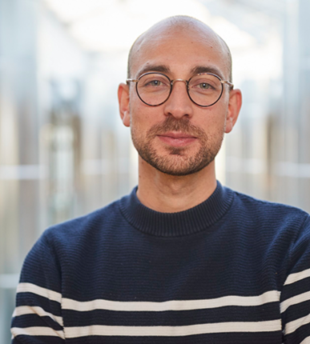
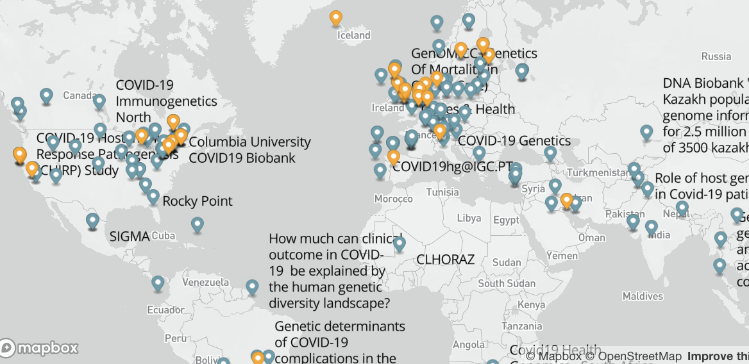

COVID-19 Host Genetics Initiative
Slide from Andrea Ganna
UK Biobank – UK
VA Million Veteran Program – US
deCODE genetics - ISL
Finngen - FI
Estonian Biobank – EST
Genes & Health – UK
Lifelines – NL
Rotterdam Study - NL
The Generation R study – NL
UK Blood Donors Cohort – UK
UK 100,000 Genomes Project – UK
Michigan Genomics Initiative - US
Netherlands Twin Register – NL
Qatar Genome Program – QAT
Mass General Brigham - Host Vulnerability to COVID-19 – US
Generation Scotland – UK
UCLA Precision Health COVID-19 Biobank - US
BioMe – US
GeneRISK – FIN
Penn Medicine Biobank - US
Biobanque Quebec COVID19 - CA
Genetic determinants of COVID-19 complications in the Brazilian population - BR
Genomic epidemiology of SARS-Cov-2 2019 (COVID-19) and host genetics in Coronavirus Disease – Stanford - US
Amsterdam UMC COVID study group - NL
The genetic predisposition to severe COVID-19 - SWE
GenOMICC (Genetics Of Mortality in Critical Care) – UK
Genetic modifiers for COVID-19 related illness - BEL
GEN-COVID, reCOVID - ITA
Corea (Genetics of COVID-related Manifestation) - KOR
Determining the Molecular Pathways and Genetic Predisposition of the Acute Inflammatory Process Caused by SARS-CoV-2 - ES
Bonn Study of COVID19 genetics - GER
COVID19-Host(a)ge – ES + ITA
Helix Exome+ COVID-19 Phenotypes - US
AncestryDNA COVID-19 Research Study – US
23andMe - US
34 studies from 16 countries.
~15% of all registered studies
18,169 COVID-19 positive cases among
> 1.4 million individuals
Andrea Ganna, PhD
https://www.covid19hg.org/
Mark Daly, PhD

Slide 3
^{FinnGen}
Notes:
HILMO -- Social Welfare and Health Care
KELA -- Social Insurance Institution a.k.a.
social security THL -- Institute for Health and Welfare
Population samples
260,405 individuals
Combined genotype and register data
Imputation
Total markers: 16,962,023
Genotyping
(655,973 markers)
National register data
Hospital biobank samples
Blood Service’s biobank
Association analyses for 2,861 endpoints
Current data freeze for release 6:
260,405 individuals

